Slide 1
1. Pointers Cont..

Slide 2
1.1 Null Pointers
It is always a good practice to assign the pointer NULL to a pointer variable in case you do not have exact address to be assigned.
This is done at the time of variable declaration.
A pointer that is assigned NULL is called a null pointer.
The NULL pointer is a constant with a value of zero defined in several standard libraries, including iostream.

Slide 3
1.1 Null Pointers
Consider the following program:
When the above code is compiled and executed, it produces the following result:

Slide 4
1.1 Null Pointers
On most of the operating systems, programs are not permitted to access memory at address 0 because that memory is reserved by the operating system.
However, the memory address 0 has special significance; it signals that the pointer is not intended to point to an accessible memory location.
But by convention, if a pointer contains the null (zero) value, it is assumed to point to nothing.

Slide 5
1.1 Null Pointers
To check for a null pointer you can use an if statement as follows:
Thus, if all unused pointers are given the null value and you avoid the use of a null pointer, you can avoid the accidental misuse of an uninitialized pointer.
Many times, uninitialized variables hold some junk values and it becomes difficult to debug the program.

Slide 6
1.2 Pointer Arithmetic
As you understood pointer is an address which is a numeric value; therefore, you can perform arithmetic operations on a pointer just as you can a numeric value.
There are four arithmetic operators that can be used on pointers: ++, --, +, and –
To understand pointer arithmetic, let us consider that ptr is an integer pointer which points to the address 1000.

Slide 7
1.2 Pointer Arithmetic
Assuming 32-bit integers, let us perform the following arithmatic operation on the pointer:
the ptr will point to the location 1004 because each time ptr is incremented, it will point to the next integer.
This operation will move the pointer to next memory location without impacting actual value at the memory location.

Slide 8
1.2 Pointer Arithmetic
If ptr points to a character whose address is 1000, then above operation will point to the location 1001 because next character will be available at 1001.

Slide 9
1.3 Incrementing Pointer
We prefer using a pointer in our program instead of an array because the variable pointer can be incremented, unlike the array name which cannot be incremented because it is a constant pointer.

Slide 10
1.3 Incrementing Pointer
The following program increments the variable pointer to access each succeeding element of the array:

Slide 11
1.3 Incrementing Pointer
When the above code is compiled and executed, it produces result something as follows:

Slide 12
1.4 Decrementing Pointer
The same considerations apply to decrementing a pointer, which decreases its value by the number of bytes of its data type as shown below:

Slide 13
1.4 Decrementing Pointer
When the above code is compiled and executed, it produces result something as follows:

Slide 14
1.5 Pointer Comparison
Pointers may be compared by using relational operators, such as ==, <, and >.
If p1 and p2 point to variables that are related to each other, such as elements of the same array, then p1 and p2 can be meaningfully compared.

Slide 15
1.5 Pointer Comparison
The following program modifies the previous example one by incrementing the variable pointer so long as the address to which it points is either less than or equal to the address of the last element of the array, which is &var[MAX - 1]:

Slide 16
1.5 Pointer Comparison
When the above code is compiled and executed, it produces result something as follows:

Slide 17
1.6 Pointers Vs Arrays
Pointers and arrays are strongly related.
In fact, pointers and arrays are interchangeable in many cases.
For example, a pointer that points to the beginning of an array can access that array by using either pointer arithmetic or array-style indexing.

Slide 18
1.6 Pointers Vs Arrays
Consider the following program:

Slide 19
1.6 Pointers Vs Arrays
When the above code is compiled and executed, it produces result something as follows:

Slide 20
1.6 Pointers Vs Arrays
However, pointers and arrays are not completely interchangeable.
For example, consider the following program:

Slide 21
1.6 Pointers Vs Arrays
It is perfectly acceptable to apply the pointer operator * to var but it is illegal to modify var value.
The reason for this is that var is a constant that points to the beginning of an array and can not be used as l-value.
Because an array name generates a pointer constant, it can still be used in pointer-style expressions, as long as it is not modified.

Slide 22
1.6 Pointers Vs Arrays
For example, the following is a valid statement that assigns var[2] the value 500:
Above statement is valid and will compile successfully because var is not changed.

Slide 23
1.6 Passing Pointers to Functions
C++ allows you to pass a pointer to a function.
To do so, simply declare the function parameter as a pointer type.
Following a simple example where we pass an unsigned long pointer to a function and change the value inside the function which reflects back in the calling function:

Slide 24
1.6 Passing Pointers to Functions

Slide 25
1.6 Passing Pointers to Functions
When the above code is compiled and executed, it produces the following result:
The function which can accept a pointer, can also accept an array as shown in the following example:

Slide 26
1.6 Passing Pointers to Functions

Slide 27
1.6 Passing Pointers to Functions
When the above code is compiled and executed, it produces the following result:

Slide 28
1.7 Return Pointers from Functions
As we have seen how C++ allows to return an array from a function, similar way C++ allows you to return a pointer from a function.
To do so, you would have to declare a function returning a pointer as in the following example:

Slide 29
1.7 Return Pointers from Functions
Second point to remember is that, it is not good idea to return the address of a local variable to outside of the function, so you would have to define the local variable as static variable.
Now, consider the following function, which will generate 10 random numbers and return them using an array name which represents a pointer i.e., address of first array element.

Slide 30
1.7 Return Pointers from Functions

Slide 31
1.7 Return Pointers from Functions
When the above code is compiled together and executed, it produces result something as follows:

Slide 32
2. Refrences

Slide 33
A reference variable is an alias, that is, another name for an already existing variable.
Once a reference is initialized with a variable, either the variable name or the reference name may be used to refer to the variable.

Slide 34
2.1 References Vs Pointers
References are often confused with pointers but three major differences between references and pointers are:
You cannot have NULL references. You must always be able to assume that a reference is connected to a legitimate piece of storage.
Once a reference is initialized to an object, it cannot be changed to refer to another object. Pointers can be pointed to another object at any time.
A reference must be initialized when it is created. Pointers can be initialized at any time.

Slide 35
2.2 Creating References in C++
Think of a variable name as a label attached to the variable's location in memory.
You can then think of a reference as a second label attached to that memory location.
Therefore, you can access the contents of the variable through either the original variable name or the reference.

Slide 36
2.2 Creating References in C++
For example, suppose we have the following example:
We can declare reference variables for i as follows.

Slide 37
2.2 Creating References in C++
For example, suppose we have the following example:

Slide 38
2.2 Creating References in C++
When the above code is compiled together and executed, it produces the following result:

Slide 39
2.3 References as Parameters
We have discussed how we implement call by reference concept using pointers.
Here is another example of call by reference which makes use of C++ reference:

Slide 40
2.3 References as Parameters
When the above code is compiled together and executed, it produces the following result:

Slide 41
2.4 Reference as Return Value
A C++ program can be made easier to read and maintain by using references rather than pointers.
A C++ function can return a reference in a similar way as it returns a pointer.
When a function returns a reference, it returns an implicit pointer to its return value.
This way, a function can be used on the left side of an assignment statement.

Slide 42
2.4 Reference as Return Value
For example, consider this simple program:

Slide 43
2.4 Reference as Return Value
When the above code is compiled together and executed, it produces the following result:

Slide 44
2.4 Reference as Return Value
When returning a reference, be careful that the object being referred to does not go out of scope.
So it is not legal to return a reference to local var. But you can always return a reference on a static variable.

Slide 45
2. Date and Time

Slide 46
The C++ standard library does not provide a proper date type.
C++ inherits the structs and functions for date and time manipulation from C.
To access date and time related functions and structures, you would need to include <ctime> header file in your C++ program.
There are four time-related types: clock_t, time_t, size_t, and tm.
The types - clock_t, size_t and time_t are capable of representing the system time and date as some sort of integer.

Slide 47
The structure type tm holds the date and time in the form of a C structure having the following elements:

Slide 48
Following are the important functions, which we use while working with date and time in C or C++.
All these functions are part of standard C and C++ library and you can check their detail using reference to C++ standard library given below.

Slide 49
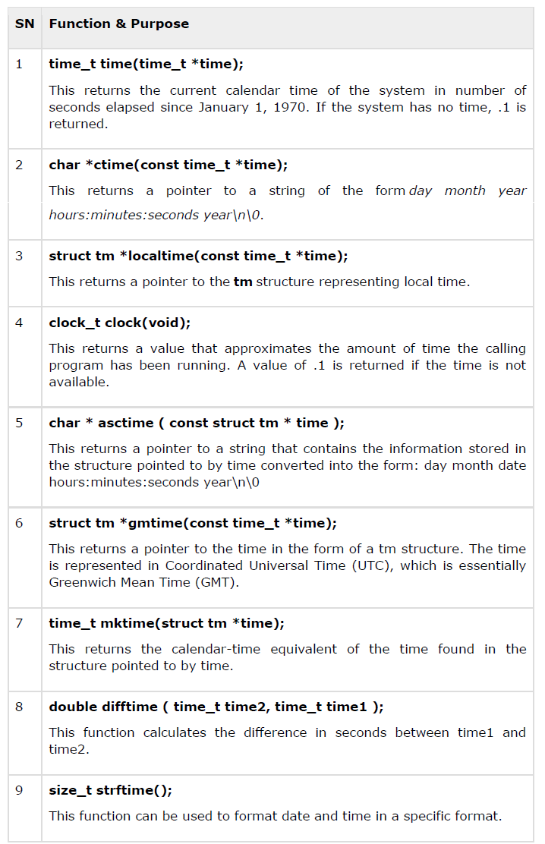

Slide 50
3.1 Current Date and Time
Suppose you want to retrieve the current system date and time, either as a local time or as a Coordinated Universal Time (UTC).
Following is the example to achieve the same:

Slide 51
3.1 Current Date and Time

Slide 52
3.1 Current Date and Time
When the above code is compiled and executed, it produces the following result:

Slide 53
3.2 Format Time using struct tm
The tm structure is very important while working with date and time in either C or C++.
This structure holds the date and time in the form of a C structure as mentioned above.
Most of the time related functions makes use of tm structure.
Following is an example which makes use of various date and time related functions and tm structure:

Slide 54
3.2 Format Time using struct tm

Slide 55
3.2 Format Time using struct tm
When the above code is compiled and executed, it produces the following result:

