Slide 1
1. STYLING WITH CSS

Slide 2
CSS stands for Cascading Style Sheets.
CSS describes how HTML elements are to be displayed on screen, paper, or in other media.
CSS saves a lot of work. It can control the layout of multiple web pages all at once.
CSS can be added to HTML elements in 3 ways:
Inline: by using the style attribute in HTML elements
Internal: by using a <style> element in the <head> section
External: by using an external CSS file
The most common way to add CSS, is to keep the styles in separate CSS files.

Slide 3
1.1 Inline CSS
An inline CSS is used to apply a unique style to a single HTML element.
An inline CSS uses the style attribute of an HTML element.
This example sets the text color of the <h1> element to GREEN:

Slide 4
1.2 Internal CSS
An internal CSS is used to define a style for a single HTML page.
An internal CSS is defined in the <head> section of an HTML page, within a <style> element:

Slide 5
1.3 External CSS
An external style sheet is used to define the style for many HTML pages.
With an external style sheet, you can change the look of an entire web site, by changing one file!
To use an external style sheet, add a link to it in the <head> section of the HTML page:

Slide 6
1.3 External CSS
An external style sheet can be written in any text editor.
The file must not contain any HTML code, and must be saved with a .css extension.
Here is how the "styles.css" looks:

Slide 7
1.4 CSS Fonts
The CSS color property defines the text color to be used.
The CSS font-family property defines the font to be used.
The CSS font-size property defines the text size to be used.

Slide 8
1.5 CSS Border
The CSS border property defines a border around an HTML element:

Slide 9
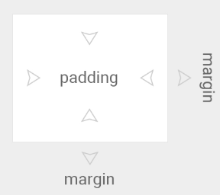
1.6 CSS Padding
The CSS padding property defines a padding (space) between the text and the border:

Slide 10
1.7 CSS Margin
The CSS margin property defines a margin (space) outside the border:

Slide 11
1.8 id Attribute
To define a specific style for one special element, add an id attribute to the element:
Then define a style for the element with the specific id:

Slide 12
1.9 class Attribute
To define a style for special types of elements, add a class attribute to the element:
Then define a style for the elements with the specific class:

Slide 13
1.10 External Refrences
External style sheets can be referenced with a full URL or with a path relative to the current web page.
This example uses a full URL to link to a style sheet:

Slide 14
1.10 External Refrences
This example links to a style sheet located in the html folder on the current web site:

Slide 15
1.10 External Refrences
This example links to a style sheet located in the same folder as the current page:

Slide 16
2. LINKS

Slide 17
2.1 HTML Links - Hyperlinks
Links are found in nearly all web pages.
Links allow users to click their way from page to page.
HTML links are hyperlinks.
You can click on a link and jump to another document.
When you move the mouse over a link, the mouse arrow will turn into a little hand.
Note: A link does not have to be text. It can be an image or any other HTML element.

Slide 18
2.2 Links - Syntax
Hyperlinks are defined with the HTML <a> tag:
The href attribute specifies the destination address (https://www.google.com/html/) of the link.
The link text is the visible part (Go to google).
Clicking on the link text will send you to the specified address.

Slide 19
2.3 Local Links
The previous used an absolute URL (a full web address).
A local link (link to the same web site) is specified with a relative URL (without https://www....).

Slide 20
2.3 Local Links
The previous used an absolute URL (a full web address).
A local link (link to the same web site) is specified with a relative URL (without https://www....).

Slide 21
2.4 The target Attribute
The target attribute specifies where to open the linked document.
The target attribute can have one of the following values:
_blank: Opens the linked document in a new window or tab
_self - Opens the linked document in the same window/tab as it was clicked (this is default)

Slide 22
2.4 The target Attribute
This example will open the linked document in a new browser window/tab:

Slide 23
2.5 Image as Link
It is common to use images as links:

Slide 24
2.6 Link Titles
The title attribute specifies extra information about an element.
The information is most often shown as a tooltip text when the mouse moves over the element.

Slide 25
2.7 HTML Link Colors
By default, a link will appear like this (in all browsers):
An unvisited link is underlined and blue
A visited link is underlined and purple
An active link is underlined and red

Slide 26
2.7 HTML Link Colors
You can change the default colors, by using CSS:

Slide 27
2.7 HTML Link Colors
A links can also be styled as a button, by using CSS:

Slide 28
2.8 Create a Bookmark
HTML bookmarks are used to allow readers to jump to specific parts of a Web page.
Bookmarks can be useful if your webpage is very long.
To make a bookmark, you must first create the bookmark, and then add a link to it.
When the link is clicked, the page will scroll to the location with the bookmark.

Slide 29
2.8 Create a Bookmark
First, create a bookmark with the id attribute:
Then, add a link to the bookmark ("Jump to book 5"), from within the same page:
Or, add a link to the bookmark ("Book to Chapter 4"), from another page:

Slide 30
2.8 Create a Bookmark

Slide 31
3. IMAGES

Slide 32
3.1 Image Syntax
In HTML, images are defined with the <img> tag.
The <img> tag is empty, it contains attributes only, and does not have a closing tag.
The src attribute specifies the URL (web address) of the image:

Slide 33
3.2 The alt Attribute
The alt attribute provides an alternate text for an image, if the user for some reason cannot view it (because of slow connection, an error in the src attribute, or if the user uses a screen reader).
The value of the alt attribute should describe the image:
If a browser cannot find an image, it will display the value of the alt attribute:

Slide 34
3.3 Image Size Width and Height
You can use the style attribute to specify the width and height of an image.

Slide 35
3.3 Image Size Width and Height
Alternatively, you can use the width and height attributes:
The width and height attributes always defines the width and height of the image in pixels.
Always specify the width and height of an image. If width and height are not specified, the page might flicker while the image loads.

Slide 36
3.4 Width and Height, or Style?
The width, height, and style attributes are valid in HTML.
However, we suggest using the style attribute. It prevents styles sheets from changing the size of images:

Slide 37
3.4 Width and Height, or Style?
The width, height, and style attributes are valid in HTML.
However, we suggest using the style attribute. It prevents styles sheets from changing the size of images:

Slide 38
3.5 Width and Height, or Style?
Some web sites store their images on image servers.
Actually, you can access images from any web address in the world:

Slide 39
3.6 Animated Images
HTML allows animated GIFs:

Slide 40
3.7 Animated Images
Use the CSS float property to let the image float to the right or to the left of a text:

Slide 41
3.8 Background Image on a HTML element
To add a background image in HTML, use the CSS property background-image.
To add a background image on an HTML element, you can use the style attribute:

Slide 42
3.8 Background Image on a HTML element
You can also specify the background image in the <style> element:

Slide 43
3.9 Background Image on a Page
If you want the entire page to have a background image, then you must specify the background image on the <body> element:

Slide 44
3.10 Background Repeat
If the background image is smaller than the element, the image will repeat itself, horizontally and vertically, until it has reach the end of the element.
The background-image property will try to fill the div element with images until it has reach the end.
To avoid the background image from repeating itself, use the background-repeat property.

Slide 45
3.11 Background Cover
If you want the background image cover the entire element, you can set the background-size property to cover.
Also, to make sure the entire element is always covered, set the background-attachment property to fixed:
The image will cover the entire element, with no stretching, the image will keep its original proportions.

Slide 46
3.12 background Stretch
If you want the background image stretch to fit the entire image in the element, you can set the background-size property to 100% 100%:
Try resizing the browser window, and you will see that the image will stretch, but always cover the entire element.

Slide 47
4. TABLES

Slide 48
4.1 Defining an HTML Table
An HTML table is defined with the <table> tag.
Each table row is defined with the <tr> tag.
A table header is defined with the <th> tag.
By default, table headings are bold and centered.
A table data/cell is defined with the <td> tag.

Slide 49
4.1 Defining an HTML Table

Slide 50
4.2 Adding Border
If you do not specify a border for the table, it will be displayed without borders.
A border is set using the CSS border property.
Remember to define borders for both the table and the table cells.
Remember to define borders for both the table and the table cells.

Slide 51
4.2 Adding Border

Slide 52
4.3 Collapsed Border
If you want the borders to collapse into one border, add the CSS border-collapse property:

Slide 53
4.4 Cell Padding
Cell padding specifies the space between the cell content and its borders.
If you do not specify a padding, the table cells will be displayed without padding.
To set the padding, use the CSS padding property:

Slide 54
4.4 Cell Padding

Slide 55
4.5 Left-align Headings
By default, table headings are bold and centered.
To left-align the table headings, use the CSS text-align property:

Slide 56
4.6 Adding Border Spacing
Border spacing specifies the space between the cells.
To set the border spacing for a table, use the CSS border-spacing property:

Slide 57
4.7 Cells that Span Many Columns
To make a cell span more than one column, use the colspan attribute:

Slide 58
4.8 Cells that Span Many Rows
To make a cell span more than one row, use the rowspan attribute:

Slide 59
4.9 Adding a Caption
To add a caption to a table, use the <caption> tag:
Note: The <caption> tag must be inserted immediately after the <table> tag.

Slide 60
4.10 A Special Style for One Table
To define a special style for a special table, row, or col use an id attribute:

Slide 61
5. LISTS

Slide 62
5.1 Unordered HTML List
An unordered list starts with the <ul> tag.
Each list item starts with the <li> tag.
The list items will be marked with bullets (small black circles) by default:

Slide 63
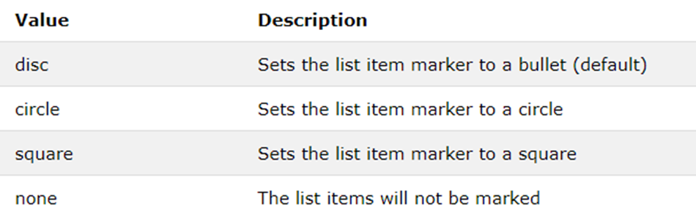
5.2 Unordered HTML List - Choose List Item Marker
The CSS list-style-type property is used to define the style of the list item marker:

Slide 64
5.2 Unordered HTML List - Choose List Item Marker

Slide 65
5.3 Ordered HTML List
An ordered list starts with the <ol> tag. Each list item starts with the <li> tag.
The list items will be marked with numbers by default:

Slide 66
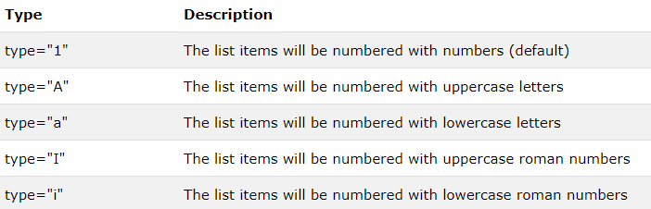
5.4 Ordered HTML List - The Type Attribute
The type attribute of the <ol> tag, defines the type of the list item marker:

Slide 67
5.4 Ordered HTML List - The Type Attribute

Slide 68
5.5 HTML Description Lists
HTML also supports description lists.
A description list is a list of terms, with a description of each term.
The <dl> tag defines the description list, the <dt> tag defines the term (name), and the <dd> tag describes each term:

Slide 69
5.5 HTML Description Lists

Slide 70
5.6 Nested HTML Lists
List can be nested (lists inside lists):
Note: List items can contain new list, and other HTML elements, like images and links, etc.

Slide 71
5.7 Nested HTML Lists
By default, an ordered list will start counting from 1.
If you want to start counting from a specified number, you can use the start attribute:

Slide 72
6. BLOCK AND INLINE ELEMENTS

Slide 73
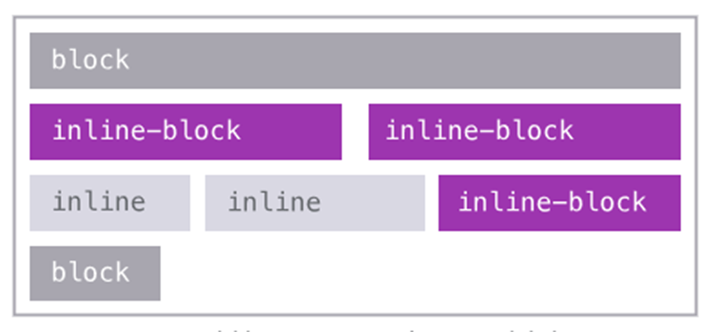
Every HTML element has a default display value depending on what type of element it is.
The two display values are: block and inline.

Slide 74
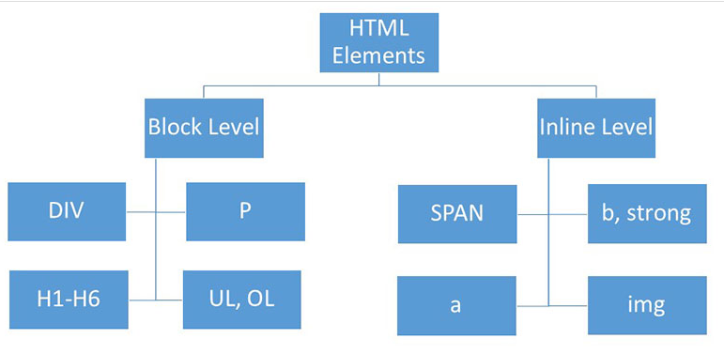

Slide 75
6.1 Block-level Elements
A block-level element always starts on a new line and takes up the full width available (stretches out to the left and right as far as it can).

Slide 76
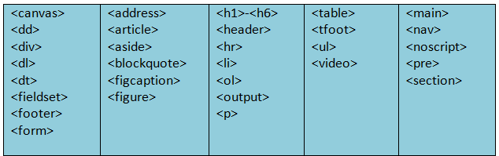
6.1 Block-level Elements

Slide 77
6.2 Inline Elements
An inline element does not start on a new line and only takes up as much width as necessary.

Slide 78
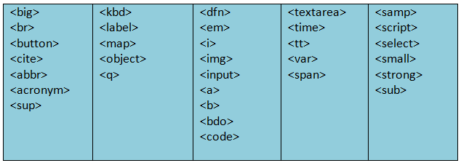
6.2 Inline Elements

Slide 79
6.3 The <div> Element
The <div> element is often used as a container for other HTML elements.
The <div> element has no required attributes, but style, class and id are common.
When used together with CSS, the <div> element can be used to style blocks of content:

Slide 80
6.4 The <span> Element
The <span> element is often used as a container for some text.
The <span> element has no required attributes, but style, class and id are common.
When used together with CSS, the <span> element can be used to style parts of the text:

Slide 81
7. CLASSE AND ID ATTRIBUTES

Slide 82
7.1 Using The class Attribute
The HTML class attribute is used to define equal styles for elements with the same class name.
So, all HTML elements with the same class attribute will get the same style.
The class attribute can be used on any HTML element.
Here we have three <div> elements that point to the same class name:

Slide 83
7.1 Using The class Attribute

Slide 84
7.2 Using The class Attribute on Inline Elements
The HTML class attribute can also be used on inline elements:

Slide 85
7.3 Select Elements With a Specific Class
In CSS, to select elements with a specific class, write a period (.) character, followed by the name of the class:

Slide 86
7.4 Multiple Classes
HTML elements can have more than one class name, each class name must be separated by a space.

Slide 87
7.5 Different Tags Can Share Same Class
Different tags, like <h2> and <p>, can have the same class name and thereby share the same style:

Slide 88
7.6 Using The id Attribute
The id attribute specifies a unique id for an HTML element (the value must be unique within the HTML document).
The id attribute can be used on any HTML element.
The id value must contain at least one character, and must not contain whitespace (spaces, tabs, etc.).
The id value can be used by CSS and JavaScript to perform certain tasks for the element with the specific id value.
In CSS, to select an element with a specific id, write a hash (#) character, followed by the id of the element.

Slide 89
7.6 Using The id Attribute

Slide 90
7.7 Difference Between Class and ID
An HTML element can only have one unique id that belongs to that single element, while a class name can be used by multiple elements:

Slide 91
8. IFRAMES

Slide 92
8.1Iframe Syntax
An iframe is used to display a web page within a web page.
An HTML iframe is defined with the <iframe> tag:
The src attribute specifies the URL (web address) of the inline frame page.

Slide 93
8.2 Iframe - Set Height and Width
Use the height and width attributes to specify the size of the iframe.
The height and width are specified in pixels by default:

Slide 94
8.2 Iframe - Set Height and Width
Or you can use CSS to set the height and width of the iframe:

Slide 95
8.3 Iframe - Remove the Border
By default, an iframe has a border around it.
To remove the border, add the style attribute and use the CSS border property.
With CSS, you can also change the size, style and color of the iframe's border:

Slide 96
8.3 Iframe - Remove the Border

Slide 97
9. JAVASCRIPT

Slide 98
9.1 <script> Tag
The <script> tag is used to define a client-side script (JavaScript).
The <script> element either contains script statements, or it points to an external script file through the src attribute.
Common uses for JavaScript are image manipulation, form validation, and dynamic changes of content.
To select an HTML element, JavaScript most often uses the document.getElementById() method.

Slide 99
9.1 <script> Tag
This JavaScript example writes "Hello JavaScript!" into an HTML element with id="demo":

Slide 100
9.2 What can JavaScript do
JavaScript can change HTML content

Slide 101
9.2 What can JavaScript do
JavaScript can change HTML styles

Slide 102
9.2 What can JavaScript do
JavaScript can change HTML attributes

Slide 103
9.3 <noscript> Tag
The <noscript> tag is used to provide an alternate content for users that have disabled scripts in their browser or have a browser that doesn't support client-side scripts:

