Slide 1
1. EMAIL LINKS

Slide 2
HTML <a> tag provides you option to specify an email address to send an email.
While using <a> tag as an email tag, you will use mailto: email address along with href attribute.
Following is the syntax of using mailto instead of using http.
Now, if a user clicks this link, it launches one Email Client (like Outlook Express etc. ) installed on your user's computer.

Slide 3
1.1 Default Settings
You can specify a default email subject and email body along with your email address.
Following is the example to use default subject and body.

Slide 4
2. Marquee TAG

Slide 5
An HTML marquee is a scrolling piece of text displayed either horizontally across or vertically down your webpage depending on the settings.
This is created by using HTML <marquees> tag.
A simple syntax to use HTML <marquee> tag is as follows:

Slide 8
3. META TAG

Slide 9
HTML lets you specify metadata - additional important information about a document in a variety of ways.
The META elements can be used to include name/value pairs describing properties of the HTML document, such as author, expiry date, a list of keywords, document author etc.
The <meta> tag is used to provide such additional information.
This tag is an empty element and so does not have a closing tag but it carries information within its attributes.

Slide 10
You can include one or more meta tags in your document based on what information you want to keep in your document but in general, meta tags do not impact physical appearance of the document so from appearance point of view, it does not matter if you include them or not.
Adding Meta Tags to Your Documents You can add metadata to your web pages by placing <meta> tags inside the header of the document which is represented by <head> and </head> tags.

Slide 11
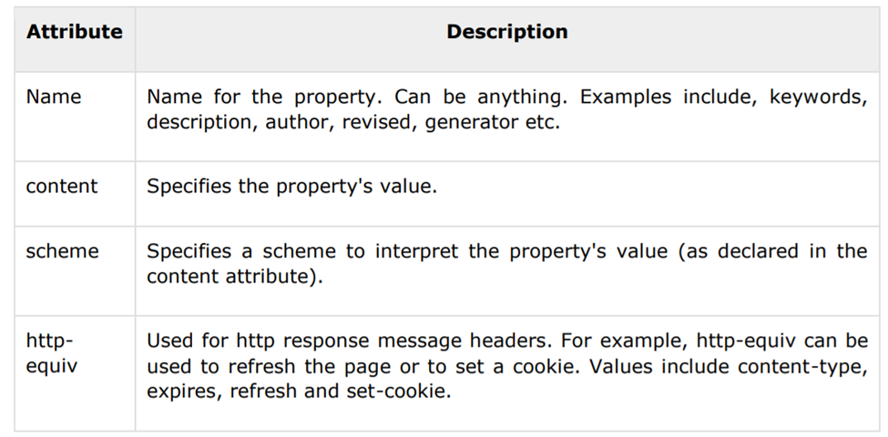
A meta tag can have following attributes in addition to core attributes:

Slide 12
3.1 Specifying Keywords
You can use <meta> tag to specify important keywords related to the document and later these keywords are used by the search engines while indexing your webpage for searching purpose.

Slide 13
3.1 Specifying Keywords
Example Following is an example, where we are adding HTML, Meta Tags, Metadata as important keywords about the document.

Slide 14
3.2 Document Description
You can use <meta> tag to give a short description about the document.
This again can be used by various search engines while indexing your webpage for searching purpose.

Slide 15
3.3 Document Revision
Date You can use <meta> tag to give information about when last time the document was updated.
This information can be used by various web browsers while refreshing your webpage.

Slide 16
3.4 Document Refreshing
A <meta> tag can be used to specify a duration after which your web page will keep refreshing automatically.
Example If you want your page keep refreshing after every 5 seconds then use the following syntax.

Slide 17
3.5 Page Redirection
You can use <meta> tag to redirect your page to any other webpage.
You can also specify a duration if you want to redirect the page after a certain number of seconds.

Slide 18
3.5 Page Redirection
Following is an example of redirecting current page to another page after 5 seconds.
If you want to redirect page immediately then do not specify content attribute.

Slide 19
3.6 Setting Author Name
You can set an author name in a web page using meta tag. See an example below:

Slide 20
3.7 Specify Character SET
Set You can use <meta> tag to specify character set used within the webpage.
Example By default, Web servers and Web browsers use ISO-8859-1 (Latin1) encoding to process Web pages.
Following is an example to set UTF-8 encoding:

Slide 21
3.7 Setting the Viewport
HTML5 introduced a method to let web designers take control over the viewport, through the <meta> tag.
The viewport is the user's visible area of a web page.
It varies with the device, and will be smaller on a mobile phone than on a computer screen.

Slide 22
3.7 Setting the Viewport
You should include the following <meta> viewport element in all your web pages:
A <meta> viewport element gives the browser instructions on how to control the page's dimensions and scaling.
The width=device-width part sets the width of the page to follow the screen-width of the device (which will vary depending on the device).
The initial-scale=1.0 part sets the initial zoom level when the page is first loaded by the browser.

Slide 23
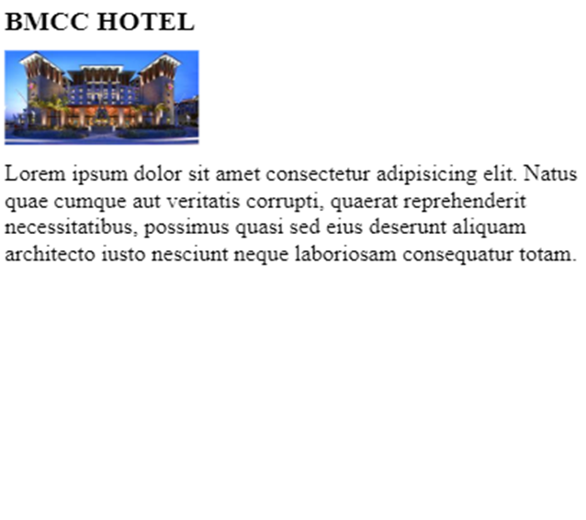
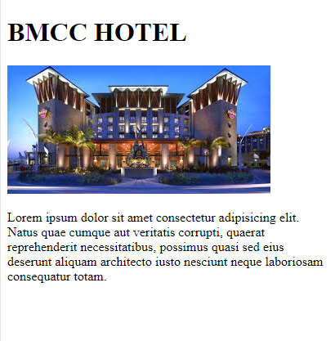
3.7 Setting the Viewport

Slide 24
4. Forms

Slide 25
HTML Forms are required, when you want to collect some data from the site visitor.
For example, during user registration you would like to collect information such as name, email address, credit card, etc.
A form will take input from the site visitor and then will post it to a back-end application such as CGI, ASP Script or PHP script etc.
The back-end application will perform required processing on the passed data based on defined business logic inside the application.
There are various form elements available like text fields, textarea fields, drop-down menus, radio buttons, checkboxes, etc.

Slide 26
The HTML <form> tag is used to create an HTML form and it has following syntax:

Slide 27
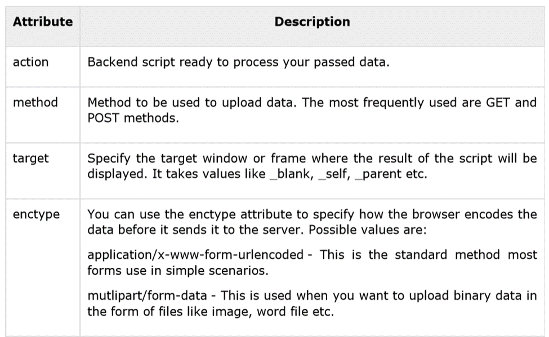
4.1 Form Attributes
Apart from common attributes, following is a list of the most frequently used form attributes:

Slide 28
4.2 HTML Form Controls
There are different types of form controls that you can use to collect data using HTML form:
Text Input Controls
Checkboxes Controls
Radio Box Controls
Select Box Controls
File Select boxes
Hidden Controls
Clickable Buttons
Submit and Reset Button

Slide 29
4.3 Text Input Controls
There are three types of text input used on forms:
Single-line text input controls - This control is used for items that require only one line of user input, such as search boxes or names. They are created using HTML <input> tag.
Password input controls - This is also a single-line text input but it masks the character as soon as a user enters it. They are also created using HTMl <input> tag.
Multi-line text input controls - This is used when the user is required to give details that may be longer than a single sentence. Multi-line input controls are created using HTML <textarea> tag.

Slide 30
4.4 Single-line text input controls
This control is used for items that require only one line of user input, such as search boxes or names.
They are created using HTML <input> tag.

Slide 31
4.4 Single-line text input controls
Here is a basic example of a single-line text input used to take first name and last name:

Slide 32
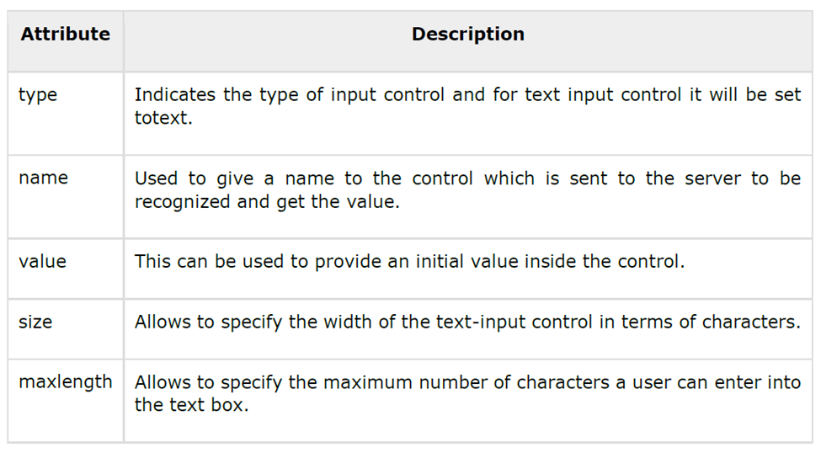
4.4 Single-line text input controls
Following is the list of attributes for <input> tag for creating text field.

Slide 33
4.5 Password Input Controls
This is also a single-line text input but it masks the character as soon as a user enters it.
They are also created using HTML <input> tag but type attribute is set to password

Slide 34
4.5 Password Input Controls
Here is a basic example of a single-line password input used to take user password:

Slide 35
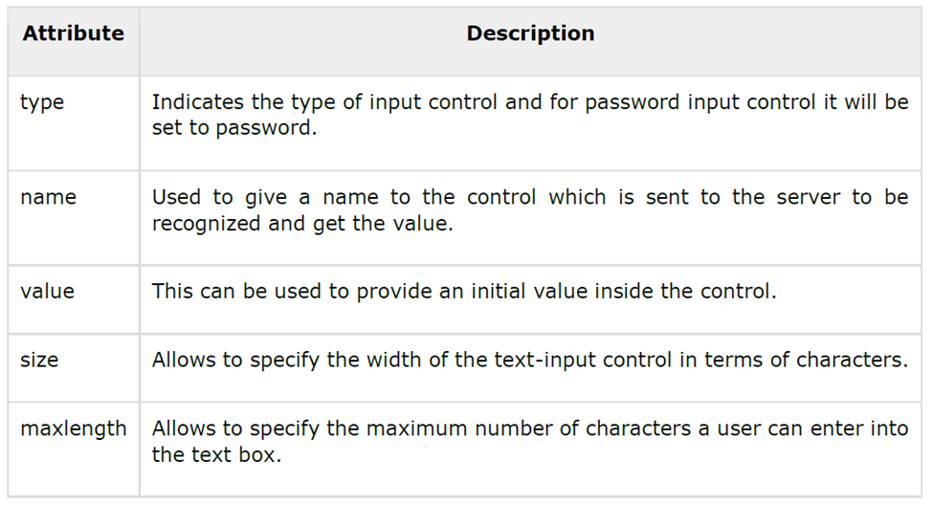
4.5 Password Input Controls
Following is the list of attributes for <input> tag for creating password field.

Slide 36
4.6 Multiple-Line Text Input Controls
This is used when the user is required to give details that may be longer than a single sentence.
Multi-line input controls are created using HTML <textarea> tag.

Slide 37
4.6 Multiple-Line Text Input Controls
Here is a basic example of a multi-line text input used to take item description:

Slide 38
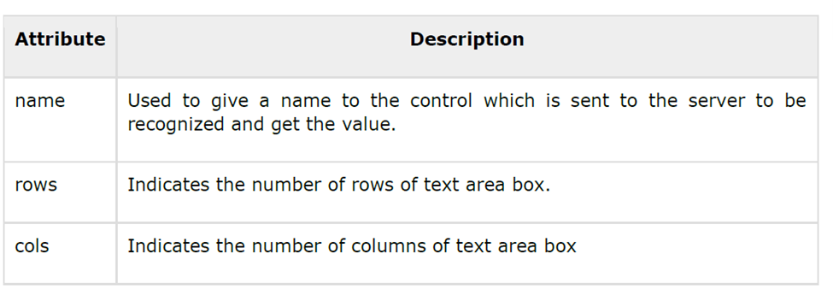
4.6 Multiple-Line Text Input Controls
Following is the list of attributes for <textarea> tag.

Slide 39
4.7 Checkbox Control
Checkboxes are used when more than one option is required to be selected.
They are also created using HTML <input> tag but type attribute is set to checkbox.

Slide 40
4.7 Checkbox Control
Here is an example HTML code for a form with two checkboxes:

Slide 41
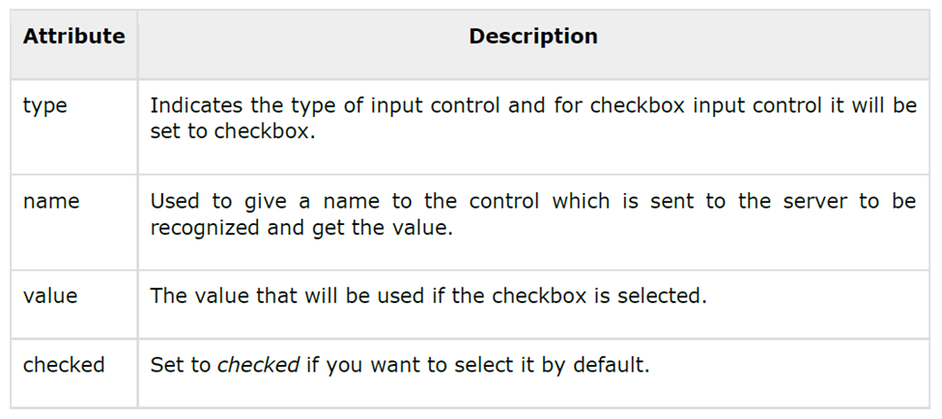
4.7 Checkbox Control
Following is the list of attributes for <checkbox> tag.

Slide 42
4.8 Radio Button Control
Radio buttons are used when out of many options, just one option is required to be selected.
They are also created using HTML <input> tag but type attribute is set to radio.

Slide 43
4.8 Radio Button Control
Here is example HTML code for a form with two radio buttons:

Slide 44
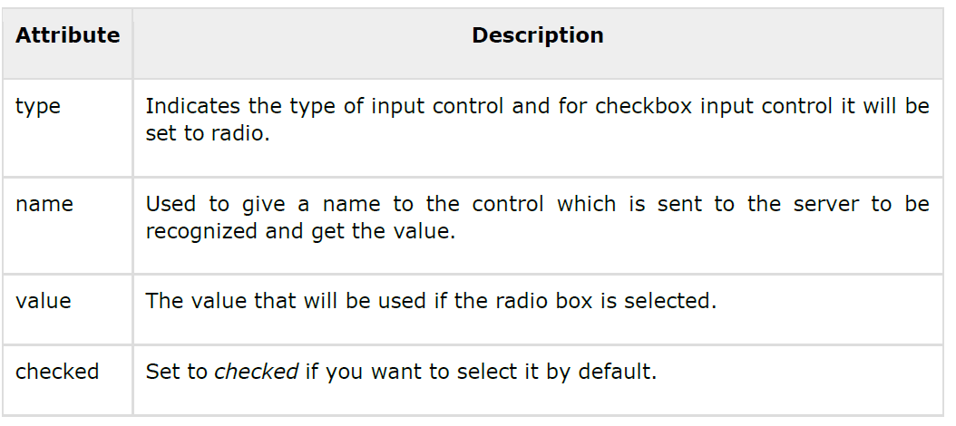
4.8 Radio Button Control
Following is the list of attributes for radio button.

Slide 45
4.9 Select Box Contol
A select box, also called drop down box which provides option to list down various options in the form of drop down list, from where a user can select one or more options.

Slide 46
4.9 Select Box Contol
Here is example HTML code for a form with one drop down box

Slide 47
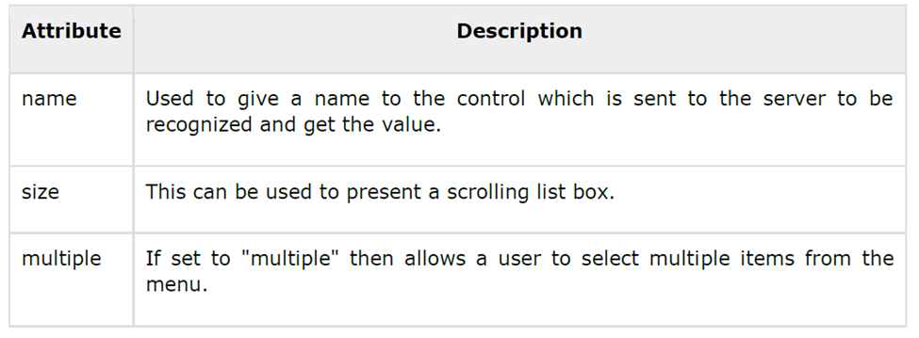
4.9 Select Box Contol
Following is the list of important attributes of <select> tag:

Slide 48
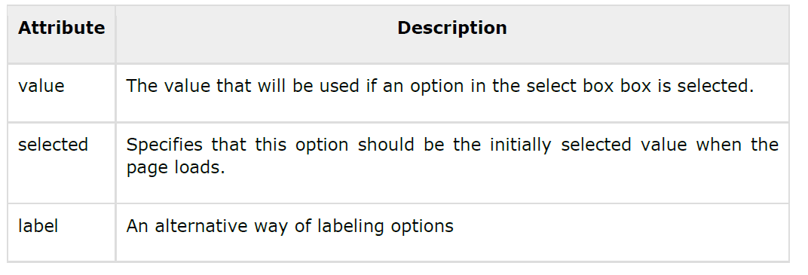
4.9 Select Box Contol
Following is the list of important attributes of <option> tag:

Slide 49
4.10 File Upload Box
If you want to allow a user to upload a file to your web site, you will need to use a file upload box, also known as a file select box.
This is also created using the <input> element but type attribute is set to file.

Slide 50
4.10 File Upload Box
Here is example HTML code for a form with one file upload box:

Slide 51
4.11 Button Controls
There are various ways in HTML to create clickable buttons.
You can also create a clickable button using <input> tag by setting its type attribute to button.

Slide 52
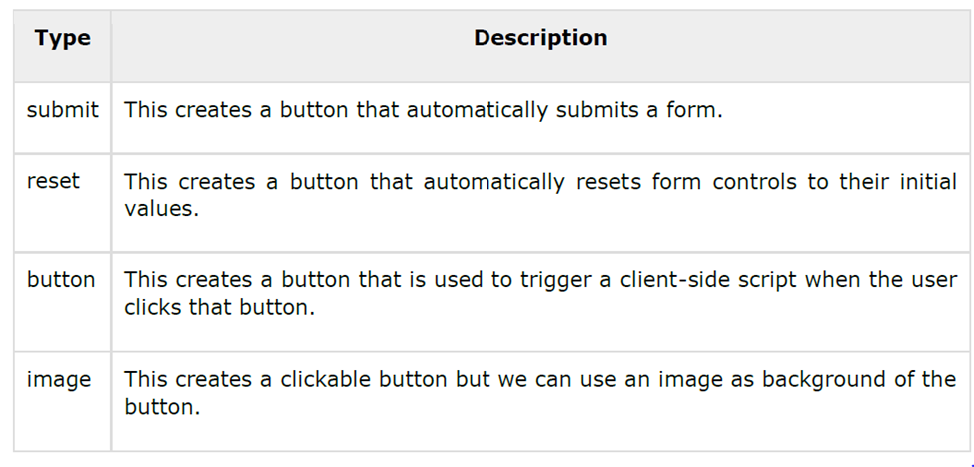
4.11 Button Controls
The type attribute can take the following values:

Slide 53
4.11 Button Controls
Here is example HTML code for a form with three types of buttons:

Slide 54
4.12 Hidden Form Controls
Hidden form controls are used to hide data inside the page which later on can be pushed to the server.
This control hides inside the code and does not appear on the actual page.
For example, following hidden form is being used to keep current page number.

Slide 55
4.12 Hidden Form Controls
When a user will click next page then the value of hidden control will be sent to the web server and there it will decide which page will be displayed next based on the passed current page.

Slide 56
5. Layouts

Slide 57
A webpage layout is very important to give better look to your website.
It takes considerable time to design a website's layout with great look and feel.
Now- a-days, all modern websites are using CSS and JavaScript based framework to come up with responsive and dynamic websites but you can create a good layout using simple HTML tables or division tags in combination with other formatting tags.

Slide 58
5.1 HTML Layouts - Using DIV, SPAN
The <div> element is a block level element used for grouping HTML elements.
While the <div> tag is a block-level element, the HTML <span> element is used for grouping elements at an inline level.
Although we can achieve pretty nice layouts with HTML tables, but tables weren't really designed as a layout tool. Tables are more suited to presenting tabular data.

Slide 59
5.1 HTML Layouts - Using DIV, SPAN

