Slide 1
1. C++ OVERVIEW

Slide 2
C++ is a statically typed, compiled, general-purpose, case-sensitive, that supports object-oriented
C++ is regarded as a middle-level language, as it comprises a combination of both high-level and low-level language features.
Note: A programming language is said to use static typing when type checking is performed during compile-time as opposed to run-time.

Slide 3
C++ was developed by Bjarne Stroustrup starting in 1979 at Bell Labs in Murray Hill, New Jersey, as an enhancement to the C language and originally named C with Classes but later it was renamed C++ in 1983.
C++ is a superset of C, and that virtually any legal C program is a legal C++ program.

Slide 4
1.1 Standard Libraries
Standard C++ consists of three important parts:
The core language giving all the building blocks including variables, data types and literals, etc.
The C++ Standard Library giving a rich set of functions manipulating files, strings, etc.
The Standard Template Library (STL) giving a rich set of methods manipulating data structures, etc.

Slide 5
1.2 Learning C++
The most important thing while learning C++ is to focus on concepts.
The purpose of learning a programming language is to become a better programmer; that is, to become more effective at designing and implementing new systems and at maintaining old ones.

Slide 6
1.3 Use of C++
C++ is used by hundreds of thousands of programmers in essentially every application domain.
C++ is being highly used to write device drivers and other software that rely on direct manipulation.
is widely used for teaching and research because it is clean enough for successful teaching of basic concepts.
Anyone who has used either an Apple Macintosh or a PC running Windows has indirectly used C++ because the primary user interfaces of these systems are written in C++.

Slide 7
2. BASIC SYNTAX

Slide 8
Let us now briefly look into what a class, object, methods, and instant variables mean.
Object - Objects have states and behaviors. Example: A dog has states - color, name, breed as well as behaviors - wagging, barking, and eating. An object is an instance of a class.
Class - A class can be defined as a template/blueprint that describes the behaviors/states that object of its type support.

Slide 9
Methods - A method is basically a behavior. A class can contain many methods. It is in methods where the logics are written, data is manipulated and all the actions are executed.
Instant Variables - Each object has its unique set of instant variables. An object's state is created by the values assigned to these instant variables.

Slide 10
2.1 C++ Program Structure
Let us look at a simple code that would print the words Hello World.

Slide 11
2.1 C++ Program Structure
Let us look at the various parts of the above program:
The C++ language defines several headers, which contain information that is either necessary or useful to your program. For this program, the header <iostream> is needed.
The line using namespace std; tells the compiler to use the std namespace. Namespaces are a relatively recent addition to C++.

Slide 12
2.1 C++ Program Structure
The next line ‘// main() is where program execution begins.’ is a single-line comment available in C++. Single-line comments begin with // and stop at the end of the line.
The line int main() is the main function where program execution begins.
The next line cout << "This is my first C++ program."; causes the message "This is my first C++ program" to be displayed on the screen.
The next line return 0; terminates main() function and causes it to return the value 0 to the calling process

Slide 13
2.2 Omitting the namespace
You might see some C++ programs that runs without the standard namespace library. The using namespace std line can be omitted and replaced with the std keyword, followed by the :: operator for some objects:

Slide 14
2.3 Semicolons & Blocks in C++
In C++, the semicolon is a statement terminator. That is, each individual statement must be ended with a semicolon. It indicates the end of one logical entity. For example, following are three different statements:

Slide 15
2.3 Semicolons & Blocks in C++
A block is a set of logically connected statements that are surrounded by opening and closing braces. For example:

Slide 16
2.3 Semicolons & Blocks in C++
C++ does not recognize the end of the line as a terminator. For this reason, it does not matter where you put a statement in a line. For example:
is the same as

Slide 17
2.4 C++ Identifiers
A C++ identifier is a name used to identify a variable, function, class, module, or any other user-defined item.
An identifier starts with a letter A to Z or a to z or an underscore (_) followed by zero or more letters, underscores, and digits (0 to 9).
C++ does not allow punctuation characters such as @, $, and % within identifiers.
C++ is a case-sensitive programming language.
Thus, Manpower and manpower are two different identifiers in C++.

Slide 18
2.4 C++ Identifiers
Here are some examples of acceptable identifiers:

Slide 19
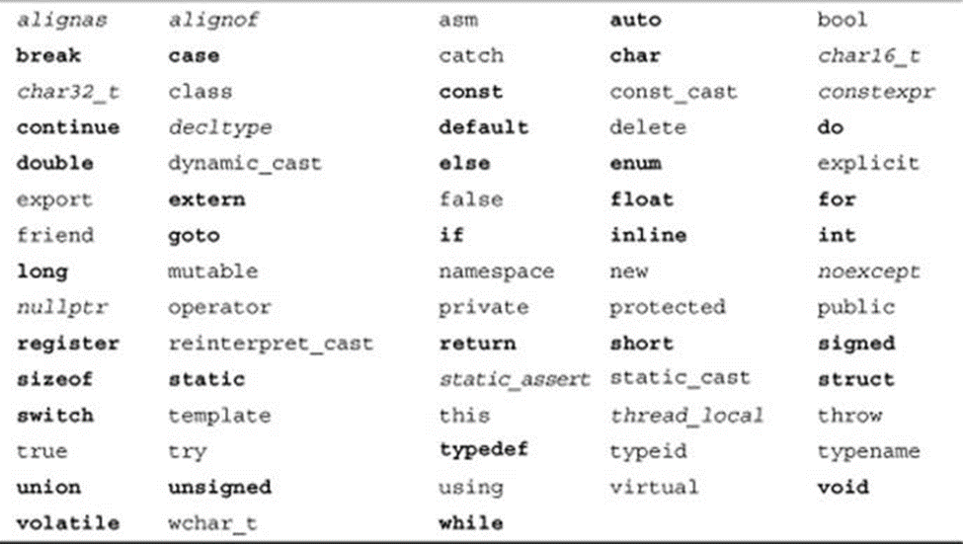
2.5 C++ Keywords
The following list shows the reserved words in C++. These reserved words may not be used as constant or variable or any other identifier names.

Slide 20
2.6 Whitespace in C++
A line containing only whitespace, possibly with a comment, is known as a blank line, and C++ compiler totally ignores it.
Whitespace is the term used in C++ to describe blanks, tabs, newline characters and comments.
Whitespace separates one part of a statement from another and enables the compiler to identify where one element in a statement, such as int, ends and the next element begins.

Slide 21
2.6 Whitespace in C++
In the above statement there must be at least one whitespace character (usually a space) between int and age for the compiler to be able to distinguish them.
In the above statement, no whitespace characters are necessary between fruit and =, or between = and apples, although you are free to include some if you wish for readability purpose.

Slide 22
2.7 Output a text (sting)
The cout object, together with the << operator, is used to output values/print text:
You can add as many cout objects as you want. However, note that it does not insert a new line at the end of the output:

Slide 23
2.8 User Input
You have already learned that cout is used to output (print) values. Now we will use cin to get user input.
cin is a predefined variable that reads data from the keyboard with the extraction operator (>>).
In the following example, the user can input a number, which is stored in the variable x. Then we print the value of x:

Slide 24
2.8 User Input
In this example, the user needs to input two numbers, and then we print the sum:

Slide 25
3. COMMENTS

Slide 26
Program comments are explanatory statements that you can include in the C++ code.
These comments help anyone reading the source code.
All programming languages allow for some form of comments.
C++ supports single-line and multi-line comments.
All characters available inside any comment are ignored by C++ compiler.

Slide 27
C++ comments start with /* and end with */. For example:
A comment can also start with //, extending to the end of the line. For example:

Slide 28
When the previous code is compiled, it will ignore // prints Hello World and final executable will produce the following result:
Hello World
Within a /* and */ comment, // characters have no special meaning.
Within a // comment, /* and */ have no special meaning.

Slide 29
Thus, you can "nest" one kind of comment within the other kind. For example:

Slide 30
4. DATA TYPES

Slide 31
While writing program in any language, you need to use various variables to store various information.
Variables are nothing but reserved memory locations to store values.
This means that when you create a variable you reserve some space in memory.
You may like to store information of various data types like character, wide character, integer, floating point, double floating point, boolean etc.
Based on the data type of a variable, the operating system allocates memory and decides what can be stored in the reserved memory.

Slide 32
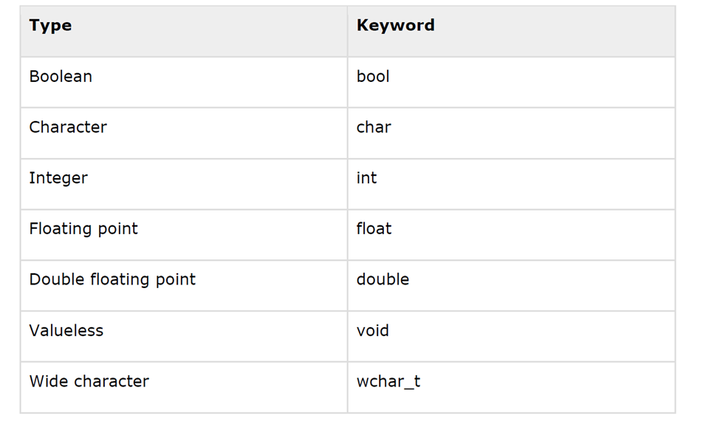
4.1 Primitive Built-in Types
C++ offers the programmer a rich assortment of built-in as well as user defined data types.
Following table lists down seven basic C++ data types:

Slide 33
4.1 Primitive Built-in Types
Several of the basic types can be modified using one or more of these type modifiers:
signed
unsigned
short
long

Slide 34
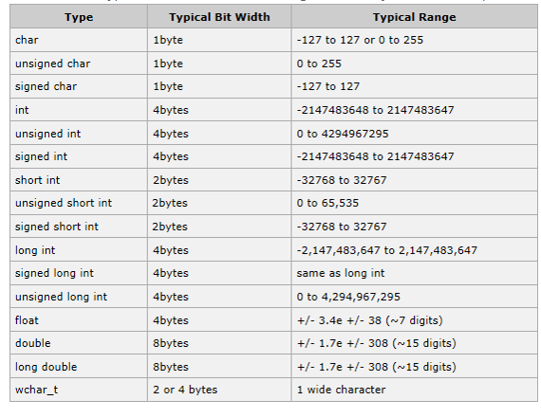
4.1 Primitive Built-in Types
The following table shows the variable type, how much memory it takes to store the value in memory, and what is maximum and minimum value which can be stored in such type of variables.

Slide 35
4.1 Primitive Built-in Types
The size of variables might be different from those shown in the above table, depending on the compiler and the computer you are using.

Slide 36
4.1 Primitive Built-in Types
This example uses endl, which inserts a new-line character after every line and << operator is being used to pass multiple values out to the screen.
We are also using sizeof() function to get size of various data types.
When the above code is compiled and executed, it produces the following result which can vary from machine to machine:

Slide 37
4.2 typedef Declarations
You can create a new name for an existing type using typedef. Following is the simple syntax to define a new type using typedef:
typedef type newname;
For example, the following tells the compiler that feet is another name for int:
Now, the following declaration is perfectly legal and creates an integer variable called distance:

Slide 38
4.3 Enumerated Typed
An enumerated type declares an optional type name and a set of zero or more identifiers that can be used as values of the type.
Each enumerator is a constant whose type is the enumeration.
Creating an enumeration requires the use of the keyword enum.
The general form of an enumeration type is:
enum enum-name { list of names } var-list;

Slide 39
4.3 Enumerated Typed
Here, the enum-name is the enumeration's type name.
The list of names is comma separated.
For example, the following code defines an enumeration of colors called colors and the variable c of type color.
Finally, c is assigned the value "blue".

Slide 40
4.3 Enumerated Typed
By default, the value of the first name is 0, the second name has the value 1, and the third has the value 2, and so on.
But you can give a name, a specific value by adding an initializer.
For example, in the following enumeration, green will have the value 5.
Here, blue will have a value of 6 because each name will be one greater than the one that precedes it.

Slide 41
5. VARIABLE TYPES

Slide 42
A variable provides us with named storage that our programs can manipulate.
Each variable in C++ has a specific type, which determines the size and layout of the variable's memory; the range of values that can be stored within that memory; and the set of operations that can be applied to the variable.
The name of a variable can be composed of letters, digits, and the underscore character.
It must begin with either a letter or an underscore.
Upper and lowercase letters are distinct because C++ is case-sensitive:

Slide 43
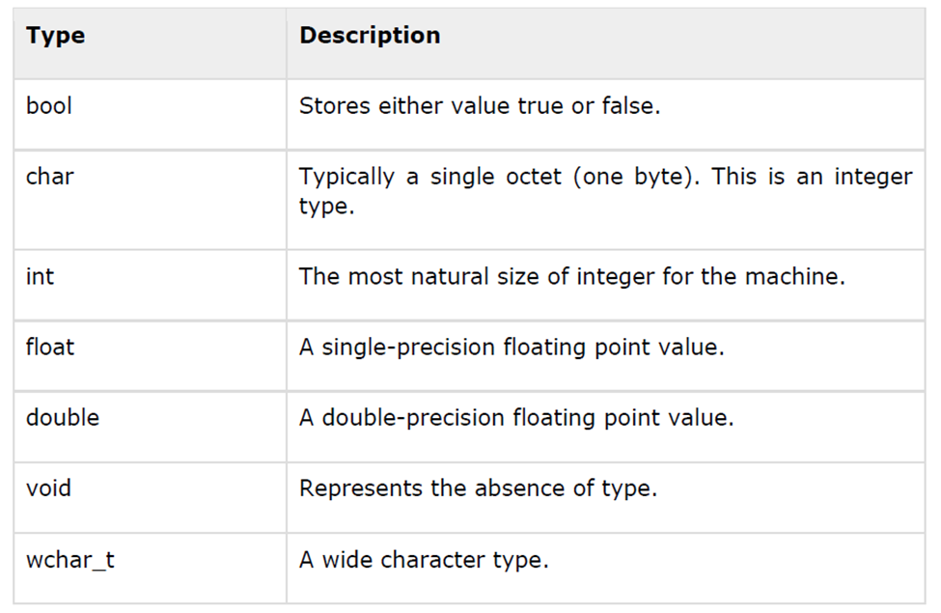
C++ also allows to define various other types of variables, which we will cover later like Enumeration, Pointer, Array, Reference, Data structures, and Classes.

Slide 44
5.1 Variable Definition in C++
A variable definition tells the compiler where and how much storage to create for the variable.
A variable definition specifies a data type, and contains a list of one or more variables of that type as follows:
type variable_list;
Here, type must be a valid C++ data type including char, w_char, int, float, double, bool or any user-defined object, etc.
variable_list may consist of one or more identifier names separated by commas.

Slide 45
5.1 Variable Definition in C++
Some valid declarations are shown here:
The line int i, j, k; both declares and defines the variables i, j and k; which instructs the compiler to create variables named i, j and k of type int.
Variables can be initialized (assigned an initial value) in their declaration.

Slide 46
5.1 Variable Definition in C++
The initializer consists of an equal sign followed by a constant expression as follows:
Some examples are:
For definition without an initializer: variables with static storage duration are implicitly initialized with NULL (all bytes have the value 0); the initial value of all other variables is undefined.

Slide 47
5.2 Variable Decleration in C++
A variable declaration provides assurance to the compiler that there is one variable existing with the given type and name so that compiler proceed for further compilation without needing complete detail about the variable.
A variable declaration has its meaning at the time of compilation only, compiler needs actual variable declaration at the time of linking of the program.

Slide 48
5.2 Variable Declaration in C++
A variable declaration is useful when you are using multiple files and you define your variable in one of the files which will be available at the time of linking of the program.
You will use extern keyword to declare a variable at any place.
Though you can declare a variable multiple times in your C++ program, but it can be defined only once in a file, a function or a block of code.

Slide 49
5.2 Variable Declaration in C++
Try the following example where a variable has been declared at the top, but it has been defined inside the main function:

Slide 50
5.2 Variable Declaration in C++
Same concept applies on function declaration where you provide a function name at the time of its declaration and its actual definition can be given anywhere else.

Slide 51
5.3 Lvalues and Rvalues
There are two kinds of expressions in C++:
lvalue : Expressions that refer to a memory location is called "lvalue" expression. An lvalue may appear as either the left-hand or right-hand side of an assignment.
rvalue : The term rvalue refers to a data value that is stored at some address in memory. An rvalue is an expression that cannot have a value assigned to it which means an rvalue may appear on the right- but not left-hand side of an assignment.

Slide 52
5.3 Lvalues and Rvalues
Variables are lvalues and so may appear on the left-hand side of an assignment.
Numeric literals are rvalues and so may not be assigned and cannot appear on the left-hand side.
Following is a valid statement:
But the following is not a valid statement and would generate compile-time error:

Slide 53
6. VARIABLE SCOPE

Slide 54
A scope is a region of the program and broadly speaking there are three places, where variables can be declared:
Inside a function or a block which is called local variables,
In the definition of function parameters which is called formal parameters.
Outside of all functions which is called global variables.
We will learn what a function is, and it's parameter later .
Here let us explain what local and global variables are.

Slide 55
6.1 Local Variables
Variables that are declared inside a function or block are local variables.
They can be used only by statements that are inside that function or block of code.
Local variables are not known to functions outside their own.

Slide 56
6.1 Local Variables
Following is the example using local variables:

Slide 57
6.2 Global Functions
Global variables are defined outside of all the functions, usually on top of the program.
The global variables will hold their value throughout the life-time of your program.
A global variable can be accessed by any function.
That is, a global variable is available for use throughout your entire program after its declaration.

Slide 58
6.2 Global Functions
Following is the example using global and local variables:

Slide 59
6.2 Global Functions
A program can have same name for local and global variables but value of local variable inside a function will take preference. For example:
When the above code is compiled and executed, it produces the following result:10

Slide 60
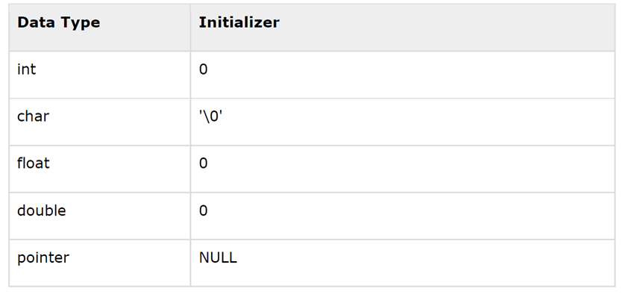
6.3 Initializing Local and Global Variables
When a local variable is defined, it is not initialized by the system, you must initialize it yourself.
Global variables are initialized automatically by the system when you define them as follows:

Slide 61
6.3 Initializing Local and Global Variables
It is a good programming practice to initialize variables properly, otherwise sometimes program would produce unexpected result.

Slide 62
7. CONSTANTS AND LITERALS

Slide 63
Constants refer to fixed values that the program may not alter and they are called literals.
Constants can be of any of the basic data types and can be divided into Integer Numerals, Floating-Point Numerals, Characters, Strings and Boolean Values.
Again, constants are treated just like regular variables except that their values cannot be modified after their definition.

Slide 64
7.1 Integer Literals
An integer literal can be a decimal, octal, or hexadecimal constant.
A prefix specifies the base or radix: 0x or 0X for hexadecimal, 0 for octal, and nothing for decimal.
An integer literal can also have a suffix that is a combination of U and L, for unsigned and long, respectively.
The suffix can be uppercase or lowercase.
Here are some examples of integer literals:

Slide 65
7.1 Integer Literals
Here are some examples of integer literals:
Following are other examples of various types of Integer literals:

Slide 66
7.2 Floatin-point literals
A floating-point literal has an integer part, a decimal point, a fractional part, and an exponent part.
You can represent floating point literals either in decimal form or exponential form.
While representing using decimal form, you must include the decimal point, the exponent, or both and while representing using exponential form, you must
include the integer part, the fractional part, or both.

Slide 67
7.2 Floatin-point literals
The signed exponent is introduced by e or E.
Here are some examples of floating-point literals:

Slide 68
7.3 Boolean Literals
There are two Boolean literals and they are part of standard C++ keywords:
A value of true representing true.
A value of false representing false.
You should not consider the value of true equal to 1 and value of false equal to 0.

Slide 69
7.4 Character Literals
Character literals are enclosed in single quotes.
If the literal begins with L (uppercase only), it is a wide character literal (e.g., L'x') and should be stored in wchar_t type of variable.
Otherwise, it is a narrow character literal (e.g., 'x') and can be stored in a simple variable of char type.
A character literal can be a plain character (e.g., 'x'), an escape sequence (e.g., '\t'), or a universal character (e.g., '\u02C0').

Slide 70
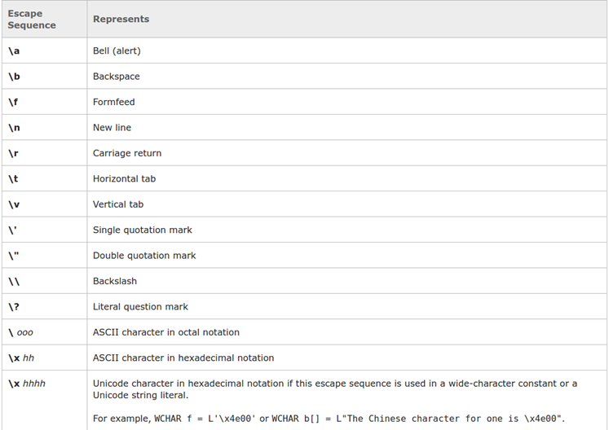
7.4 Character Literals
There are certain characters in C++ when they are preceded by a backslash they will have special meaning and they are used to represent like newline (\n) or tab (\t).
Here, you have a list of some of such escape sequence codes:

Slide 71
7.4 Character Literals
Following is the example to show a few escape sequence characters:

Slide 72
7.5 String Literals
String literals are enclosed in double quotes.
A string contains characters that are similar to character literals: plain characters, escape sequences, and universal characters.
You can break a long line into multiple lines using string literals and separate them using whitespaces.

Slide 73
7.5 String Literals
Here are some examples of string literals. All the three forms are identical strings.

Slide 74
7.6 Defining Constants
There are two simple ways in C++ to define constants:
Using #define preprocessor.
Using const keyword.

Slide 75
7.7 The #define Preprocessor
Following is the form to use #define preprocessor to define a constant:
#define identifier value
Following example explains it in detail:

Slide 76
7.8 The const Keyword
You can use const prefix to declare constants with a specific type as follows:
const type variable = value;
Following example explains it in detail:

Slide 77
8. MODIFIERS TYPES

Slide 78
C++ allows the char, int, and double data types to have modifiers preceding them.
A modifier is used to alter the meaning of the base type so that it more precisely fits the needs of various situations.
The data type modifiers are listed here:
Signed
Unsigned
Long
short

Slide 79
The modifiers signed, unsigned, long, and short can be applied to integer base types.
In addition, signed and unsigned can be applied to char, and long can be applied to double.
The modifiers signed and unsigned can also be used as prefix to long or short modifiers. For example, unsigned long int.

Slide 80
C++ allows a shorthand notation for declaring unsigned, short, or long integers.
You can simply use the word unsigned, short, or long, without int.
It automatically implies int.
For example, the following two statements both declare unsigned integer variables.
unsigned x;
unsigned int y;

Slide 81
To understand the difference between the way signed and unsigned integer modifiers are interpreted by C++, you should run the following short program:

Slide 82
When this program is run, following is the output:
-15536 50000
The above result is because the bit pattern that represents 50,000 as a short unsigned integer is interpreted as -15,536 by a short.

Slide 83
8. STORAGE CLASSES

Slide 84
A storage class defines the scope (visibility) and life-time of variables and/or functions within a C++ Program.
These specifiers precede the type that they modify.
There are following storage classes, which can be used in a C++ Program
Auto
Register
Static
Extern

Slide 85
8.1 The auto Storage Class
The auto storage class is the default storage class for all local variables.
The example above defines two variables with the same storage class, auto can only be used within functions, i.e., local variables.

Slide 86
8.2 The register Storage Class
The register storage class is used to define local variables that should be stored in a register instead of RAM.
This means that the variable has a maximum size equal to the register size (usually one word).
The register should only be used for variables that require quick access such as counters.
It should also be noted that defining 'register' does not mean that the variable will be stored in a register.
It means that it MIGHT be stored in a register depending on hardware and implementation restrictions.

Slide 87
8.3 The static Storage Class
The static storage class instructs the compiler to keep a local variable in existence during the life-time of the program instead of creating and destroying it each time it comes into and goes out of scope.
Therefore, making local variables static allows them to maintain their values between function calls.
The static modifier may also be applied to global variables. When this is done, it causes that variable's scope to be restricted to the file in which it is declared.
In C++, when static is used on a class data member, it causes only one copy of that member to be shared by all objects of its class.

Slide 88
8.4 The extern Storage Class
The extern storage class is used to give a reference of a global variable that is visible to ALL the program files.
When you use 'extern' the variable cannot be initialized as all it does is point the variable name at a storage location that has been previously defined.
When you have multiple files and you define a global variable or function, which will be used in other files also, then extern will be used in another file to give reference of defined variable or function.

Slide 89
8.4 The extern Storage Class
Just for understanding extern is used to declare a global variable or function in another file.
The extern modifier is most commonly used when there are two or more files sharing the same global variables or functions as explained below.

Slide 90
8.4 The extern Storage Class
First File: main.cpp
Second File: support.cpp

Slide 91
8.4 The extern Storage Class
Here, extern keyword is being used to declare count in another file. Now compile these two files as follows:
$g++ main.cpp support.cpp -o write
This will produce write executable program, try to execute write and check

Slide 92
9. OPERATORS

Slide 93
An operator is a symbol that tells the compiler to perform specific mathematical
or logical manipulations. C++ is rich in built-in operators and provide the
following types of operators:
Arithmetic Operators
Relational Operators
Logical Operators
Bitwise Operators
Assignment Operators
Misc Operators

Slide 94
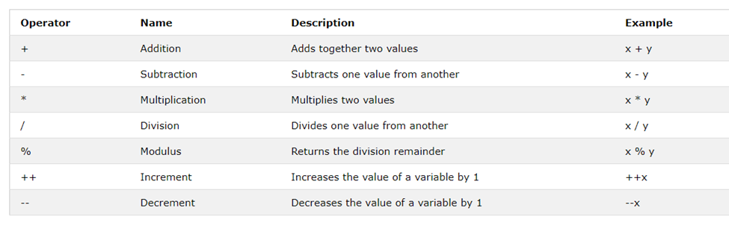
9.1 Arithmetic Operators
There are following arithmetic operators supported by C++ language:

Slide 95
9.1 Arithmetic Operators

Slide 96
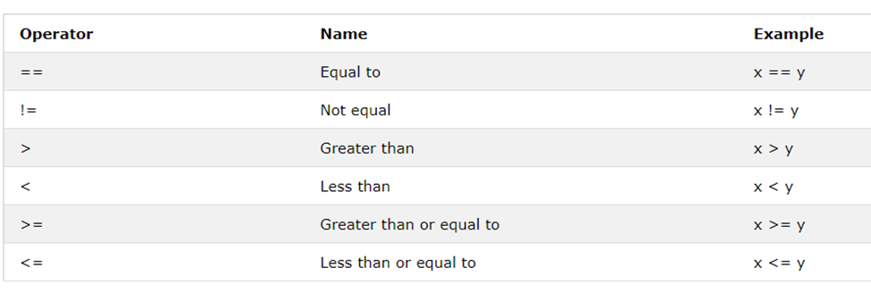
9.2 Relational Operators
There are following relational operators supported by C++ language

Slide 97
9.2 Relational Operators

Slide 98
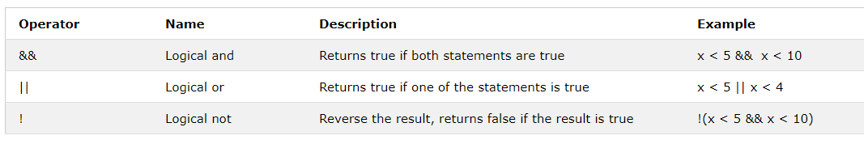
9.3 Relational Operators
There are following logical operators supported by C++ language.

Slide 99
9.2 Logical Operators

Slide 100
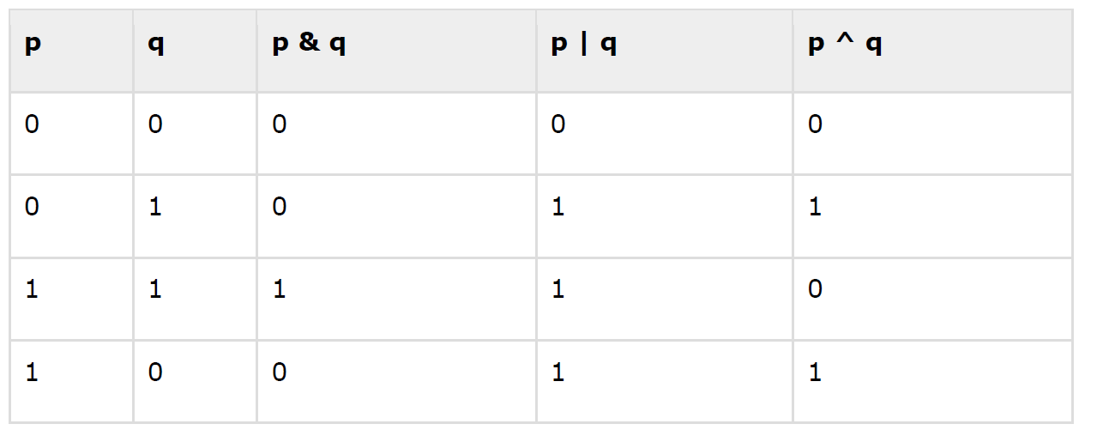
9.4 Bitwise Operators
Bitwise operator works on bits and perform bit-by-bit operation. The truth tables for &, |, and ^ are as follows:

Slide 101
9.4 Bitwise Operators
Assume if A = 60; and B = 13; now in binary format they will be as follows:
A = 0011 1100
B = 0000 1101
-----------------
A&B = 0000 1100
A|B = 0011 1101
A^B = 0011 0001
~A = 1100 0011

Slide 102
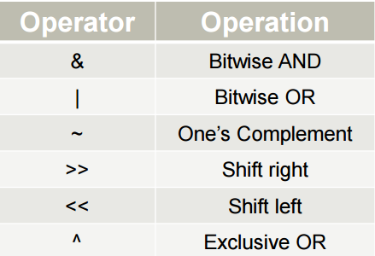
9.4 Bitwise Operators
The Bitwise operators supported by C++ language are listed in the following

Slide 103
9.4 Bitwise Operators
Try the following example to understand all the bitwise operators available in C++.

Slide 104
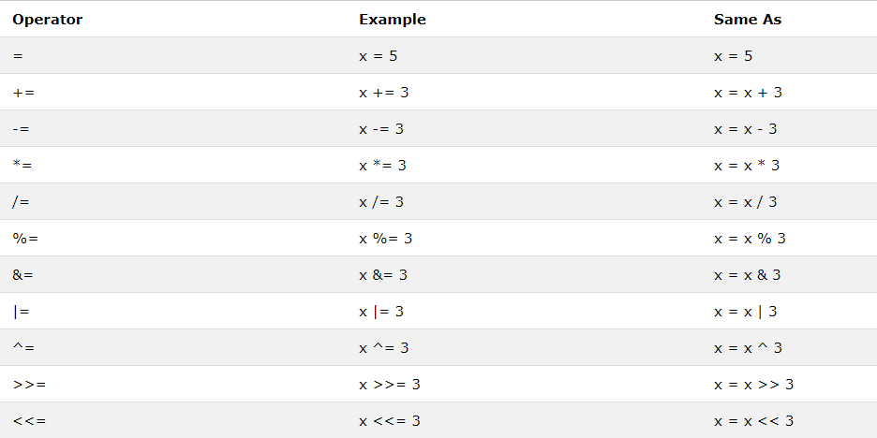
9.5 Assignment Operators
There are following assignment operators supported by C++ language:

Slide 105
9.6 Assignment Operators
Try the following example to understand all the assignment operators available in C++.

