Slide 1
1. LOOPS

Slide 2
There may be a situation, when you need to execute a block of code several number of times.
In general, statements are executed sequentially.
The first statement in a function is executed first, followed by the second, and so on
Programming languages provide various control structures that allow for more complicated execution paths.

Slide 3
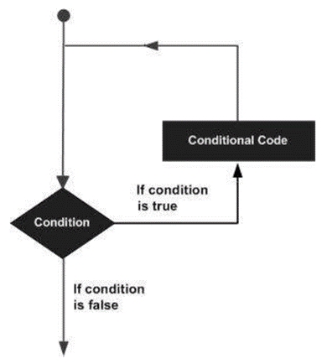
A loop statement allows us to execute a statement or group of statements multiple times and following is the general from of a loop statement in most of the programming languages:

Slide 4
C++ programming language provides the following type of loops to handle looping requirements.

Slide 5
1.1 While Loop
A while loop statement repeatedly executes a target statement as long as a given condition is true.
The syntax of a while loop in C++ is:

Slide 6
1.1 While Loop
Here, statement(s) may be a single statement or a block of statements.
The condition may be any expression, and true is any non-zero value.
The loop iterates while the condition is true.
When the condition becomes false, program control passes to the line immediately following the loop.

Slide 7
1.1 While Loop
Here, key point of the while loop is that the loop might not ever run.
When the condition is tested and the result is false, the loop body will be skipped and the
first statement after the while loop will be executed.

Slide 8
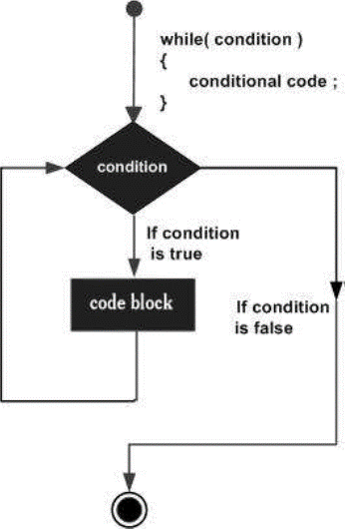
1.1 While Loop

Slide 9
1.1 While Loop

Slide 10
1.1 While Loop
When the previous code is compiled and executed, it produces the following result:

Slide 11
1.2 For Loop
A for loop is a repetition control structure that allows you to efficiently write a loop that needs to execute a specific number of times.
The syntax of a for loop in C++ is:

Slide 12
1.2 For Loop
The init step is executed first, and only once
This step allows you to declare and initialize any loop control variables.
Next, the condition is evaluated. If it is true, the body of the loop is executed.
If it is false, the body of the loop does not execute and flow of control jumps to the next statement just after the for loop.

Slide 13
1.2 For Loop
After the body of the for loop executes, the flow of control jumps back up to the increment statement.
This statement allows you to update any loop control variables.
The condition is now evaluated again. If it is true, the loop executes and the process repeats itself (body of loop, then increment step, and then again condition).
After the condition becomes false, the for loop terminates.

Slide 14
1.2 For Loop

Slide 15
1.2 For Loop
When the previous code is compiled and executed, it produces the following result:

Slide 16
1.3 do..while loop
Unlike for and while loops, which test the loop condition at the top of the loop, the do...while loop checks its condition at the bottom of the loop.
A do...while loop is similar to a while loop, except that a do...while loop is guaranteed to execute at least one time.
The syntax of a do...while loop in C++ is:

Slide 17
1.3 do..while loop
Notice that the conditional expression appears at the end of the loop, so the statement(s) in the loop execute once before the condition is tested.
If the condition is true, the flow of control jumps back up to do, and the statement(s) in the loop execute again.
This process repeats until the given condition becomes false.

Slide 18
1.3 do..while loop

Slide 19
1.3 do..while loop

Slide 20
1.3 do..while loop
When the previous code is compiled and executed, it produces the following result:

Slide 21
1.4 Nested loops
A loop can be nested inside of another loop. C++ allows at least 256 levels of nesting.
The syntax for a nested for loop statement in C++ is as follows:

Slide 22
1.4 Nested loops
A loop can be nested inside of another loop. C++ allows at least 256 levels of nesting.
The syntax for a nested for loop statement in C++ is as follows:

Slide 23
1.4 Nested loops
The syntax for a nested while loop statement in C++ is as follows:

Slide 24
1.4 Nested loops
The following program uses a nested for loop to find the prime numbers from 2 to 100:

Slide 25
1.5 Loop control statements
Loop control statements change execution from its normal sequence.
When execution leaves a scope, all automatic objects that were created in that scope are destroyed.
C++ supports the following control statements.
Statement | Description
break statement | Terminates the loop or switch statement and transfers execution to the statement immediately following the loop or switch.
continue statement | Causes the loop to skip the remainder of its body and immediately retest its condition prior to reiterating.

Slide 26
1.6 Break Statement
The break statement can be used when the break statement is encountered inside a loop, the loop is immediately terminated and program control resumes at the next statement following the loop.
If you are using nested loops (i.e., one loop inside another loop), the break statement will stop the execution of the innermost loop and start executing the next line of code after the block.

Slide 27
1.6 Break Statement

Slide 28
1.6 Break Statement

Slide 29
1.7 Continue Statement
The continue statement works somewhat like the break statement.
Instead of forcing termination, however, continue forces the next iteration of the loop to take place, skipping any code in between.
For the for loop, continue causes the conditional test and increment portions of the loop to execute.
For the while and do...while loops, program control passes to the conditional tests.

Slide 30
1.7 Continue Statement

Slide 31
1.7 Continue Statement

Slide 32
1.8 Infinite Loop
A loop becomes infinite loop if a condition never becomes false.
The for loop is traditionally used for this purpose.
Since none of the three expressions that form the ‘for’ loop are required, you can make an endless loop by leaving the conditional expression empty.

Slide 33
1.8 Infinite Loop

Slide 34
1.8 Infinite Loop
When the conditional expression is absent, it is assumed to be true.
You may have an initialization and increment expression, but C++ programmers more commonly use the ‘for (;;)’ construct to signify an infinite loop.
NOTE: You can terminate an infinite loop by pressing Ctrl + C keys.

