Slide 1
1. Strings

Slide 2
C++ provides following two types of string representations:
The C-style character string.
The string class type introduced with Standard C++.

Slide 3
1.1 The C-Style Character String
The C-style character string originated within the C language and continues to
be supported within C++.
This string is actually a one-dimensional array of characters which is terminated by a null character '\0'.
Thus a null-terminated string contains the characters that comprise the string followed by a null.

Slide 4
1.1 The C-Style Character String
The following declaration and initialization create a string consisting of the word
"Hello".
To hold the null character at the end of the array, the size of the character array containing the string is one more than the number of characters in the word "Hello."

Slide 5
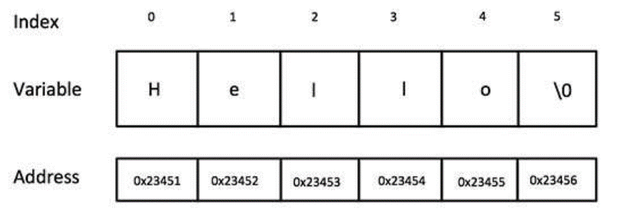
1.1 The C-Style Character String
If you follow the rule of array initialization, then you can write the above statement as follows:
Following is the memory presentation of above defined string in C/C++:

Slide 6
1.1 The C-Style Character String
Actually, you do not place the null character at the end of a string constant.
The C++ compiler automatically places the '\0' at the end of the string when it initializes the array.

Slide 7
1.1 The C-Style Character String
Let us try to print above-mentioned string:
When the above code is compiled and executed, it produces the following result:

Slide 8
1.1 The C-Style Character String
C++ supports a wide range of functions that manipulate null-terminated strings:

Slide 9
1.1 The C-Style Character String
Following example makes use of few of the above-mentioned functions:

Slide 10
1.1 The C-Style Character String
When the above code is compiled and executed, it produces result something as follows:

Slide 11
1.2 The String Class in C++
The standard C++ library provides a string class type that supports all the
operations mentioned above, additionally much more functionality.

Slide 12
1.3 String Concatenation
The + operator can be used between strings to add them together to make a new string.
This is called concatenation:

Slide 13
1.4 String Length
A string in C++ is actually an object, which contain functions that can perform certain operations on strings.
For example, the length of a string can be found with the length() function:

Slide 14
1.5 Access Strings
You can access the characters in a string by referring to its index number inside square brackets [].
This example prints the first character in myString:

Slide 15
1.6 Change String Characters
To change the value of a specific character in a string, refer to the index number, and use single quotes:

Slide 16
1.7 Example
Let us check the following example:

Slide 17
1.7 Example
When the above code is compiled and executed, it produces result something as follows:

Slide 18
2. Pointers

Slide 19
As you know every variable is a memory location and every memory location has its address defined which can be accessed using ampersand (&) operator which denotes an address in memory.
Consider the following which will print the address of the variables defined:

Slide 20
When the above code is compiled and executed, it produces the following result:
Address of var1 variable: 0xbfebd5c0
Address of var2 variable: 0xbfebd5b6

Slide 21
1.1 What are Pointers??
A pointer is a variable whose value is the address of another variable.
Like any variable or constant, you must declare a pointer before you can work with it.
The general form of a pointer variable declaration is:
type *var-name;

Slide 22
1.1 What are Pointers??
Here, type is the pointer's base type; it must be a valid C++ type and varname is the name of the pointer variable.
The asterisk you used to declare a pointer is the same asterisk that you use for multiplication.
However, in this statement the asterisk is being used to designate a variable as a pointer.

Slide 23
1.1 What are Pointers??
Following are the valid pointer declaration:
int *ip; // pointer to an integer
double *dp; // pointer to a double
float *fp; // pointer to a float
char *ch // pointer to character

Slide 24
1.1 What are Pointers??
The actual data type of the value of all pointers, whether integer, float, character, or otherwise, is the same, a long hexadecimal number that represents a memory address.
The only difference between pointers of different data types
is the data type of the variable or constant that the pointer
points to.

Slide 25
1.2 Using Pointers in C++
There are few important operations, which we will do with the pointers very frequently.
(a) We define a pointer variable.
(b) Assign the address of a variable to a pointer.
(c) Finally access the value at the address available in the pointer variable.
This is done by using unary operator * that returns the value of the variable located at the address specified by its operand.

Slide 26
1.2 Using Pointers in C++
Following example makes use of these operations:

Slide 27
1.2 Using Pointers in C++
When the above code is compiled and executed, it produces result something as follows:

Slide 28
1.3 Modify the Pointer Value
You can also change the pointer's value. But note that this will also change the value of the original variable:

