Slide 1
1. HOW WEBSITES WORKS

Slide 2
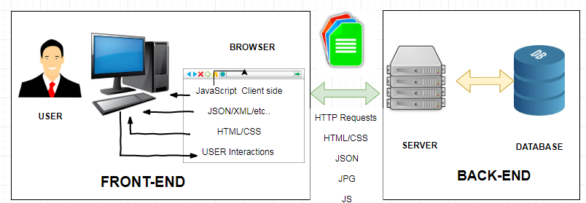
The main components of any given web framework are:
User
Browser
Webserver
Backend services (Data-Base).
The following image provides a basic diagram to make it easier to visualize the components in a website/web application.

Slide 3
1.1 User
User expectations define the requirements for developing a good website.
These expectations have changed a lot over the years. Users used to accept the slow experience of the web, but no longer.
They expect websites to behave closer to applications installed on their computers and mobile devices.
1.2 Browser
The browser plays three roles in the web framework.
Provides communication to and from the webserver.
Interprets the data from the server and renders it into the view that the user sees.
Handles user interaction through the keyboard, mouse, touchscreen, or other input device and takes the appropriate action.

Slide 4
The following are the most common types of data the browser uses to render the final user view as well as define the webpage behavior.
HTML files: Provide the fundamental structure of the DOM.
CSS files: Define how each of the elements on the page is to be styled; for example, font, color, borders, and spacing.
Client-side scripts: JavaScript files, that provide added functionality to the webpage, manipulate the DOM to change the look of the webpage, and provide any necessary logic required to display the page and provide functionality.
Media files: Image, video, and sound files are rendered as part of the webpage.
Data: Any data, such as XML, JSON, or raw text, can be provided by the webserver as a response to an AJAX request. Rather than sending a request back to the server to rebuild the webpage, new data can be retrieved via AJAX and inserted into the webpage via JavaScript.
HTTP headers: The HTTP protocol defines a set of headers that can be used by the browser and client-side scripts to define the behavior of the webpage. For example, cookies are contained in the HTTP headers. The HTTP headers also define the type of data in the request as well as the type of data expected to be returned to the browser.

Slide 5
1. HTML, CSS, & JAVASCRIPT INTRODCTION

Slide 6
HyperText Markup Language (HTML), Cascading Style Sheets (CSS), and JavaScript are the languages that run the web. They’re very closely related, but they’re also designed for very specific tasks. Understanding how they interact will go a long way towards becoming a web developer. We’ll be expanding on this throughout the tutorial, but the gist of it is:
HTML is for adding meaning to raw content by marking it up.
CSS is for formatting that marked up content.
JavaScript is for making that content and formatting interactive.

Slide 7
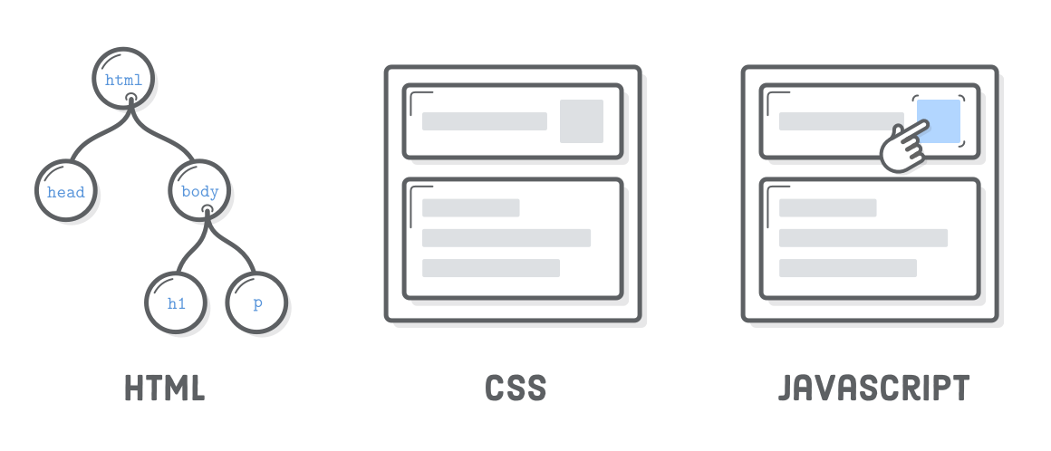
Think of HTML as the abstract text and images behind a web page, CSS as the page that actually gets displayed, and JavaScript as the behaviors that can manipulate both HTML and CSS.

Slide 8


For example, you might mark some particular run of text as a paragraph with this HTML:
Then, you can set the size and color of that paragraph with some CSS:
And, if you want to get fancy, you can re-write that paragraph when the user clicks it with some JavaScript (we’ll save the fancy stuff for a future tutorial):
<p id='some-paragraph'>This is a paragraph.</p>

Slide 9
As you can see, HTML, CSS, and JavaScript are totally different languages, but they all refer to one another in some way. Most websites rely on all three, but the appearance of every website is determined by HTML and CSS. That makes this bootcamp a great starting point for your web development journey.

Slide 10
2. LANGUAGES VS WEB DEVELOPMENT

Slide 11
Unfortunately, mastering HTML, CSS, and JavaScript is only a prerequisite for becoming a professional web developer. There are a bunch of other practical skills that you need to run a website:
Organizing HTML into reusable templates
Standing up a web server
Moving files from your local computer to your web server
Reverting to a previous version when you screw something up
Pointing a domain name at your server

Slide 12
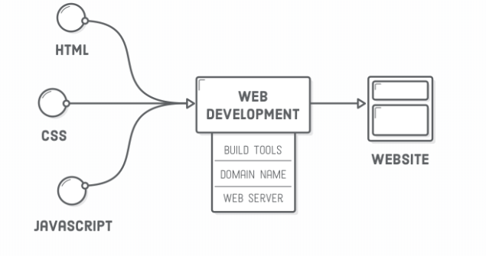
Dealing with these complexities involves setting up various “environments” to organize your files and handle the building/deploying of your website. All of this is orthogonal to the actual HTML, CSS, and JavaScript code that make up a website. This tutorial focuses entirely on the languages of HTML and CSS—not setting up those underlying environments.

Slide 13
3. FUNDAMENTALS NOT FRAMEWORKS

Slide 14
There’s all sorts of front-end web development frameworks out there (Bootstrap, ZURB foundation, and Pure CSS, just to name a few). The goal of every single one of them is to abstract away some of the redundant aspects of creating web pages from scratch. These kinds of frameworks are an important part of real-world web development, and they’re definitely worth exploring—but only after mastering the basics with HTML & CSS.

Slide 15
4. INTRODUCTION TO HTML

Slide 16
4.1 What is HTML?
HTML is the standard markup language for creating Web pages.
HTML stands for Hyper Text Markup Language
HTML describes the structure of a Web page
HTML consists of a series of elements
HTML elements tell the browser how to display the content
HTML elements are represented by tags
HTML tags label pieces of content such as "heading", "paragraph", "table", and so on
Browsers do not display the HTML tags, but use them to render the content of the page

Slide 17
4.2 Simple HTML Document

Slide 18
4.2 Simple HTML Document
The <!DOCTYPE html> declaration defines this document to be HTML5
The <html> element is the root element of an HTML page
The <head> element contains meta information about the document
The <title> element specifies a title for the document
The <body> element contains the visible page content
The <h1> element defines a large heading
The <p> element defines a paragraph

Slide 19
4.3 HTML Tags
HTML tags are element names surrounded by angle brackets:
<tagname>content goes here...</tagname>
HTML tags normally come in pairs like <p> and </p>
The first tag in a pair is the start tag, the second tag is the end tag
The start tag is also called the opening tag, and the end tag the closing tag.
The end tag is written like the start tag, but with a forward slash inserted before the tag name

Slide 20
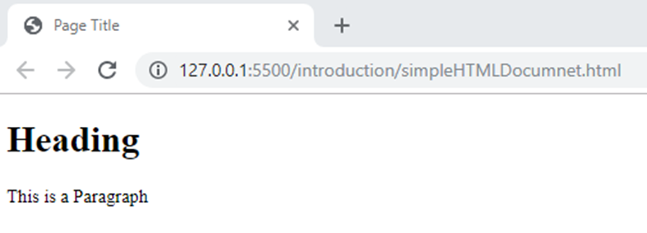
4.4 Web Browsers
The purpose of a web browser (Chrome, Edge, Firefox, Safari) is to read HTML documents and display them.
The browser does not display the HTML tags, but uses them to determine how to display the document:

Slide 21
4.5 HTML Page Structure
Below is a visualization of an HTML page structure:

Slide 22
4.6 The <!DOCTYPE> Definition
The <!DOCTYPE> declaration represents the document type, and helps browsers to display web pages correctly.
It must only appear once, at the top of the page (before any HTML tags).
The <!DOCTYPE> declaration is not case sensitive.
The <!DOCTYPE> declaration for HTML5 is:
<!DOCTYPE html>

Slide 23
4.7 HTML Versions
Since the early days of the web, there have been many versions of HTML:

Slide 24
4.8 Text Editor
Web pages can be created and modified by using professional HTML editors.
Also a simple text editor like Notepad (PC) or TextEdit (Mac) can be used.
We will use Visual studio Code editor throughout this course
You can download visual studio code from https://code.visualstudio.com/

Slide 25
5. HTML BASICS

Slide 26
5.1 HTML Document
All HTML documents must start with a document type declaration: <!DOCTYPE html>.
The HTML document itself begins with <html> and ends with </html>.
The visible part of the HTML document is between <body> and </body>.

Slide 27
5.2 Headings
HTML headings are defined with the <h1> to <h6> tags.
<h1> defines the most important heading.
<h6> defines the least important heading

Slide 28
5.3 Paragraphs
HTML paragraphs are defined with the <p> tag:

Slide 29
5.4 Links
HTML links are defined with the <a> tag:
The link's destination is specified in the href attribute.
Attributes are used to provide additional information about HTML elements.

Slide 30
5.5 Images
HTML images are defined with the <img> tag.
The source file (src), alternative text (alt), width, and height are provided as attributes:

Slide 31
5.6 Buttons
HTML buttons are defined with the <button> tag:

Slide 32
5.7 Lists
HTML lists are defined with the <ul> (unordered/bullet list) or the <ol> (ordered/numbered list) tag, followed by <li> tags (list items):

Slide 33
6. HTML ELEMENTS

Slide 34
6.1 HTML ELEMENTS
An HTML element usually consists of a start tag and an end tag, with the content inserted in between:
<tagname>Content </tagname>
The HTML element is everything from the start tag to the end tag:
<p>This is a paragraph Element </p>
HTML elements with no content are called empty elements. Empty elements do not have an end tag, such as the <br> element (which indicates a line break).

Slide 35
6.2 Nested Elements
HTML elements can be nested (elements can contain elements).
All HTML documents consist of nested HTML elements.
This example contains four HTML elements:

Slide 36
6.2 Nested Elements
The <html> element defines the whole document.
It has a start tag <html> and an end tag </html>.
Inside the <html> element is the <body> element.
The <body> element defines the document body.
It has a start tag <body> and an end tag </body>.
Inside the <body> element is two other HTML elements: <h1> and <p>.
The <h1> element defines a heading.
It has a start tag <h1> and an end tag </h1>.
The element content is: Nested h1 inside body tag that is inside html tag
The <p> element defines a paragraph.
It has a start tag <p> and an end tag </p>.
The element content is: My first paragraph.

Slide 37
6.3 Don’t Forget End Tags
Some HTML elements will display correctly, even if you forget the end tag.
The following example works in all browsers, because the closing tag is considered optional.
Never rely on this. It might produce unexpected results and/or errors if you forget the end tag.

Slide 38
6.4 Empty HTML Elements
HTML elements with no content are called empty elements.
<br> is an empty element without a closing tag (the <br> tag defines a line break):
Empty elements can be "closed" in the opening tag like this: <br />.

Slide 39
7. HTML ATTRIBUTES

Slide 40
7.1 HTML Attributes
All HTML elements can have attributes
Attributes provide additional information about an element
Attributes are always specified in the start tag
Attributes usually come in name/value pairs like: name="value"

Slide 41
7.2 href Attribute
HTML links are defined with the <a> tag.
The link address is specified in the href attribute:

Slide 42
7.3 src Attribute
HTML images are defined with the <img> tag.
The filename of the image source is specified in the src attribute:

Slide 43
7.4 The width and height Attributes
HTML images also have width and height attributes, which specifies the width and height of the image.
The width and height are specified in pixels by default; so width="500" means 500 pixels wide.

Slide 44
7.5 The alt Attribute
The alt attribute specifies an alternative text to be used, if an image cannot be displayed.
The alt attribute is also useful if the image cannot be displayed (e.g. if it does not exist):
The value of the alt attribute can be read by screen readers.
This way, someone "listening" to the webpage, e.g. a vision impaired person, can "hear" the element.

Slide 45
7.5 The alt Attribute

Slide 46
7.6 The style Attribute
The style attribute is used to specify the styling of an element, like color, font, size etc.

Slide 47
7.7 The lang Attribute
The language of the document can be declared in the <html> tag.
The language is declared with the lang attribute.
Declaring a language is important for accessibility applications (screen readers) and search engines.
The first two letters specify the language (en).
If there is a dialect, add two more letters (US).

Slide 48
7.7 The lang Attribute

Slide 49
7.8 The title Attribute
In the following example a title attribute is added to the <p> element.
The value of the title attribute will be displayed as a tooltip when you mouse over the paragraph:

Slide 50
7.9 Good Practices
The HTML5 standard does not require lowercase attribute names.
The title attribute can be written with uppercase or lowercase like title or TITLE.
Always use lowercase attribute names.
The HTML5 standard does not require quotes around attribute values.
Using quotes are the most common. Omitting quotes can produce errors.
Always use quotes around attribute values.

Slide 51
7.10 Attributes Summary
All HTML elements can have attributes
The title attribute provides additional "tool-tip" information
The href attribute provides address information for links
The width and height attributes provide size information for images
The alt attribute provides text for screen readers.

Slide 52
7.11 Attributes Table

Slide 53
8. HEADINGS

Slide 54
8.1 HTML Headings
Headings are defined with the <h1> to <h6> tags.
<h1> defines the most important heading. <h6> defines the least important heading.
Browsers automatically add some white space (a margin) before and after a heading

Slide 55
8.1 HTML Headings
Search engines use the headings to index the structure and content of your web pages.
Users often skim a page by its headings. It is important to use headings to show the document structure.
<h1> headings should be used for main headings, followed by <h2> headings, then the less important <h3>, and so on.
Use HTML headings for headings only. Don't use headings to make text BIG or bold.

Slide 56
8.2 Bigger Headings
Each HTML heading has a default size. However, you can specify the size for any heading with the style attribute, using the CSS font-size property

Slide 57
8.3 HTML Horizontal Rules
The <hr> tag defines a thematic break in an HTML page, and is most often displayed as a horizontal rule.
The <hr> element is used to separate content (or define a change) in an HTML page:

Slide 58
8.3 The HTML <head> Element
The HTML <head> element is a container for metadata.
HTML metadata is data about the HTML document.
Metadata typically define the document title, character set, styles, scripts, and other meta information.
Metadata is not displayed.
The <head> element is placed between the <html> tag and the <body> tag:

Slide 59
8.3 The HTML <head> Element

Slide 60
9. PARAGRAPHS

Slide 61
9.2 HTML Display
You cannot be sure how HTML will be displayed.
Large or small screens, and resized windows will create different results.
With HTML, you cannot change the output by adding extra spaces or extra lines in your HTML code.
The browser will remove any extra spaces and extra lines when the page is displayed:

Slide 62
9.2 HTML Display

Slide 63
9.3 Line Breaks
The HTML <br> element defines a line break.
Use <br> if you want a line break (a new line) without starting a new paragraph:

Slide 64
9.4 <pre> Element
The HTML <pre> element defines preformatted text.
The text inside a <pre> element is displayed in a fixed-width font (usually Courier), and it preserves both spaces and line breaks:

Slide 65
10. STYLES

Slide 66
10.1 style Attribute
Setting the style of an HTML element, can be done with the style attribute.
The HTML style attribute has the following syntax:
<tagname style="property:value;">
The property is a CSS property. The value is a CSS value.

Slide 67
10.2 Background Color
The CSS background-color property defines the background color for an HTML element.

Slide 68
10.3 Text Color
The CSS color property defines the text color for an HTML element:

Slide 69
10.4 Fonts
The CSS font-family property defines the font to be used for an HTML element:

Slide 70
10.4 Text size
The CSS font-size property defines the text size for an HTML element:

Slide 71
10.5 Text Aligment
The CSS text-align property defines the horizontal text alignment for an HTML element:

Slide 72
10.6 Example

Slide 73
10.7 Summary
Use the style attribute for styling HTML elements
Use background-color for background color
Use color for text colors
Use font-family for text fonts
Use font-size for text sizes
Use text-align for text alignment

Slide 74
11. FORMATTING

Slide 75
11.1 Formatting Elements
HTML also defines special elements for defining text with a special meaning.
HTML uses elements like <b> and <i> for formatting output, like bold or italic text.
Formatting elements were designed to display special types of text:

Slide 76
11.2 <b> and <strong> Elements
The HTML <b> element defines bold text, without any extra importance.

Slide 77
11.2 <b> and <strong> Elements
The HTML <strong> element defines strong text, with added semantic "strong" importance.

Slide 78
11.3 <i> and <em> Elements
The HTML <i> element defines italic text, without any extra importance

Slide 79
11.3 <i> and <em> Elements
The HTML <em> element defines emphasized text, with added semantic importance.

Slide 80
11.4 <small> Elements
The HTML <small> element defines smaller text:

Slide 81
11.5 <mark> Elements
The HTML <mark> element defines marked/highlighted text:

Slide 82
11.6 <del> Elements
The HTML <del> element defines deleted/removed text.

Slide 83
11.7 <ins> Elements
The HTML <ins> element defines inserted/added text.

Slide 84
11.8 <sub> Elements
The HTML <sub> element defines subscripted text.

Slide 85
11.9 <sup> Elements
The HTML <sup> element defines superscripted text.

Slide 86
11.10 Example

Slide 87
12. QUOTATION

Slide 88
12.1 <q> for Short Quotations
The HTML <q> element defines a short quotation.
Browsers usually insert quotation marks around the <q> element.

Slide 89
12.2 <blockquote> for Quotations
The HTML <blockquote> element defines a section that is quoted from another source.
Browsers usually indent <blockquote> elements.

Slide 90
12.3 <abbr> for Abbreviations
The HTML <abbr> element defines an abbreviation or an acronym.
Marking abbreviations can give useful information to browsers, translation systems and search-engines.

Slide 91
12.4 <address> for Contact Information
The HTML <address> element defines contact information (author/owner) of a document or an article.
The <address> element is usually displayed in italic. Most browsers will add a line break before and after the element.

Slide 92
12.5 <cite> for Work Title
The HTML <cite> element defines the title of a work.
Browsers usually display <cite> elements in italic.

Slide 93
12.6 <bdo> for Bi-Directional Override
The HTML <bdo> element defines bi-directional override.
The <bdo> element is used to override the current text direction:

Slide 94
13. COMMENTS

Slide 95
13.1 Comment Tag
You can add comments to your HTML source by using the following syntax:
<!-- Write your comments here -->
Notice that there is an exclamation point (!) in the opening tag, but not in the closing tag.
With comments you can place notifications and reminders in your HTML:

Slide 96
13.1 Comment Tag

Slide 97
13.1 Comment Tag
Comments are also great for debugging HTML, because you can comment out HTML lines of code, one at a time, to search for errors:

