Slide 1
Work Journal
Jarrod McGee

Slide 2
Installation Instructions
Included in the README.txt in the project folder.

Slide 3
Problem
Physical work journals are tedious and give little info
Can be lost or damaged
Don’t provide data

Slide 4
Solution
Digital work journal
Reflective data analysis

Slide 5
Tools Used
Eclipse
SQLite
DB Browser for SQLite
Java Swing
JFreeChart

Slide 6
OOP Concepts Applied
Inheritance
Generics
ArrayList<>
Code reuse
Error checking

Slide 7
Classes
LoginWindow
WelcomeMenuScreen
ViewDataScreen
Charts
AddEntryScreen
ViewEntriesScreen
DataBaseHelper
Entry

Slide 8
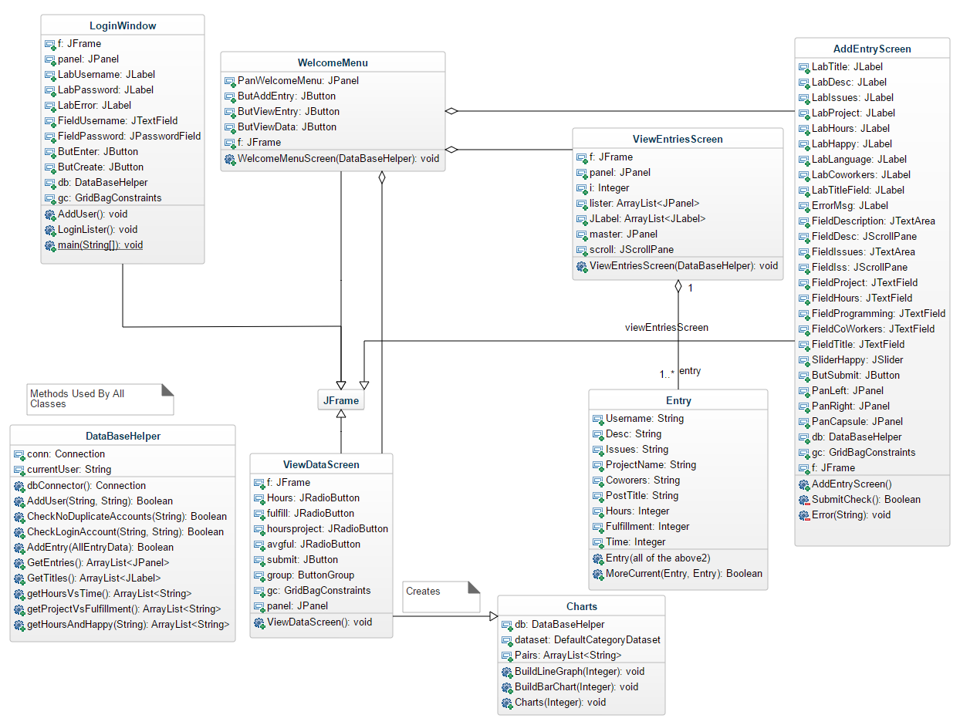
Class Diagram

Slide 9
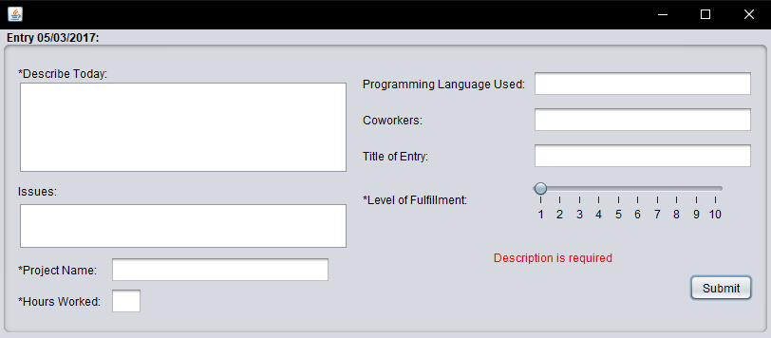
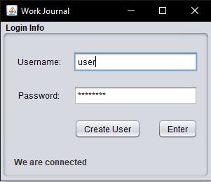
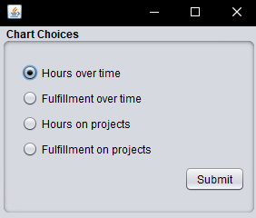
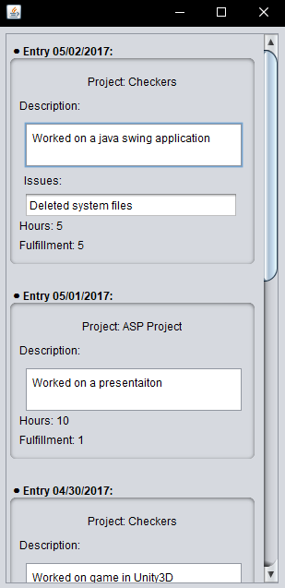
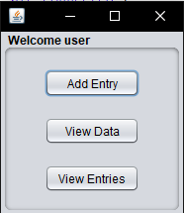
Activity Diagram

Slide 10
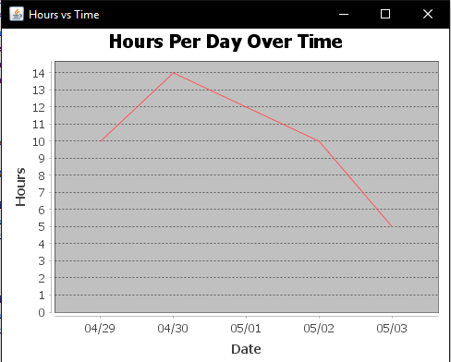
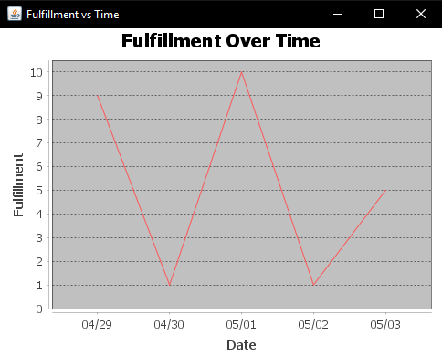
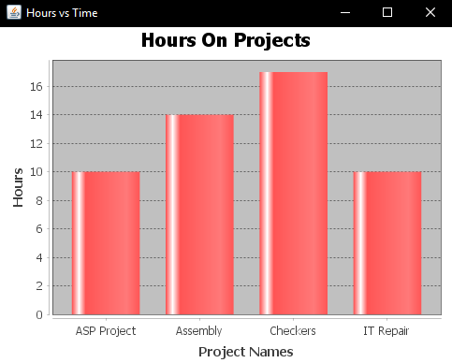
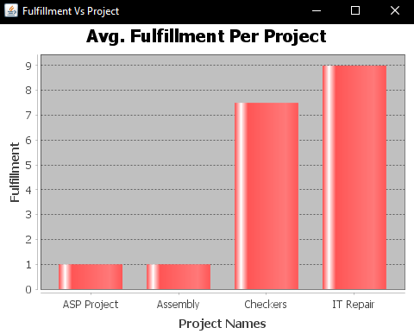
Charts

Slide 11
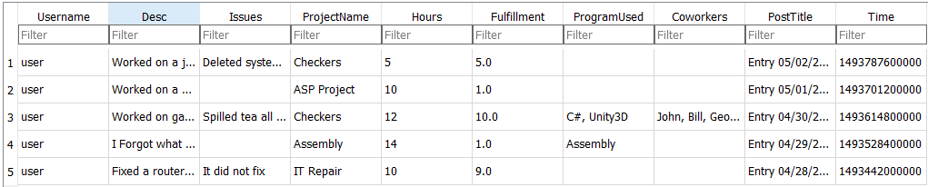
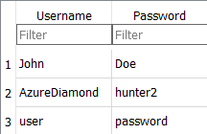
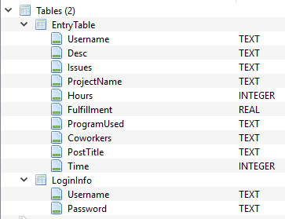
Database Design
EntryTable
LoginInfo

Slide 12
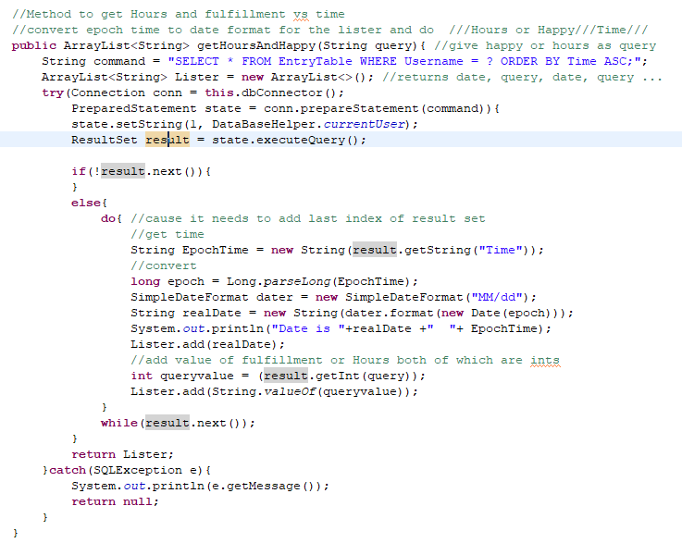
Code Walkthroughs

Slide 13
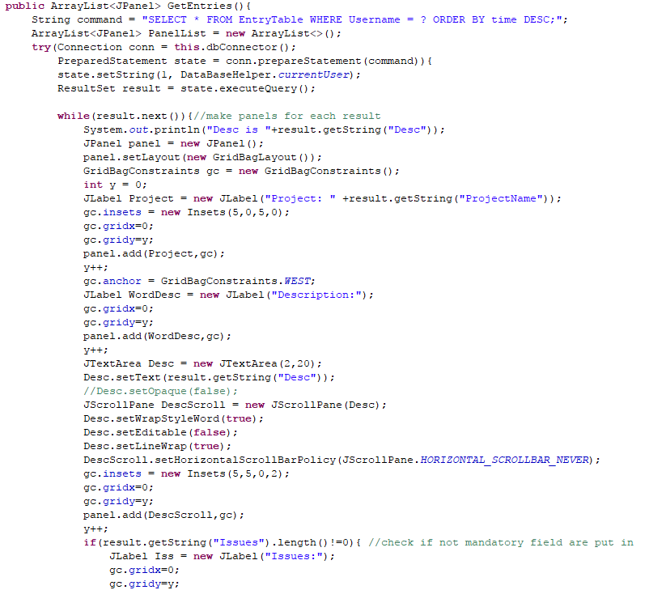
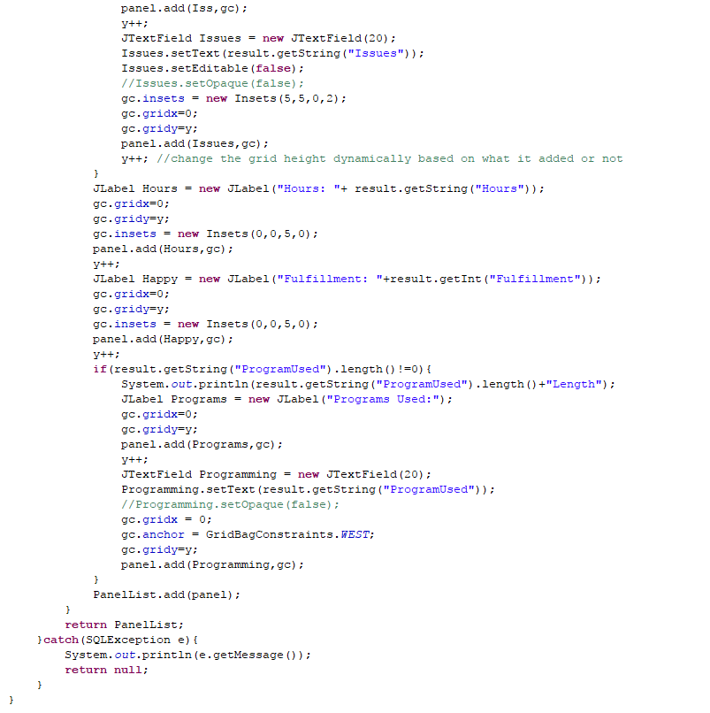

Slide 14
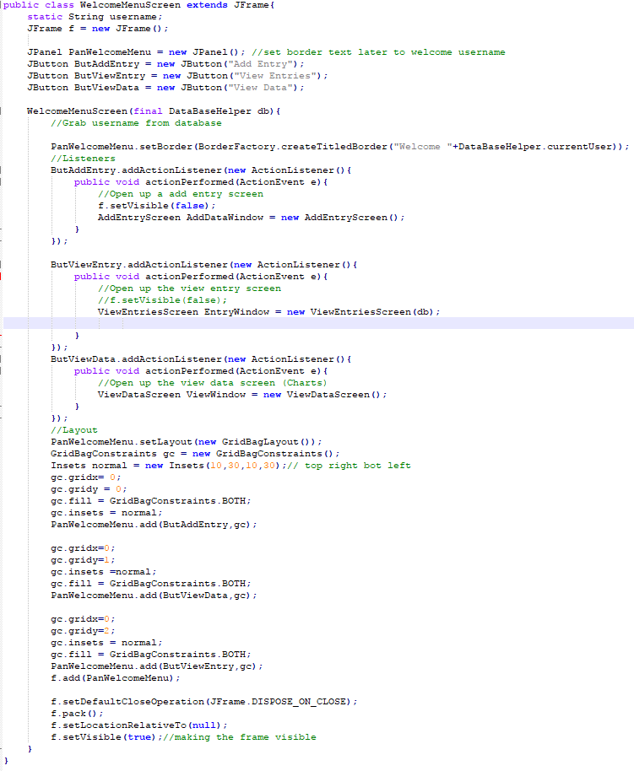

Slide 15
Looking Forward
More charts
Customized input better
Move away from SQLite

