Slide 1
Model-Based RL
Reinforcement Learning
School of Data Science
University of Virginia
Last updated: October 11, 2025

Slide 2
Agenda
> Model-Free RL
> Model-Based RL
> World Models

Slide 3


Model Free vs. Model-Based
So far we have looked at model-free approaches
There was no transition model
Instead, we sampled next state by running action in environment:

Slide 4
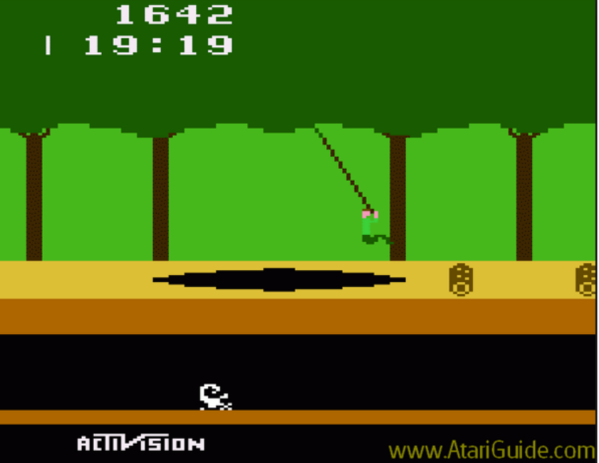
Reminder about Model-Free RL
In some cases, we devised toy rules
In other cases, we ran a simulator

Slide 5
Reminder about Model-Free RL
In some cases, we devised toy rules
In other cases, we ran a simulator
Of course, a simulator might use a model
But the RL agent doesn’t know or learn the model

Slide 6
Disadvantages of Model-Free RL
> Lower sample efficiency: without a model, agent only learns from experience

Slide 7

Disadvantages of Model-Free RL
> Lower sample efficiency: without a model, agent only learns from experience
> Can’t plan ahead: it is not possible to simulate rollouts and learn from them

Slide 8
Disadvantages of Model-Free RL
> Lower sample efficiency: without a model, agent only learns from experience
> Can’t plan ahead: it is not possible to simulate rollouts and learn from them
> Adaptability is challenging: if environment / reward function changes, a lot of experience
is required for learning

Slide 9
Disadvantages of Model-Free RL
> Lower sample efficiency: without a model, agent only learns from experience
> Can’t plan ahead: it is not possible to simulate rollouts and learn from them
> Adaptability is challenging: if environment / reward function changes, a lot of experience
is required for learning
> Lack of interpretability: value functions and policies can be black boxes

Slide 10
Model-Based RL – General Strategy
Two parts:
1. Learn a dynamics function to model observed state transitions
2. Use model predictions to learn what actions to take (e.g., learn a policy)

Slide 11
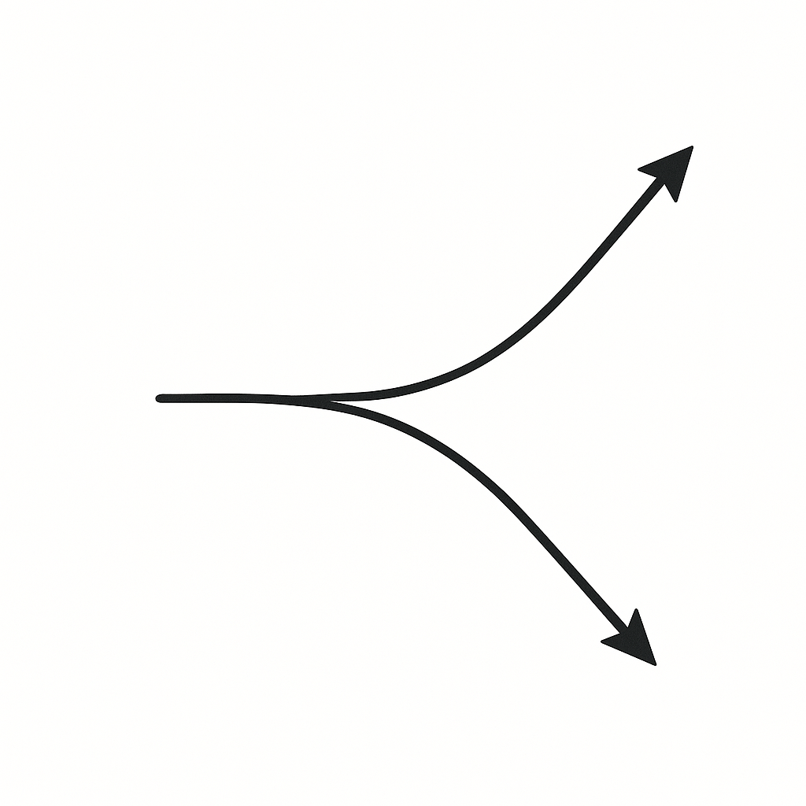
Action Selection and Horizon
We can use model predictions to learn what actions to take
For example, our usual strategy is to maximize return (= expected total discounted reward)
Q: What horizon to use?
Infinite horizon won’t work … prediction errors can compound
Instead, we use some planning horizon H

Slide 12

Action Selection with Finite Planning Horizon
1. Set planning horizon H
2. Generate K random action sequences each with length H, denoted
3. Use the dynamics model to predict the future states after taking each action sequence
4. Evaluate the return associated with each candidate action sequence
5. Select the best action sequence
This method is called random shooting

Slide 13
Refinement to Action Selection: Replanning
Since our model is imperfect, we might have compounding errors as we plan into the future
We can adopt a model predictive control (MPC) approach:
1. At each time step, we perform random shooting or something else
2. Select the best H-step action sequence
3. Only take the first action from the sequence
4. Now replan at the next time step using updated state information

Slide 14

Refinement to Dynamics Model: Ensemble
We are using some model (e.g., a neural network) to predict the next state
A method for potentially improving predictions is to use a set of models
These can be independently initialized
At inference time: For each candidate action sequence, generate N independent rollouts
Average the rewards of the rollouts to select the best sequence

Slide 15
Model-Based RL
Q: Given model-free RL limitations, why don’t we always use a model?

Slide 16
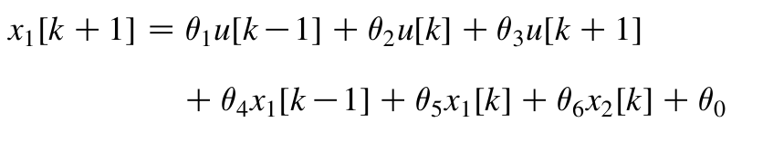
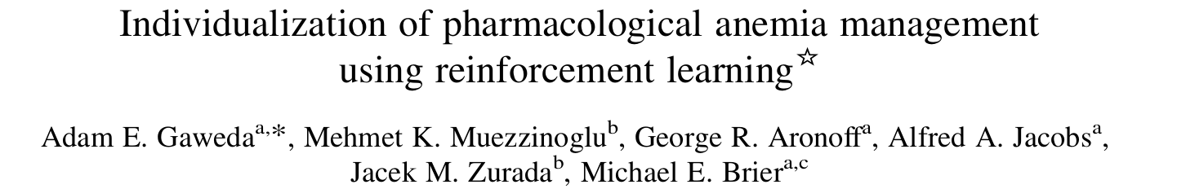
Model-Based RL
Q: Given model-free RL limitations, why don’t we always use a model?
A: Because developing an accurate model can be hard.

Slide 17
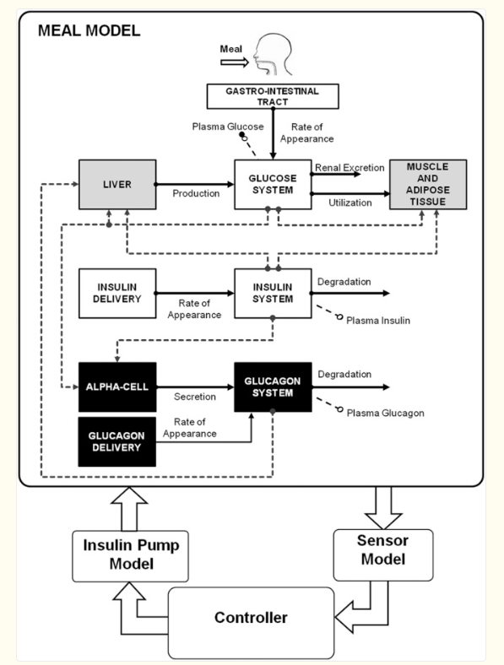
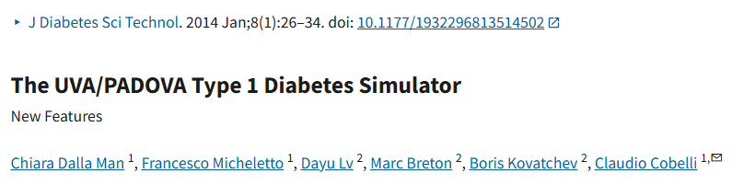
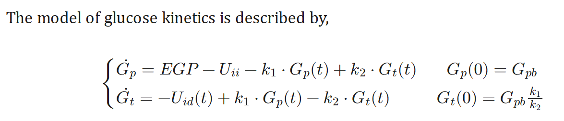
Model-Based RL: Diabetes Simulator

Slide 18
World Models

Slide 19

World Models
A world model (David Ha, Jürgen Schmidhuber, 2018) is a learned model of the dynamics:
Useful for:
> Predicting next state
> Planning
> Imagining possible futures without taking the actions in real environment.
Critical when it would be dangerous or costly to try the actions in real world.
worldmodels.github.io

Slide 20
World Models – Classic Model
From Ha & Schmidhuber paper, architecture has three parts:
VAE (encoder) | Compress high-dim obs (e.g., images) into a low-dim latent space
MDN-RNN | Learn to predict next latent state, given current latent state, action
Controller | “Small” policy network that decides actions in latent space

Slide 21
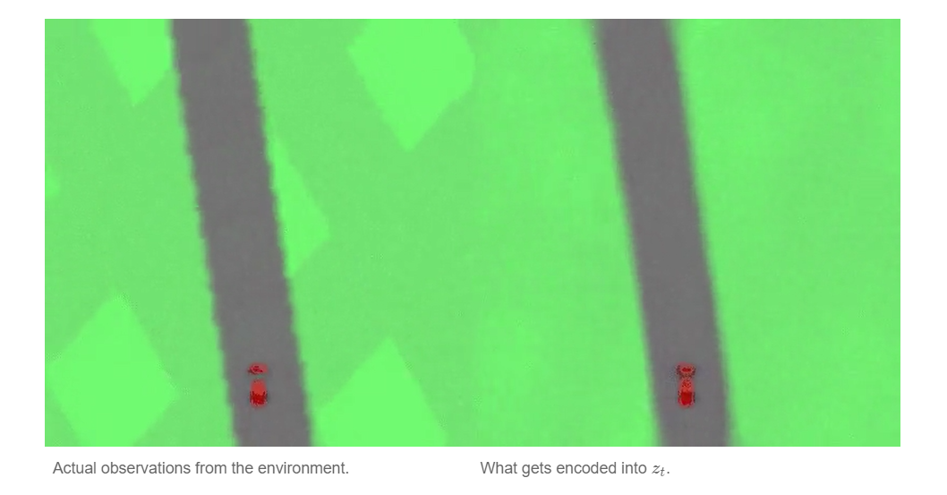
Car Racing Experiment - Image Encoding

Slide 22
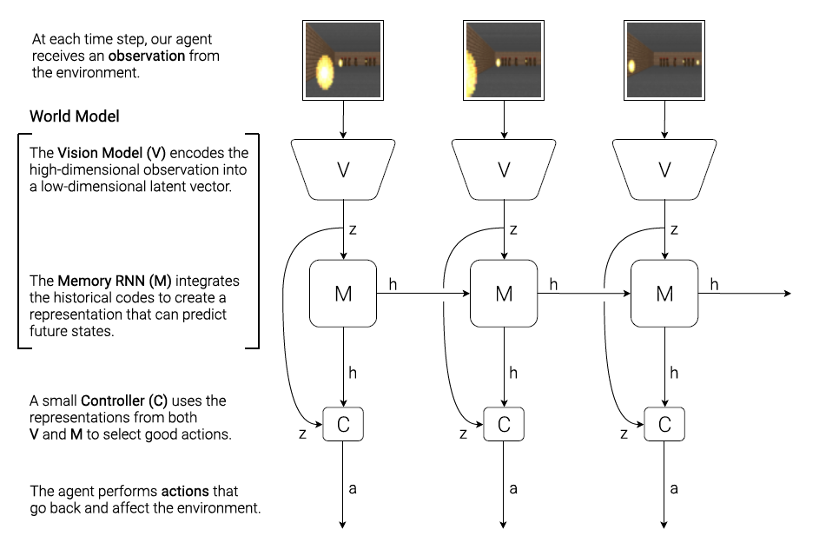
World Model with Images
David Ha, Jürgen Schmidhuber, 2018

Slide 23
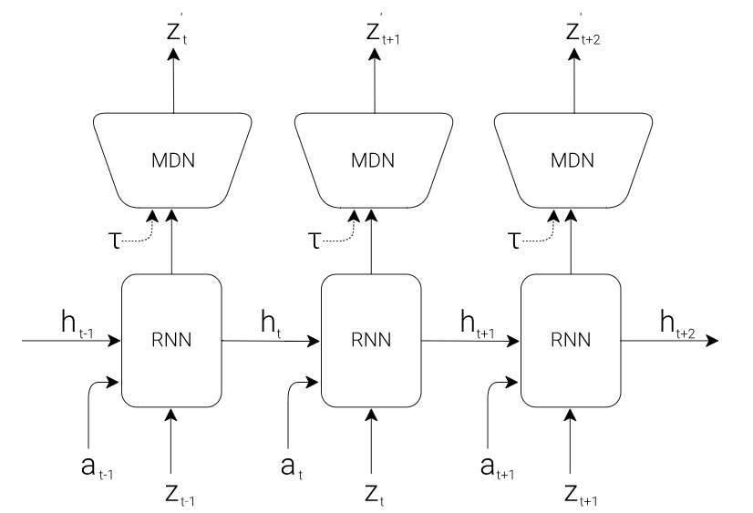




MDN-RNN
Predicts next latent state as density function
Approximated as mixture of Gaussians
RNN used to model
where denotes the action
is the hidden state
is the temperature for controlling uncertainty
MDN component outputs parameters of mixture distn.

Slide 24
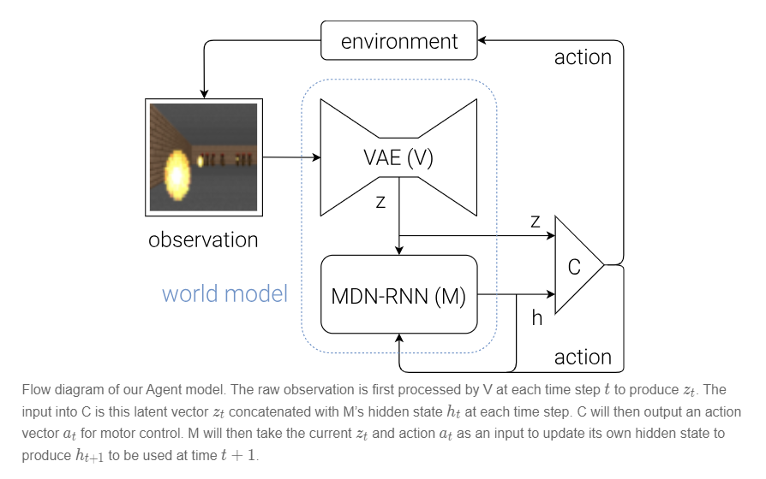
Putting the Pieces Together

Slide 25
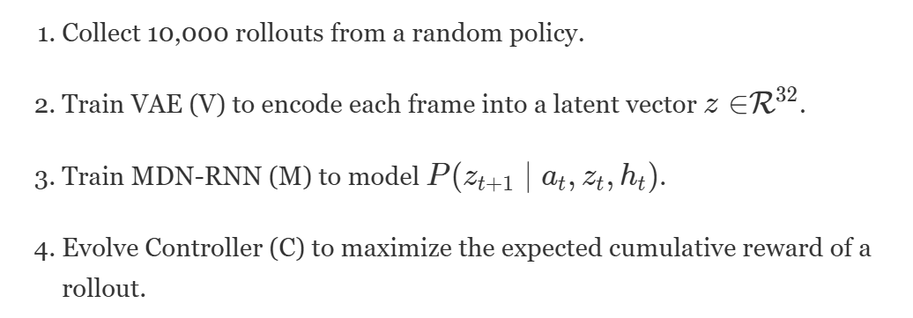
Car Racing Experiment - Procedure

Slide 26
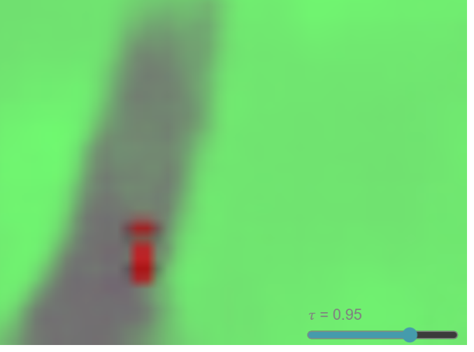
Learning in a Dream
We have seen the procedure for training a simple policy to solve tasks
Can train the agent insides its “dream” environment
Then transfer policy back to actual environment
Explore the paper and interactive demo:
https://worldmodels.github.io/

