Slide 1
Extensions to Q-Learning 1
Reinforcement Learning
School of Data Science
University of Virginia
Last updated: October 16, 2025

Slide 2
Agenda
> Double Q-Learning
> Prioritized Experience Replay

Slide 3
Double Q-Learning

Slide 4

Main Idea
DQN requires target estimates of this form:
The max() operation is used to estimate value
There may be noise in the system
Tends to produce a bias: overestimating value of Q
Paper: Deep Reinforcement Learning with Double Q-learning
Hado van Hasselt, Arthur Guez, David Silver. Google DeepMind

Slide 5
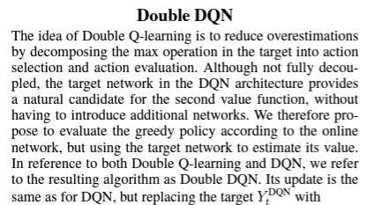


Main Idea, contd.
Decompose max() operation into action selection, action evaluation
Notice there are two Qs
- One determines greedy policy using online network
- Another fairly evaluates the policy using the target network

Slide 6
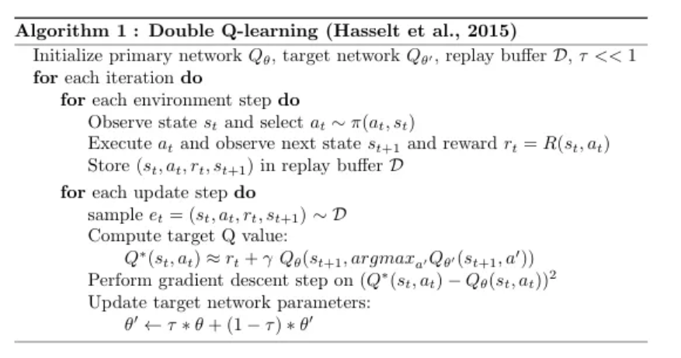
Double Q-Learning Algorithm

Slide 7
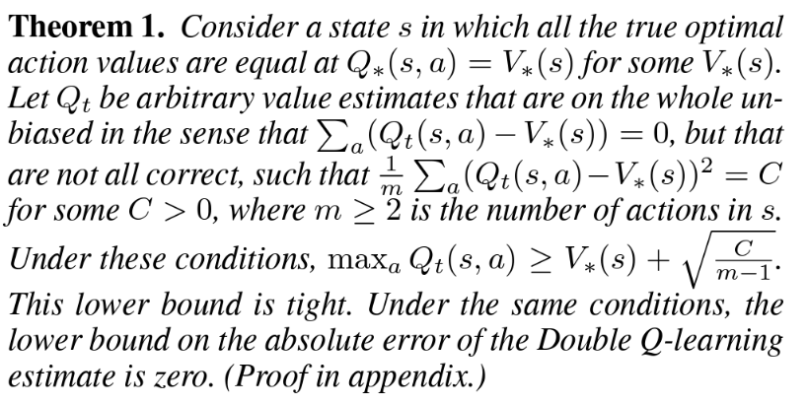
Bias Estimates
=> For larger #actions m, the lower bound decreases
Hence, overoptimism increases for larger m

Slide 8
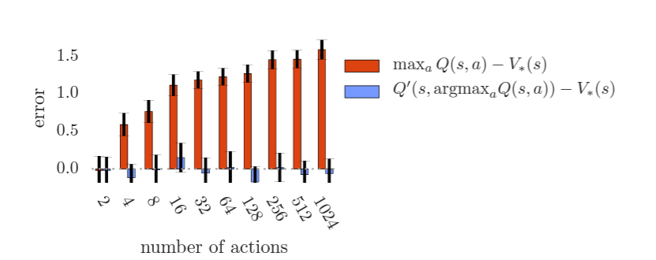
Bias Estimates, contd.
Red bars quantify this overoptimism
The gap increases for increasing #actions
However, for Double Q-Learning, bias remains small

Slide 9
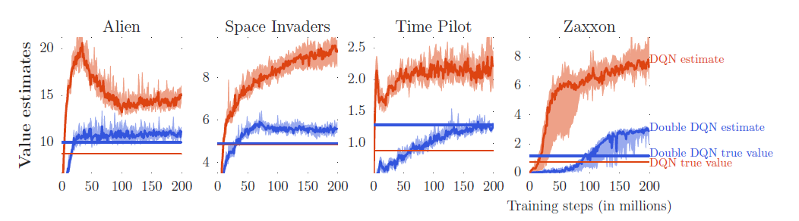
Bias Estimates - Atari
Red = DQN Blue = Double DQN
DQN is overestimating values more than Double DQN (compare the curves)

Slide 10
Bias Estimates - Atari
Red = DQN Blue = Double DQN
DQN is overestimating values more than Double DQN (compare the curves)
Horizontal lines are actual discounted value of best learned policy (unbiased)
Computed by running learned policy and averaging actual discounted returns
Double DQN best policy (blue horiz. line) outperforms DQN best policy (red horiz. line)

Slide 11
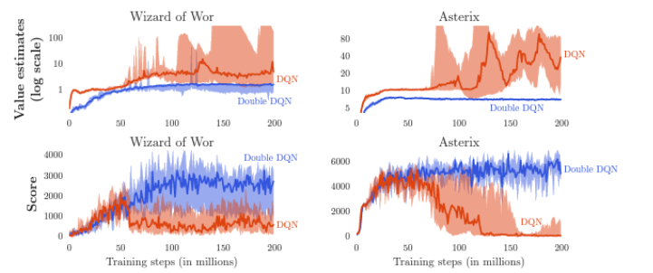
Bias Estimates – Atari, Extreme Cases
In these cases, overoptimism in DQN is extreme (red curve)
Where red separates from blue, bias increases

Slide 12
Bias Estimates – Atari, Extreme Cases
In these cases, overoptimism in DQN is extreme (red curve)
Where red separates from blue, bias increases
This has detrimental effect on score (Double DQN outperforms)
Double DQN is also more stable

Slide 13
Double DQN - Implementation Example

Slide 14
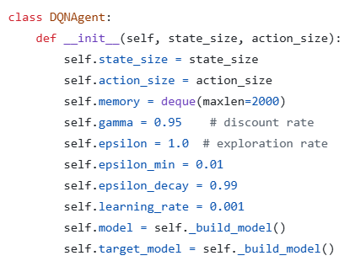
RL Applied to Sepsis Case – DQN Agent
Instantiate online and target models
Source: https://github.com/keon/deep-q-learning

Slide 15
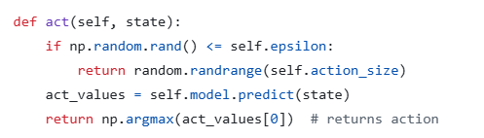
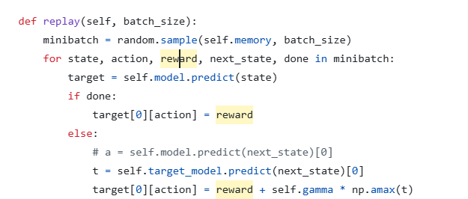
RL Applied to Sepsis Case – Act & Evaluate
Action selection using online network
Evaluation using target network
Source: https://github.com/keon/deep-q-learning

Slide 16
Findings
The bias resulting from max() in DQN can be large, and it matters
Double DQN can be more stable and reliable than DQN
Double DQN can find better policies than DQN
The code change to implement Double DQN is small

Slide 17
Prioritized Experience Replay

Slide 18
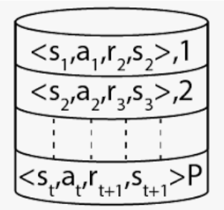
Buffer
DQN uses a buffer to store, retrieve, and replay past transitions (st, at, rt+1, st+1)
This makes DQN more efficient than Q-Learning
The transitions are sampled uniformly at random
Prioritized Experience Replay (PER)
tries to be more strategic about sampling
Paper: Prioritized Experience Replay. Schaul et. al.

Slide 19

Priority
PER uses absolute TD error as the priority
Could select transition with max abs TD error, but greedy approach may backfire
Instead, paper uses stochastic prioritization with two methods:
1) Proportional
2) Rank-based

Slide 20

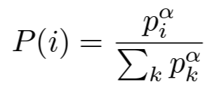
Proportional Priority
Define proportional priority where
Epsilon prevents transitions from not being visited when error is zero
Define probability of sampling transition
Alpha controls amount of prioritization; alpha = 0 is uniform case.

Slide 21

Rank-Based Priority
Rank is used for robustness
Define probability of sampling transition
Ranks are based on absolute TD error

Slide 22
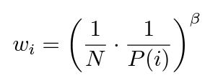

Importance Sampling
PER induces bias by changing probability of transition selection
Can adjust for bias with importance sampling
Case where beta = 1 fully compensates for non-uniform probabilities
For Q-learning updates, use weighted by
For stability, scale weights by 1 / max

Slide 23
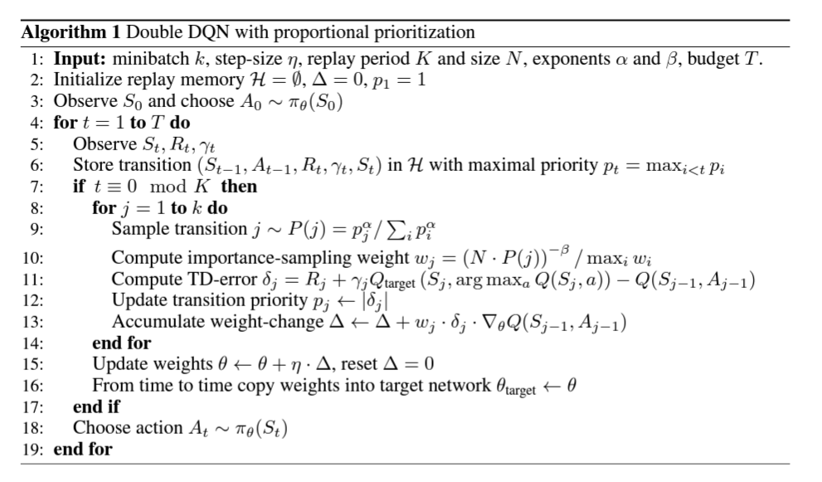
Algorithm
Uses two networks
Done for stability
Proportional priority
Hard update

Slide 24
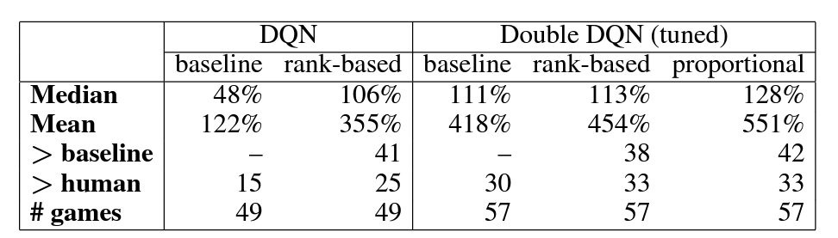
Results: Summary of Normalized Scores
Baseline: sample experience replay buffer uniformly
DQN with rank-based priority results in higher scores for 41 out of 49 games
Double DQN is similarly helped by PER

Slide 25
Results: Summary of Normalized Scores
Baseline: sample experience replay buffer uniformly
Median and mean are normalized scores

Slide 26
Results: Summary of Normalized Scores
DQN with rank-based priority results in higher scores for 41 out of 49 games
Double DQN is similarly helped by PER

