Slide 1
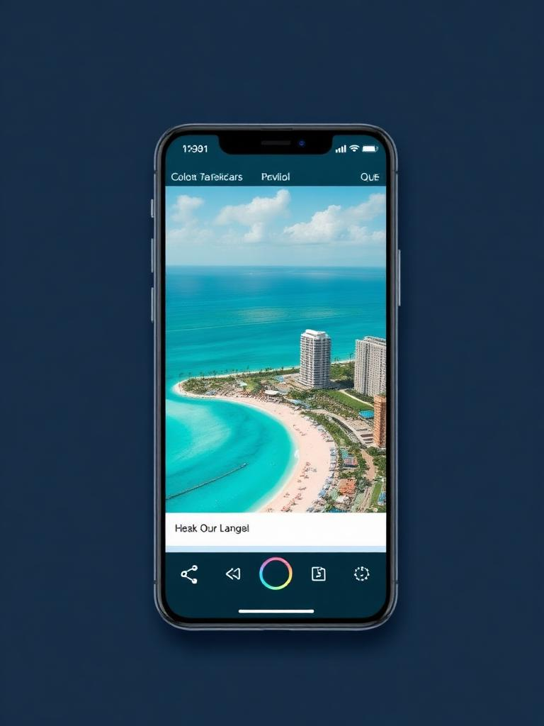
TRAVIDZ
Creator-led travel commerce · Seed round
£2.5M SAFE · 18-mo runway · Next: Series A at £18M ARR run-rate
PROBLEM
SOLUTION
Discovery moved to creators; booking didn't. £675B of global leisure-travel bookings flow through OTAs that pay creators £0 and own the customer. Creators send the intent — OTAs keep the margin and the data.
Shoppable travel feed. Creator posts trip → traveller books in 2 taps → creator earns for life. Native checkout, unified inventory (stays · tours · experiences), persistent attribution.
PROGRAMME · FOUNDING 5,000
UNIT ECONOMICS (V6 MODEL)
Founding Creator cap
• 11% gross commission on every booking
5,000
50/50 split locked
• Stripe 2.9% + £0.20 shared off the top
24 months
• Net pool split 50/50/50/40/30 by tier
Power tier · rolling 12mo GBV
£25k
• Blended Y5 take-rate 4.65% net to Travidz
• Stays + tours/experiences only · no restaurants
FOUNDERS
GROWTH PLAN: PROVE → SCALE → DEFEND
Discover. Book. Earn.
Brendan
Co-founder · CEO
The shoppable feed for travel.
PROVE
M0-18 · UK · 2.4k cr · £44M GBV · 40% M3 retention
Linda
Co-founder
▶ Live pitch · travidz.com/invest
SCALE
M18-44 · EU-5 · 14k cr · £259M · CAC payback <6mo
Hiring
Eng & growth post-seed
DEFEND
M44-60 · 24k cr · £444M UK Base · Global Viral upside £1.32B
Creators
Travellers
Suppliers
TAM
SAM
Y5 SOM
THE ASK · £2.5M SAFE
£87.6B / £675B
£25.2B / £175B
£444M → £1.32B
£2.5M
Seed · post → Series A
UK / Global · ONS · Eurostat · UNWTO
28.8% creator-influenced × bookable (UK) · 26% global
24k cr × £18.5k GBV · 4.65% net take
GTM 40%
Eng 35%

