Slide 1
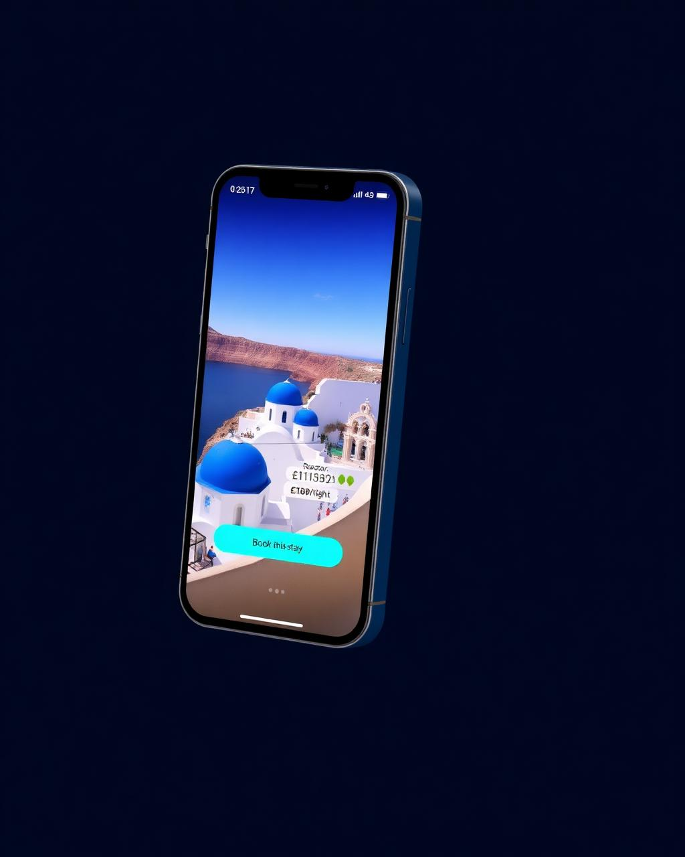
TRAVIDZ
Creator-led travel commerce · Seed round
£2.5M SAFE · 18-mo runway · Next: Series A at £18M ARR run-rate
PROBLEM
SOLUTION
Discovery moved to creators; booking didn't. £343B flows through OTAs that pay creators £0 and own the customer. Creators send the intent — OTAs keep the margin and the data.
Shoppable travel feed. Creator posts trip → traveller books in 2 taps → creator earns for life. Native checkout, unified inventory (stays · tours · experiences), persistent attribution.
TRACTION
BUSINESS MODEL
Waitlist (organic, UK)
• Take-rate 4-7% · blended Y5 4.65%
3,200+
Creator LOIs · 4.2M reach
• Creator rev-share 30-50% of net
85
• ~55% contribution margin at scale
Supply signed · 3 cities
12
• Zero paid acquisition Y1-2 (creator-led)
TEAM
GROWTH PLAN: PROVE → SCALE → DEFEND
CEO
ex-Booking.com · scaled supply 0→1
PROVE
M0-18 · UK · 2.4k cr · £44M GBV · 40% M3 retention
CTO
ex-TikTok Shop · creator-commerce rails
Discover. Book. Earn.
M18-44 · EU-5 · 14k cr · £259M · CAC payback <6mo
The shoppable feed for travel.
SCALE
CPO
ex-Airbnb · marketplace growth
DEFEND
M44-60 · 24k cr · £444M · ledger + supply lock-in
Creators
Travellers
Suppliers
TAM
SAM
Y5 SOM
THE ASK · £2.5M SAFE
£87.6B / £343B
£23.2B / £82.9B
£444M · £20.7M
£2.5M
Seed · post → Series A
UK / UK+EU-5 · ONS · Eurostat
36% creator-influenced × 80% bookable
GBV · net rev @ 4.65% (1.9% of UK SAM)
GTM 40%
Eng 35%

