Slide 1
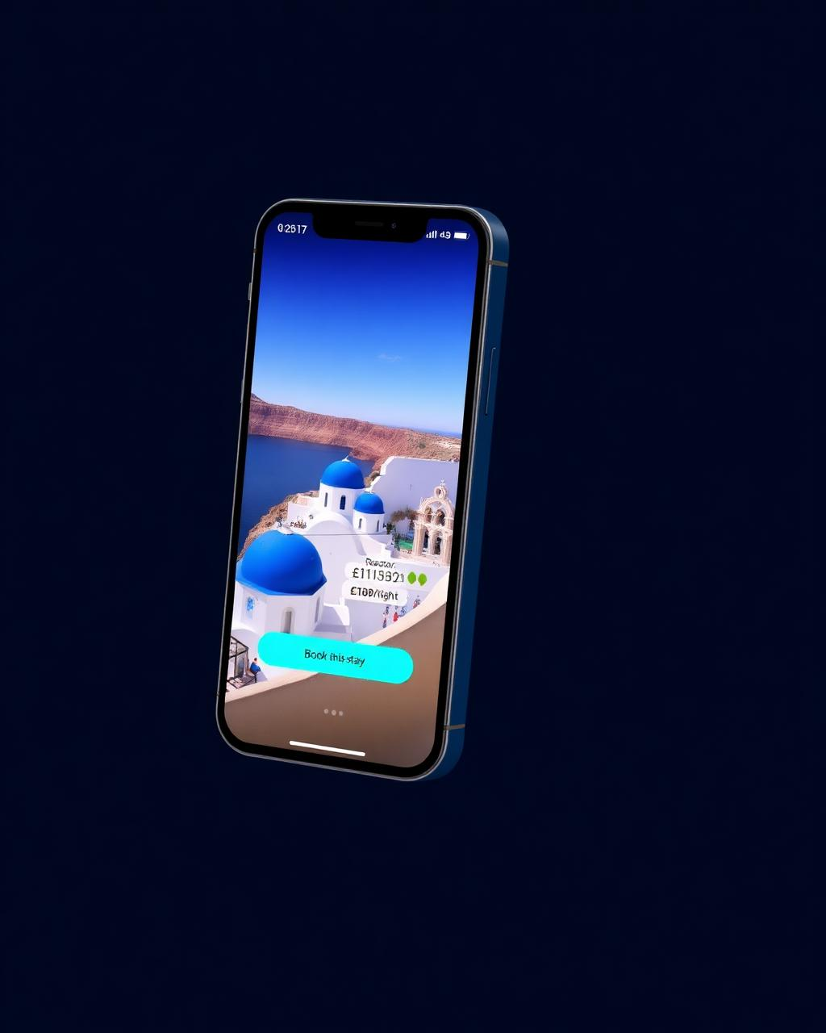
TRAVIDZ
Creator-led travel commerce · Seed round
£2.5M SAFE · 18-mo runway · Next: Series A at £18M ARR run-rate
PROBLEM
SOLUTION
Discovery moved to creators; booking didn't. £675B of global leisure-travel bookings flow through OTAs that pay creators £0 and own the customer. Creators send the intent — OTAs keep the margin and the data.
Shoppable travel feed. Creator posts trip → traveller books in 2 taps → creator earns for life. Native checkout, unified inventory (stays · tours · experiences), persistent attribution.
TRACTION
BUSINESS MODEL
Waitlist (organic, UK)
• Take-rate 4-7% · blended Y5 4.65%
3,200+
Creator LOIs · 4.2M reach
• Creator rev-share 30-50% of net
85
• ~55% contribution margin at scale
Supply signed · 3 cities
12
• Zero paid acquisition Y1-2 (creator-led)
• Breakeven M48 · Y1 −£1.56M · +£181k cushion
TEAM
GROWTH PLAN: PROVE → SCALE → DEFEND
Discover. Book. Earn.
CEO
ex-Booking.com · scaled supply 0→1
The shoppable feed for travel.
PROVE
M0-18 · UK · 2.4k cr · £44M GBV · 40% M3 retention
CTO
ex-TikTok Shop · creator-commerce rails
▶ Live pitch · wander-spark-feed.lovable.app/invest
SCALE
M18-44 · EU-5 · 14k cr · £259M · CAC payback <6mo
CPO
ex-Airbnb · marketplace growth
DEFEND
M44-60 · 24k cr · £350M UK Base · Global Viral upside £1.32B
Creators
Travellers
Suppliers
TAM
SAM
Y5 SOM
THE ASK · £2.5M SAFE
£87.6B / £675B
£23.2B / £175B
£350M → £1.32B
£2.5M
Seed · post → Series A
UK / Global · ONS · Eurostat · UNWTO
26% creator-influenced × bookable (global blend)
UK Base → Global Viral · £16.2M → £61.6M net @ 4.65%
GTM 40%
Eng 35%

