Slide 1
TRAVIDZ
Seed round · Confidential
The feed that books the holiday.
Travidz is short-form travel video where every clip is bookable in two taps. TikTok-native discovery, Booking.com-native economics.
Seed raise · £2.5M SAFE · 18-month runway
1 / 14

Slide 2
TRAVIDZ
THE WINDOW
2 / 14
Every category got its TikTok moment.
Travel's is now.
$250B
62%
$15T
Creator economy in 2025, up from $210B in 2024.
of social-led trip planners make a specific booking decision after viewing creator content.
Leisure travel opportunity by 2040 — no native social-commerce winner yet.
Travidz is the first product built for the moment travellers stop scrolling and start spending.
Source: Influencer Marketing Hub Creator Earnings Report 2025; Phocuswright 2024; BCG Leisure Travel Outlook 2024.

Slide 3
TRAVIDZ
THE PROBLEM
3 / 14
Discovery lives on social.
Booking lives somewhere else.
Travellers find the trip on TikTok and Instagram.
39%
Then they leave: open Google → search the hotel → check Booking → compare on Trivago → return to the original creator.
of global travellers source trip ideas from social platforms.
Result: the intent leaks. Creators don't get paid for the booking they caused. Operators bid for the same clicks twice. Travellers pay the inefficiency tax.
3 tabs · 8 min
avg. journey from inspiration to booking today.
Source: Booking.com Trip Inspiration Survey 2024 (42,513 travellers, 33 markets).

Slide 4
TRAVIDZ
THE SOLUTION
4 / 14
One feed. One tap. One transaction.
01
02
03
Scroll
Tap
Book
Vertical creator video feed of real hotels, beaches, restaurants, tours.
The deal card surfaces inline — price, dates, what's included, in the creator's voice.
Native checkout. The creator earns. The business pays one flat 8% commission. The traveller gets the deal they saw.
TikTok UX. Booking.com economics. One product.

Slide 5
TRAVIDZ
WHY NOW
5 / 14
Three lines crossed in 2025.
AUDIENCE
BEHAVIOUR
SUPPLY
Gen Z + Millennials
Short-form video
Operators want creators
are now the majority of leisure travel spending — and they shop where they scroll.
is the default discovery surface — but no traveller wants to copy-paste a hotel name into a second app.
but lack a clean attribution and payout rail. Travidz is that rail.
Source: Skift Research 2026; Statista Influencer Market 2025 ($32.55B).

Slide 6
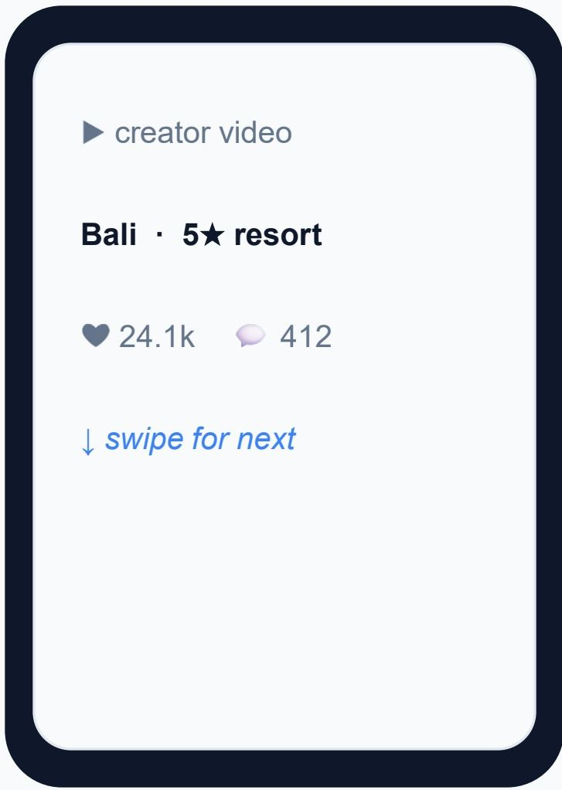
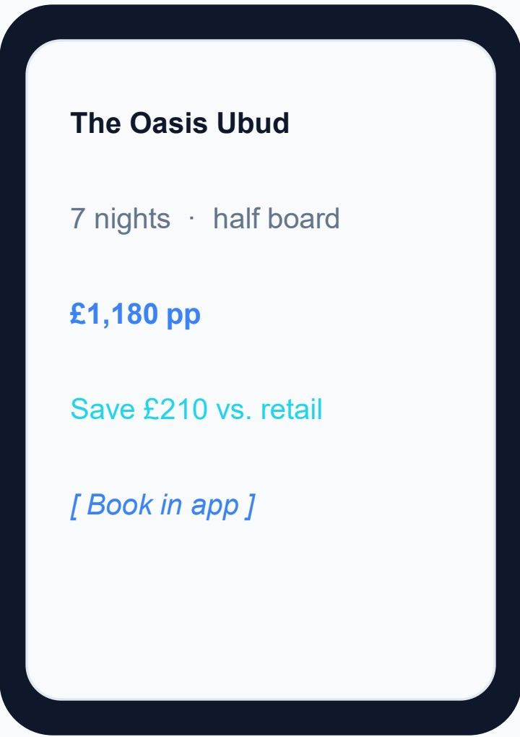
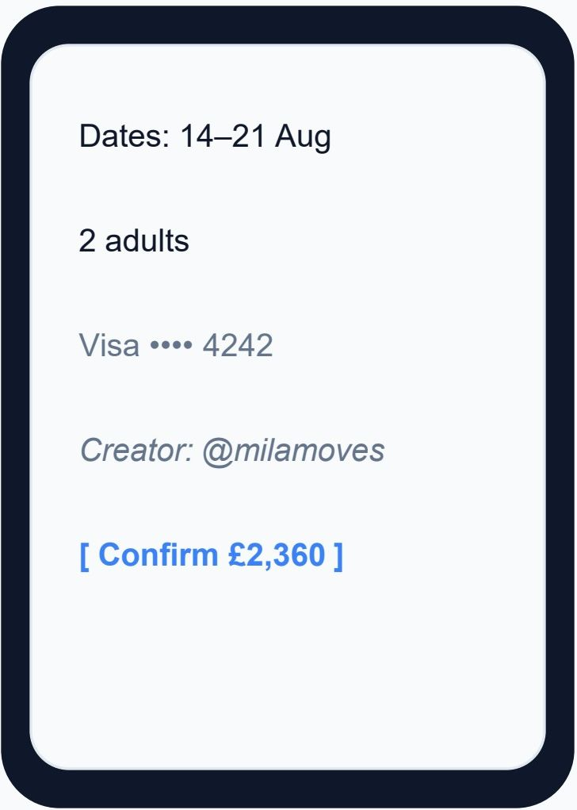
TRAVIDZ
THE PRODUCT
6 / 14
Built mobile-first. Designed to convert.
Feed
Deal card
Checkout

Slide 7
TRAVIDZ
MARKET
7 / 14
A £675B global prize. £87.6B in our backyard.
TAM
£87.6B / £675B
UK / Global leisure travel GBV
UK ONS · EU-5 Eurostat · Global UNWTO
SAM
£23.2B / £175B
Creator-influenced × bookable component
UK 26% × 80% bookable · Global blend
SOM
£350M → £1.32B
Travidz Year-5 GBV (UK Base → Global Viral)
24,000 active creators · £14.5k-£18.5k GBV / cr / yr
Y5 UK Base SOM = 1.5% of UK SAM · Global Viral upside = 0.75% of Global SAM. Bottom-up from the financial model.
Source: ONS Travel Trends · Eurostat 2023 · UNWTO Tourism Highlights · Travidz_Market_Research_TAM_SOM_v9_Global.xlsx

Slide 8
TRAVIDZ
BUSINESS MODEL
8 / 14
8% to Travidz. Split with the creator who drove the booking.
EVERY BOOKING
Tier
Creator
Travidz
8%
Founding (first 500, life)
50%
50%
Power (£25k rolling 12mo)
50%
50%
New (months 0–6)
50%
50%
Maturing (months 7–18)
40%
60%
blended commission to Travidz
Mature (19+ months)
30%
70%
92% to operator · creator keeps a tapered share by tenure
As the cohort matures, blended Travidz take-rate glides from 4.0% → 4.65%.

Slide 9
TRAVIDZ
UNIT ECONOMICS · YEAR 5
9 / 14
A flywheel that gets more efficient as it scales.
UK BASE CASE
24,000
£350M
£16.2M
4.65%
active creators
annual GBV
Travidz net revenue
blended take-rate
GLOBAL VIRAL UPSIDE
72,000
£1.32B
£61.6M
4.65%
active creators
annual GBV
Travidz net revenue
blended take-rate
Power-creator tier (£25k+ rolling-12mo) locks supply forever · Maturing cohort silently lifts net take · 8% gross commission stays constant to operators.
Source: Travidz_Financial_Model_v2_Global.xlsx (Base scenario, Y5).

Slide 10
TRAVIDZ
GO TO MARKET
10 / 14
Founding Creators → flywheel → category default.
PHASE 1 · PROVE
PHASE 2 · SCALE
PHASE 3 · DEFEND
Now → Month 6
Month 6 → 18
Month 18 → 36
Founding 500
Power tier unlocks
Operator pull
Recruit the first 500 UK travel creators. Lifetime 50% commission. They post; their audience converts; supply seeds demand.
Creators crossing £25k rolling-12mo GBV lock at 50% forever. Every unlock becomes a recruiting asset.
Hotels and DMOs proactively onboard for distribution. CAC drops; blended take-rate climbs as the cohort matures.

Slide 11
TRAVIDZ
GROWTH PLAN
11 / 14
Prove → Scale → Defend.
Each phase has a raise, a measurable gate, and a defensibility milestone.
1
PROVE
2
SCALE
3
DEFEND
M0–18 · Seed £2.5M
M18–44 · Series A £8M
M44–60+ · Series B £20M
Founding-500 lock-in.
Paid-UA flywheel.
No.1 Go Travel Platform.
EXIT GATES
EXIT GATES
EXIT GATES
• 2,400 creators
• 14,000 creators
• 24,000 creators
• £44M GBV
• £259M GBV
• £350M UK Base GBV
• 4.12% take-rate
• 4.72% take-rate
• Global Viral upside £1.32B
• 100 power-tier locks
• £12M ARR
• Category default in UK + EU-5
• 250 verified operators
DEFENSIBILITY
DEFENSIBILITY
DEFENSIBILITY
Founding-500 locked at 50% for life — irreversible supply moat.
First-mover in EU-5 creator-led booking. Power-tier compounds.
Two-sided network effects; switching cost for creators & operators.

Slide 12
TRAVIDZ
COMPETITIVE LANDSCAPE
12 / 14
No one owns the top-right quadrant. Yet.
More bookable ↑
Travel OTAs sit bottom-left (booking but not social).
Booking.com
TRAVIDZ
Social platforms sit top-right (social but not bookable).
Expedia
Airbnb
Less social ←
More social →
Travidz is the only product native to both.
Instagram
TikTok
← Less bookable

Slide 13
TRAVIDZ
THE ASK
13 / 14
£2.5M Seed for 18 months. Then Series A on real GBV.
40%
PHASE 1 · PROVE
Creator GTM & founding-500 programme
18-Month Gates
35%
Engineering: feed, search, ranking, payments
✓ 2,400+ active creators
15%
Operator supply & destination expansion
✓ £44M annualised GBV
10%
✓ 100+ power-tier locks
G&A, legal, compliance
✓ 250+ verified operators
✓ Take-rate past 4.1%
PATH TO BREAKEVEN
EBITDA breakeven M48 · Y1 EBITDA −£1.56M · Peak deficit fully funded with +£181k cushion
£2.5M takes us through the burn trough on cash — Series A becomes a growth round, not a survival round.
These unlock a Series A on demonstrated unit economics, not assumed ones.

Slide 14
TRAVIDZ
Every category had its TikTok moment.
Travel's is now.
Let's not be the round you tell people about in five years.
Brendan & Linda @ travidz.com · travidz.com · Seed · £2.5M SAFE
14 / 14

