Slide 1
Seed bankroll: $20,000 for the rest of the 2026 season
A gift that funds a betting bankroll. Nothing is owed back.
Not an investment, not a loan, not a security.
Every number here comes from a script in the repository and carries its uncertainty.
Prepared September 17, 2026

Slide 2
The ask
item | value
amount | $20,000
horizon | weeks 4–15 of the 2026 regular season, Sept 24 to Dec 12 (12 weeks)
what it funds | two totals strategies already running, units re-sized off the bankroll each week
expected bets | ~118: 6–12 Greenline unders a week (~107), ~11 over-zero overs
recommended unit | Greenline 0.5% of bankroll per bet ($100 at the start), over-zero 1% ($200), re-sized each Monday
afterwards | bankroll and profit stay in the operation for 2027

Slide 3
What gets bet: two legs, one bankroll
Win rates are shown with their 95% intervals. Break-even is 52.4% at −110, 54.5% at −120.
 | Over-zero (floor-bias OVERs) | Greenline totals (PFF flags, ~85% unders)
what it is | in-house model: totals pinned too low against heavy favorites | vendor projection disagreeing with the market
record | 151–83, 64.5% (58.2–70.4%), walk-forward 2016–25 | 27–22, 55.1% (41–68%), 2026 wk 2; + 114–87 personal unders 2023–25
planning win rate | 58.2%, the interval floor | bracket: 55.0% (2026 only) to 56.4% (pooled)
price | −120 or better | −110
bets left in 2026 | ~11, median +$133 | 6–12 a week by plan, ~107 total (~16% of flags)
role | better evidence, nearly spent for 2026; matters in 2027 | carries the whole 2026 projection
Conflict rule: same game flagged on opposite sides → Greenline takes it, over-zero skips it.
Excluded: the spread model (research, not a bet); Greenline spreads and moneylines (21–28 and 21–25 in week 2).

Slide 4
Bets per week
Plan: 6–12 Greenline unders a week, capped by that week's FBS-vs-FBS slate (Greenline flags every such game). Over-zero ~11 bets spread across the span.
week | FBS games (= flags) | Greenline unders | over-zero bets | staked at start units
4 | 58 | 6–12 (mean 9) | 0.9 | $1,077
5 | 56 | 6–12 (mean 9) | 0.9 | $1,077
6 | 58 | 6–12 (mean 9) | 0.9 | $1,077
7 | 59 | 6–12 (mean 9) | 0.9 | $1,077
8 | 56 | 6–12 (mean 9) | 0.9 | $1,077
9 | 56 | 6–12 (mean 9) | 0.9 | $1,077
10 | 62 | 6–12 (mean 9) | 0.9 | $1,077
11 | 67 | 6–12 (mean 9) | 0.9 | $1,077
12 | 66 | 6–12 (mean 9) | 0.9 | $1,077
13 | 65 | 6–12 (mean 9) | 0.9 | $1,077
14 | 67 | 6–12 (mean 9) | 0.9 | $1,077
15 | 9 | 6–9 (mean 8) | 0.9 | $991
total | 679 | ~107 | ~11 | $12,834
6 to 12 unders plus about 1 over-zero over in a typical week. Championship week has only 9 games, so 6 to 9.
Each week's count is drawn uniformly from the range, so volume is the plan, not a forecast.
A typical week stakes $1,000 to $1,100 at the starting units; units re-size each Monday. Weeks 14 and 15 use 2025's schedule.

Slide 5
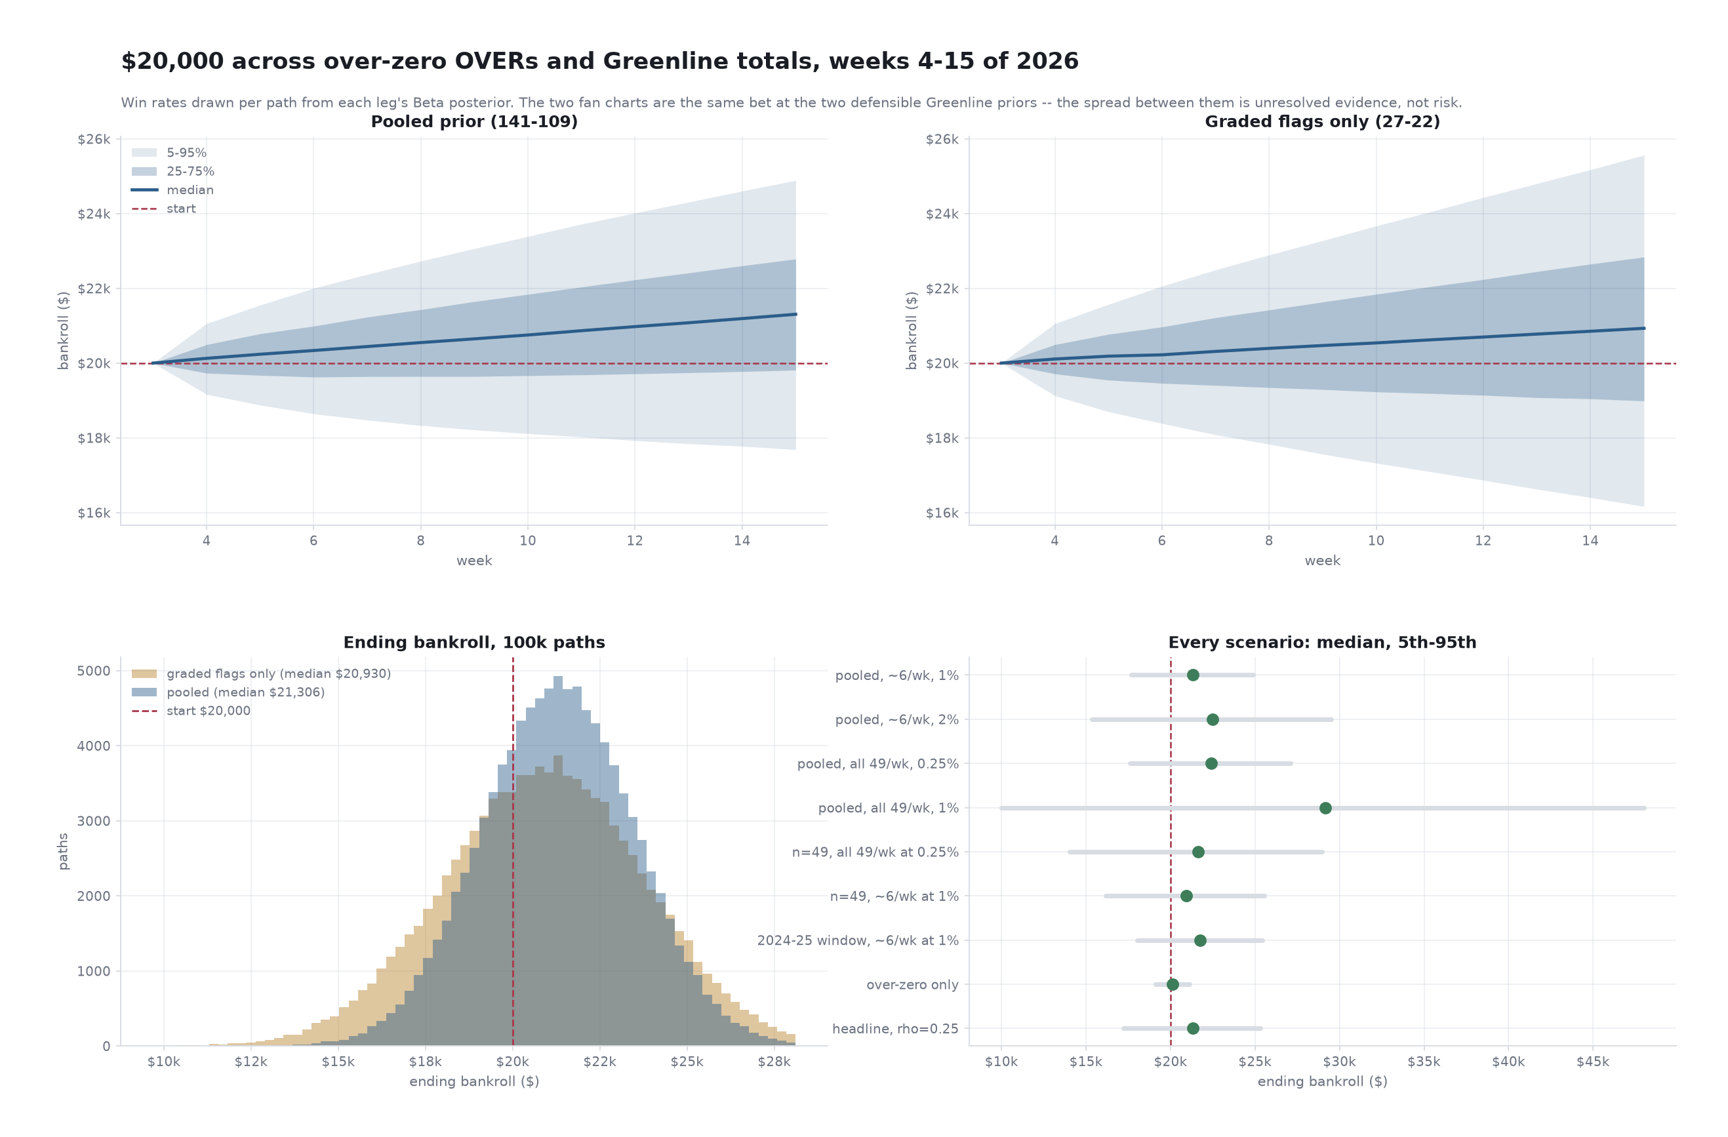
The projection: bracketed, not resolved
100,000 paths, win rates drawn per path from each record. Two panels = the two defensible Greenline priors.

Slide 6
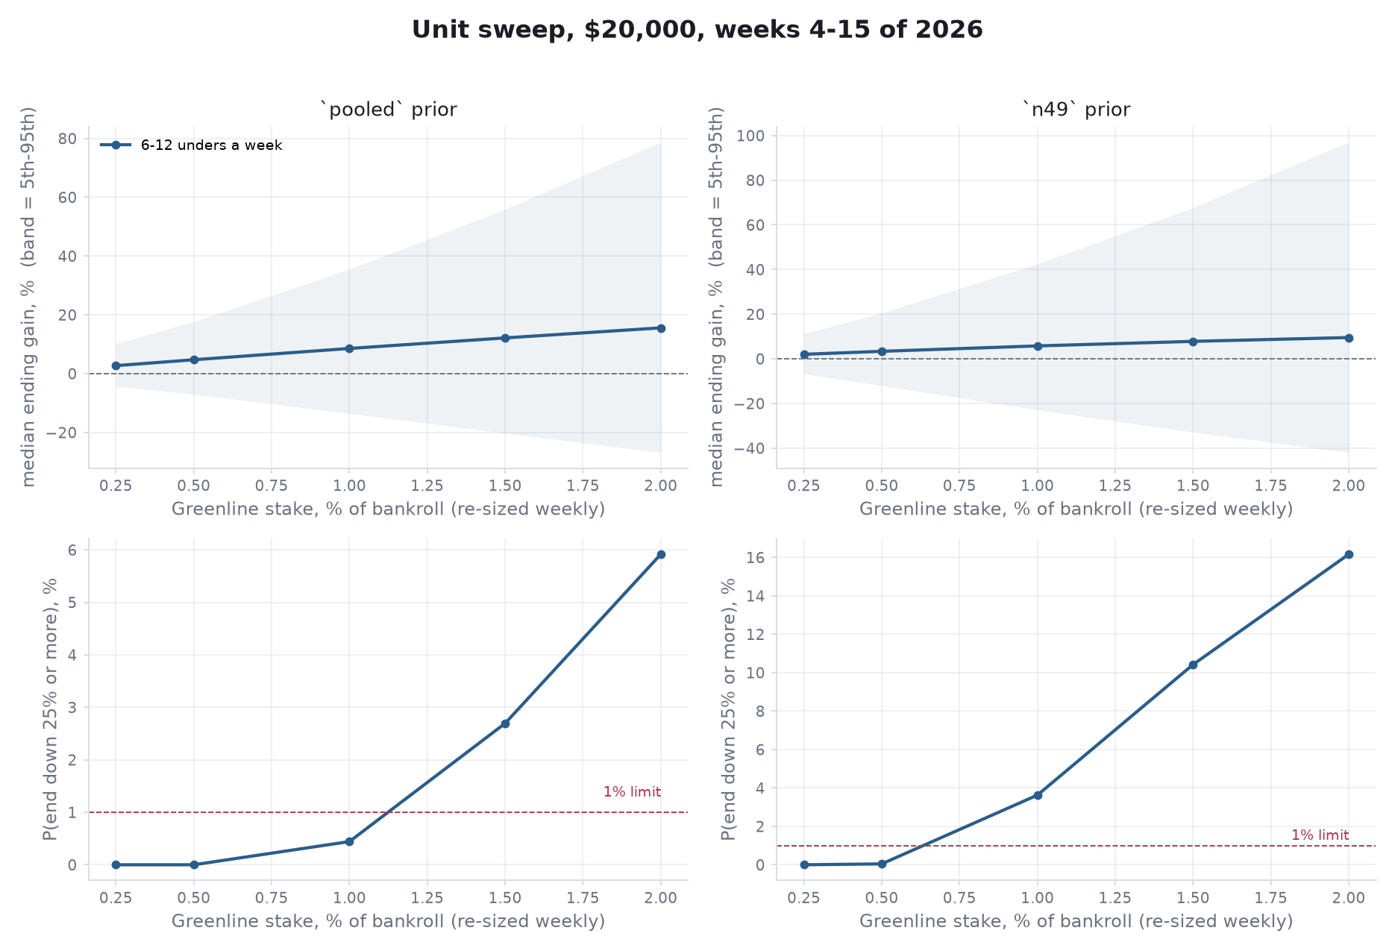
Choosing the stake
Largest median gain such that ≤1% of paths end down 25% and none go to zero, under both priors. 6–12 unders a week, units re-sized weekly.
Recommended: Greenline 0.5% of bankroll ($100 at the start), over-zero 1% ($200), re-sized each Monday.
Median $20,945 pooled / $20,673 2026-only.
5th pct $18,598 / $17,600. P(−25%) 0% under both.
1% ($200) passes only under the pooled prior (median $21,714 / $21,157; P(−25%) 0.4% / 3.6%). Upgrade path once four more weeks are graded.
Unit size does not change the downside ratio. Volume does, and 6–12 a week is a little above the 13% rate the record was earned at. The ledger prices that.

Slide 7
Risk, stated plainly
At the recommended 0.5% / 1% units, re-sized weekly. No stop-loss.
measure | pooled prior | 2026-only prior
P(season ends below $20,000) | 26.0% | 36.9%
P(ends below $15,000) | 0.0% | 0.0%
P(passes through $0) | 0 of 50,000 | 0 of 50,000
median ending bankroll | $20,945 | $20,673
5th percentile | $18,598 | $17,600
95th percentile | $23,541 | $24,112
worst single week, median | −$534 | −$551
total staked, 12 weeks | $13,126 | $13,051
Roughly one season in three ends below $20,000. That is mostly not knowing the true win rate, which a 12-week season cannot average away.
One season in twenty ends worse than about −$1,900.
Same-Saturday correlation is assumed (ρ = 0.10), not measured. It moves the tail by a few hundred dollars and the median not at all.
Stress-tested: 0.5% passes all 25 skeptical scenarios (weaker priors, weaker marginal bets, correlation to 0.5, all at once). 1% fails 13 of them.

Slide 8
What the numbers do not support
• Greenline as independently validated. n=49 in 2026, interval 41–68%. The pooled record is 80% the same signal bet in earlier seasons.
• The pooled prior transferring in full. The 201 past unders sat ~6 points higher in total than the 2026 flags. Pooling probably overstates.
• Any coverage above 13%. Every 'bet more flags' row assumes the picked-flag win rate applies to flags that were passed on.
• A reproducible selection rule. 'Bet ~6 of 49 a week' is a volume assumption; no script picks which six.
• A 2027 projection. Not modeled yet. Needs over-zero at full-season volume and a full graded Greenline season.
• Within-week compounding. Units re-size on Monday, not per bet; Saturday kickoffs are simultaneous. Re-sizing moves the 12-week median by under $100 either way.

Slide 9
What the money does each week
day | step
Wednesday | capture Greenline flags; seed the bet ledger
Thursday–Saturday | bet 6–12 unders at −110 or better; over-zero board at −120 or better
Monday | grade flags; mark which were bet; re-size units off the bankroll; rerun the projection
Marking which flags get bet is the one manual step and the one that resolves the biggest open question (coverage).
Four more graded weeks puts the 2026 flags at n≈250 on their own. The prior stops doing the work and the stake decision gets revisited then.

