Slide 1
Seed bankroll: $20,000 to grow across seasons
A gift that seeds a betting bankroll meant to compound: the rest of 2026, all of 2027, golf once graded. Nothing is owed back.
Not an investment, not a loan, not a security.
Every number here comes from a script in the repository and carries its uncertainty.
Prepared September 21, 2026

Slide 2
The ask
item | value
amount | $20,000
horizon | rest of 2026 (Sept 24 to Dec 12), then 2027 and onward. Bowls excluded
what it funds | two totals strategies already running, units re-sized off the bankroll each Monday; golf once graded
expected bets | rest of 2026 ~118 (6–12 Greenline unders a week + ~11 over-zero); 2027 ~250
unit today | Greenline 1% of bankroll per bet ($200 at the start), over-zero 1%. Re-derived each Monday
profit | stays in the bankroll

Slide 3
What gets bet: two legs, one bankroll
Win rates are shown with their 95% intervals. Break-even is 52.4% at −110, 54.5% at −120.
 | Over-zero (floor-bias OVERs) | Greenline totals (PFF flags, ~85% unders)
what it is | in-house model: totals pinned too low against heavy favorites | vendor projection disagreeing with the market
record | 151–83, 64.5% (58.2–70.4%), walk-forward 2016–25; 21–9 on the 2026 board | 32–26, 55.2% (42.5–67.3%), published 2026 under list wks 2–3; + 114–87 personal unders 2023–25
planning win rate | 58.2%, the interval's lower endpoint | 56.1%: published under list + 2023–25 unders at half weight. Bracket 55.1% to 56.4%
price | −120 or better | −110
bets left in 2026 | ~11, median +$133; 30–51 in a full season | 6–12 a week by plan, ~107 in 2026, ~134 in 2027
role | better evidence, nearly spent for 2026; ~a third of 2027's profit | carries the 2026 projection
Conflict rule: same game flagged on opposite sides → over-zero takes it, Greenline skips it.
Excluded: the pred-tracker-model (research, not a bet); Greenline spreads and moneylines (21–28 and 21–25 in week 2).

Slide 4
Bets per week
Plan: 6–12 Greenline unders a week, capped by that week's FBS-vs-FBS slate (Greenline flags every such game). Over-zero ~11 bets spread across the span.
week | FBS games (= flags) | Greenline unders | over-zero bets | staked at today's units
4 | 58 | 6–12 (mean 9) | 0.9 | $1,977
5 | 56 | 6–12 (mean 9) | 0.9 | $1,977
6 | 58 | 6–12 (mean 9) | 0.9 | $1,977
7 | 59 | 6–12 (mean 9) | 0.9 | $1,977
8 | 56 | 6–12 (mean 9) | 0.9 | $1,977
9 | 56 | 6–12 (mean 9) | 0.9 | $1,977
10 | 62 | 6–12 (mean 9) | 0.9 | $1,977
11 | 67 | 6–12 (mean 9) | 0.9 | $1,977
12 | 66 | 6–12 (mean 9) | 0.9 | $1,977
13 | 65 | 6–12 (mean 9) | 0.9 | $1,977
14 | 67 | 6–12 (mean 9) | 0.9 | $1,977
15 | 9 | 6–9 (mean 8) | 0.9 | $1,805
total | 679 | ~107 | ~11 | $23,549
6 to 12 unders plus about 1 over-zero over in a typical week. Championship week has only 9 games, so 6 to 9.
Each week's count is drawn uniformly from the range, so volume is the plan, not a forecast.
A typical week stakes about $2,000 at today's units; units re-size each Monday. Weeks 14 and 15 use 2025's schedule.

Slide 5
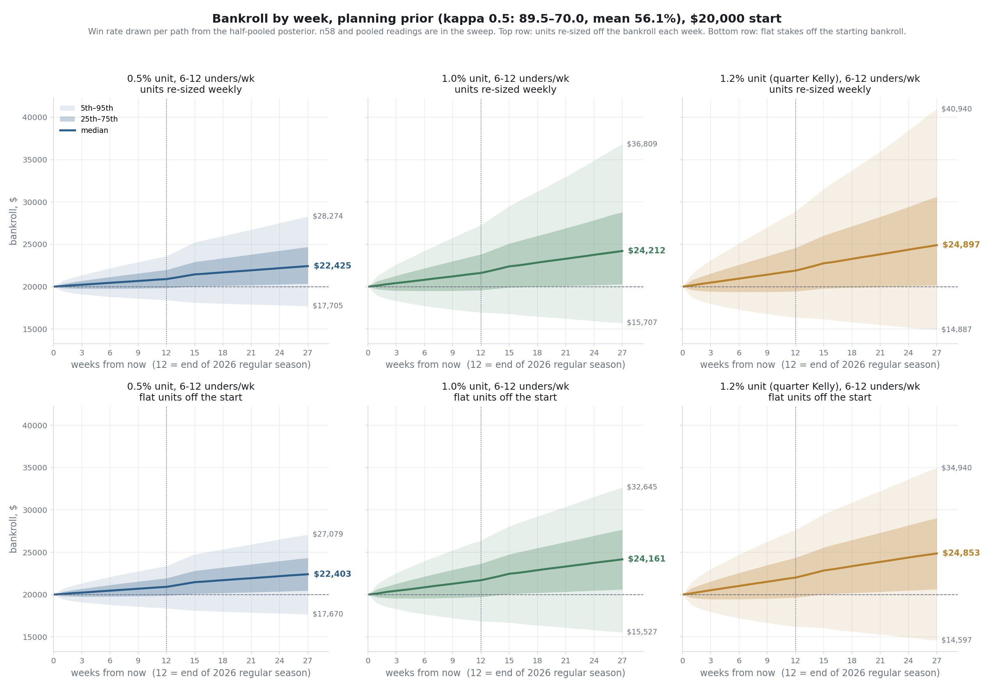
The projection: rest of 2026 and through 2027
100,000 paths, win rate drawn per path from the planning prior. Top row re-sized weekly, bottom row flat. Week 12 = end of 2026.

Slide 6
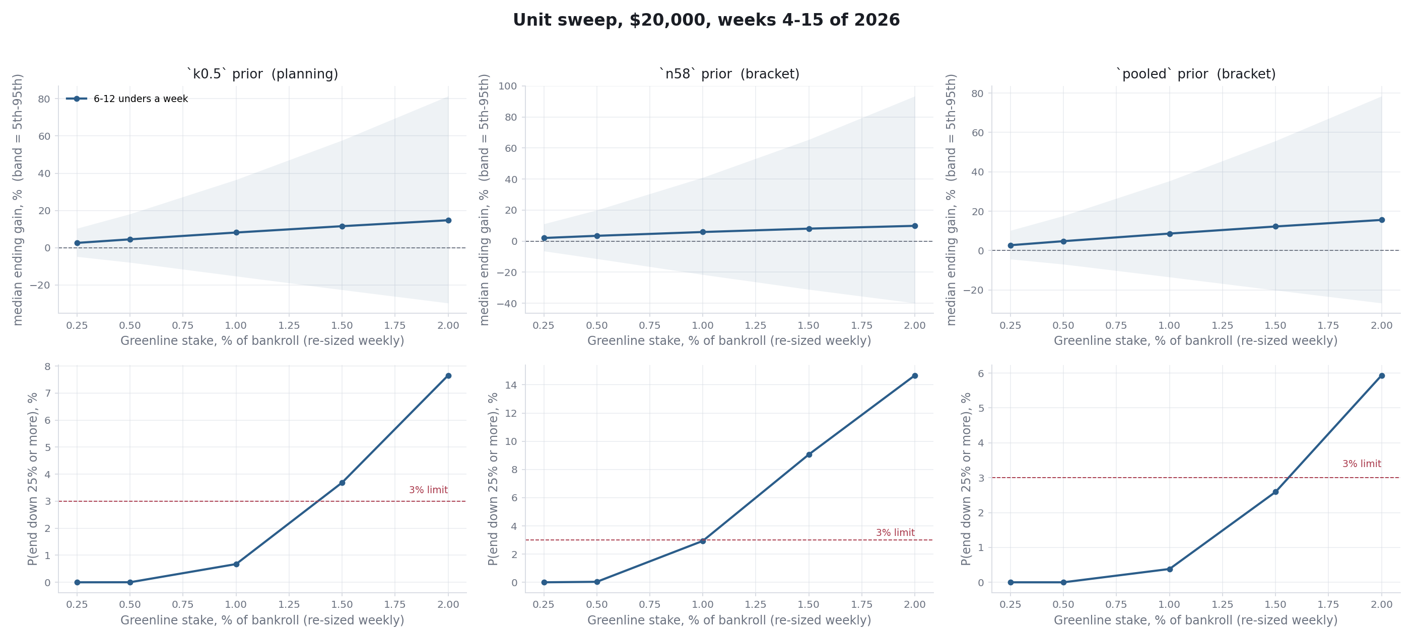
Choosing the unit
Rule: the smaller of quarter Kelly off the planning prior and the largest unit at which ≤3% of seasons end down 25%. 6–12 unders a week, re-sized weekly.
Quarter Kelly off the planning prior (56.1%), shrunk for 9 simultaneous bets: 1.30%.
The 3% cap binds first: 1% has P(−25%) 0.7%; 1.5% fails at 3.8%. Unit today: 1%.
At 1%: median $21,633 planning / $21,174 n58 / $21,725 pooled. 5th pct $16,951. P(−25%) 0.7% / 2.9% / 0.4%.
0.5% is the all-weather fallback: median $20,903, P(−25%) 0.00%.
Unit size does not change the downside ratio; volume does. The unit is re-derived every Monday and heads toward 1.3% if the 2026 record holds.

Slide 7
Risk, stated plainly
At 1% / 1% units, re-sized weekly, rest of 2026. No stop-loss.
measure | planning prior | n58 bracket | pooled bracket
P(season ends below $20,000) | 29.8% | 37.5% | 27.3%
P(ends below $15,000) | 0.7% | 2.9% | 0.4%
P(passes through $0) | 0 of 50,000 | 0 of 50,000 | 0 of 50,000
median ending bankroll | $21,633 | $21,174 | $21,725
5th percentile | $16,951 | $15,684 | $17,309
95th percentile | $27,307 | $28,201 | $27,074
worst single week, median | −$1,055 | −$1,073 | −$1,050
total staked, 12 weeks | $24,504 | $24,300 | $24,559
About three seasons in ten end below $20,000. That is mostly not knowing the true win rate, which one season cannot average away.
A 10% mid-season drawdown happens in about a third of seasons at 1%; a 20% drawdown in one in twenty.
Same-Saturday correlation is assumed (ρ = 0.10), not measured.
Stress-tested under the 3% cap: 1% passes 17 of 25 skeptical scenarios and the combined case on the planning prior; 0.5% passes all 25.

Slide 8
The rate, and a week
Medians, computed per simulated path. A season is the unit that compounds; the bankroll is idle 259 days between seasons.
growth | 1% unit | 0.5% unit
rest of 2026, 12 weeks | +8.2% | +4.5%
a full 2027 season | +11.9% | +7.3%
CAGR, 1.21 yrs to Dec 2027 | +16.8% | +9.8%
ending bankroll, Dec 2027 | $24,155 | $22,410
a week | 1% unit | 0.5% unit
median week | $125 | $67
middle half of weeks | −$328 to $669 | −$171 to $341
5th–95th pct week | −$1,080 to $1,360 | −$556 to $703
worst week, median | −$1,055 | −$536
weeks ending in profit | 58.1% | 58.2%
No annualised figure for 2026 alone: 79 days of betting then 259 idle would turn +8% into something near +43%. The CAGR row spans the whole funded window with the idle months counted in.
A typical week makes $125 and the worst week of a typical season loses $1,055. Four weeks in ten lose money at both units — stake size moves the size of the swing, never its frequency.
Dollar rows are the 2026 leg only; stakes re-size weekly, so a 2027 week is not the same week.

Slide 9
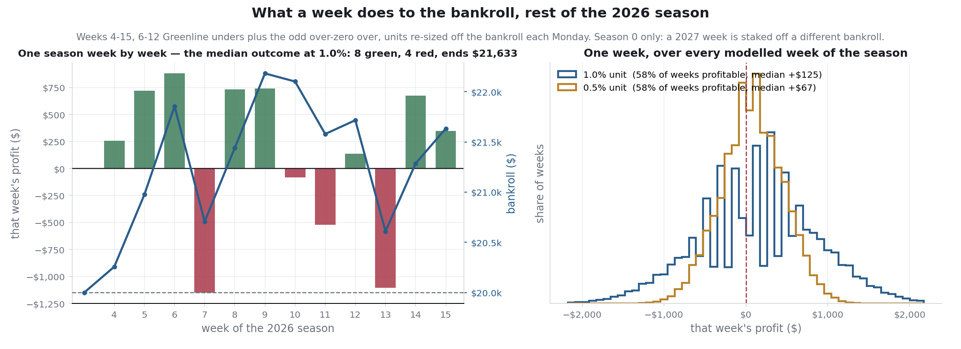
A week, drawn
Left: the simulated season whose ending bankroll is closest to the median of all 50,000. Right: the spread of a single week at both units.

Slide 10
What the numbers do not support
• Greenline as independently validated. n=58 in 2026, interval 42.5–67.3%. The planning prior is half personal history of the same signal.
• The 2027 numbers as a forecast. They assume the edge persists unchanged on 2025's schedule.
• Golf. No record, no price, no volume. A placeholder leg until graded.
• A reproducible selection rule. 'Bet 6–12 of the week's flags' is a volume plan; no script picks which ones.
• Kelly as today's rule. Quarter Kelly is 1.3%; the 3% drawdown cap binds at 1%. That is where the unit is headed if the record holds.
• The negative cross-leg correlation as a hedge. A common model-or-market failure that hurts both legs is not modeled.

Slide 11
What the money does each week
day | step
Wednesday | capture Greenline flags; seed the bet ledger
Thursday–Saturday | bet 6–12 unders at −110 or better; over-zero board at −120 or better
Monday | grade flags; mark which were bet; re-derive the unit (min of quarter Kelly and the 3% cap); re-size off the bankroll
The planning prior is fixed: 2026 flags plus the 2023–25 unders at half weight. The unit moves only by the Monday rule. Golf enters with a graded record, at the same rule.
Marking which flags get bet is the one manual step. It turns '6–12 a week' from a plan into evidence.

