Slide 1
BETTING THE OVER
A scoreboard has a floor
A small, repeatable pricing mistake in college football betting lines —
and what it takes to actually profit from it.
Based on 12,493 real games, 2013–2025
Notes:
This deck explains one specific betting strategy. No math background needed. I'll build up the betting vocabulary first, then the idea, then the evidence, then the honest limitations.

Slide 2
The whole strategy, in one sentence
In lopsided games with low scoring expectations, bet that the two teams will combine for MORE points than the sportsbook predicts.
64.5%
30–50
10 yrs
of these bets won
bets per season
of testing
vs. the 52.4% you need
about 2% of all games
9 of 10 seasons profitable
Notes:
Everything after this slide is either explaining why this works, showing the evidence, or being honest about the risks.

Slide 3
BETTING BASICS — 1 OF 3
First: what is a “total”?
Before a game, the sportsbook publishes a number: how many points it expects both teams to score, added together.
EXAMPLE
Total: 41
You bet on which side of that number reality lands:
OVER
Combined score is HIGHER than the number
Final score 28–17 → 45 points 45 is above 41, so the OVER wins. Final score 14–10 → 24 points 24 is below 41, so the OVER loses.
UNDER
Combined score is LOWER than the number
This strategy only ever bets the OVER.
Notes:
Key point: the total is about combined points only. Who wins the game is irrelevant to this bet.

Slide 4
BETTING BASICS — 2 OF 3
Second: what is a “spread”?
The spread is the sportsbook's estimate of how lopsided the game is — how many points the favorite is expected to win by.
Spread of 3
Spread of 21
Spread of 35
A close game between
evenly matched teams.
A blowout is expected —
one team is far better.
A total mismatch.
Why we care: the spread and the total together tell you roughly how many points each team is expected to score on its own. That per-team number is where the whole strategy lives.
!
Notes:
Spread + total is enough to back out each team's expected points. Underdog expected points = (total - spread) / 2.

Slide 5
BETTING BASICS — 3 OF 3
Third: winning half your bets loses money
Sportsbooks charge a fee, built into the odds. The standard price is written “−110”.
You risk $110
Bet 100 times, win 50:
to win $100.
+$5,000 won − $5,500 lost
Lose, and you're out the full $110.
= −$500
52.4%
is “breakeven” — the win rate where you make exactly nothing. Anything below it and the house fee grinds you down. This is why beating a coin flip isn't enough, and why the 64% you'll see later matters.
Notes:
This is the single most important slide for understanding the claim. 57% only sounds unimpressive until you know 52.4% is the bar.

Slide 6
THE INSIGHT
A team cannot score negative points
Obvious — but the sportsbook's math quietly ignores it.
1
The book prices a team's average expected score.
Say a big underdog is expected to score about 10 points.
2
Reality can beat that estimate by a lot.
A great day might mean 30 points — 20 above expectation.
3
But reality can only miss it by so much.
A disastrous day means 0 points. Not −8. The bottom is chopped off.
4
So actual scores average a bit higher than predicted.
The upside runs free; the downside hits a floor.
Notes:
Analogy: a store that can discount to $0 but never below. Average selling price ends up above what the pricing formula says.

Slide 7
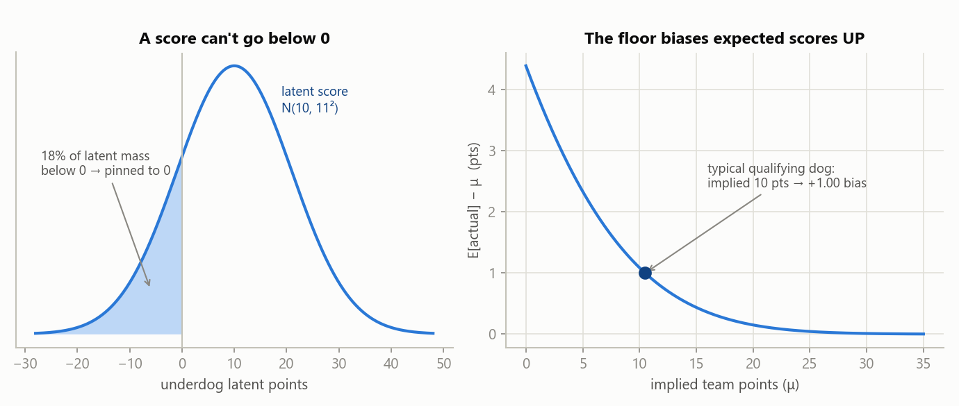
THE INSIGHT
The same idea, drawn
LEFT: the bell curve of what an underdog might score. Everything left of 0 is impossible — those outcomes all become “0”.
RIGHT: how much that pushes the real average up. Big for a team expected to score ~10. Near zero at 25+.
Notes:
The right panel is why the strategy only fires on lopsided, low-scoring games — that's the only place the effect is large enough to matter.

Slide 8
THE INSIGHT
Why this makes the OVER underpriced
+
Totals: the effects ADD
−
Spreads: they CANCEL
Both teams get nudged upward, and a total adds the two scores together. The nudges stack — so real combined scores land above the posted number more often than the book expects.
A spread is the difference between the two scores, so one team's nudge subtracts the other's. They mostly cancel out and the spread stays fairly priced.
→ There is an edge here.
→ No edge here.
We also checked the mirror image — and it isn't there.
Is there a ceiling on scoring that would make the UNDER cheap in high-scoring games? We tested it directly. There is no such effect. The floor at zero is real; a ceiling is not. That asymmetry is a good sign — a made-up story would have predicted both.
Notes:
The failed under-test is evidence FOR the model. It made a falsifiable prediction about where the edge should NOT be, and that held.

Slide 9
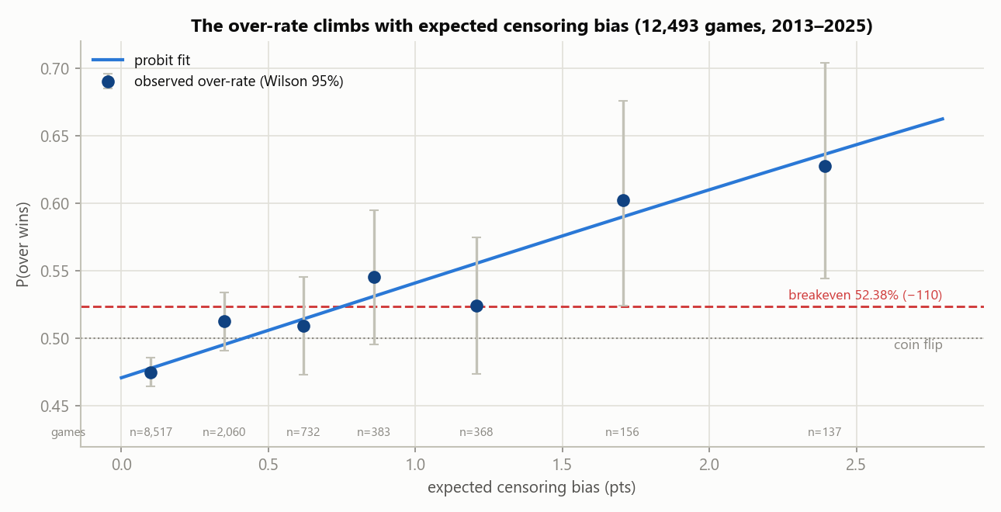
THE EVIDENCE
Does it actually show up in real games?
How to read this: left to right = games where the floor effect should be weakest → strongest. Bottom to top = how often the over actually won. The dots climb, and they cross the red breakeven line right where the theory said they would. The grey bars are uncertainty — smaller groups on the right, so more wobble.
Notes:
12,493 games. Nobody told the data to do this — bin by predicted effect size, and the win rate lines up.

Slide 10
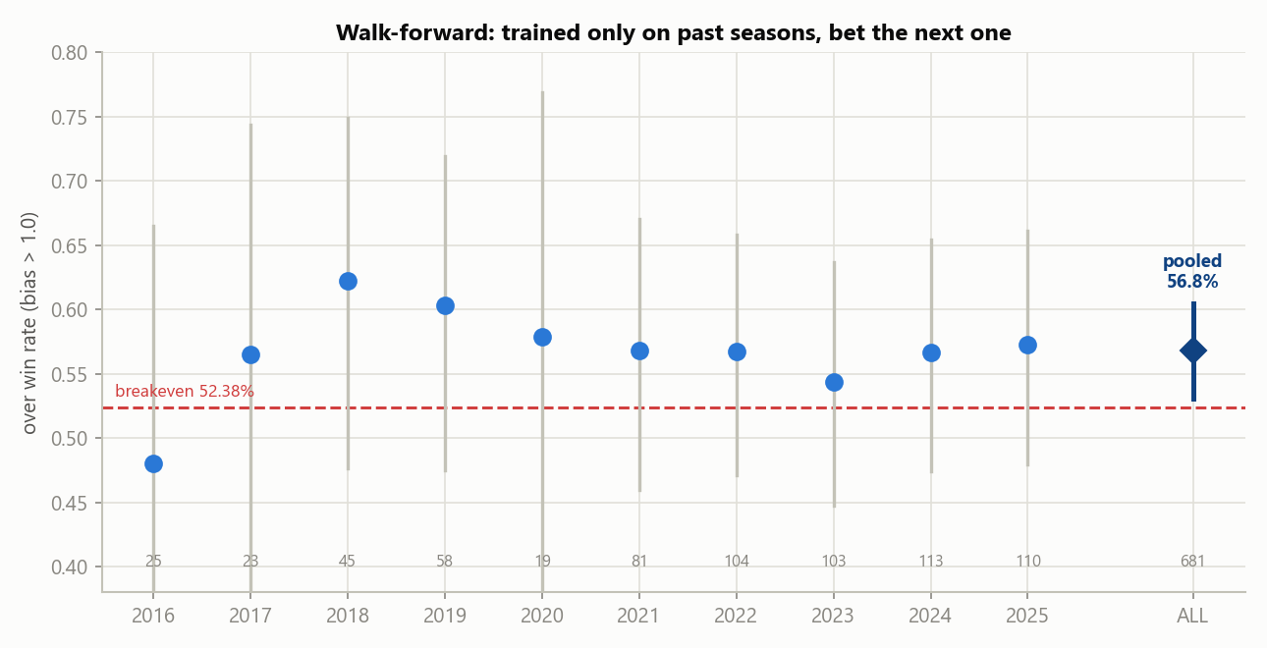
THE EVIDENCE
The honest test: no peeking at the future
It's easy to look brilliant on games you already know the outcome of. So the model was retrained each year using only seasons that came before, then made to bet the next season blind.
9 of 10
64.5%
52.4%
seasons profitable
won overall, 234 bets
was the bar to clear
Notes:
Each dot is one season's win rate; the vertical bars are uncertainty. Note 2016 below the line — that's the losing season, and it's expected.

Slide 11
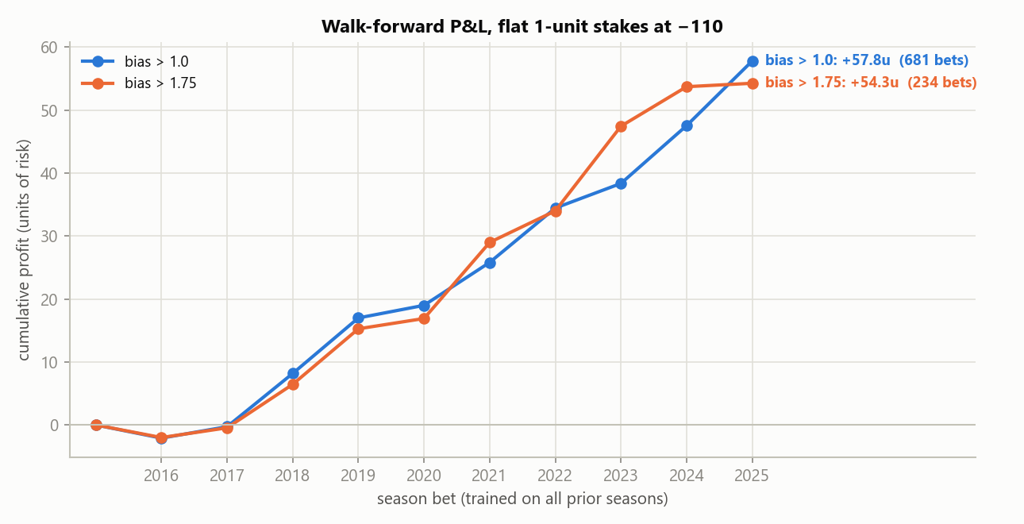
THE EVIDENCE
What that looked like as money
A “unit” is one standard bet. If a unit is $100, the blue line finished about +$5,800 across ten seasons and 681 bets — under the original research filter. Today's tighter rule kept about +$5,400 of that on a third of the bets.
Note the flat start. Two years of going nowhere before it climbed. A real edge does not feel like a winning streak.
Notes:
The orange line is the stricter filter — a third as many bets, nearly the same profit.

Slide 12
USING IT
Which games qualify?
The rule of thumb: ( total − spread ) ÷ 2 is about 7.5 or less
That arithmetic estimates the underdog's expected points. When it lands near 7 or below, the floor effect is big enough to bet.
Spread
Total
Underdog expected pts
Verdict
3.5
62.5
29.5
Skip
14
47.5
16.75
Skip
21.5
44.5
11.5
Skip — close
21
41
10.0
Skip — no edge
30
47
8.5
Skip — no edge
35
48.5
6.75
BET the over
About 2% of games qualify — roughly 30–50 bets a season.
Notes:
In practice: ranked team vs overmatched opponent, service-academy games, weather-suppressed totals with big favorites.

Slide 13
USING IT
The rules you'd actually follow
1
Only bet games that pass the filter
2
Only bet the over on the full-game total
Underdog expected points around 7 or below. Nothing else qualifies.
Not the under. Not the spread. Not first-half or single-team bets — those are untested.
3
Refuse a bad price
4
Take the lowest total available
Take −120 or better, never worse than −125. Bad pricing eats the edge — not optional.
Shop between sportsbooks. Every point matters, and a lower number is strictly better for an over.
5
Bet small and flat
6
Recheck if the line moves
About 1% of your bankroll per bet, the same amount every time. No chasing, no doubling up.
The verdict depends on the current numbers. New numbers, new calculation.
Notes:
Rule 3 is the one people break. The edge is about 4.5 points of win rate; bad juice can eat half of it.

Slide 14
BEING HONEST
What goes wrong
!
A losing season is normal
Even a fully real edge loses money in roughly 1 season in 5 at worst. One test season lost 8%. That is the model working as expected, not breaking.
!
The edge is modest, not massive
It wins about 64% (plan on 58%). Over 30–50 bets a season, luck easily swamps that gap in any single year.
!
It may stop working
This comes from a public research paper. Sportsbooks read those too. If they adjust these numbers, the edge quietly disappears.
!
It cannot absorb much money
Qualifying games are obscure and lightly bet. Wager enough and you move the line yourself, erasing your own edge.
Notes:
If someone leaves remembering only one slide besides the idea, it should be this one.

Slide 15
BEING HONEST
How confident should you be?
Two different claims here, and they are not equally strong.
VERY STRONG
SOLID, BUT THINNER
The lines really do ignore the floor.
You'd actually profit from it.
That the sportsbook's number is mispriced in these games is about as clear as this kind of data gets. It replicates in a separate era of games, survives every robustness check we ran, and shows no sign of fading through 2025.
This rests on 234 real bets. That's enough to be meaningfully better than chance, but not enough to pin down the exact size of the edge. The true long-run number could be noticeably better or worse than 64.5% — plan on 58%.
In plain terms: we're confident the mistake exists. We're reasonably confident you can make money on it — and we'd want more seasons before saying exactly how much.
Notes:
Distinguishing 'the market is wrong' from 'therefore I get paid' is the intellectually honest core of this deck.

Slide 16
WHAT TO TAKE AWAY
1
Scores can't go below zero, so lopsided low-scoring games quietly run a little higher than the posted number.
2
Betting the over in exactly those games won about 64% of the time over ten seasons of blind testing — against a 52.4% breakeven.
3
It's a small, slow, volatile edge on roughly 30–50 obscure games a year. Not a money printer.
This is research, not financial advice.
Sports betting loses money for almost everyone who does it. A small edge — if it's real and if it lasts — is grindy and volatile. Bet only what you can afford to lose, and only where it's legal for you to do so.
Notes:
End here. Don't oversell it — the honesty is the credibility.

