Slide 1
Data Analyst Professional Practical Exam DA601P
Pens and Printers Sales Analysis
Written by Brandon McKimmy
Date: January 20th, 2024
Notes:
Data Analyst Professional Practical Exam DA601P
Pens and Printers Sales Analysis
Written by Brandon McKimmy
Date: January 20th, 2024

Slide 2
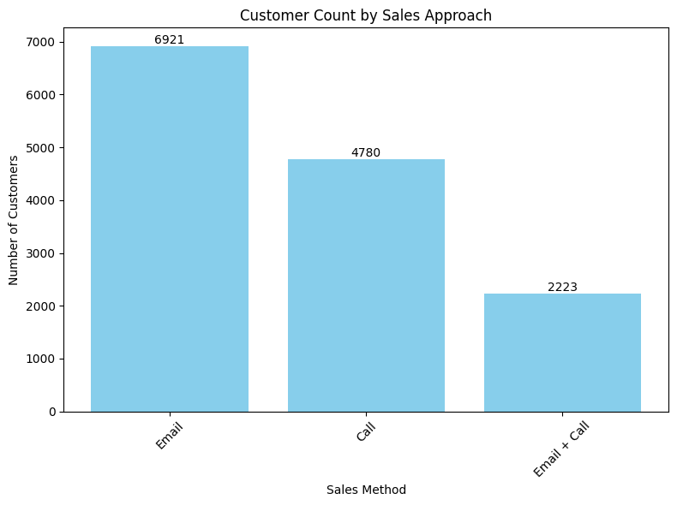
Customer Engagement
How many customers were there for each approach?
"Email" is the most effective sales approach with 6,921 customers.
"Call" comes in second with 4,780 customers.
The combined approach "Email + Call" has the least, with 2,223 customers.
Notes:
Customer Engagement
How many customers were there for each approach?
The bar graph is titled "Customer Count by Sales Approach" and displays the number of customers for three different sales methods. The sales methods are "Email," "Call," and "Email + Call." The number of customers for each method is shown above the corresponding bars on the graph.
"Email" is the most effective sales approach with 6,921 customers.
"Call" comes in second with 4,780 customers.
The combined approach "Email + Call" has the least, with 2,223 customers.

Slide 3
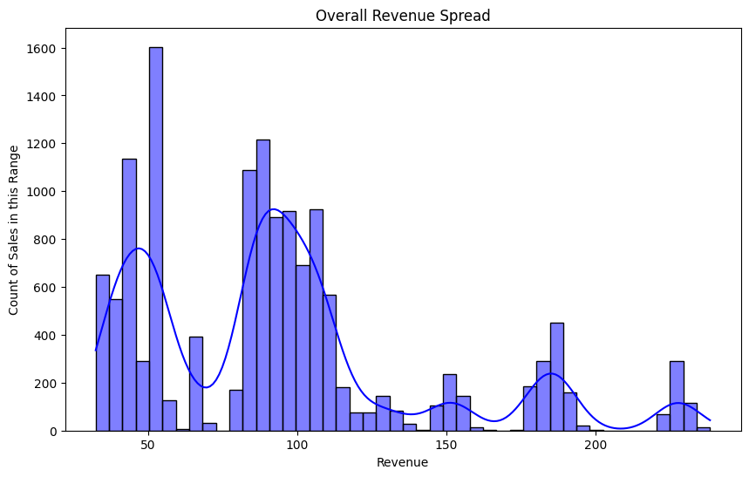
Revenue Analysis
What does the spread of the revenue look like for each method?
Peak Performance: The peak suggests where sales are the highest. We see a lot of action for 50 and 90 items, which might be our sweet spot for pricing or the most common type of product we're selling.
Where the Line Peaks: The highest part of the line (50 or 90) indicates highest sales.
Where the Line is Lower: The data suggests staying away from the valleys such as 70 and anything above 120.
Notes:
Revenue Analysis
What does the spread of the revenue look like for each method?
Peak Performance: The peak suggests where sales are the highest. We see a lot of action for 50 and 90 items, which might be our sweet spot for pricing or the most common type of product we're selling.
Where the Line Peaks: The highest part of the line (50 or 90) indicates highest sales.
Where the Line is Lower: The data suggests staying away from the valleys such as 70 and anything above 120.

Slide 4
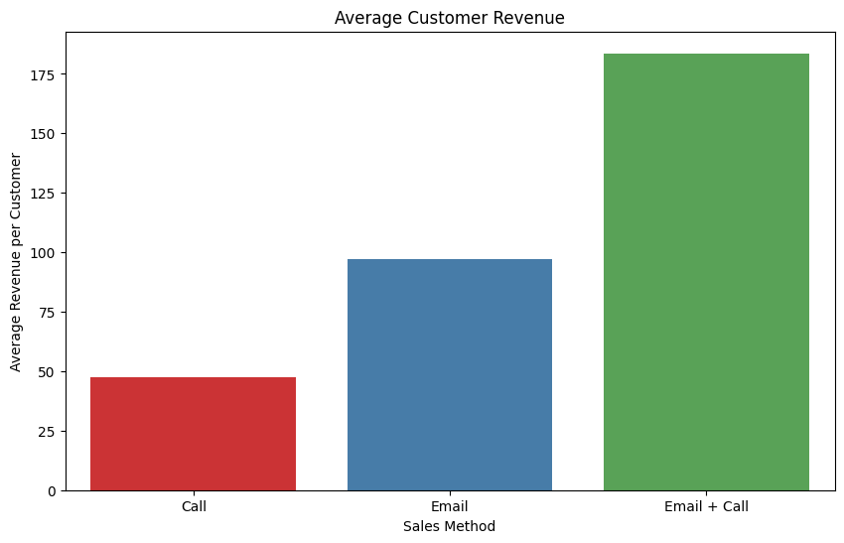
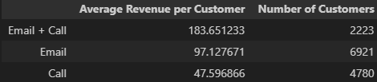
Revenue Analysis (cont.)
What does the spread of the revenue look like overall? And for each method?
Calls:
Average revenue per customer hovers around $50.
Emails:
With an average revenue per customer at $100, this is indicating higher efficiency.
Email + Call:
The combined approach averages over $175 in revenue per customer, highlighting its superior profitability, especially for high-engagement sales scenarios.
Notes:
Revenue Analysis (cont.)
What does the spread of the revenue look like overall? And for each method?
Calls:
Average revenue per customer hovers around $50.
Emails:
With an average revenue per customer at 100, this is indicating higher efficiency.
Email + Call:
The combined approach averages over 175 in revenue per customer, highlighting its superior profitability, especially for high-engagement sales scenarios.

Slide 5
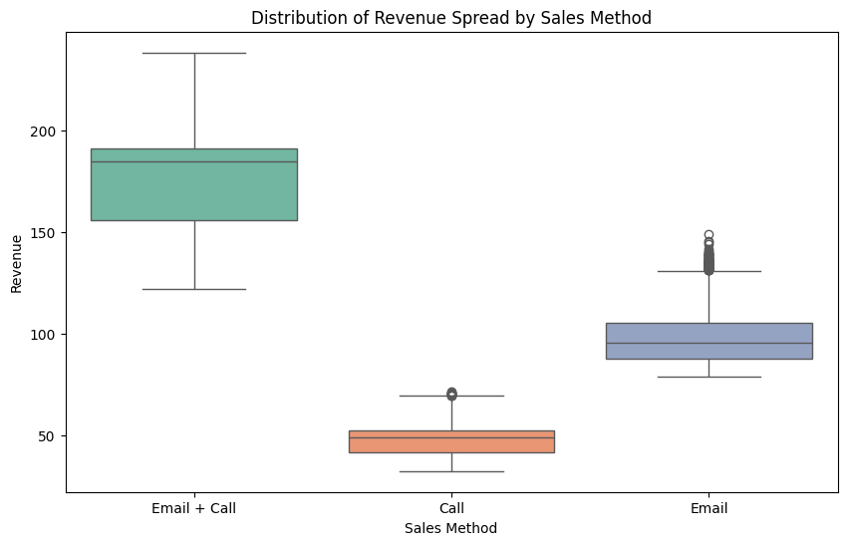
Revenue Analysis (cont.)
What does the spread of the revenue look like overall? And for each method?
Email + Call:
This method exhibits a broad revenue range, between under 150 and over 200. The presence of outliers above 200 signifies exceptional sales occurrences, likely from combined communication efforts leading to higher transaction values.
Call:
The revenue for the 'Call' method mostly centers around 50, with some outliers above this mark. These outliers suggest that even though the call method tends to yield moderate transaction sizes, it can occasionally result in significantly higher sales, possibly from successful negotiations or in-depth customer interactions.
Email:
The 'Email' method shows a concentration of sales under 100 and just over 100, with outliers around 150. These outliers may represent successful marketing campaigns or special offers that have resonated with customers, prompting them to spend more.
Notes:
Revenue Analysis (cont.)
What does the spread of the revenue look like overall? And for each method?
Email + Call:
This method exhibits a broad revenue range, between under 150 and over 200. The presence of outliers above 200 signifies exceptional sales occurrences, likely from combined communication efforts leading to higher transaction values.
Call:
The revenue for the 'Call' method mostly centers around 50, with some outliers above this mark. These outliers suggest that even though the call method tends to yield moderate transaction sizes, it can occasionally result in significantly higher sales, possibly from successful negotiations or in-depth customer interactions.
Email:
The 'Email' method shows a concentration of sales under 100 and just over 100, with outliers around 150. These outliers may represent successful marketing campaigns or special offers that have resonated with customers, prompting them to spend more.

Slide 6
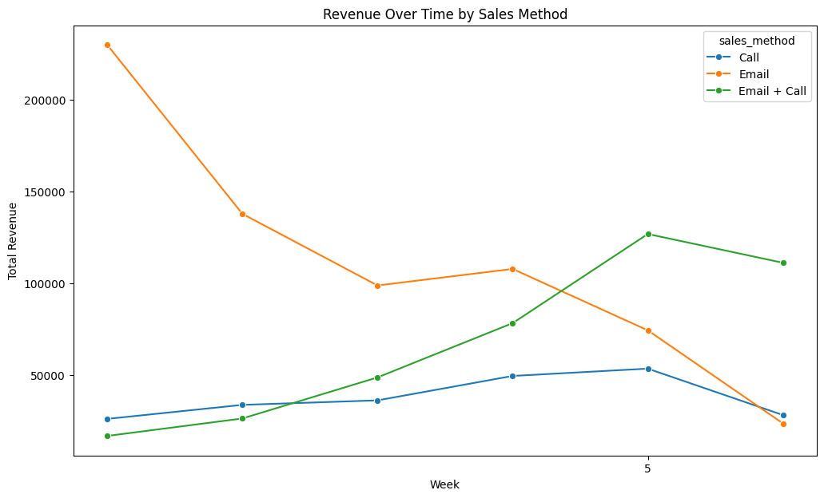
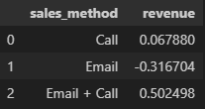
Trend Insights
Was there any difference in revenue over time for each of the methods?
This metric is designed to monitor the week-over-week growth efficiency of each sales method.
Initial Values for the Metric:
Call: Average weekly growth of approximately 6.79%.
Email: Average weekly decline of approximately 31.67%.
Email + Call: Average weekly growth of approximately 50.25%.
These values suggest that the "Email + Call" method is currently the most successful in terms of weekly revenue growth, whereas the "Email" method shows a decline. Monitoring these trends is crucial for making informed decisions on sales strategies
Notes:
Trend Insights
Was there any difference in revenue over time for each of the methods?
This metric is designed to monitor the week-over-week growth efficiency of each sales method.
Initial Values for the Metric:
Call: Average weekly growth of approximately 6.79%.
Email: Average weekly decline of approximately 31.67%.
Email + Call: Average weekly growth of approximately 50.25%.
These values suggest that the "Email + Call" method is currently the most successful in terms of weekly revenue growth, whereas the "Email" method shows a decline. Monitoring these trends is crucial for making informed decisions on sales strategies

Slide 7
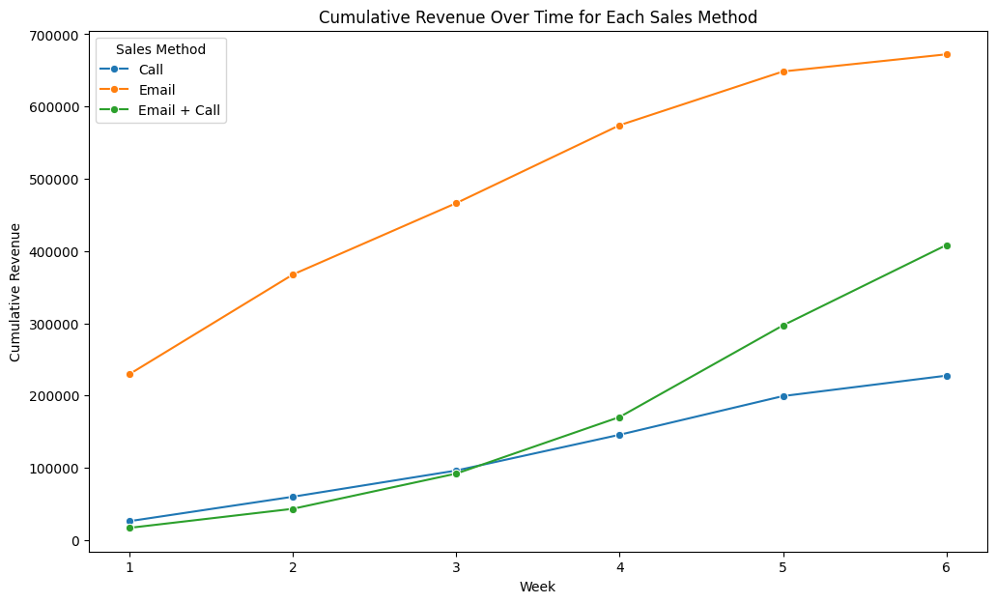
Strategic Direction
Based on the data, which method would you recommend we continue to use?
Email Method:
Started week 1 just above 200,000, displaying a robust growth trajectory to close week 6 just shy of 700,000. This indicates a strong market presence and a high rate of customer acquisition or upselling through email outreach.
Call Method:
Commenced week 1 with a modest beginning, indicative of slower initial sales, and concluded week 6 slightly above 200,000. This slower growth suggests that while effective, the call method may require more time to convert sales or may serve a niche segment.
Email + Call Method:
Initiated week 1 with numbers not as strong as the email-only method but showed a steady increase to finish week 6 slightly over 400,000. This demonstrates the combined strategy's ability to capture significant market share, possibly pointing to the added value of personalized follow-ups.
Notes:
Strategic Direction
Based on the data, which method would you recommend we continue to use?
Email Method:
Started week 1 just above 200,000, displaying a robust growth trajectory to close week 6 just shy of 700,000. This indicates a strong market presence and a high rate of customer acquisition or upselling through email outreach.
Call Method:
Commenced week 1 with a modest beginning, indicative of slower initial sales, and concluded week 6 slightly above 200,000. This slower growth suggests that while effective, the call method may require more time to convert sales or may serve a niche segment.
Email + Call Method:
Initiated week 1 with numbers not as strong as the email-only method but showed a steady increase to finish week 6 slightly over 400,000. This demonstrates the combined strategy's ability to capture significant market share, possibly pointing to the added value of personalized follow-ups.

Slide 8
Business Focus and Metrics to Monitor
Sales Efficiency Index (SEI)
Based on the analysis, here are the key metrics for each sales method:
Call: Total Revenue: $227,513.02, SEI (Sales Efficiency Index): 113,756.51
Email: Total Revenue: $672,220.61, SEI: 672,220.61
Email + Call: Total Revenue: $408,256.69, SEI: 136,085.56
Recommendation:
Email: Despite its lower total revenue compared to "Email + Call", the Email method has the highest SEI, indicating it is the most efficient in terms of revenue generated per unit of effort. If the goal is to maximize efficiency (revenue per effort), then the Email method is recommended.
Email + Call: This method has the second-highest SEI and a significant total revenue, indicating it's also an effective method but requires more effort compared to Email alone.
Call: This method has the lowest SEI and total revenue among the three. It may not be the most efficient method in terms of the effort required.
Notes:
Business Focus, Metrics and Evaluation
Based on the analysis, here are the key metrics for each sales method:
Call: Total Revenue: $227,513.02, SEI (Sales Efficiency Index): 113,756.51
Email: Total Revenue: $672,220.61, SEI: 672,220.61
Email + Call: Total Revenue: $408,256.69, SEI: 136,085.56
Recommendation:
Email: Despite its lower total revenue compared to "Email + Call", the Email method has the highest SEI, indicating it is the most efficient in terms of revenue generated per unit of effort. If the goal is to maximize efficiency (revenue per effort), then the Email method is recommended.
Email + Call: This method has the second-highest SEI and a significant total revenue, indicating it's also an effective method but requires more effort compared to Email alone.
Call: This method has the lowest SEI and total revenue among the three. It may not be the most efficient method in terms of the effort required.

Slide 9
Business Focus and Metrics to Monitor(cont.)
Adjusted Sales Efficiency Index (ASEI)
Definition: ASEI measures the efficiency of each sales method in generating revenue, adjusted for the estimated effort.
Calculation:
ASEI = Total Revenue Generated by Sales Method
Estimated Effort Score × Number of Transactions
ASEI = Estimated Effort Score×Number of Transactions Total Revenue Generated by Sales Method
Analysis and Business Metric Recommendation:
The Email method has the highest ASEI, indicating it's the most efficient in terms of revenue per transaction and effort. This method balances a high total revenue with a large number of transactions effectively.
The Email + Call method, while effective in total revenue, shows a moderate level of efficiency when adjusted for the number of transactions and estimated effort.
The Call method has the lowest ASEI, suggesting it's less efficient compared to the other methods.
Notes:
Business Focus, Metrics and Evaluation (cont.)
Adjusted Sales Efficiency Index (ASEI)
Definition: ASEI measures the efficiency of each sales method in generating revenue, adjusted for the estimated effort.
Calculation:
ASEI = Total Revenue Generated by Sales Method
Estimated Effort Score × Number of Transactions
ASEI = Estimated Effort Score×Number of Transactions Total Revenue Generated by Sales Method
Analysis and Business Metric Recommendation:
The Email method has the highest ASEI, indicating it's the most efficient in terms of revenue per transaction and effort. This method balances a high total revenue with a large number of transactions effectively.
The Email + Call method, while effective in total revenue, shows a moderate level of efficiency when adjusted for the number of transactions and estimated effort.
The Call method has the lowest ASEI, suggesting it's less efficient compared to the other methods.

Slide 10
Final Summary Including Recommendations:
Summary:
Sales Method Performance: The "Email + Call" method generally generates the highest revenue, but it requires more effort. The "Email" method, while producing lower total revenue, is the most efficient when considering the Sales Efficiency Index (SEI) and Adjusted Sales Efficiency Index (ASEI).
Revenue Over Time: There were fluctuations in revenue over time for all sales methods. The "Email + Call" method showed significant growth, indicating its effectiveness in certain periods.
Customer Engagement: The data suggests varying levels of engagement and success with different sales methods. This indicates the importance of tailoring the sales approach to customer preferences and behaviors.
Recommendations:
Focus on Efficient Methods: Prioritize the "Email" method for its high efficiency, especially in scenarios where resource optimization is crucial. This method maximizes revenue per unit of effort and transaction.
Strategic Use of Combined Methods: Utilize the "Email + Call" method strategically for high-value sales or key customer segments where the higher effort can be justified by a correspondingly higher revenue return.
Reevaluate the Call Method: Given its lower efficiency and revenue generation, consider reevaluating or optimizing the "Call" method. This might involve training, script adjustments, or integrating technology to enhance effectiveness.
Monitor Adjusted SEI: Regularly track the Adjusted Sales Efficiency Index (ASEI) to assess the ongoing efficiency of each sales method. Use this metric to make informed decisions on resource allocation and strategy adjustments.
Customer-Centric Approach: Tailor sales strategies to customer preferences and behaviors, which may vary across different segments. A more personalized approach can enhance customer engagement and sales success.
Continuous Review and Adaptation: The sales landscape is dynamic. Regularly review sales strategies and data metrics to adapt to changing market conditions, customer needs, and business goals.
By implementing these recommendations and continuously monitoring key metrics, the business can optimize its sales strategies for both efficiency and effectiveness, leading to sustained growth and success.
Notes:
Final Summary Including Recommendations:
Summary:
Sales Method Performance: The "Email + Call" method generally generates the highest revenue, but it requires more effort. The "Email" method, while producing lower total revenue, is the most efficient when considering the Sales Efficiency Index (SEI) and Adjusted Sales Efficiency Index (ASEI).
Revenue Over Time: There were fluctuations in revenue over time for all sales methods. The "Email + Call" method showed significant growth, indicating its effectiveness in certain periods.
Customer Engagement: The data suggests varying levels of engagement and success with different sales methods. This indicates the importance of tailoring the sales approach to customer preferences and behaviors.
Recommendations:
Focus on Efficient Methods: Prioritize the "Email" method for its high efficiency, especially in scenarios where resource optimization is crucial. This method maximizes revenue per unit of effort and transaction.
Strategic Use of Combined Methods: Utilize the "Email + Call" method strategically for high-value sales or key customer segments where the higher effort can be justified by a correspondingly higher revenue return.
Reevaluate the Call Method: Given its lower efficiency and revenue generation, consider reevaluating or optimizing the "Call" method. This might involve training, script adjustments, or integrating technology to enhance effectiveness.
Monitor Adjusted SEI: Regularly track the Adjusted Sales Efficiency Index (ASEI) to assess the ongoing efficiency of each sales method. Use this metric to make informed decisions on resource allocation and strategy adjustments.
Customer-Centric Approach: Tailor sales strategies to customer preferences and behaviors, which may vary across different segments. A more personalized approach can enhance customer engagement and sales success.
Continuous Review and Adaptation: The sales landscape is dynamic. Regularly review sales strategies and data metrics to adapt to changing market conditions, customer needs, and business goals.
By implementing these recommendations and continuously monitoring key metrics, the business can optimize its sales strategies for both efficiency and effectiveness, leading to sustained growth and success.

