Slide 1
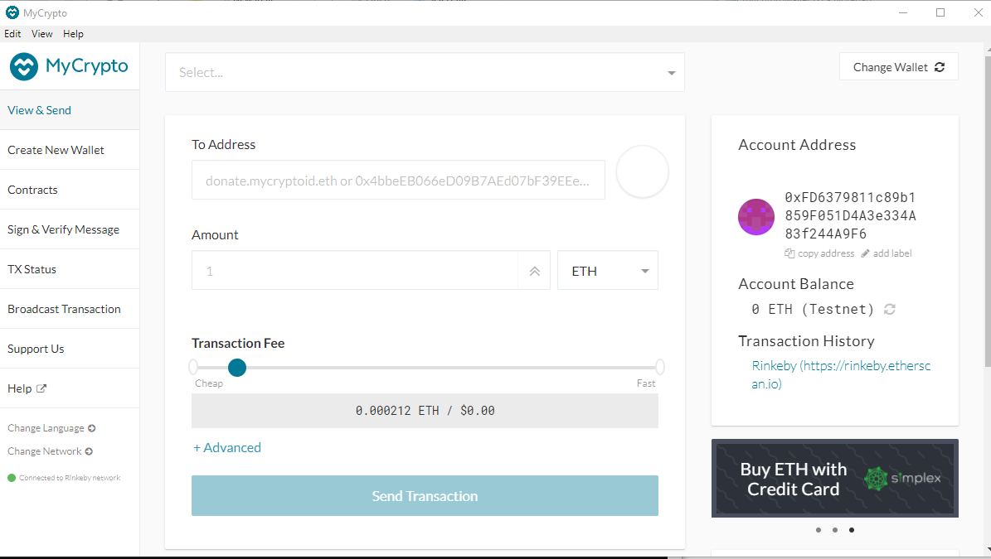

Slide 2
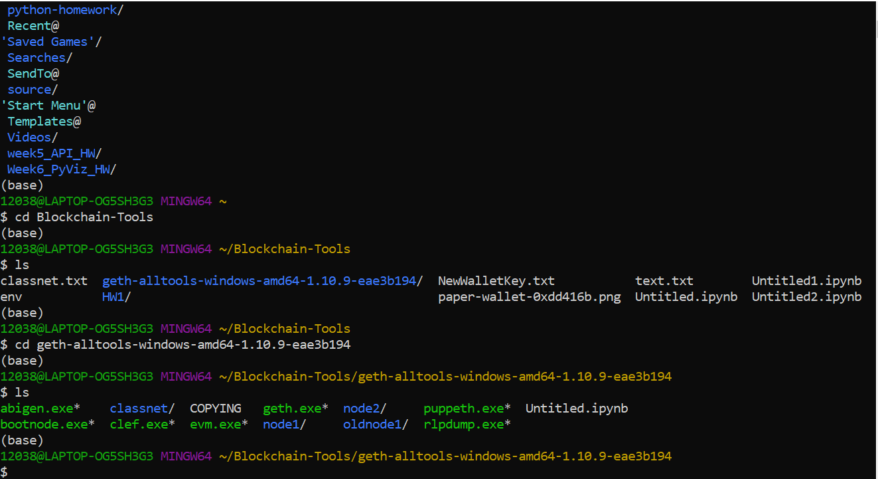
2 nodes created

Slide 3
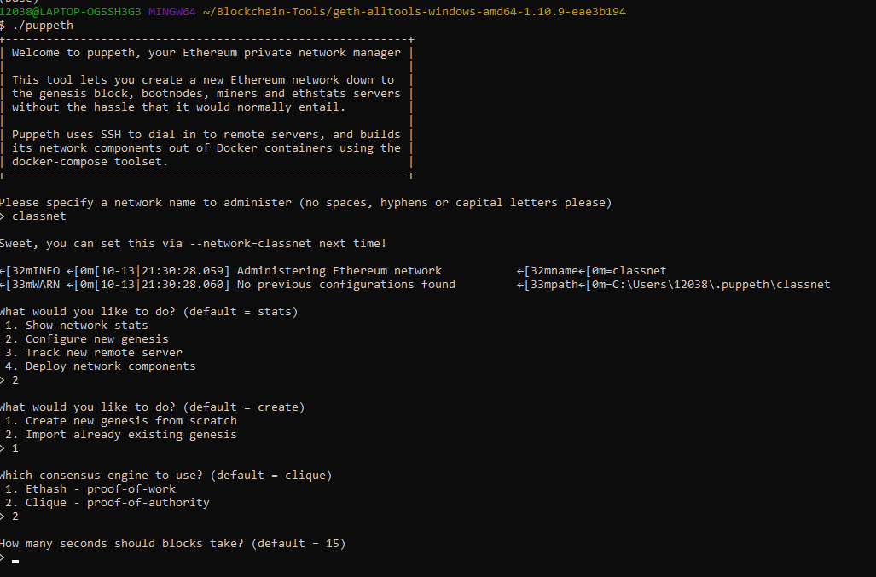
Creating a genesis block using proof of authority

Slide 4
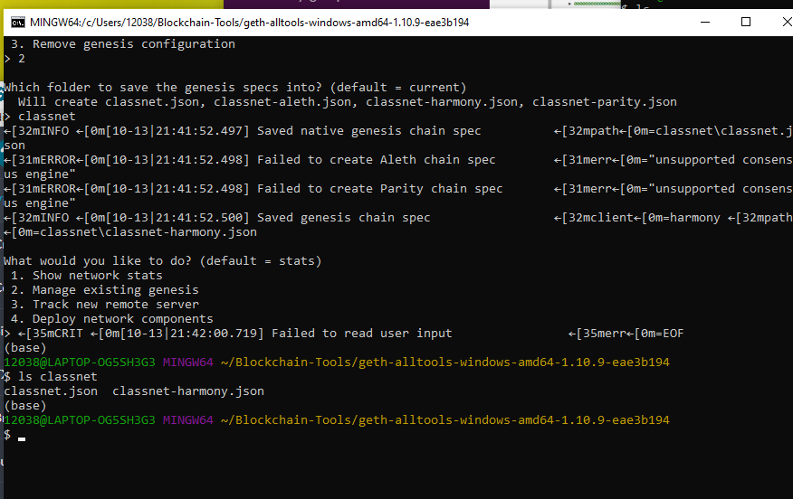
nodes with the genesis' json file

Slide 5
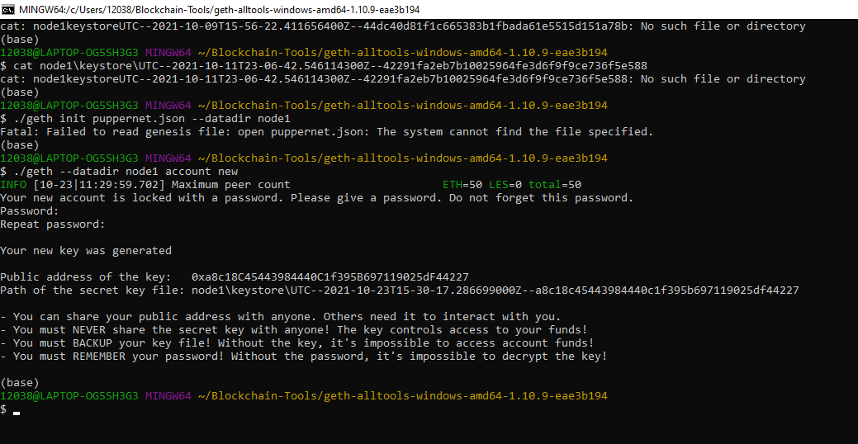

Slide 6
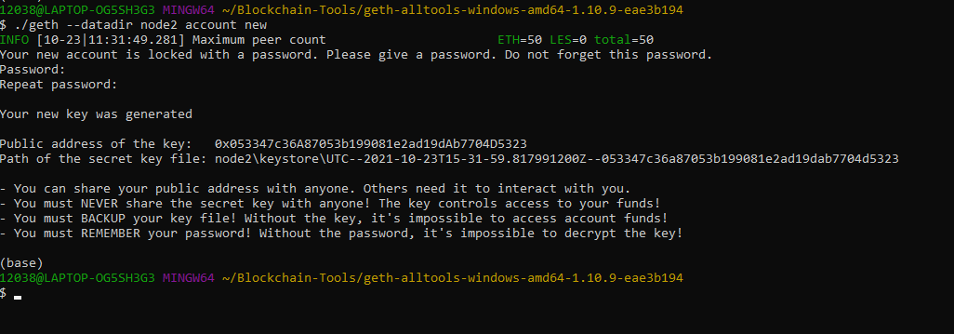

Slide 7
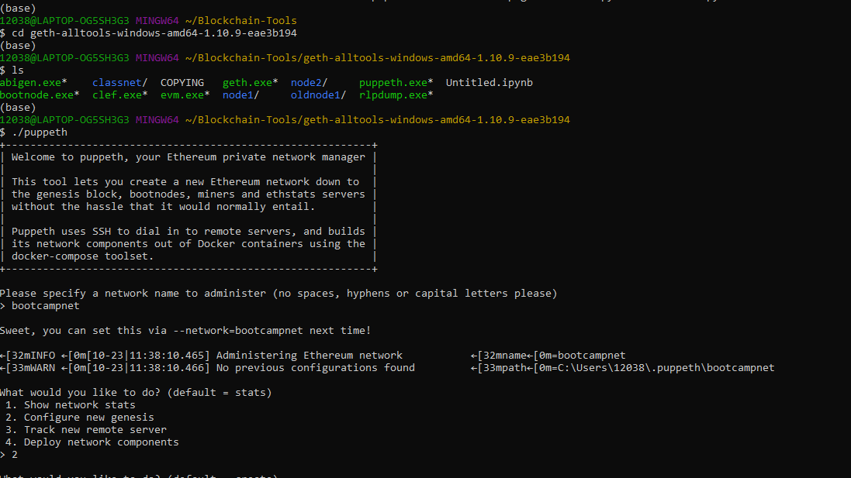

Slide 8
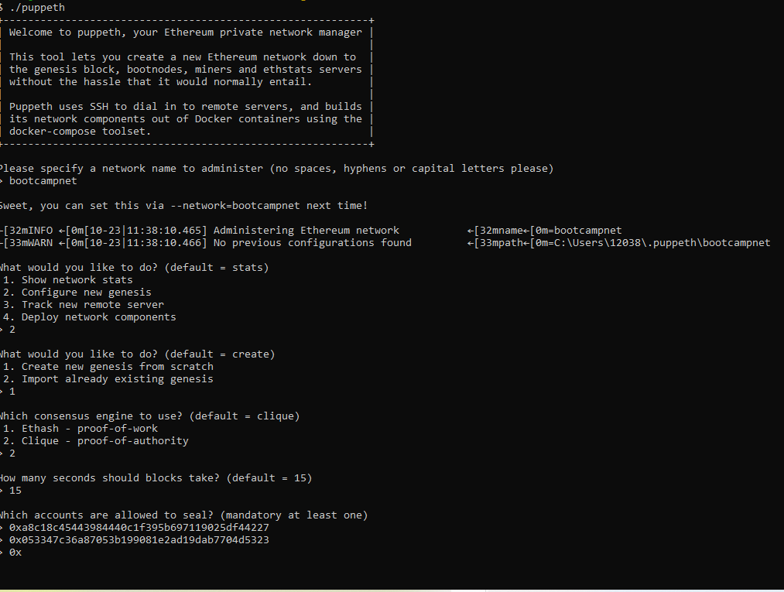

Slide 9
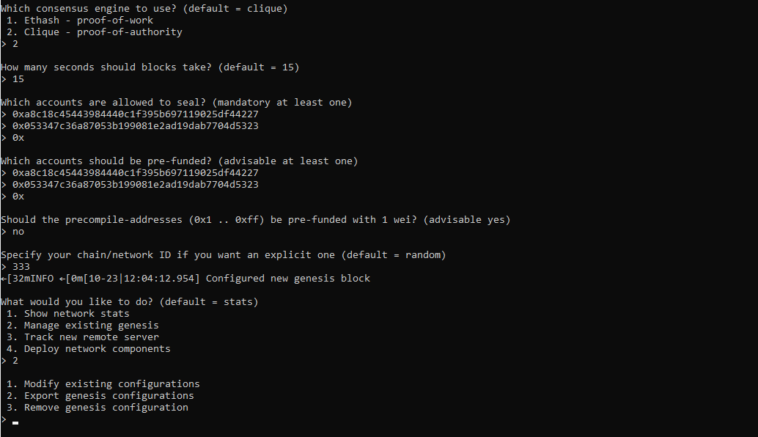

Slide 10
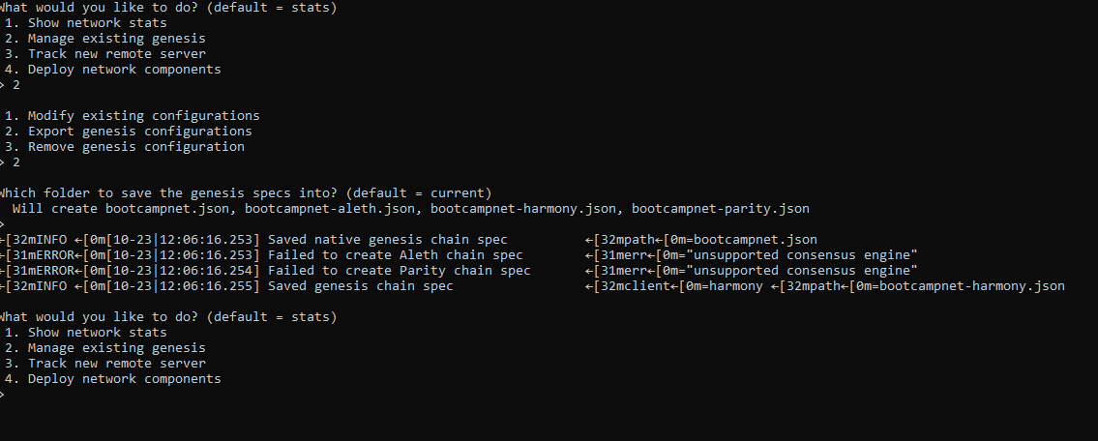
Export genesis configurations. This will fail to create two of the files, but you only need networkname.json.

Slide 11

Screenshot the puppeth configuration once complete and save it to the Screenshots folder.

Slide 12
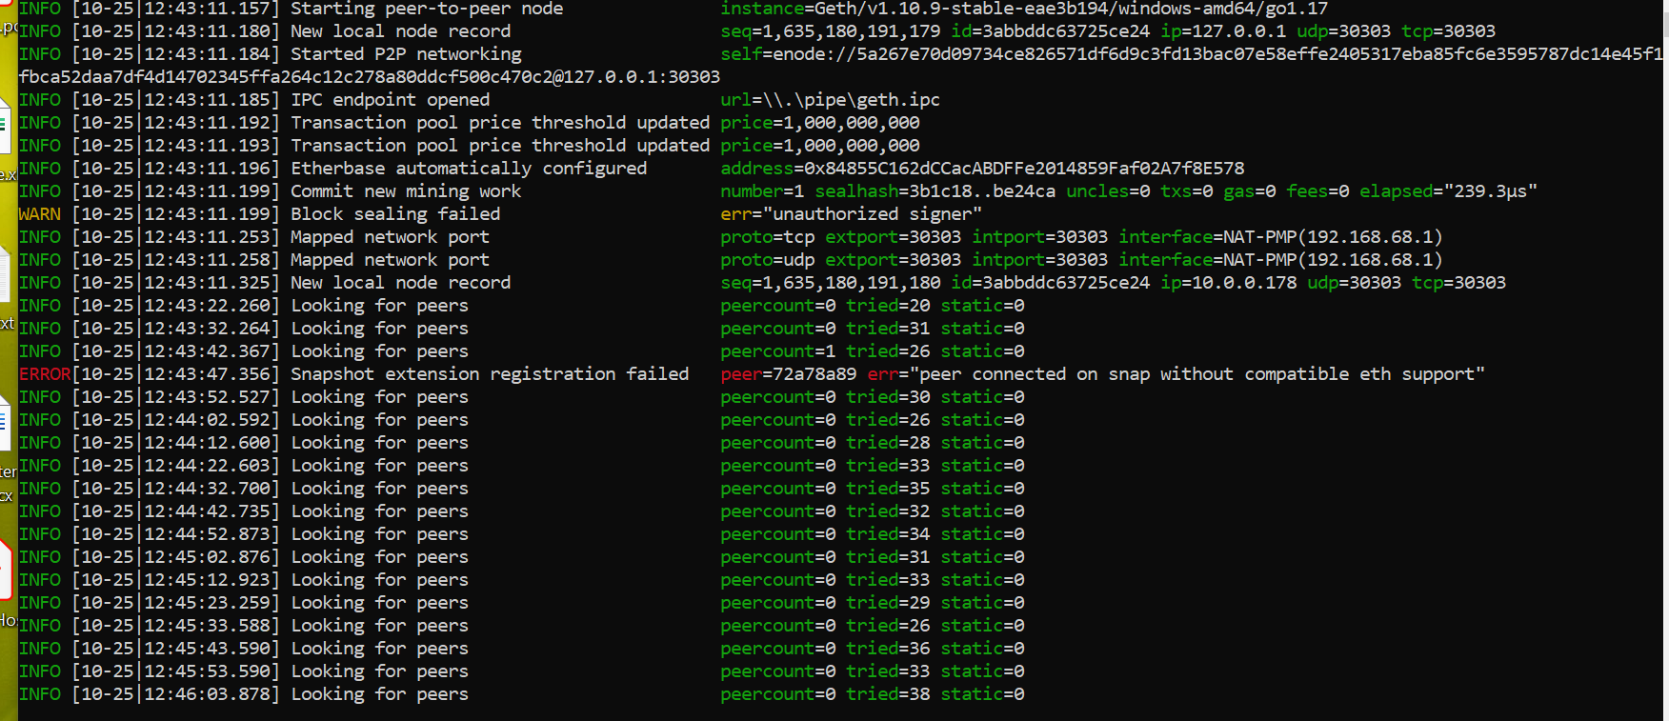
./geth –datadir node1 –mine –minderthreads 1

Slide 13
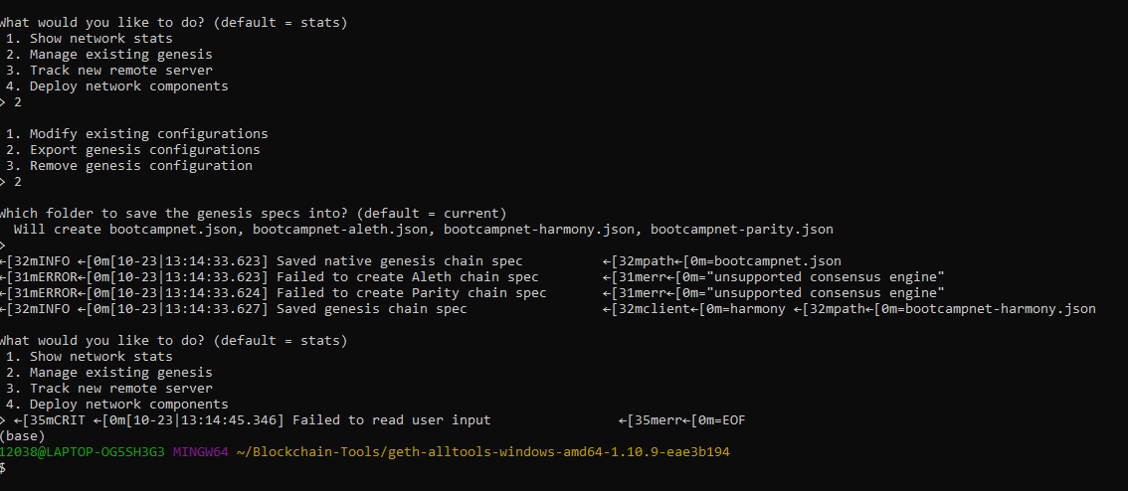

Slide 14
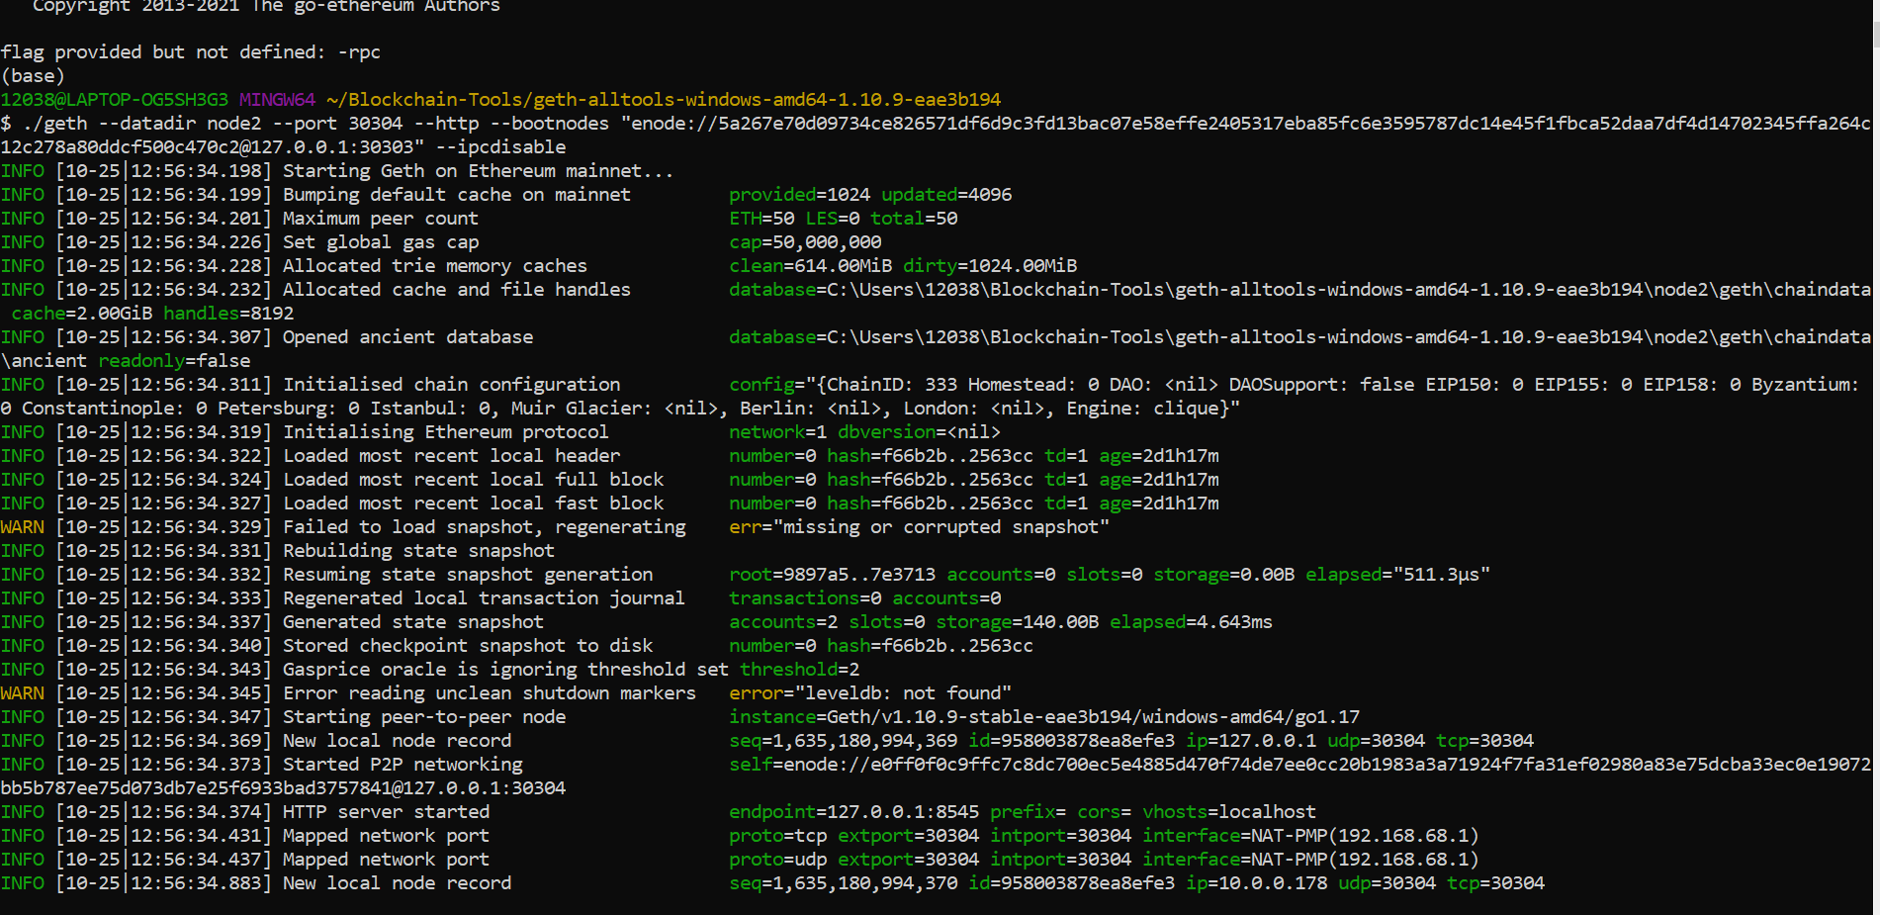

Slide 15
