Slide 1
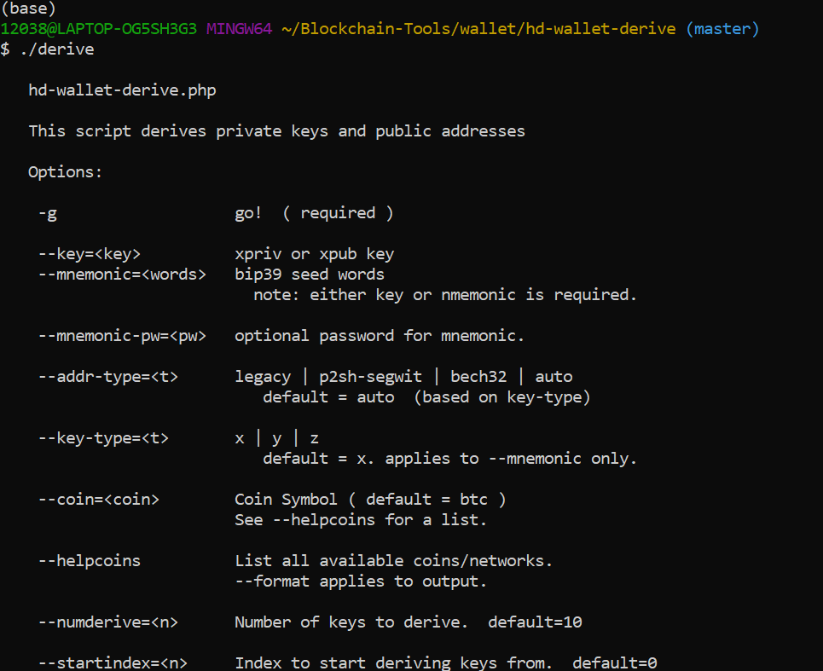
Symbolic link:

Slide 2

Test to see the ./derive works:

Slide 3
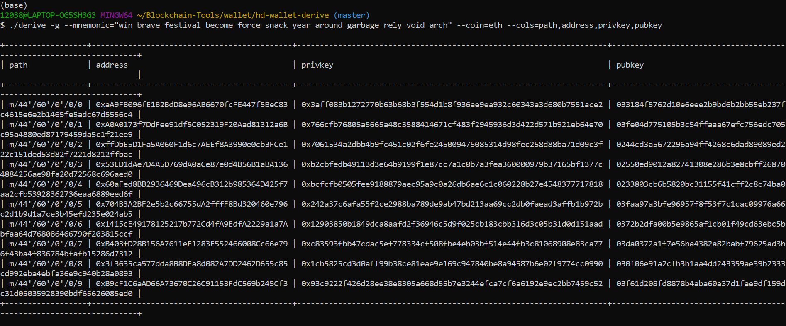
Testing the derive command works:

Slide 4

Using the derive symbolic link to create a json file output

Slide 5


Slide 6
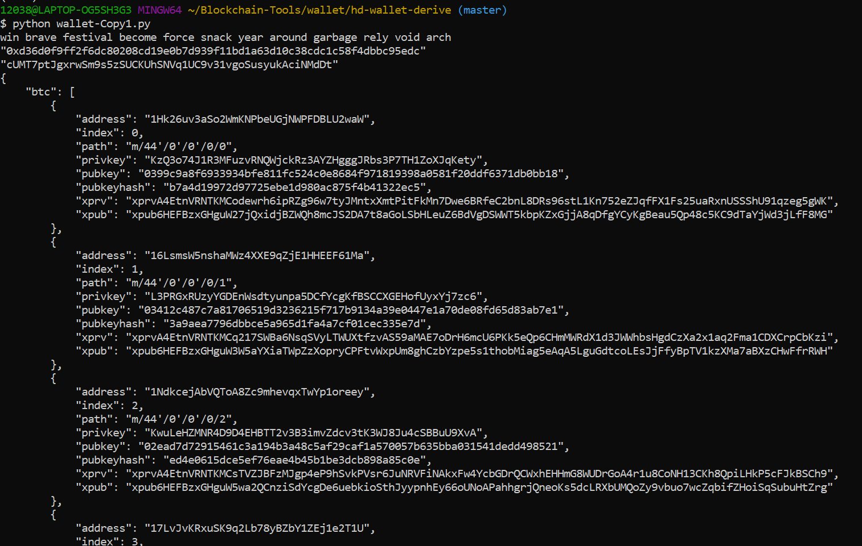
Derive wallet keys
4. Derive the wallet keys

Slide 7
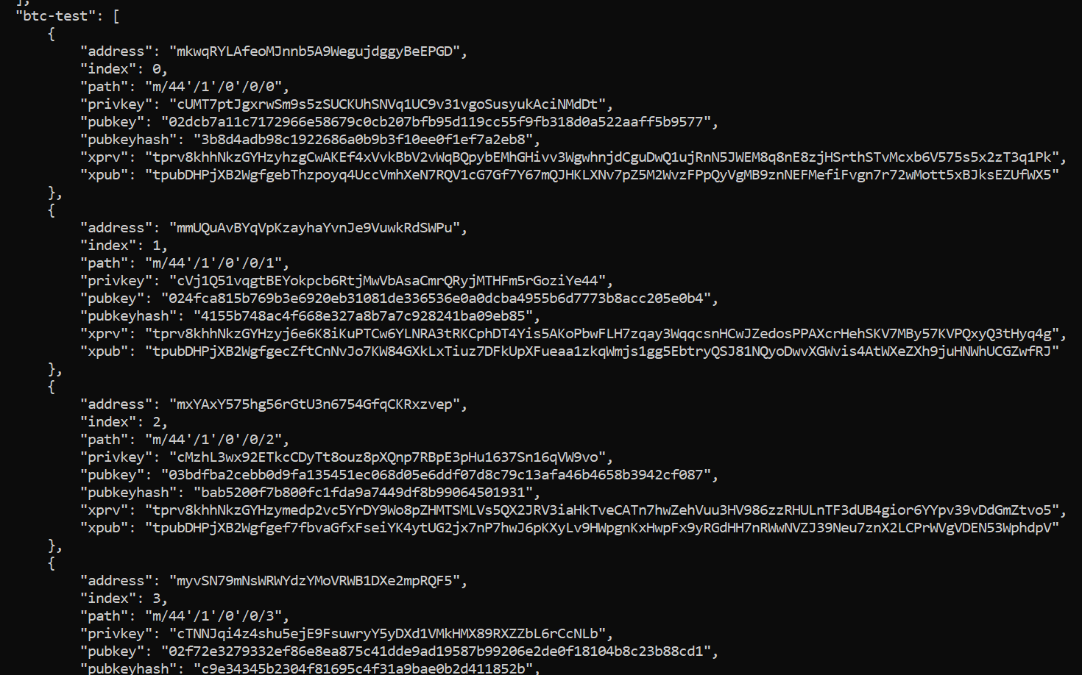

Slide 8
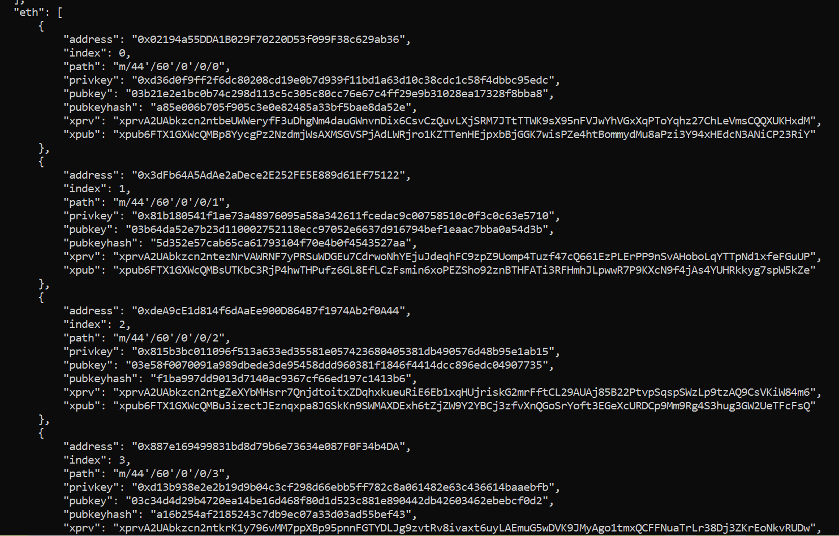

Slide 9
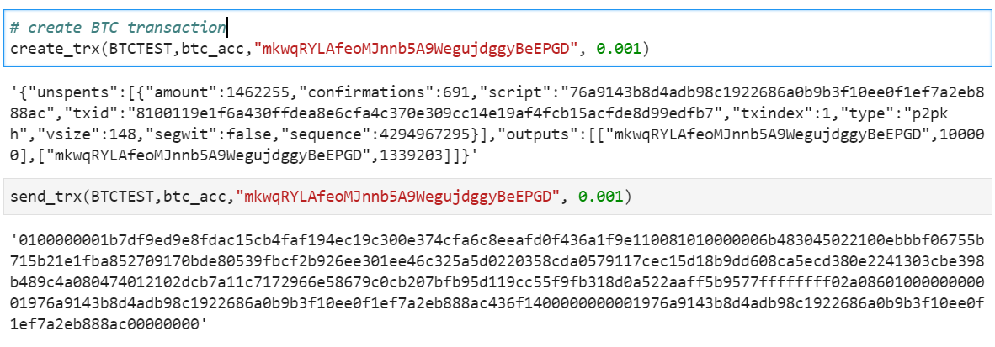

Slide 10
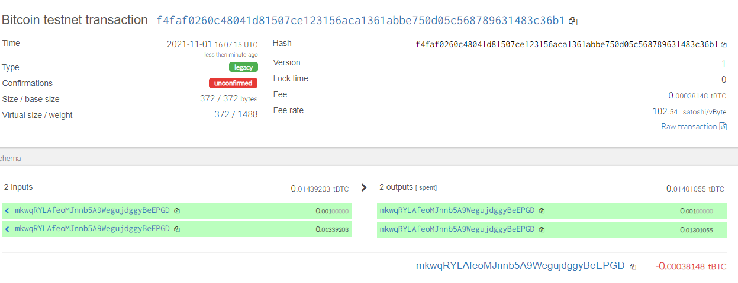

Slide 11
