Slide 1
Insulin Level Prediction using Machine Learning Approach
Presented By
Md. Tahmidul Meshkat (2013-1-60-039)
Anindya Podder (2013-2-60-056)
B.M. Rakibul Hasan (2014-1-60-039)
Supervisor
Dr. Shamim H Ripon
Associate Professor, CSE
East West University

Slide 2
Objectives
Insulin level sequence prediction using recurrent neural network (Long Short Term Memory).
Prediction on train data with loss function and accuracy using Neural Network.
Discover meaningful pattern and frequent insulin level using Predictive Apriori Algorithm based on time slot period.

Slide 3
Outline
Methodology
Data set and preprocessing
Result Analysis
Conclusion
Future Work

Slide 4

Methodology
Raw Diabetes
Dataset
Preprocess Diabetes Dataset
Code=33
Apply Recurrent neural network (LSTM)
Use Artificial Neural Network
Apply Predictive Apriori Algorithm
Prediction sequence of insulin level and next state insulin level
Predicting frequent item set and association rule with accuracy
Prediction on train data with accuracy

Slide 5
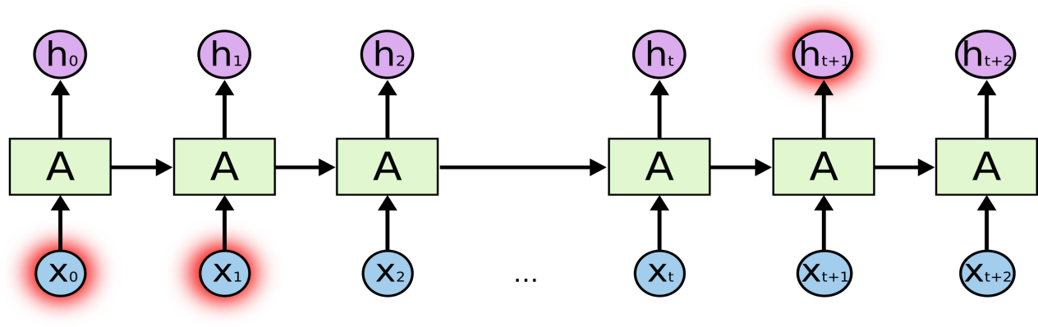
Recurrent Neural Network

Slide 6
RNN (LSTM) Condition
Need a long sequence of data.
Data must be preprocessed.
Data must be with time series and Date.
For next insulin value prediction need One column of data.

Slide 7
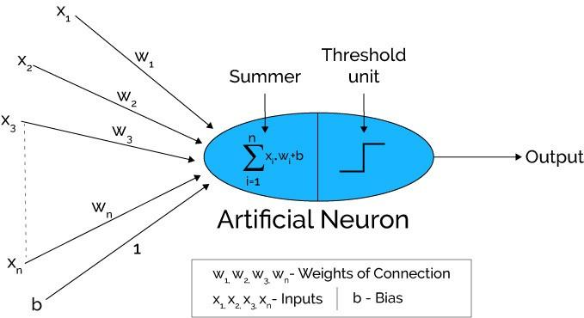
Artificial Neural Network
The Artificial Neural Network receives input from the external world in the form of pattern and image in vector form.
Each input is multiplied by its corresponding weights.
The weighted inputs are all summed up inside computing unit (artificial neuron).
The sum corresponds to any numerical value ranging from 0 to infinity. the threshold value is set up. For this, the sum is passed through activation function.

Slide 8
Predictive Apriori
Predictive Apriori Algorithm:
This algorithm searches with an increasing support threshold for the best 'n' rules concerning a support-based corrected confidence value.

Slide 9
RNN Mechanism
Load dataset as pandas data frame.(Extract NumpyArray
Normalize data(rescale our data 0 to 1 using MinMaxScaler in Scikit Learn Library
Load Dataset from
Csv file(use SciPy environment with keras and backend theano or tensor flow
Fit random seed(using numpy.seed()
Fit LSTM network(1 input,4 LSTM block,1 Output layer for prediction
Reshape data(need samples, timesteps and features)
Convert array of values into dataset matrix.(look_back for previous step)
Split the dataset(67% train and 33% test)
Make prediction(calculate RMSE)

Slide 10
RNN Mechanism Cont.
Compile Model
(Binary classification's problem define “mean_square_error”,for gradient decent algorithm use “Adam", accuracy “metrics”
Load Dataset
(Use NumPy
Function loadtxt()
Define Model(3 input_dim,neuron 50 in input layer,Relu,Hidden layer 100 neurons activation Relu,output Layer 1 neuron, linear Activation
Evaluate of performance(calculate MSE with accuracy)
Fit Model(Number of Len(data) number of epochs)

Slide 11
Why it better
1.Solve gradient decent problem
2.Long sequence probability will never zero
3. Reduce time Complexity
4.Don’t show observable state calculation
5.Doctor‘s can predict state wise prediction
Predict a label of sequence , next insulin level sequence and predict one state to another state sequence
Predict on train data with accuracy
Find frequent itemset and association rule

Slide 12
Data Set and Preprocessing
Data Set information
Diabetes Dataset(main Dataset)
This dataset records only provided "logical time" slots (breakfast, lunch, dinner, bedtime).
fixed times were assigned to breakfast (08:00), lunch (12:00), dinner (18:00), and bedtime (22:00).
Each value contain an insulin level of breakfast,lunch,dinner,bedtime.
Date | Time | Code | Value
04-21-1991 | 9:09 | 58 | 100
04-21-1991 | 9:09 | 33 | 009
04-21-1991 | 17:08 | 62 | 119
04-24-1991 | 7:52 | 34 | 014
04-21-1991 | 12:53 | 60 | 072
04-22-1991 | 23:00 | 48 | 094
10-10-1989 | 18:00 | 33 | 010
10-11-1989 | 18:00 | 62 | 153
01-12-1990 | 12:00 | 60 | 60
Code field:
33=insulin dose
34=NPH insulin dose
48 = Unspecified blood glucose measurement
58 = Pre-breakfast blood glucose measurement
60 = Pre-lunch blood glucose measurement 62 = Pre-supper blood glucose measurement

Slide 13
Data Set and preprocessing
Preprocessing
Preprocessed Data
We take only code =33 from data set.
Get breakfast,lunch,dinner,bedtime value from timing slot.
Take 36 months data to predict .
Data | Code | breakfast | lunch | Dinner | Bedtime
04-17-1989 | 33 | 19.0 | 18.0 | 9.0 | 0.0
04-17-1989 | 33 | 6.0 | 12.0 | 0.0 | 0.0
05-17-1989 | 33 | 17.0 | 15.0 | 6.0 | 2.0
05-17-1989 | 33 | 18.0 | 15.0 | 8.0 | 2.0

Slide 14
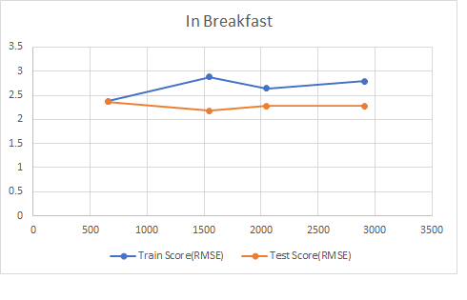
Result Analysis
RNN Prediction for Data Error (Breakfast)
DataSet | Data (preprocessed) | Train Score(RMSE) | Test Score(RMSE)
0-14 | 655 | 2.38 | 2.37
0-31 | 1545 | 2.88 | 2.18
0-46 | 2050 | 2.64 | 2.28
0-64 | 2905 | 2.79 | 2.28
Table: Prediction train Score and test Score
Figure: Breakfast prediction

Slide 15
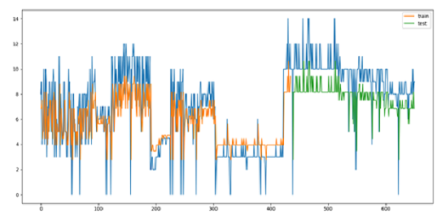
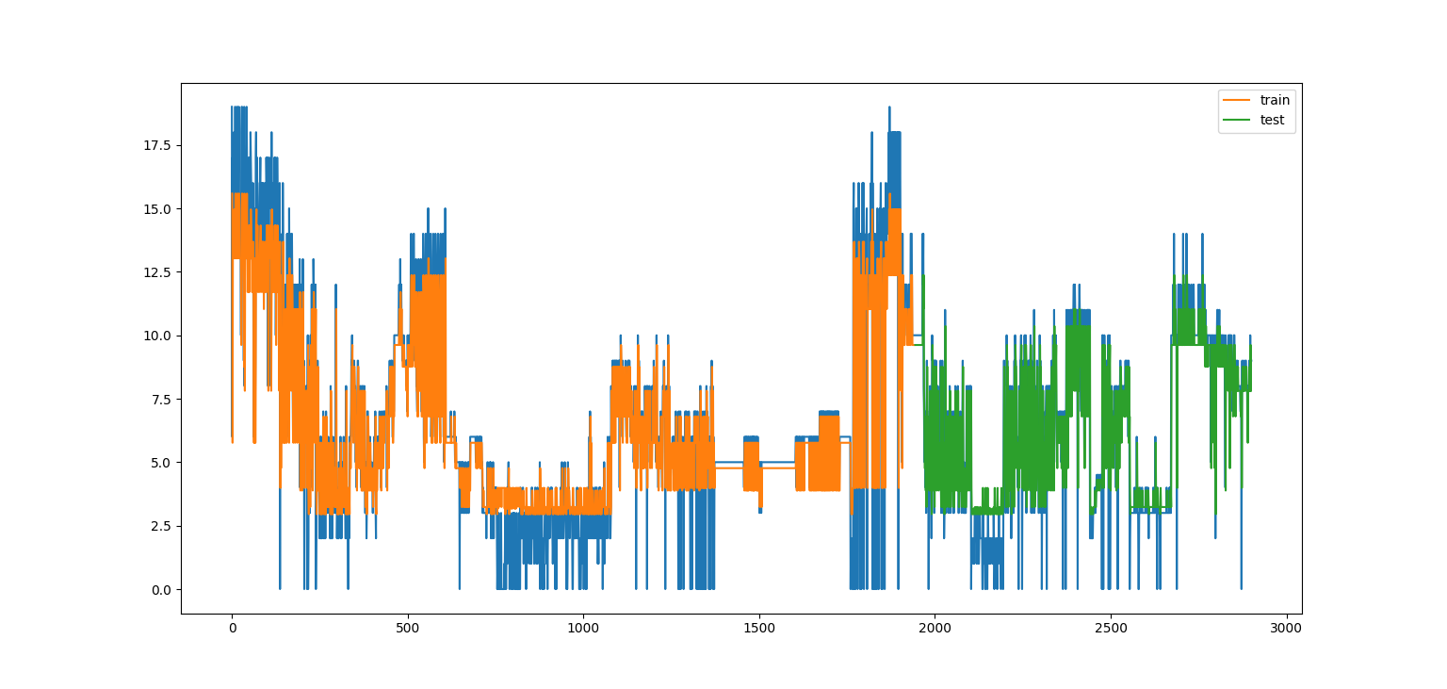
Result Analysis Cont.
RNN Prediction for Breakfast
Figure: Breakfast prediction (0-14)
Figure: Breakfast prediction (0-64)

Slide 16
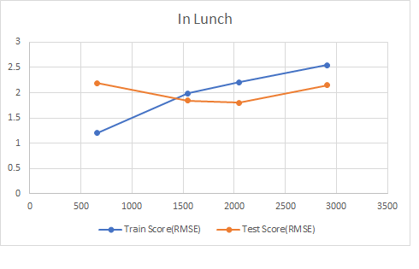
Result Analysis Cont.
RNN Prediction for Data Error (Lunch)
Dataset | Data(preprocessed) | Train Score(RMSE) | Test Score(RMSE)
0-14 | 655 | 1.20 | 2.19
0-31 | 1545 | 1.99 | 1.84
0-46 | 2050 | 2.21 | 1.80
0-64 | 2905 | 2.55 | 2.15
Table: Prediction train Score and test Score
Figure: Lunch prediction

Slide 17
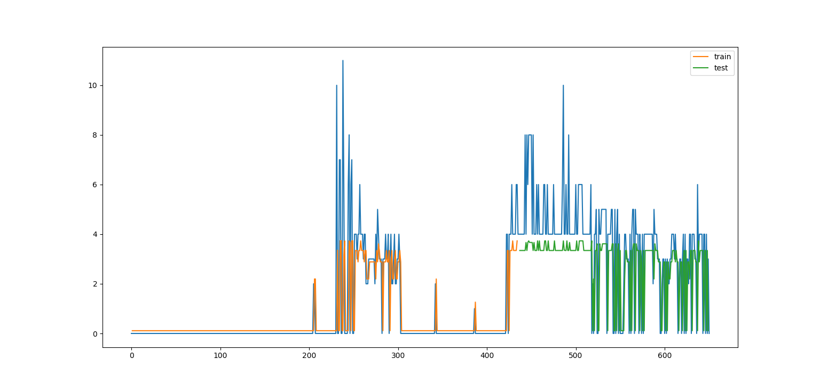
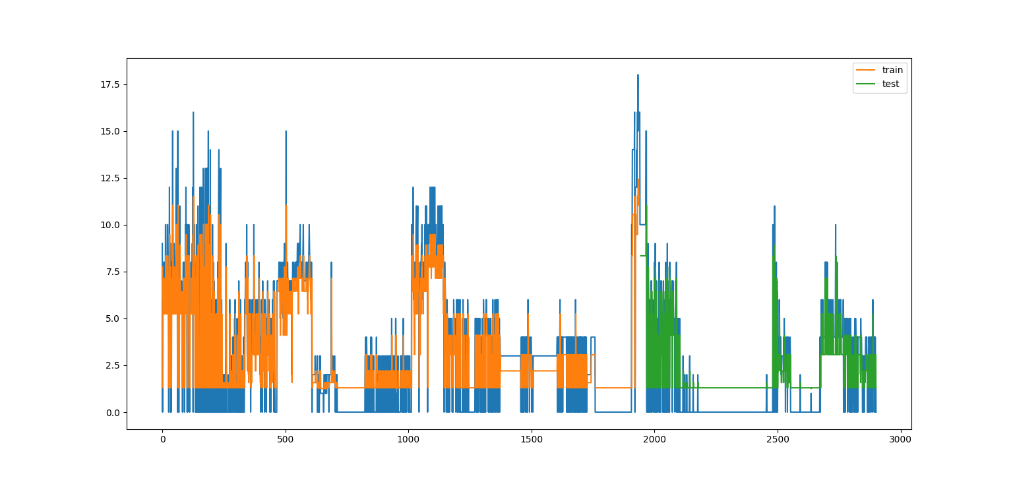
Result Analysis Cont.
RNN Prediction for Lunch
Figure: Lunch prediction (0-14)
Figure: Lunch prediction (0-64)

Slide 18
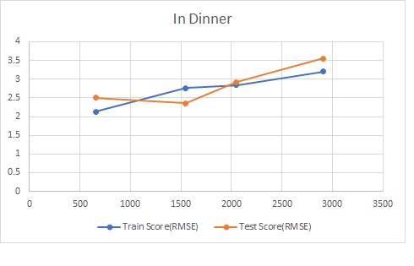
Result Analysis Cont.
RNN Prediction for Data Error (Dinner)
Dataset | Data(preprocessed) | Train Score(RMSE) | Test Score(RMSE)
0-14 | 655 | 2.13 | 2.50
0-31 | 1545 | 2.76 | 2.36
0-46 | 2050 | 2.84 | 2.92
0-64 | 2905 | 3.20 | 3.55
Table: Prediction train Score and test Score
Figure: Dinner prediction

Slide 19
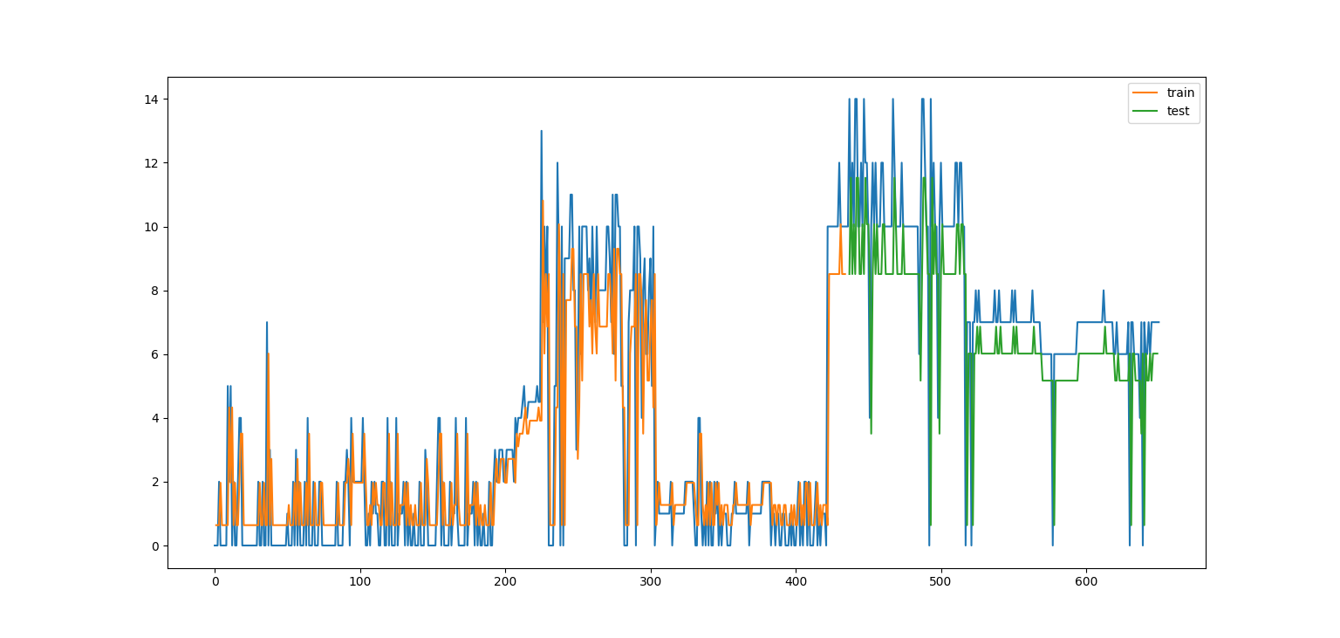
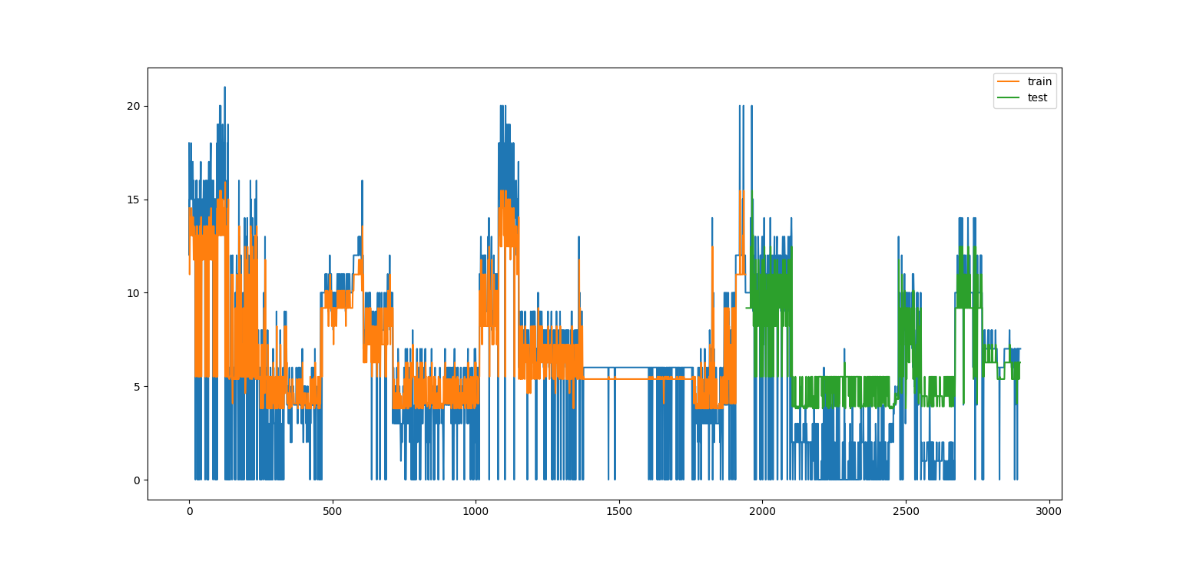
Result Analysis Cont.
RNN Prediction for Dinner
Figure: Dinner prediction (0-14)
Figure: Dinner prediction (0-64)

Slide 20
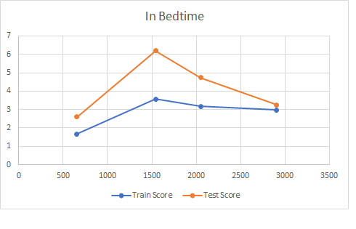
Result Analysis Cont.
RNN Prediction for Data Error (Bedtime)
Dataset | Data(preprocessed) | Train Score(RMSE) | Test Score(RMSE)
0-14 | 655 | 1.67 | 2.60
0-31 | 1545 | 3.57 | 6.20
0-46 | 2050 | 3.17 | 4.74
0-64 | 2905 | 2.97 | 3.26
Table: Prediction train Score and test Score
Figure: Bedtime prediction

Slide 21
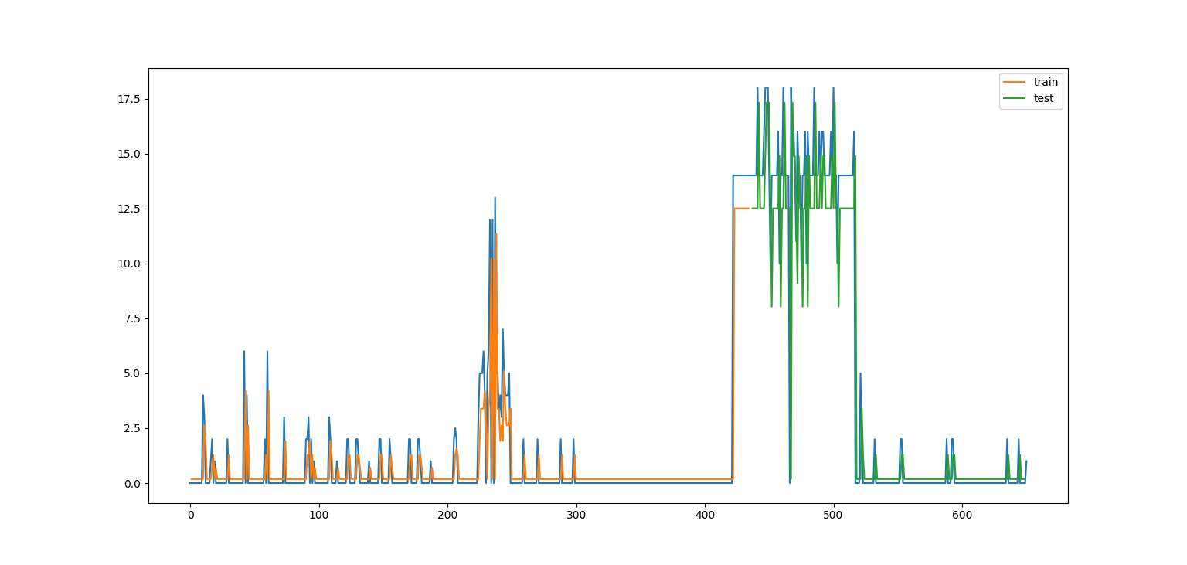
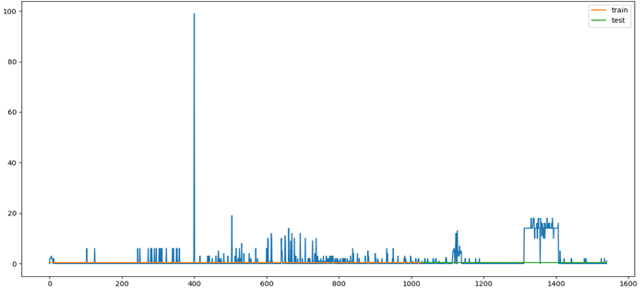
Result Analysis Cont.
RNN Prediction for Bedtime
Figure: Bedtime prediction (0-14)
Figure: Bedtime prediction (0-64)

Slide 22
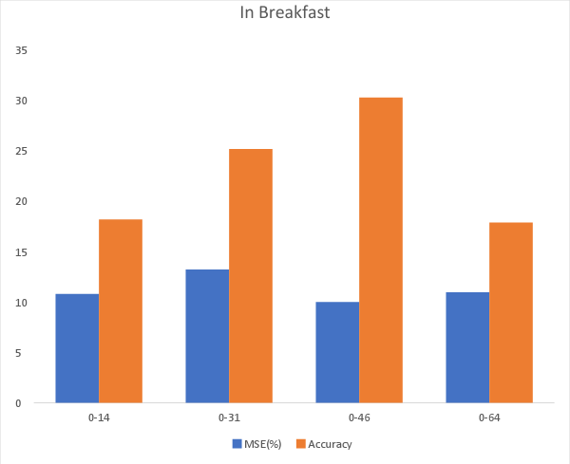
Result Analysis Cont.
ANN Prediction with Data Error & Accuracy(Breakfast)
Data Set | Data | Epoch | Training Data | MSE (%) | Accuracy
0-14 | 655 | 655 | 588 | 10.79077052 | 18.18181818
0-31 | 1545 | 1545 | 1389 | 13.21224167 | 25.16129023
0-46 | 2050 | 2050 | 1844 | 9.997701812 | 30.24390251
0-64 | 2905 | 2905 | 2613 | 10.95711449 | 17.86941581
Table: Prediction train Score and test Score
Figure: Breakfast prediction

Slide 23
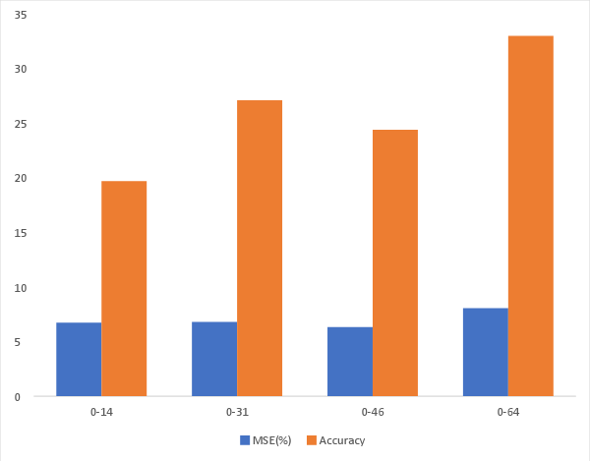
Result Analysis Cont.
ANN Prediction with Data Error & Accuracy(Lunch)
Data Set | Data | Epoch | Training Data | MSE (%) | Accuracy
0-14 | 655 | 655 | 588 | 6.743752022 | 19.69697
0-31 | 1545 | 1545 | 1389 | 6.809755664 | 27.09677
0-46 | 2050 | 2050 | 1844 | 6.334257019 | 24.39024
0-64 | 2905 | 2905 | 2613 | 8.058921011 | 32.98969
Table: Prediction train Score and test Score
Figure: Lunch prediction

Slide 24
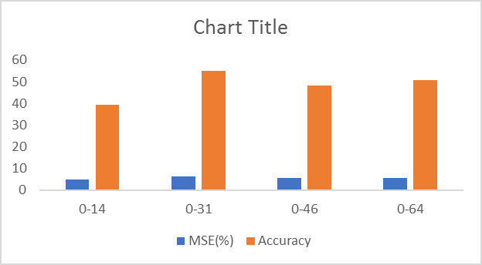

Result Analysis Cont.
ANN Prediction with Data Error & Accuracy(Dinner)
Data Set | Data | Epoch | Training Data | MSE(%) | Accuracy
0-14 | 655 | 655 | 588 | 26.19357392 | 21.21212121
0-31 | 1545 | 1545 | 1389 | 12.80214388 | 29.67741939
0-46 | 2050 | 2050 | 1844 | 14.44231148 | 27.31707321
0-64 | 2905 | 2905 | 2613 | 13.27945396 | 24.74226804
Table: Prediction train Score and test Score
Figure: Dinner prediction

Slide 25
Result Analysis Cont.
RNN Prediction with Data Error & Accuracy(Dinner)
Data Set | Data | Epoch | Training Data | MSE (%) | Accuracy
0-14 | 655 | 655 | 588 | 4.758682193 | 39.39393939
0-31 | 1545 | 1545 | 1389 | 6.154442058 | 54.83870937
0-46 | 2050 | 2050 | 1844 | 5.524987688 | 48.29268307
0-64 | 2905 | 2905 | 2613 | 5.667004256 | 50.85910653
Table: Prediction train Score and test Score
Figure: Dinner prediction

Slide 26
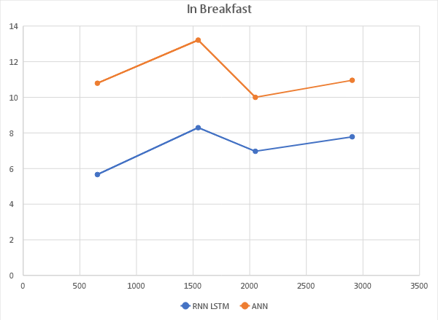
Result Analysis Cont.
Breakfast Error comparison between RNN & ANN
 |  | RNN LSTM | ANN
Dataset | Data | MSE (Epoch 100) | MSE
0-14 | 655 | 5.6644 | 10.79077052
0-31 | 1545 | 8.2944 | 13.21224167
0-46 | 2050 | 6.9696 | 9.997701812
0-64 | 2905 | 7.7841 | 10.95711449
Table: Breakfast Error comparison between RNN & ANN
Figure: Breakfast Comparison

Slide 27
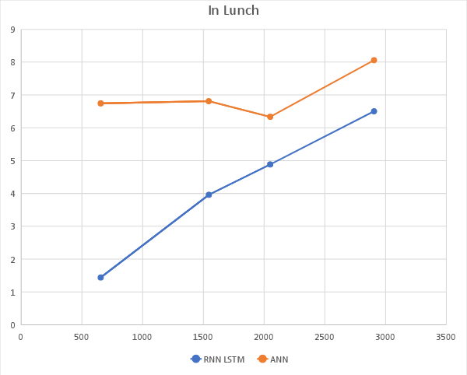
Result Analysis Cont.
Lunch Error comparison between RNN & ANN
 |  | RNN LSTM | ANN
Dataset | Data | MSE (Epoch 100) | MSE
0-14 | 655 | 1.44 | 6.743752022
0-31 | 1545 | 3.9601 | 6.809755664
0-46 | 2050 | 4.8841 | 6.334257019
0-64 | 2905 | 6.5025 | 8.058921011
Table: Lunch Error comparison between RNN & ANN
Figure: Lunch Comparison

Slide 28
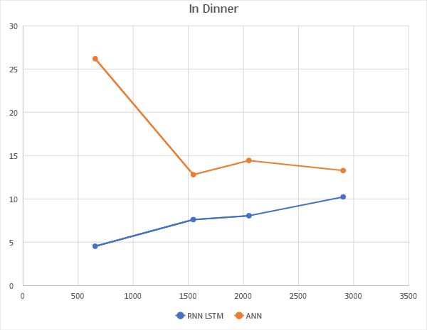
Result Analysis Cont.
Breakfast Error comparison between RNN & ANN
 |  | RNN LSTM | ANN
Dataset | Data | MSE(Epoch 100) | MSE
0-14 | 655 | 4.5369 | 26.19357392
0-31 | 1545 | 7.6176 | 12.80214388
0-46 | 2050 | 8.0656 | 14.44231148
0-64 | 2905 | 10.24 | 13.27945396
Table: Dinner Error comparison between RNN & ANN
Figure: Dinner Comparison

Slide 29
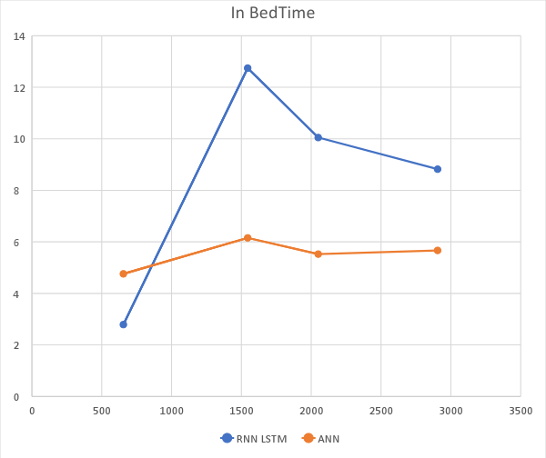
Result Analysis Cont.
Bedtime Error comparison between RNN & ANN
 |  | RNN LSTM | ANN
Dataset | Data | MSE (Epoch 100) | MSE
0-14 | 655 | 2.7889 | 4.758682193
0-31 | 1545 | 12.7449 | 6.154442058
0-46 | 2050 | 10.0489 | 5.524987688
0-64 | 2905 | 8.8209 | 5.667004256
Table: Bedtime Error comparison between RNN & ANN
Figure: Bedtime Comparison

Slide 30
Predictive Apriori
rules sorted according to: expected predicted accuracy
Predictive accuracy of a rule r:
support based correction of the confidence value
Inherent pruning strategy:
Output the best n rules according to:
Expected pred. accuracy among n best
Rule not subsumed by a rule with at least the same expected pred. accuracy
Prefer more general rule
Adaptations to mine class association rules:
Generate frequent item sets from all data (class attribute deleted) as rule body
Generate rule for each class label

Slide 31
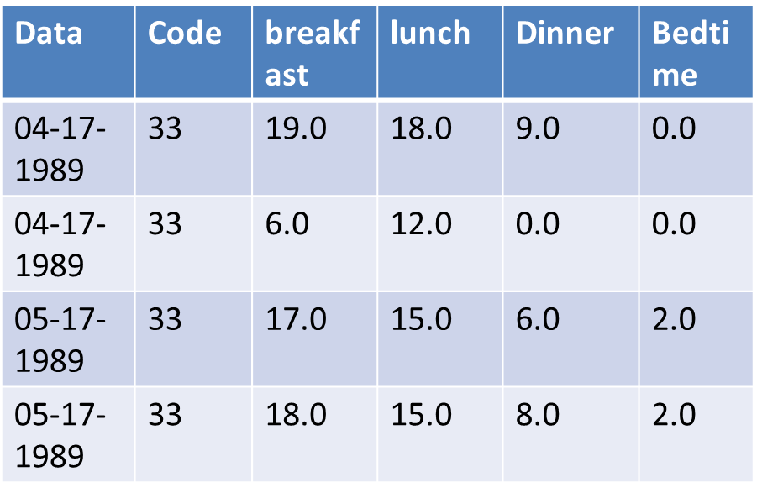
Data set for Apriori
Convert each numerical value as String.
Ex: Dinner=1=> Dinner=“oneD”
Eliminate which row has 50% zero
Donot work for numerical value
Donot get meaningful pattern
Data | Code | Breakfast | Lunch | Dinner | Bedtime
04-17-1989 | 33 | nineteenM | eighteenL | nineD | zeroB
04-17-19899 | 33 | sixM | twelveL | zeroD | zeroB
05-17-1989 | 33 | seventeenM | fifteenL | sixD | twoB
05-17-1989 | 33 | eighteenM | fifteenL | eightD | twoB
Eliminate

Slide 32
Result Analysis Cont.
Association rules using Predictive Apriori Accuracy
Here we show five best association rules:
1. Bedtime=twoB Breakfast=fiveM Lunch=threeL 67 ==> Dinner=sixD 67 acc:(0.99482)
2. Bedtime=sixB Breakfast=fiveM Dinner=sixD 16 ==> Lunch=threeL 16 acc:(0.992)
3. Bedtime=sixB Breakfast=fiveM Lunch=threeL 16 ==> Dinner=sixD 16 acc:(0.992)
4. Breakfast=tenM Lunch=sixteenL 7 ==> Dinner=twelveD 7 acc:(0.97711)
5. Bedtime=twoB Dinner=tenD Lunch=tenL 7 ==> Breakfast=tenM 7 acc:(0.97711)

Slide 33
Conclusion
We have described a machine learning approach of predicting insulin dose levels and presented the results of experiments. From the graphs we have shown the comparison between predicted data & data and it can be observed that results are very encouraging and reliable. In short we can say that if we train our system with more input data set, it generate more error free insulin prediction.

Slide 34
Future Work
Prediction for remaining Insulin Codes
Prediction using Beum Welch Algorithm
Comparison with Randomized Algorithm

