Slide 1
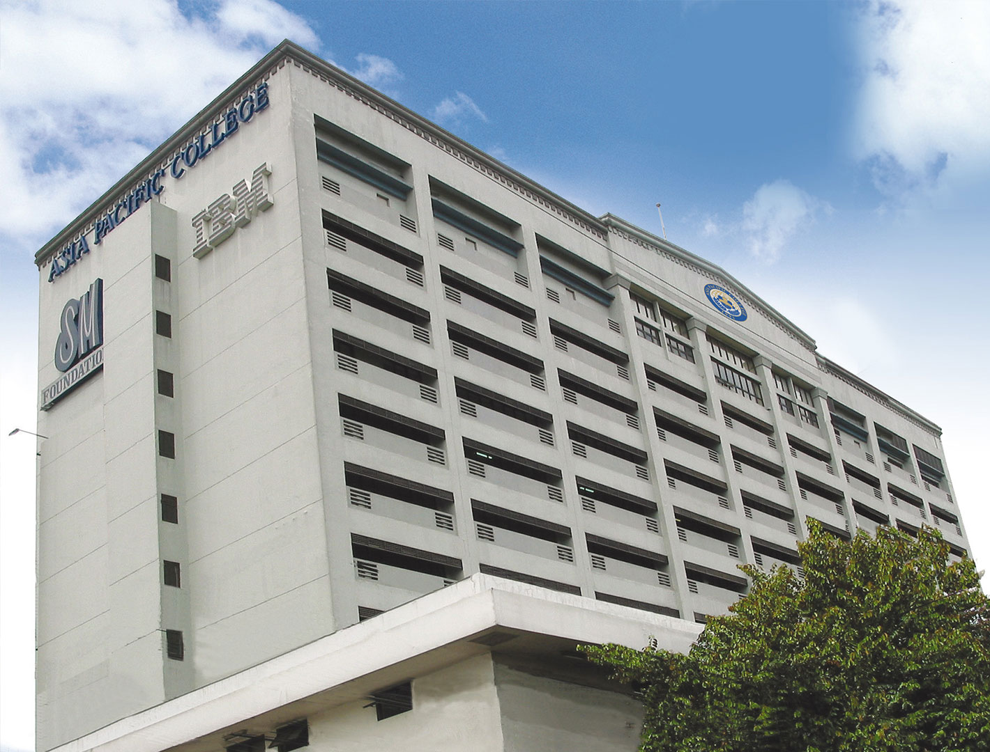
Needfinding
Dela Cruz, Brian & Realiza, Aaron Jay

Slide 2
What activity did you choose to examine?
Room Reservation in Asia Pacific College

Slide 3

How did you examine it, with what methods?
We examined it by observing them in the reception and by interviewing people who often reserves a room in APC.

Slide 4
What major insights or breakdowns did you discover?
Interviewee #1
No one will sign the reservation form when the adviser is not present.
It is frightening to make room reservation in the 4th floor reception.
Interviewee #2
The adviser already signed the reservation form and I just found out that the room is not already available.
There are conflicts regarding the reservations, I already reserved for a room but there is a class that time.

Slide 5
What promising unmet needs were identified as a result?
The purpose of reserving the room is not allowed.
Notes:
https://www.youtube.com/watch?v=KwGNmKTLnfE
https://www.youtube.com/watch?v=_nnSS8PyHSk

