Slide 1
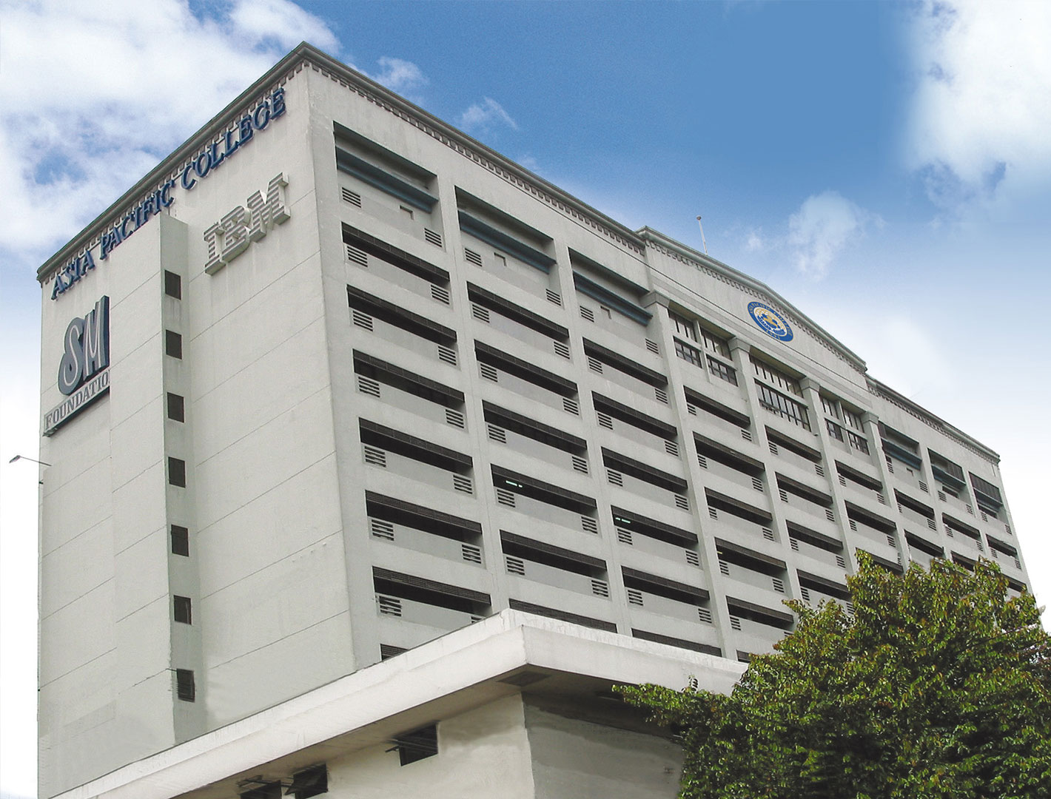
Needfinding
Dela Cruz, Brian & Realiza, Aaron Jay

Slide 2
What activity did you choose to examine?
Room Reservation in Asia Pacific College

Slide 3

How did you examine it, with what methods?
We examined it by observing them in the reception and by interviewing people who often reserves a room in APC.

Slide 4
What major insights or breakdowns did you discover?
No one will sign the reservation form when the adviser is not present.
It is frightening to make room reservation in the 4th floor reception.
The adviser already signed the reservation form and I just found out that the room is not already available.
There are conflicts regarding the reservations, I already reserved for a room but there is a class that time.

Slide 5
What promising unmet needs were identified as a result?
The purpose of reserving the room is not allowed.
Notes:
https://www.youtube.com/watch?v=KwGNmKTLnfE
https://www.youtube.com/watch?v=_nnSS8PyHSk

