Slide 1
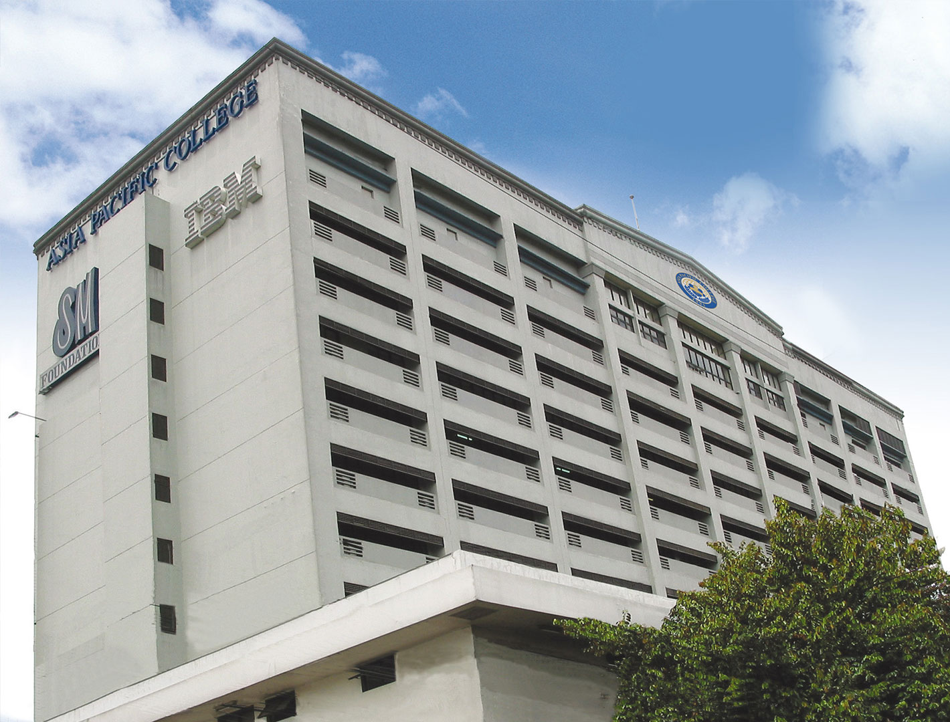
Needfinding
Dela Cruz, Brian & Realiza, Aaron Jay

Slide 2
What activity did you choose to examine?
Room Reservation in Asia Pacific College

Slide 3

How did you examine it, with what methods?
We examined it by observing them in the reception and by interviewing people who often reserves a room in APC.

Slide 4
How did you examine it, with what methods?
Based from our observations we discussed about how we can improve the process of reserving a room in Asia Pacific College by identifying the user needs.

Slide 5
What major insights or breakdowns did you discover?
Interviewee #1
No one will sign the reservation form when the adviser is not present.
It is frightening to make room reservation in the 4th floor reception.
Interviewee #2
The adviser already signed the reservation form and I just found out that the room is not already available.
There are conflicts regarding the reservations, I already reserved for a room but there is a class that time.

Slide 6
What promising unmet needs were identified as a result?
The purpose of reserving the room is not allowed.
Notes:
https://www.youtube.com/watch?v=KwGNmKTLnfE
https://www.youtube.com/watch?v=_nnSS8PyHSk

Slide 7
Identified Needs
Students need a way to make the reservation form signed or approved by the adviser even when the adviser is not around the campus.
Students reserving a room needs another way of reserving a room aside from communicating with the receptionist personally.
Students should be properly informed of the available and occupied schedule of the rooms.
Accuracy of room schedules because I noticed that there is an overlap between schedules that is why there is a class on a reserved room by the student.
Students need an efficient way of having an approval from their adviser.
Faculties need a time efficient way of making a reservation of rooms.

Slide 8
Interviews
What are your struggles, hardships, or problems regarding room reservation in Asia Pacific College?
Interviewee # 1
No one will sign the reservation form when the adviser is not present.
It is frightening to make room reservation in the 4th floor reception.

Slide 9
Interviews
What are your struggles, hardships, or problems regarding room reservation in Asia Pacific College?
Interviewee # 2
The adviser already signed the reservation form and I just found out that the room is not already available.
There are conflicts regarding the reservations, I already reserved for a room but there is a class that time.

Slide 10
Point of View
Students need endorsement from their adviser when reserving a room, but they don’t have to find their adviser just for an approval
Students needs an alternative way of reserving a room that should not be frightening.
Students needs an access to the available and occupied room for easier reservation
Students needs a concrete and unchanging confirmation and reservation of rooms.
Students need endorsement from their adviser when reserving a room, but they don't have to go back and forth through the floors.
Faculties needs an alternative way of reserving a room for time efficiency.

