Slide 1


Databases
Levente Erős – eros@db.bme.hu
Ruba AlMahasneh - mahasnehr@tmit.bme.hu

Slide 2
Databases
Databases
Laboratory
Lectures
Practice
Janos Varga
Team of instructors
Levente Erős
Entry test (Material for labs) https://www.db.bme.hu/databases/
Exercise (24H)
Marked out 5 each-fecske
Exams
Attendance 70%

Slide 3
1 Test
Labs 5 Marks (averaged)
If you participate the practices
Then you have the signature
Then you can sit for the Final exam
https://www.db.bme.hu/databases/

Slide 4
What is a Database
A Database: is a structured collection of knowledge on a subset of the real world, typically stored electronically in a computer system. A database is usually controlled by a database management system (DBMS).
Database management system (DBMS) is an important type of programming system, used today on the biggest and the smallest computers. DBMS allows us to access and control the data, find relationships, patterns ..etc
1. Storing data in a structured way
2. Providing means for accessing data

Slide 5
Which of these are considered Databases, explain?
Data accessed through the internet
Word documents
Shopping list
Phone book
Excel sheet
Can you think of other examples?
How does the structuredness of the data affect accessing and extracting information from the database? What about the tools’ complexity (sophistication level) ?

Slide 6
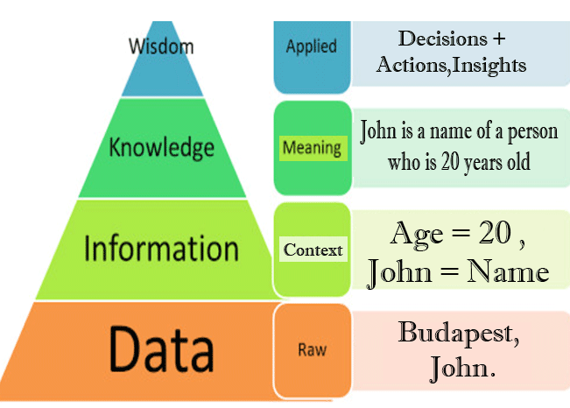
Data VS Information VS Knowledge
Data <> information
Data : does not have semantic or meaning yet [can be meaningless], 20, John, Budapest.
Information: has idea behind it [processed data]. If we added context to it. Age = 20 , John = name, current location = Budapest
Knowledge: John is a name of a person who is 20 years old. [pieces of information related to each other => Row of a table]
We search for knowledge via DBMS. Finding relations between pieces of information that represent the real world.
What other knowledge we can extract from this context?

Slide 7
DBMS's capabilities
a) Support for at least one data model, or mathematical abstraction through which the user can view the data.
b) Support for certain high-level languages that allow the user to define the structure of data, access data, and manipulate data.
c) Transaction management, the capability to provide correct, concurrent access to the database by many users at once.
d) Access control, the ability to limit access to data by unauthorized users, and the ability to check the validity of data.
e) Resiliency, the ability to recover from system failures without losing data.

Slide 8
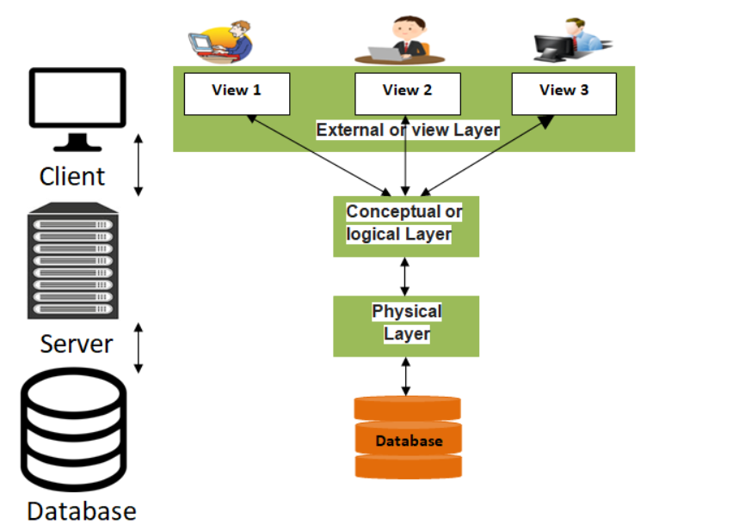
Database Architecture

Slide 9
Database Architecture
External Data Model: This is highest level architecture and closest to the user. The user doesn’t need to know the database schema details such as data structure, table definition etc.
Logical Data Model: The purpose is to develop technical map of rules and data structures.→ ER modeling [Relational Data Models, Relations ,Tables ,Queries]
Physical Data Model: Data blocks, data files, indices for searching. responsible for allocating space of the data
Why it is important to have those separate layers?
What if some damage happened to the hard drive and I had to replace it do I lose all the information I have on the other layers?

Slide 10
Why are Models Used?
What is modeling? To model/map a subset of our world in which we want to store data.
Subset of the world, why is that beneficial ?
Simplify (less detailed, manageable)
Two of the modeling techniques are the ER (entity–relationship) modeling and Relational Data Modeling.
Data model is mathematical formalism with two parts:
Describe the data and the connections /relationships between the data elements
Define operations on data elements: Accessibility of information through that model (query,add,update..etc)
Note: MetaModel (Rules for creating a model)

Slide 11
The Entity-Relationship (ER) Model
Description of the conceptual without the attention to efficiency or physical database design (segregation of duties).
Real database systems are built depending on relational model (server as blueprints).
Obtaining the conceptual scheme that offers the most efficiency can be quite difficult but ER models can facilitate this process. There are numerous good enough solutions but it’s the engineers/architecture preference.

Slide 12
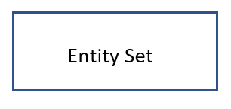
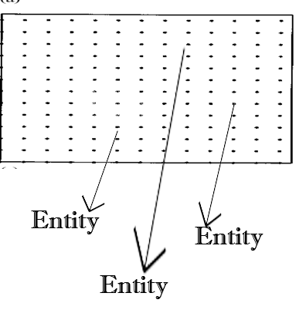
Entities
Entity: a thing (physical or logical) that exists and is distinguishable from others (by distinctive features, properties = attributes)
For example : each person is an entity. Each automobile is an entity. An ant is an entity if we had a way to distinguish one from another (say paint little numbers on their backs). We are interested in the data about entities We store it in the database.
Share the same Kind/Type of attributes

Slide 13
Entity Sets/Types
A group consisting of all "similar" entities forms an entity set.
Examples of entity sets are (all persons, all red-haired persons, all automobiles)
Do all attributes have the same values?
Example: The Hungarian’s Department of Motor Vehicles may design its database scheme to have an entity set AUTOMOBILES. This includes all the automobiles presently registered in Hungary, not all automobiles in the world.
Other examples you can think of ?

Slide 14

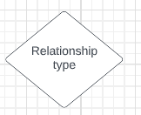
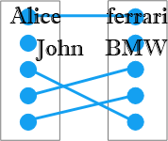
Relationship Sets/Types
Diamonds represent the relationship sets defined among two or more entity sets. There are two Types of relationship sets (identifying/determining relationship and relationship).
A relationship set among entity sets is an ordered list of entity sets.

Slide 15
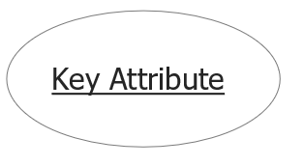
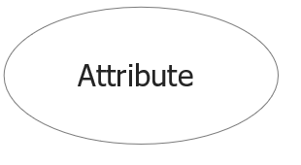
Attributes and Keys
Each entity set has a set of attribute types associated with it.
Each entity set must have a distinguishable key. Why?
Entity sets have properties called attribute types. Each entity in the set is associated with a value from a domain of values for that attribute.
Domain for an attribute usually a set of integers, real numbers, or character strings etc.
An attribute set (or set of attributes) whose values uniquely identify each entity in an entity set is called a key for that entity set.

Slide 16
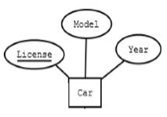
Attributes and Keys
In the figure. How many entity sets do we have ? What are their attribute types?
Do all cars have the same license plate (values)?
Question: What are possible attribute types of the entity set PERSONS ? What is each attribute set’s possible domain?

Slide 17
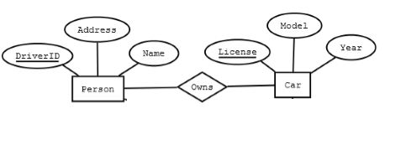
Entity-Relationship Diagram-ERD Elements-Chen Notation
Rectangles represent entity sets.
Circles represent attributes. They are linked to their entity sets by (undirected) edges. Sometimes, attributes that are part of the key for their entity set will be underlined.
Diamonds represent relationship sets. They are
linked to their constituent entity sets by edges,
which can be undirected edges or directed edges.

Slide 18
Relationship set’s Cardinality-Chen Notation
A relationship set where two entity sets are participating is called a binary relationship type
Each relationship instance connects exactly two entities by a label (semantic).
Cardinalities of binary relationship sets represents the maximum number of entities of an entity set A that can be assigned by the relationship set (type) to a single entity of the other entity set B.
Why we used Binary? Is there other relationship types you can think?

Slide 19
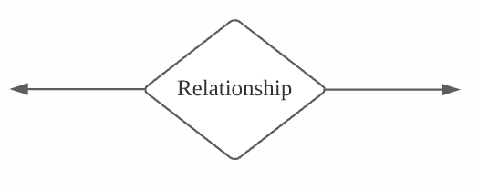
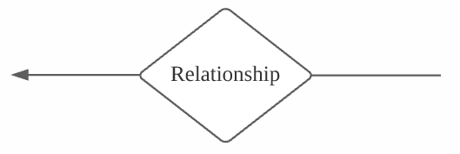
Relationship Set Cardinalities -Chen Notation
One-to-One (1:1) relationship set: Each entity of both sets can be connected to at most one entity of each other.
One-to-Many (1: N) relationship set: Each entity of the second entity set can be connected to at most one entity of the first entity set. Each entity of the first entity set can be connected to an arbitrary number of entities of the second entity set can be connected to at most one entity of each other.

Slide 20
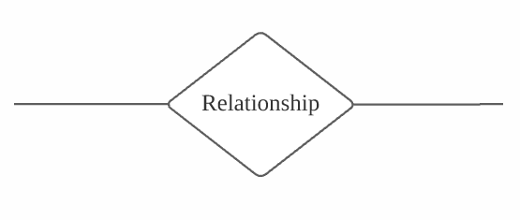
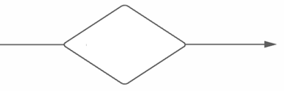
Relationship Set Cardinalities-Chen Notation
Many-to-Many (M: N) relationship set: Each entity of both entity sets can be connected to an arbitrary number of entities of each the other entity set.
Ex: There are two parents for each child, and a given individual may have any number of children.
Many-to-One (M: 1) relationship set: one entity in entity set E2 is associated with zero or more entities in entity set E1, but each entity in entity set E1 is associated with at most one entity in entity set E2.

Slide 21
Quiz
Suppose we have an entity set PERSONS and PARENT OF relationship set
What is the possible relationship?
What are the entity sets?

Slide 22
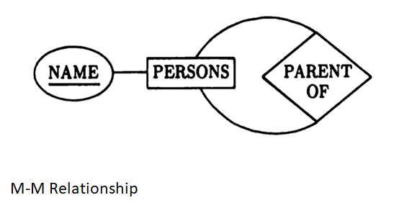
Question: Apply this concept on relationship of enrolment between courses and students.

Slide 23
Example
Suppose we want to represent the relationship between Person(s) and his Car(s)
Draw the ER diagram ?
Define the attributes for Persons ?
Define the attributes for Cars?
What other entity sets you might think of that are related to this Diagram?

Slide 24
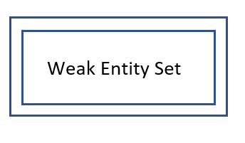
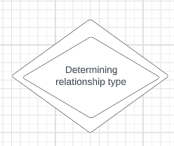

Extended ER Modeling
Weak entity set
“Strong” Entity set
Determining relationship type
Specialization (Isa Hierarchies) - specialized entity sets

Slide 25
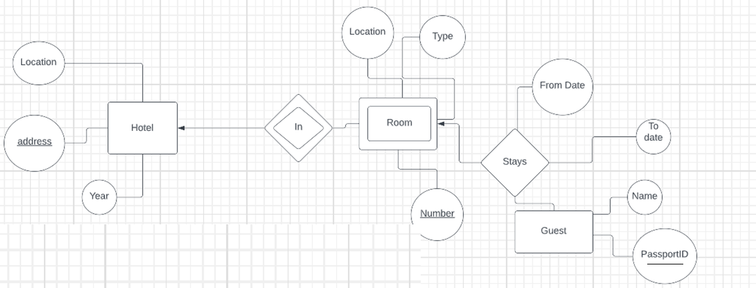
Example-Weak Entity Set

Slide 26
Example-Weak Entity Set
In the previous example what are the key attribute sets for the weak entity ? (Rooms)
Can the Room# by itself serve as key attribute set? Why?
What do we call those key attribute sets that the weak entity set borrow from the strong entity set?
What do we call the relationship set (that has double border line diamond shape) that connects the weak entity set with the strong entity set?

Slide 27
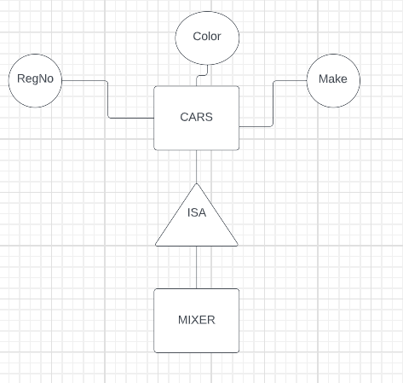
Isa Hierarchies (Specialization)
A isa B, read "A is a B" if entity set B is a generalization of entity set A, or equivalently, A is a special kind of B.

Slide 28
Borrowed Key Attribute Sets
Example: A corporation might well have an entity set EMPLOYEES, with attributes such as ID_NO, NAME, and SALARY. If this corporation was a baseball team, some employees are the players, would have other important attributes, like BATTING-AVG or HOME-RUNS, BUT the other employees would not have. How can we design the entity sets (for PLAYERS and EMPLOYEES)?
what is the Key attribute ( that will uniquely identify any player) of the Entity Set PLAYERS?
Does this entity set have its own key or it borrows it from EMPLOYEES Entity set? Explain?

Slide 29
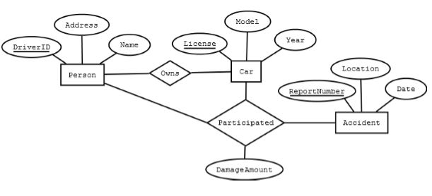
Arity- Relationship Sets Degree

Slide 30
Brain teaser
Why ER looked at as a half-data model?

Slide 31
Example-Enhance this ER Model?
What are the Entity sets in the diagram ?
What is the relationship set between DEPTS and MANAGERS?
What is the relationship set between DEPTS and EMPS?
Name each Entity Set’s Key attribute.

Slide 32
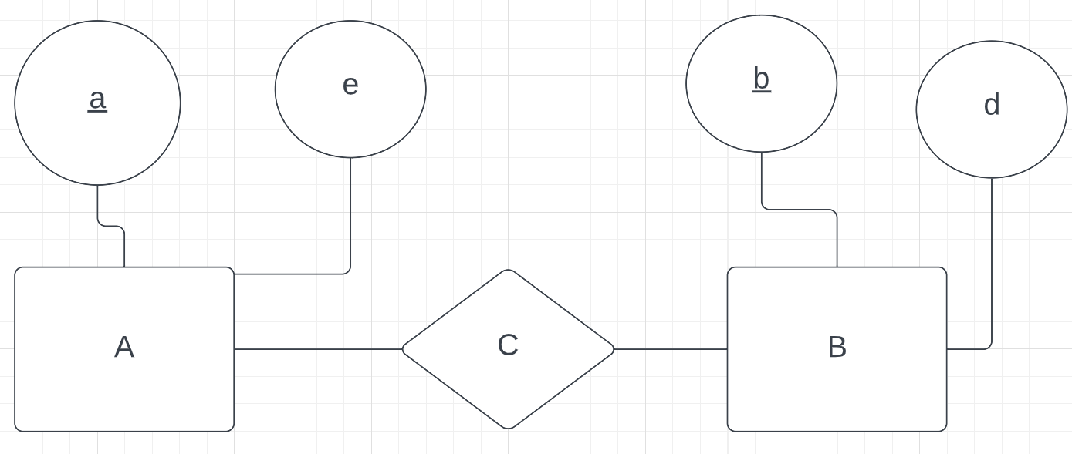
Transcribing Relationship types
Relationship instances are identified by the connected entities
A weak entity set is identified by its key (if any) and the key(s) of the determining connected entity sets.

Slide 33
Thank You
Levente Erős – eros@db.bme.hu
Ruba AlMahasneh - mahasnehr@tmit.bme.hu

