Slide 1
Indexing structures
Erős Levente, 2024

Slide 2
Sparse Index, structure
Key+pointer (k, p) pairs in index file
Key is the lowest search key attribute value of the pointed data block
1 index entry per data block
data file ordered on block level
Index record / index entry containing search key attribute value and pointer
Index block
1 | 7 | 10 | 17 | 21 | 40 | … | …
 |  |  |  |  |  | … | …
Index file
pointer
Data file
17 |  | 18 | 1 | 3 | 6 | 7 | 8 | 9 | 25 | 21 | 30 | 15 | 11 | 10 | 40 | 41 | 42
Data block
Data record (only search key attribute value is displayed here while whole record, i.e. all attribute values are stored in reality)

Slide 3
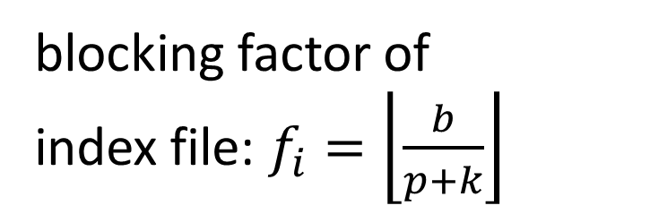
Sparse Index, structure
blocking factor of index file: $f_{i}=\left\lfloor \frac{b}{p+k}\right\rfloor$
Index record / index entry containing search key attribute value and pointer
Index block
1 | 7 | 10 | 17 | 21 | 40 | … | …
 |  |  |  |  |  | … | …
Index file
pointer
Data file
17 |  | 18 | 1 | 3 | 6 | 7 | 8 | 9 | 25 | 21 | 30 | 15 | 11 | 10 | 40 | 41 | 42
Data block
Data record (only search key attribute value is displayed here while whole record, i.e. all attribute values are stored in reality)

Slide 4
Sparse Index, search
Only blocks are shown
index file
data file

Slide 5
Sparse Index, search
Only blocks are shown

Slide 6
Sparse Index, search
Only blocks are shown

Slide 7
Sparse Index, search
Only blocks are shown

Slide 8
Sparse Index, search
Only blocks are shown

Slide 9
Sparse Index, search
Only blocks are shown

Slide 10

Sparse Index, search
Only blocks are shown
Binary search + 1 block read from the data file
$\left\lceil \log_{2}\left(b_{i}+1\right)\right\rceil +1$

Slide 11
Sparse Index, Insert
Search+insert into appropriate block
Case 1: Inserting 19
1 | 7 | 10 | 17 | 21 | 40 | … | …
 |  |  |  |  |  | … | …
17 |  | 18 | 1 | 3 | 6 | 7 | 8 | 9 | 25 | 21 | 30 | 15 | 11 | 10 | 40 | 41 | 42

Slide 12
Sparse Index, Insert
Search+insert into appropriate block
Case 1: Inserting 19
1 | 7 | 10 | 17 | 21 | 40 | … | …
 |  |  |  |  |  | … | …
17 | 19 | 18 | 1 | 3 | 6 | 7 | 8 | 9 | 25 | 21 | 30 | 15 | 11 | 10 | 40 | 41 | 42

Slide 13
Sparse Index, Insert
Search+insert into appropriate block
Case 2: Inserting 20 – destination block is the same, but has no space
1 | 7 | 10 | 17 | 21 | 40 | … | …
 |  |  |  |  |  | … | …
17 | 19 | 18 | 1 | 3 | 6 | 7 | 8 | 9 | 25 | 21 | 30 | 15 | 11 | 10 | 40 | 41 | 42

Slide 14
Sparse Index, Insert
Search+insert into appropriate block
Case 2: Inserting 20 – splitting data block, splitting index block if needed
1 | 7 | 10 | 17 | 21 | 40 | … | …
 |  |  |  |  |  | … | …
17 | 18 |  | 1 | 3 | 6 | 7 | 8 | 9 | 25 | 21 | 30 | 15 | 11 | 10 | 40 | 41 | 42 | 19

Slide 15
Sparse Index, Insert
Search+insert into appropriate block
Case 2: Inserting 20 – splitting data block, splitting index block if needed
1 | 7 | 10 | 17 | 21 | 40 | … | …
 |  |  |  |  |  | … | …
17 | 18 |  | 1 | 3 | 6 | 7 | 8 | 9 | 25 | 21 | 30 | 15 | 11 | 10 | 40 | 41 | 42 | 19 | 20

Slide 16
Sparse Index, Insert
Search+insert into appropriate block
Case 2: Inserting 20
1 | 7 | 10 |  | 17 | 19 |  |  | 21 | 40 | … | …
 |  |  |  |  |  |  |  |  |  | … | …
17 | 18 |  | 1 | 3 | 6 | 7 | 8 | 9 | 25 | 21 | 30 | 15 | 11 | 10 | 40 | 41 | 42 | 19 | 20

Slide 17
B* tree, structure
Sparse indices built on each other
sparse index on topmost level has 1 block – root of the tree
Index blocks contain keys and pointers
the pointer to the left of key K points to a subtree each element of which is <K
the pointer to the right of key K points to a subtree each element of which is >=K
the number of pointers in a block may be by 1 greater than the number of keys
for interval search, lowest level tree blocks can be linked by pointers
 | 17 |  | ---
 | 7 |  | 10
 | 21 |  | 40
17 |  | 18 | 1 | 3 | 6 | 7 | 8 | 9 | 25 | 21 | 30 | 15 | 11 | 10 | 40 | 41 | 42

Slide 18
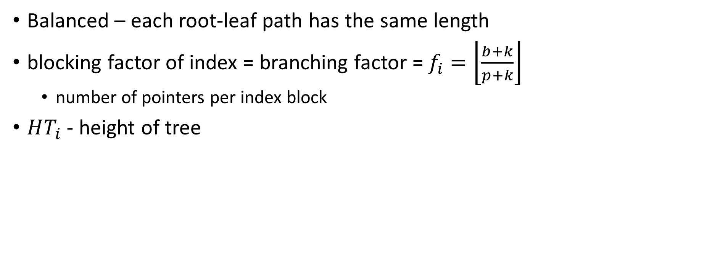
B* tree, structure
Balanced – each root-leaf path has the same length
blocking factor of index = branching factor = $f_{i}=\left\lfloor \frac{b+k}{p+k}\right\rfloor$
number of pointers per index block
$HT_{i}$ - height of tree
 | 17 |  | ---
 | 7 |  | 10
 | 21 |  | 40
17 |  | 18 | 1 | 3 | 6 | 7 | 8 | 9 | 25 | 21 | 30 | 15 | 11 | 10 | 40 | 41 | 42

Slide 19
B* tree, search
Searching for 18
 | 17 |  | ---
 | 7 |  | 10
 | 21 |  | 40
17 |  | 18 | 1 | 3 | 6 | 7 | 8 | 9 | 25 | 21 | 30 | 15 | 11 | 10 | 40 | 41 | 42

Slide 20
B* tree, search
Searching for 18
 | 17 |  | ---
 | 7 |  | 10
 | 21 |  | 40
17 |  | 18 | 1 | 3 | 6 | 7 | 8 | 9 | 25 | 21 | 30 | 15 | 11 | 10 | 40 | 41 | 42

Slide 21

B* tree, search
Searching for 18
with each index block read, all pointers are discarded, but a single one
search space is shrunk to its $f_{i}$th , only the $f_{i}$th portion of the index (and the data file) is considered from the next search step on
$\left\lceil \log_{f_{i}}\left(b_{i}+1\right)\right\rceil +1=$ $HT_{i}$
 | 17 |  | ---
 | 7 |  | 10
 | 21 |  | 40
17 |  | 18 | 1 | 3 | 6 | 7 | 8 | 9 | 25 | 21 | 30 | 15 | 11 | 10 | 40 | 41 | 42

Slide 22
B* tree, search
B* tree
data file

Slide 23
B* tree, search
B* tree
data file

Slide 24
B* tree, search
B* tree
data file

Slide 25
B* tree, search
B* tree
data file

Slide 26
B* tree, search
B* tree
data file

Slide 27
B* tree, search
B* tree
data file

Slide 28
B* tree, search
B* tree
data file

Slide 29
B* tree, search
B* tree
data file

Slide 30
B* tree, search
B* tree
data file

Slide 31
B* tree, insert
Search+insert into appropriate block
Case 1: Inserting 19
 | 17 |  | ---
 | 7 |  | 10
 | 21 |  | 40
17 |  | 18 | 1 | 3 | 6 | 7 | 8 | 9 | 25 | 21 | 30 | 15 | 11 | 10 | 40 | 41 | 42

Slide 32
B* tree, insert
Search+insert into appropriate block
Case 1: Inserting 19
 | 17 |  | ---
 | 7 |  | 10
 | 21 |  | 40
17 |  | 18 | 1 | 3 | 6 | 7 | 8 | 9 | 25 | 21 | 30 | 15 | 11 | 10 | 40 | 41 | 42

Slide 33
B* tree, insert
Search+insert into appropriate block
Case 1: Inserting 19
 | 17 |  | ---
 | 7 |  | 10
 | 21 |  | 40
17 |  | 18 | 1 | 3 | 6 | 7 | 8 | 9 | 25 | 21 | 30 | 15 | 11 | 10 | 40 | 41 | 42

Slide 34
B* tree, insert
Search+insert into appropriate block
Case 1: Inserting 19
 | 17 |  | ---
 | 7 |  | 10
 | 21 |  | 40
17 | 19 | 18 | 1 | 3 | 6 | 7 | 8 | 9 | 25 | 21 | 30 | 15 | 11 | 10 | 40 | 41 | 42

Slide 35
B* tree, insert
Search+insert into appropriate block
Case 2: Inserting 43 – block is full, block shall be split
can lead to splitting index blocks
can lead to splitting root block → new root, +1 layer
 | 17 |  | ---
 | 7 |  | 10
 | 21 |  | 40
17 | 19 | 18 | 1 | 3 | 6 | 7 | 8 | 9 | 25 | 21 | 30 | 15 | 11 | 10 | 40 | 41 | 42

Slide 36
B* tree, insert
Search+insert into appropriate block
Case 2: Inserting 43 – block is full, block shall be split
can lead to splitting index blocks
can lead to splitting root block → new root, +1 layer (not in this case)
 | 17 |  | ---
 | 7 |  | 10
 | 21 |  | 40
17 | 19 | 18 | 1 | 3 | 6 | 7 | 8 | 9 | 25 | 21 | 30 | 15 | 11 | 10 | 40 | 41 |  | 42 | 43

Slide 37
B* tree, insert
Search+insert into appropriate block
Case 2: Inserting 43 – block is full, block shall be split
can lead to splitting index blocks
can lead to splitting root block → new root, +1 layer (not in this case)
 | 17 |  | 40
 | 7 |  | 10
 | 21 |  | ---
 | 42 |  | ---
17 | 19 | 18 | 1 | 3 | 6 | 7 | 8 | 9 | 25 | 21 | 30 | 15 | 11 | 10 | 40 | 41 |  | 42 | 43

Slide 38
Dense Index, structure
Key+pointer (k, p) pairs in index file
Key is the search key attribute value of the pointed data record (block including the given record is pointed to physically)
1 index entry per data record
data file unordered
not a standalone structure – sparse index / B* tree on top
Sparse index
Dense index file
1 | 3 | 4 | 5 | 6 | 7 | 8 | 9 | 10 | 11 | 12 | 13 | 14 | 15 | 16 | 17
Data file
13 | 5 | 12 | 4 | 11 | 14 | 1 | 15 | 3 | 10 | 6 |  | 16 | 17 | 7 | 8 | 9

Slide 39
Dense Index, structure
blocking factor of index file: $f_{i}=\left\lfloor \frac{b}{p+k}\right\rfloor$
Sparse index
Dense index file
1 | 3 | 4 | 5 | 6 | 7 | 8 | 9 | 10 | 11 | 12 | 13 | 14 | 15 | 16 | 17
Data file
13 | 5 | 12 | 4 | 11 | 14 | 1 | 15 | 3 | 10 | 6 |  | 16 | 17 | 7 | 8 | 9

Slide 40
Dense Index, search
Searching sparse index / B* tree +1 block read from dense index +1 block read from data file
Sparse index
Dense index file
1 | 3 | 4 | 5 | 6 | 7 | 8 | 9 | 10 | 11 | 12 | 13 | 14 | 15 | 16 | 17
Data file
13 | 5 | 12 | 4 | 11 | 14 | 1 | 15 | 3 | 10 | 6 |  | 16 | 17 | 7 | 8 | 9

Slide 41
Dense Index, insert
Insert anywhere in the data file
create new index entry in the ordered dense index file (if needed, split records, and modify sparse index / B* tree too)
Sparse index
Dense index file
1 | 3 | 4 | 5 | 6 | 7 | 8 | 9 | 10 | 11 | 12 | 13 | 14 | 15 | 16 | 17
Data file
13 | 5 | 12 | 4 | 11 | 14 | 1 | 15 | 3 | 10 | 6 |  | 16 | 17 | 7 | 8 | 9

Slide 42
Inverted files
What if we would like to search based on multiple search keys (one at a time)?
for example: search by name OR search by phone number
Sparse index 1
Sparse index 2
Dense index 1
Dense index 2
Data file

