Slide 1
optimization of relational queries
Dr. Gajdos Sándor – Dr. Erős Levente
November 2014 – October 2024
BME–TMIT

Slide 2
GOAL
Execute a SQL query on a physically stored database
Get an overview of query processing possibilities
Expect methods that a query optimizer can cooks from
Don’t expect precise guidelines of how to implement _the_ _perfect_ _optimizer_
Don’t get lost in the details, just try to grasp the concepts

Slide 3
contents
Overview of optimization process
Catalog cost estimation
Optimization approaches
Cost based optimization
Heuristic optimization

Slide 4
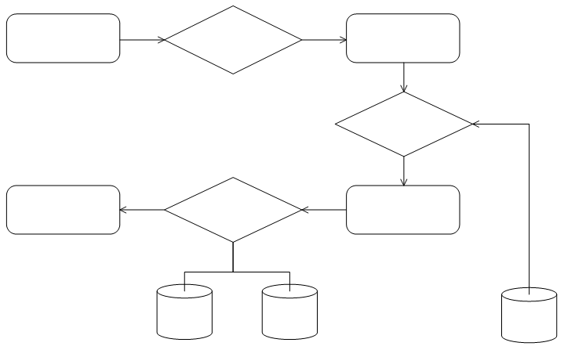
Overview OF QUERY PROCESSING
query
interpreter and compiler
relational algebra expression
optimizer
query output
evaluator engine
execution plan
statistics about data
data

Slide 5
Steps OF QUERY PROCESSING
(Syntactical) analysis, compilation
Does it make sense?
Input: SQL statement
Result: relational algebra expression
Cost optimization (main part)
Evaluation

Slide 6
Catalog based cost estimation
The following statistical data is stored in the so-called catalog
Catalog data about relations
Catalog data about indexes
Query cost
Cost is estimated based on catalog data.

Slide 7

Catalog data about relations
$n_{r}$: number of records in relation $r$
$b_{r}$: number of blocks storing the records of relation $r$
$s_{r}$: size of a record
$f_{r}$: how many records fit in a data block

Slide 8
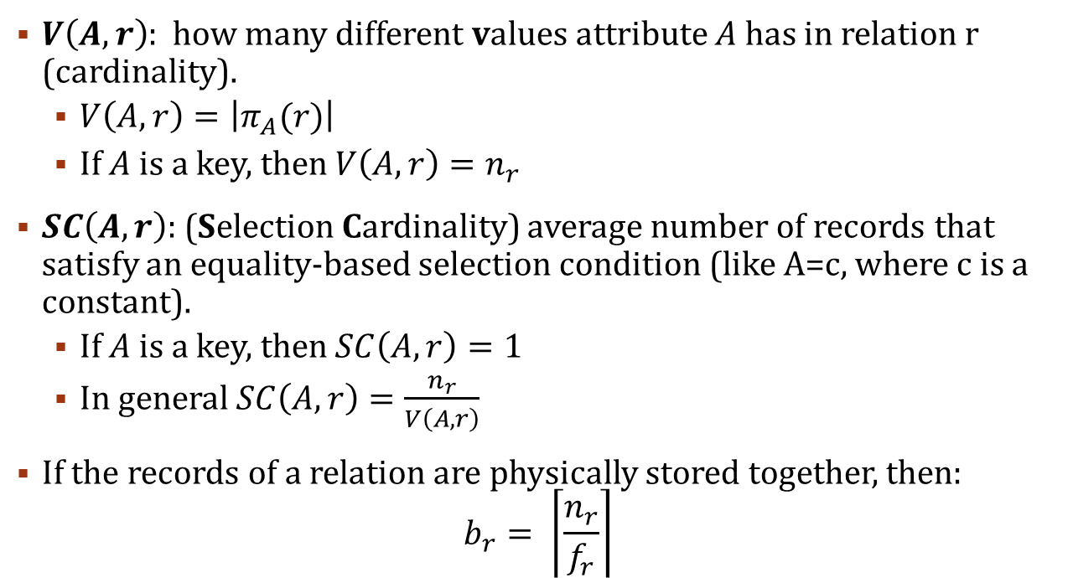
Catalog data about relations
$V\left(A,r\right)$: how many different values attribute $A$ has in relation r (cardinality).
$V\left(A,r\right)=\left|π_{A}(r)\right|$
If $A$ is a key, then $V\left(A,r\right)=n_{r}$
$SC\left(A,r\right)$: (Selection Cardinality) average number of records that satisfy an equality-based selection condition (like A=c, where c is a constant).
If $A$ is a key, then $SC\left(A,r\right)=1$
In general $SC\left(A,r\right)=\frac{n_{r}}{V\left(A,r\right)}$
If the records of a relation are physically stored together, then:
$$b_{r}= \left\lceil \frac{n_{r}}{f_{r}}\right\rceil$$

Slide 9
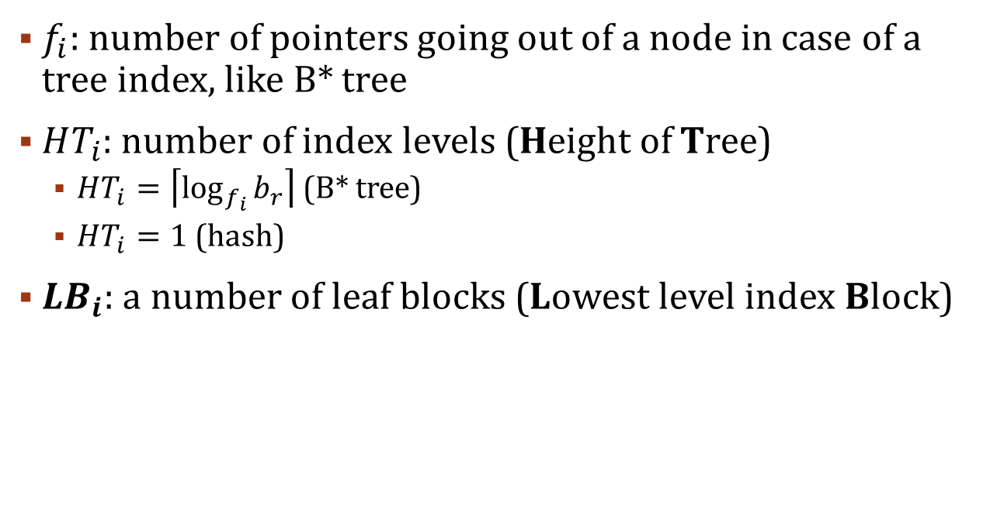
Catalog data about indexes
$f_{i}$: number of pointers going out of a node in case of a tree index, like B* tree
$HT_{i}$: number of index levels (Height of Tree)
$HT_{i}=\left\lceil \log_{f_{i}}{b_{r}}\right\rceil$ (B* tree)
$HT_{i}=1$ (hash)
$LB_{i}$: a number of leaf blocks (Lowest level index Block)

Slide 10
Cost of query
Definition:
Number of block reading and writing operations from the disc (without writing out the result).
Takes the most time by far – good metric
By orders of magnitude more costly then performing operations in the RAM, etc.

Slide 11
Cost of operations – outline
Selection
Selection algorithms (basic, indexed, comparison based)
complex selection
Join
Types
Size estimation
Join algorithms
Other
Filtering repetitions
Union, intersection, subtraction

Slide 12
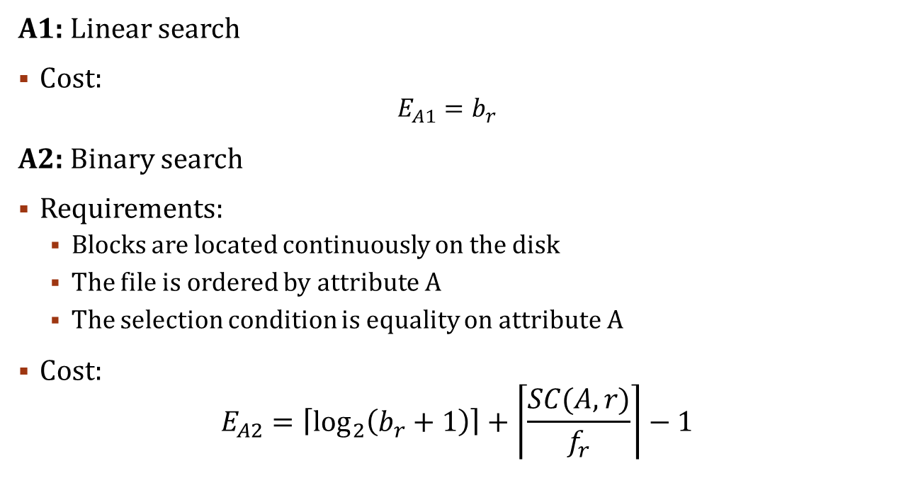
Basic selection algorithms (=)
A1: Linear search
Cost:
$$E_{A1}=b_{r}$$
A2: Binary search
Requirements:
Blocks are located continuously on the disk
The file is ordered by attribute A
The selection condition is equality on attribute A
Cost:
$$E_{A2}=\left\lceil \log_{2}\left(b_{r}+1\right)\right\rceil +\left\lceil \frac{SC(A,r)}{f_{r}}\right\rceil −1$$
finding first block further blocks

Slide 13
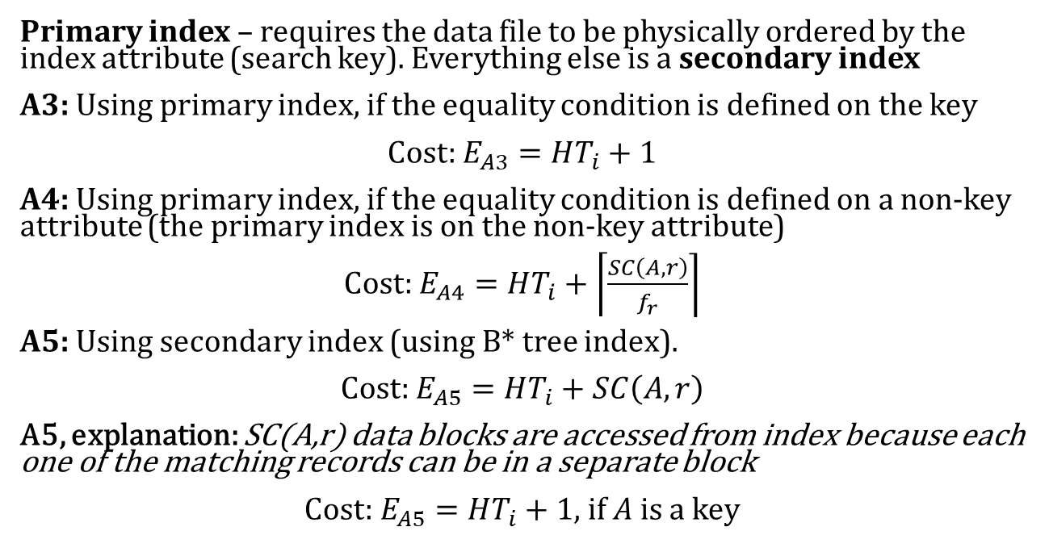
Indexed search algorithms
Primary index – requires the data file to be physically ordered by the index attribute (search key). Everything else is a secondary index
A3: Using primary index, if the equality condition is defined on the key
Cost: $E_{A3}=HT_{i}+1$
A4: Using primary index, if the equality condition is defined on a non-key attribute (the primary index is on the non-key attribute)
Cost: $E_{A4}=HT_{i}+\left\lceil \frac{SC\left(A,r\right)}{f_{r}}\right\rceil$
A5: Using secondary index (using B* tree index).
Cost: $E_{A5}=HT_{i}+SC\left(A,r\right)$
A5, explanation: SC(A,r) data blocks are accessed from index because each one of the matching records can be in a separate block
$\text{Cost}\text{:} E_{A5}=HT_{i}+1$, if $A$ is a key

Slide 14
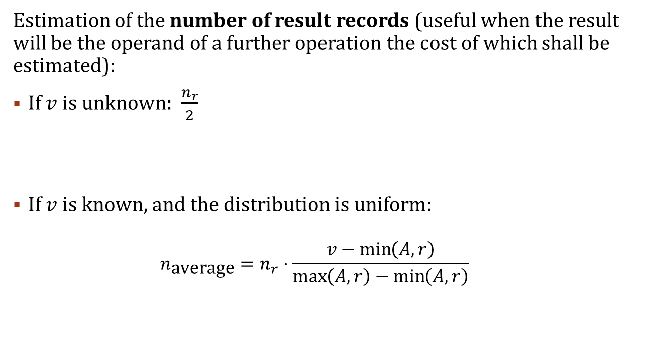
Comparison based selection – σ_{A ≤ v}(r)
Estimation of the number of result records (useful when the result will be the operand of a further operation the cost of which shall be estimated):
If $v$ is unknown: $\frac{n_{r}}{2}$
If $v$ is known, and the distribution is uniform:
$$n_{\text{average}}=n_{r}⋅\frac{v−\min\left(A,r\right)}{\max\left(A, r\right)−\min\left(A,r\right)}$$

Slide 15
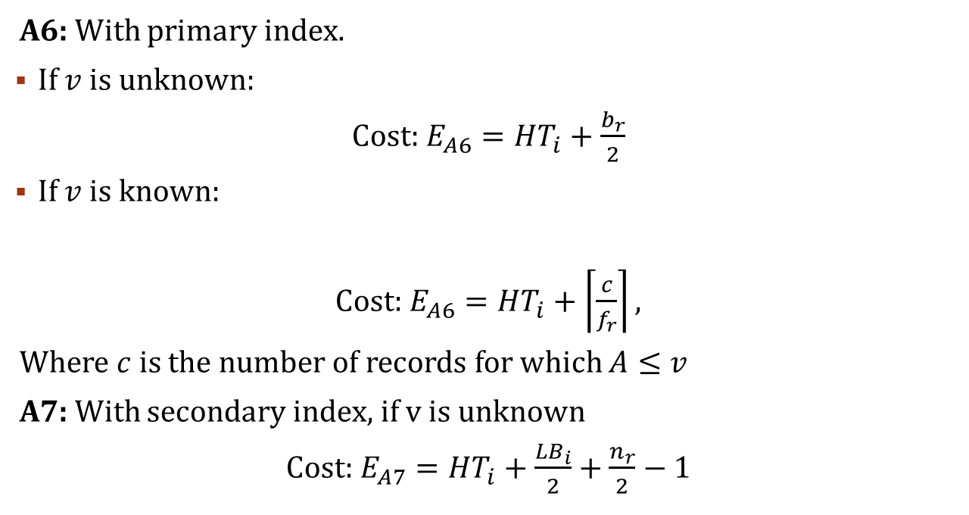
Comparison based selection – σ_{A ≤ v}(r)
A6: With primary index.
If $v$ is unknown:
Cost: $E_{A6}=HT_{i}+\frac{b_{r}}{2}$
If $v$ is known:
Cost: $E_{A6}=HT_{i}+\left\lceil \frac{c}{f_{r}}\right\rceil ,$
Where $c$ is the number of records for which $A≤v$
A7: With secondary index, if v is unknown
Cost: $E_{A7}=HT_{i}+\frac{LB_{i}}{2}+\frac{n_{r}}{2}−1$

Slide 16
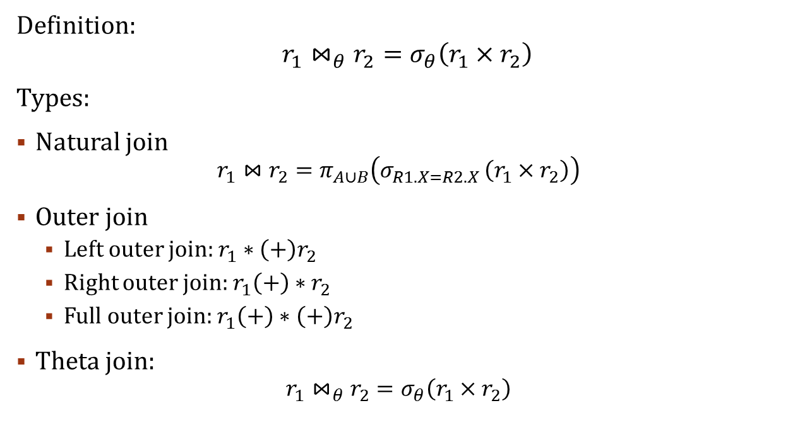
Join operation
Definition:
$$r_{1}⋈_{θ}r_{2}=σ_{θ}\left(r_{1}×r_{2}\right)$$
Types:
Natural join
$$r_{1}⋈r_{2}=π_{A∪B}\left(σ_{R1.X=R2.X }\left(r_{1}×r_{2}\right)\right)$$
Outer join
Left outer join: $r_{1}∗{\left(+\right)r}_{2}$
Right outer join: $r_{1}\left(+\right)∗r_{2}$
Full outer join: $r_{1}\left(+\right)∗{\left(+\right)r}_{2}$
Theta join:
$$r_{1}⋈_{θ}r_{2}=σ_{θ}\left(r_{1}×r_{2}\right)$$

Slide 17
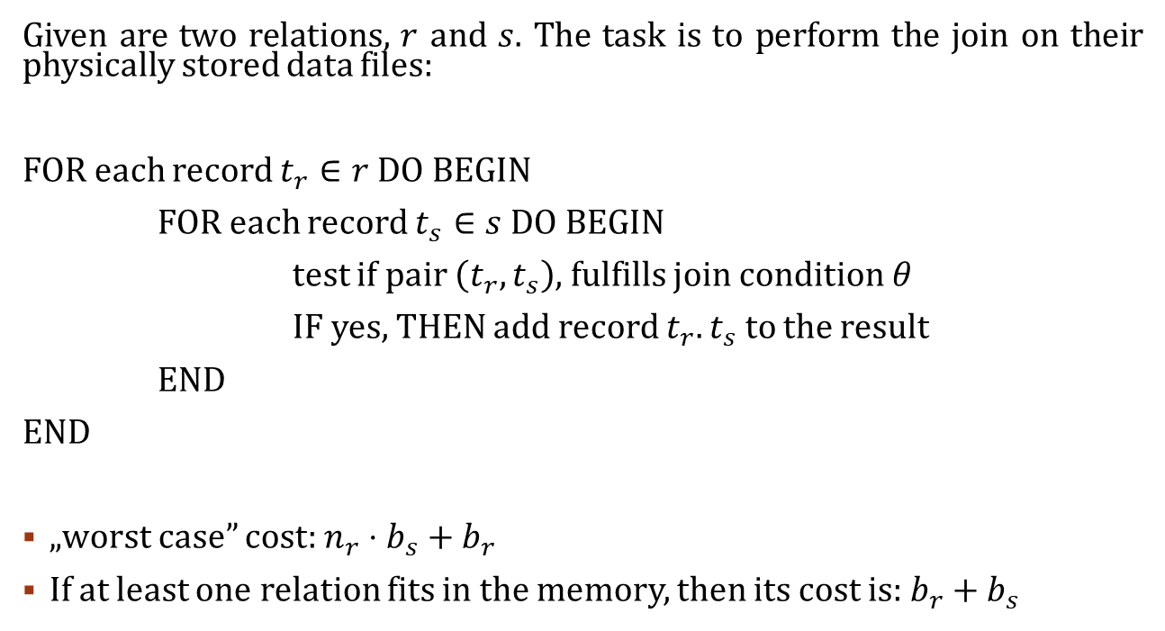
Join operation: Nested loop join
Given are two relations, $r$ and $s$. The task is to perform the join on their physically stored data files:
FOR each record $t_{r}∈r$ DO BEGIN
FOR each record $t_{s}∈s$ DO BEGIN
test if pair $\left(t_{r},t_{s}\right)$, fulfills join condition $θ$
IF yes, THEN add record $t_{r}.t_{s}$ to the result
END
END
„worst case” cost: $n_{r}⋅b_{s}+b_{r}$
If at least one relation fits in the memory, then its cost is: $b_{r}+b_{s}$

Slide 18
Join operation: Nested loop join
block in RAM
1 record
1 record
1 record
1 record
...
1 block
1 block
1 block
r
s

Slide 19
Join operation: Nested loop join
record being compared
1 record
1 record
1 record
1 record
...
1 block
1 block
1 block
r
s

Slide 20
Join operation: Nested loop join
r
s

Slide 21
Join operation: Nested loop join
r
s

Slide 22
Join operation: Nested loop join
r
s

Slide 23
Join operation: Nested loop join
r
s

Slide 24
Join operation: Nested loop join
r
s

Slide 25
Join operation: Nested loop join
r
s

Slide 26
Join operation: Nested loop join
r
s

Slide 27
Join operation: Nested loop join
r
s

Slide 28
Join operation: Nested loop join
r
s

Slide 29
Join operation: Nested loop join
r
s

Slide 30
Join operation: Nested loop join
r
s

Slide 31
Join operation: Nested loop join
r
s

Slide 32
Join operation: Nested loop join
r
s

Slide 33
Join operation: Nested loop join
r
s

Slide 34
Join operation: Nested loop join
r
s

Slide 35
Join operation: Nested loop join
r
s

Slide 36
Join operation: Nested loop join
r
s

Slide 37
Join operation: Nested loop join
r
s

Slide 38
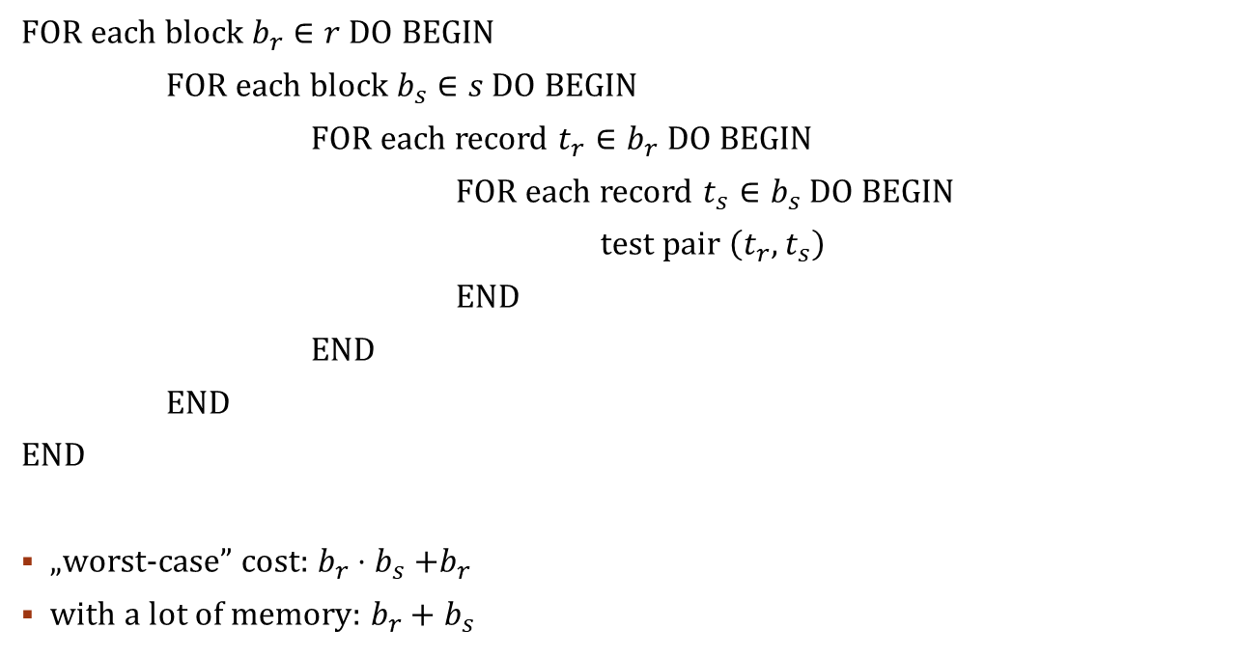
Join operation: Block nested loop join
FOR each block $b_{r}∈r$ DO BEGIN
FOR each block $b_{s}∈s$ DO BEGIN
FOR each record $t_{r}∈b_{r}$ DO BEGIN
FOR each record $t_{s}∈b_{s}$ DO BEGIN
test pair $\left(t_{r},t_{s}\right)$
END
END
END
END
„worst-case” cost: $b_{r}{⋅b}_{s}+b_{r}$
with a lot of memory: $b_{r}+b_{s}$

Slide 39
Join operation: BLOCK Nested loop join
r
s

Slide 40
Join operation: BLOCK Nested loop join
r
s

Slide 41
Join operation: BLOCK Nested loop join
r
s

Slide 42
Join operation: BLOCK Nested loop join
r
s

Slide 43
Join operation: BLOCK Nested loop join
r
s

Slide 44
Join operation: BLOCK Nested loop join
r
s

Slide 45
Join operation: BLOCK Nested loop join
r
s

Slide 46
Join operation: BLOCK Nested loop join
r
s

Slide 47
Join operation: BLOCK Nested loop join
r
s

Slide 48
Join operation: BLOCK Nested loop join
r
s

Slide 49
Join operation: BLOCK Nested loop join
r
s

Slide 50
Join operation: BLOCK Nested loop join
r
s

Slide 51
Join operation: BLOCK Nested loop join
r
s

Slide 52
Join operation: BLOCK Nested loop join
r
s

Slide 53
Join operation: BLOCK Nested loop join
r
s

Slide 54
Join operation: BLOCK Nested loop join
r
s

Slide 55
Join operation: BLOCK Nested loop join
r
s

Slide 56
Join operation: BLOCK Nested loop join
r
s

Slide 57
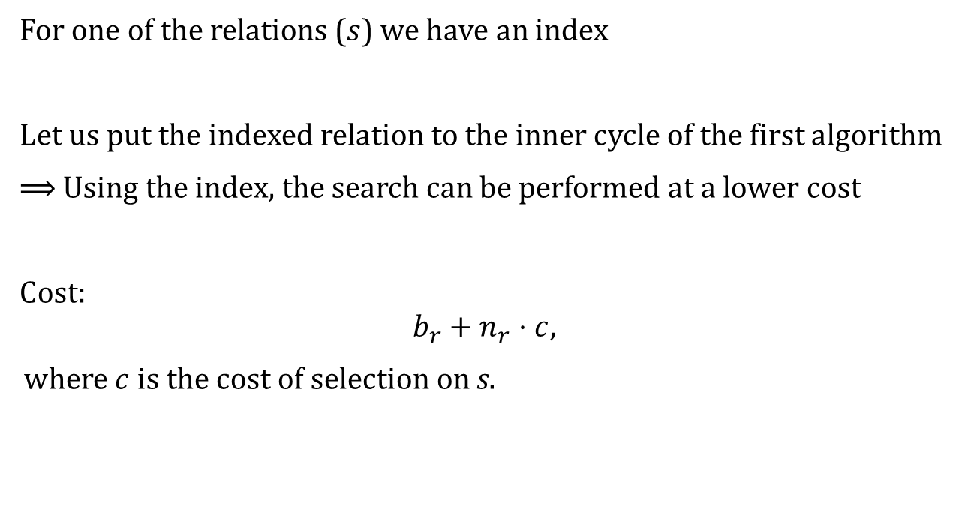
Join operation: indexed nested loop join
For one of the relations ($s$) we have an index
Let us put the indexed relation to the inner cycle of the first algorithm
⟹ Using the index, the search can be performed at a lower cost
Cost:
$$b_{r}+n_{r}⋅c,$$ where $c$ is the cost of selection on s.

Slide 58
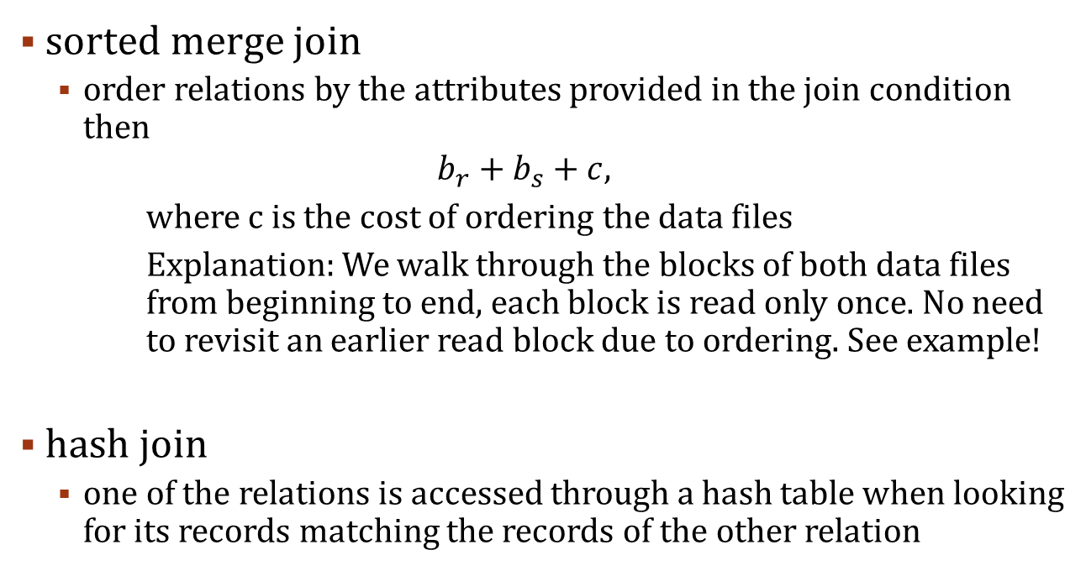
FUrther join implementations
sorted merge join
order relations by the attributes provided in the join condition then
$$b_{r}+b_{s}+c,$$
where c is the cost of ordering the data files
Explanation: We walk through the blocks of both data files from beginning to end, each block is read only once. No need to revisit an earlier read block due to ordering. See example!
hash join
one of the relations is accessed through a hash table when looking for its records matching the records of the other relation

Slide 59
Join operation: sorted merge join
matching
record
1
2
3
4
5
6
7
8
9
1
1
1
1
7
9
9
9
9
r
s

Slide 60
Join operation: sorted merge join
1
2
3
4
5
6
7
8
9
1
1
1
1
7
9
9
9
9
r
s

Slide 61
Join operation: sorted merge join
1
2
3
4
5
6
7
8
9
1
1
1
1
7
9
9
9
9
r
s

Slide 62
Join operation: sorted merge join
1
2
3
4
5
6
7
8
9
1
1
1
1
7
9
9
9
9
r
s

Slide 63
Join operation: sorted merge join
1
2
3
4
5
6
7
8
9
1
1
1
1
7
9
9
9
9
r
s

Slide 64
Join operation: sorted merge join
1
2
3
4
5
6
7
8
9
1
1
1
1
7
9
9
9
9
r
s

Slide 65
Join operation: sorted merge join
1
2
3
4
5
6
7
8
9
1
1
1
1
7
9
9
9
9
r
s

Slide 66
Join operation: sorted merge join
1
2
3
4
5
6
7
8
9
1
1
1
1
7
9
9
9
9
r
s

Slide 67
Join operation: sorted merge join
1
2
3
4
5
6
7
8
9
1
1
1
1
7
9
9
9
9
r
s

Slide 68
Join operation: sorted merge join
1
2
3
4
5
6
7
8
9
1
1
1
1
7
9
9
9
9
r
s

Slide 69
Join operation: sorted merge join
1
2
3
4
5
6
7
8
9
1
1
1
1
7
9
9
9
9
r
s

Slide 70
Further operations
Filtering repetitions (ordering, and then deleting)
Projection (projection, then filtering repetitions)
Union (ordering of both relations, and filtering duplications during merge)
Intersection (ordering both relations, then leaving only the repetitions during merge)
Subtraction (ordering both relations, and then during merge, we only leave those elements in the result set, which are only present in the first relation)

Slide 71
Methods for evaluating expressions
Materialization
Evaluating a single operation of a complex expression at a time
Pipelining
Multiple operations are evaluated in parallel
The result of an opeartion is immediately transferred to the input of the next operation

Slide 72
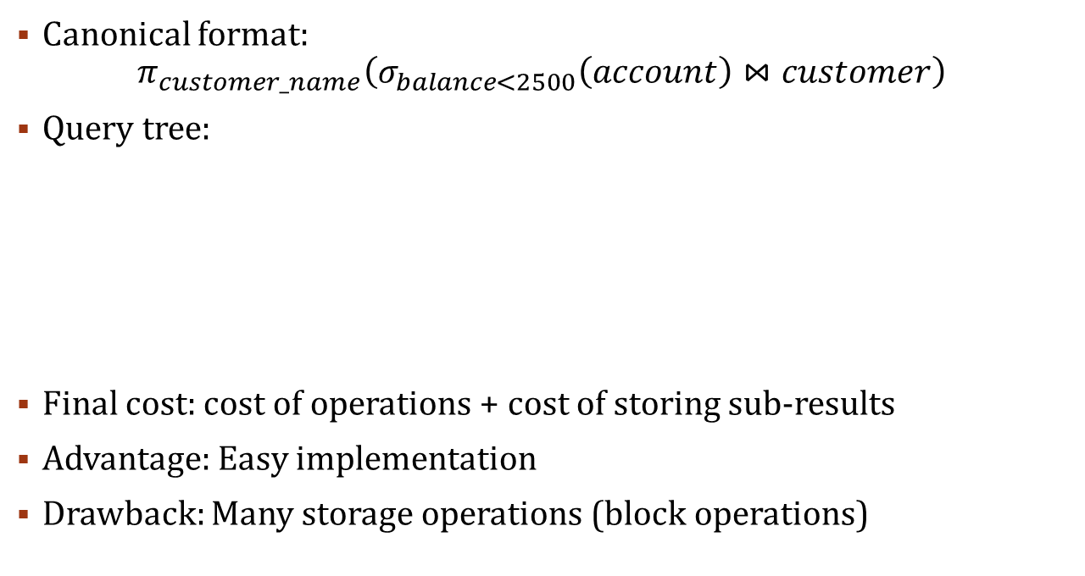
Methods for evaluating expressions: materialization
Canonical format:
$$π_{customer_name}\left(σ_{balance<2500}\left(account\right)⋈customer\right)$$
Query tree:
Final cost: cost of operations + cost of storing sub-results
Advantage: Easy implementation
Drawback: Many storage operations (block operations)

Slide 73
Methods for evaluating expressions: Pipelining
Parallel evaluation
Operations create sub-results for the following operation, based on the sub-results of the preceding operation
Does not calculate the whole relation (sub-result) at a time
Advantage:
No temporary storage needed
Low memory requirement
Drawback:
Narrows down the algorithms that can be used

Slide 74
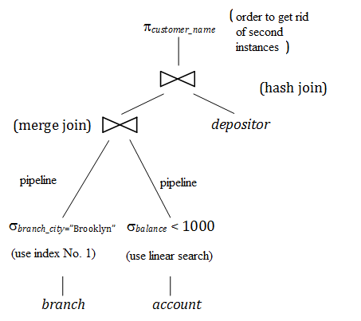
Choosing the execution plan
Many execution plans are possible for the same result
Execution plan includes:
Which operations are performed?
In what order?
By which algorithm?
By which workflow?
One exact execution plan:

Slide 75
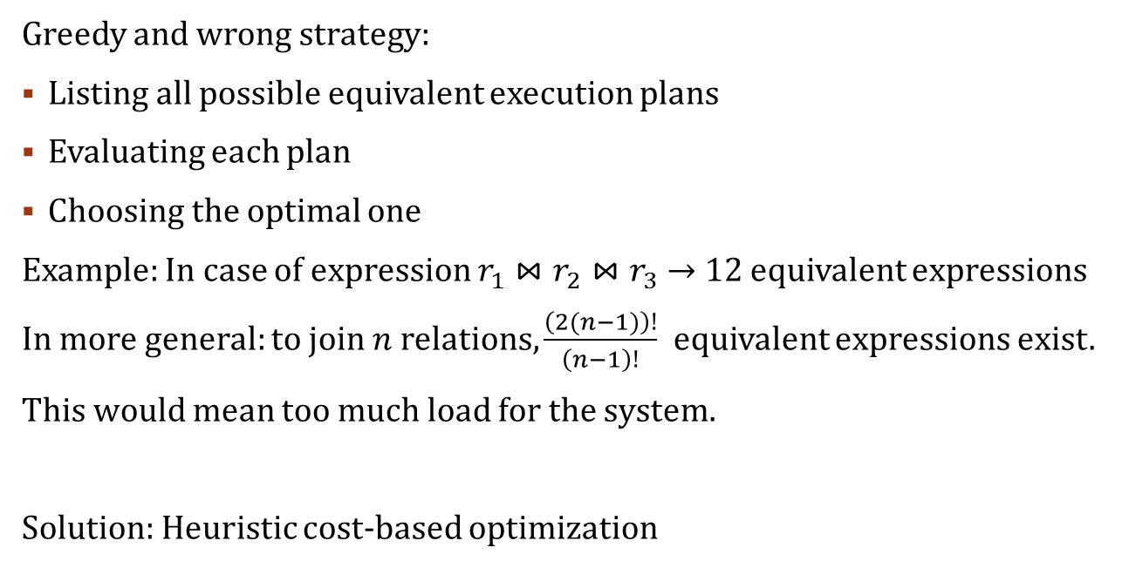
CHOOSING THE EXECUTION PLAN: cost-based optimization
Greedy and wrong strategy:
Listing all possible equivalent execution plans
Evaluating each plan
Choosing the optimal one
Example: In case of expression $r_{1}⋈r_{2}⋈r_{3}→$ 12 equivalent expressions
In more general: to join $n$ relations, $\frac{\left(2(n−1)\right)!}{\left(n−1\right)!}$ equivalent expressions exist.
This would mean too much load for the system.
Solution: Heuristic cost-based optimization

Slide 76
CHOOSING THE EXECUTION PLAN: heuristic, rule based optimization
Manipulating the query tree
Example:
EMPLOYEE (EMPLOYEE_ID, LAST_NAME, FIRST_NAME, BIRTH_DATE, …)
PROJECT (PROJECT_ID, PNAME, …)
WORKS_ON (PROJECT_ID, EMPLOYEE_ID)
select last_name from employee, works_on, project where employee.birth_date > '1957.12.31' and works_on.project_id = project.project_id and works_on.employee_id = employee.employee_id and project.pname = 'Aquarius'

Slide 77


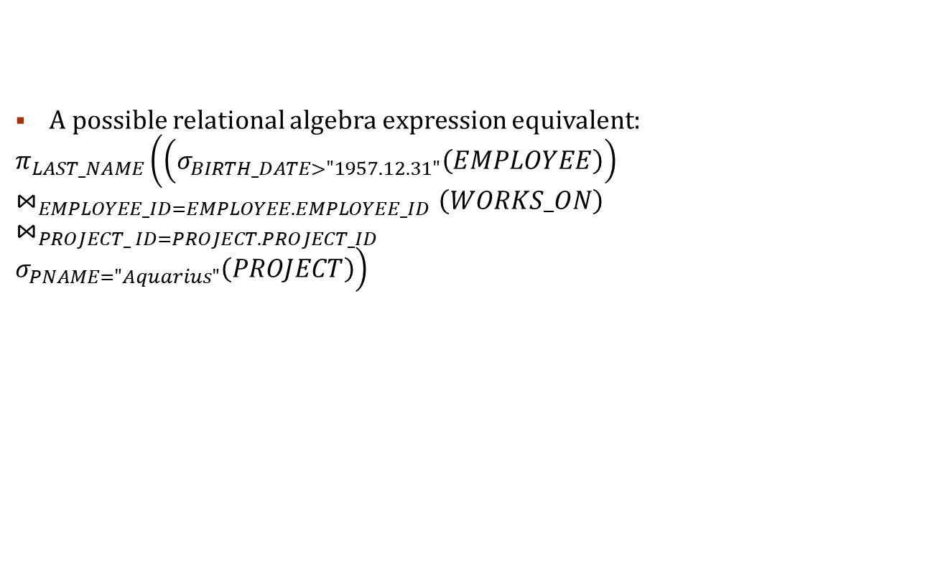



CHOOSING THE EXECUTION PLAN: heuristic, rule based optimization
$$π_{LAST_NAME}$$
A possible relational algebra expression equivalent:
$$π_{LAST_NAME}\left(\left(σ_{BIRTH_DATE>"1957.12.31"}\left(EMPLOYEE\right)\right)\right.$$
$$⋈_{EMPLOYEE_ID=EMPLOYEE.EMPLOYEE_ID}\left(WORKS_ON\right)$$
$$⋈_{PROJECT_ ID=PROJECT.PROJECT_ID }$$
$$\left.σ_{PNAME="Aquarius"}\left(PROJECT\right)\right)$$
$$⋈_{PROJECT_ ID=PROJECT.PROJECT_ID }$$
$$⋈_{EMPLOYEE_ID=EMPLOYEE.EMPLOYEE_ID}$$
$$σ_{PNAME="Aquarius"}$$
$$σ_{BIRTH_DATE>"1957.12.31"}$$
WORKS_ON
PROJECT
EMPLOYEE

Slide 78


CHOOSING THE EXECUTION PLAN: heuristic, rule based optimization
Goal: choosing the quickest equivalent
Step 1: canonical format (Cartesian, selection, projection)
$$π_{LAST_NAME}$$
$$σ_{PNAME = "Aquarius" ∧ PROJECT_ID = PROJECT.PROJECT_ID ∧ EMPLOYEE_ID = EMPLOYEE.EMPLOYEE_ID ∧ BIRTH_DATE > "1957.12.31" }$$
$$×$$
$$×$$
PROJECT
EMPLOYEE
WORKS_ON

Slide 79






CHOOSING THE EXECUTION PLAN: heuristic, rule based optimization
$$π_{LAST_NAME}$$
Step 2: sinking selections
$$σ_{PROJECT_ ID=PROJECT.PROJECT_ID }$$
$$×$$
$$σ_{EMPLOYEE_ID=EMPLOYEE.EMPLOYEE_ID}$$
$$σ_{PNAME="Aquarius"}$$
$$×$$
PROJECT
$$σ_{BIRTH_DATE>"1957.12.31"}$$
WORKS_ON
EMPLOYEE

Slide 80




CHOOSING THE EXECUTION PLAN: heuristic, rule based optimization
$$π_{LAST_NAME}$$
Step 3: rearranging leaves
$$σ_{EMPLOYEE_ID=EMPLOYEE.EMPLOYEE_ID}$$
$$×$$
$$σ_{PROJECT_ ID=PROJECT.PROJECT_ID }$$
$$σ_{BIRTH_DATE>"1957.12.31"}$$
$$×$$
EMPLOYEE
$$σ_{PNAME="Aquarius"}$$
WORKS_ON
PROJECT

Slide 81



CHOOSING THE EXECUTION PLAN: heuristic, rule based optimization
$$π_{LAST_NAME}$$
Step 4: join
$$⋈_{EMPLOYEE_ID=EMPLOYEE.EMPLOYEE_ID}$$
$$⋈_{PROJECT_ ID=PROJECT.PROJECT_ID }$$
$$σ_{BIRTH_DATE>"1957.12.31"}$$
$$σ_{PNAME="Aquarius"}$$
WORKS_ON
EMPLOYEE
PROJECT

Slide 82







CHOOSING THE EXECUTION PLAN: heuristic, rule based optimization
$$π_{LAST_NAME}$$
Step 5: sinking projections
$$⋈_{EMPLOYEE_ID=EMPLOYEE.EMPLOYEE_ID}$$
$$π_{EMPLOYEE_ID}$$
$$π_{EMPLOYEE_ID, LAST_NAME}$$
$$⋈_{PROJECT_ ID=PROJECT.PROJECT_ID }$$
$$σ_{BIRTH_DATE>"1957.12.31"}$$
$$π_{PROJECT_ID}$$
$$π_{PROJECT_ID, EMPLOYEE_ID}$$
EMPLOYEE
$$σ_{PNAME="Aquarius"}$$
WORKS_ON
PROJECT

Slide 83
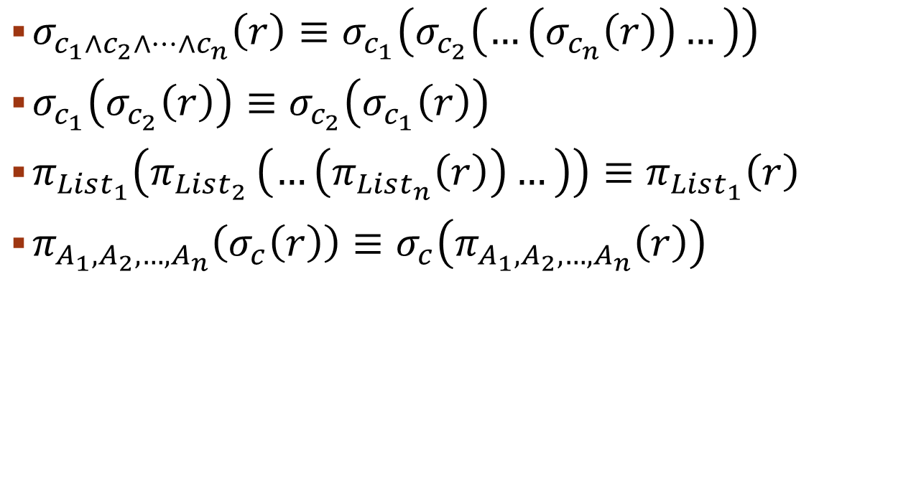
When are two trees equivalent? Relational algebra transformations I.
$σ_{c_{1}∧c_{2}∧…∧c_{n}}\left(r\right)≡σ_{c_{1}}\left(σ_{c_{2}}\left(…\left(σ_{c_{n}}\left(r\right)\right)…\right)\right)$
$σ_{c_{1}}\left(σ_{c_{2}}\left(r\right)\right)≡σ_{c_{2}}\left(σ_{c_{1}}\left(r\right)\right)$
$π_{List_{1}}\left(π_{List_{2} }\left(…\left(π_{List_{n}}\left(r\right)\right)…\right)\right)≡π_{List_{1}}\left(r\right)$
$π_{A_{1},A_{2},…,A_{n}}\left(σ_{c}\left(r\right)\right)≡σ_{c}\left(π_{A_{1},A_{2},…,A_{n}}\left(r\right)\right)$

Slide 84
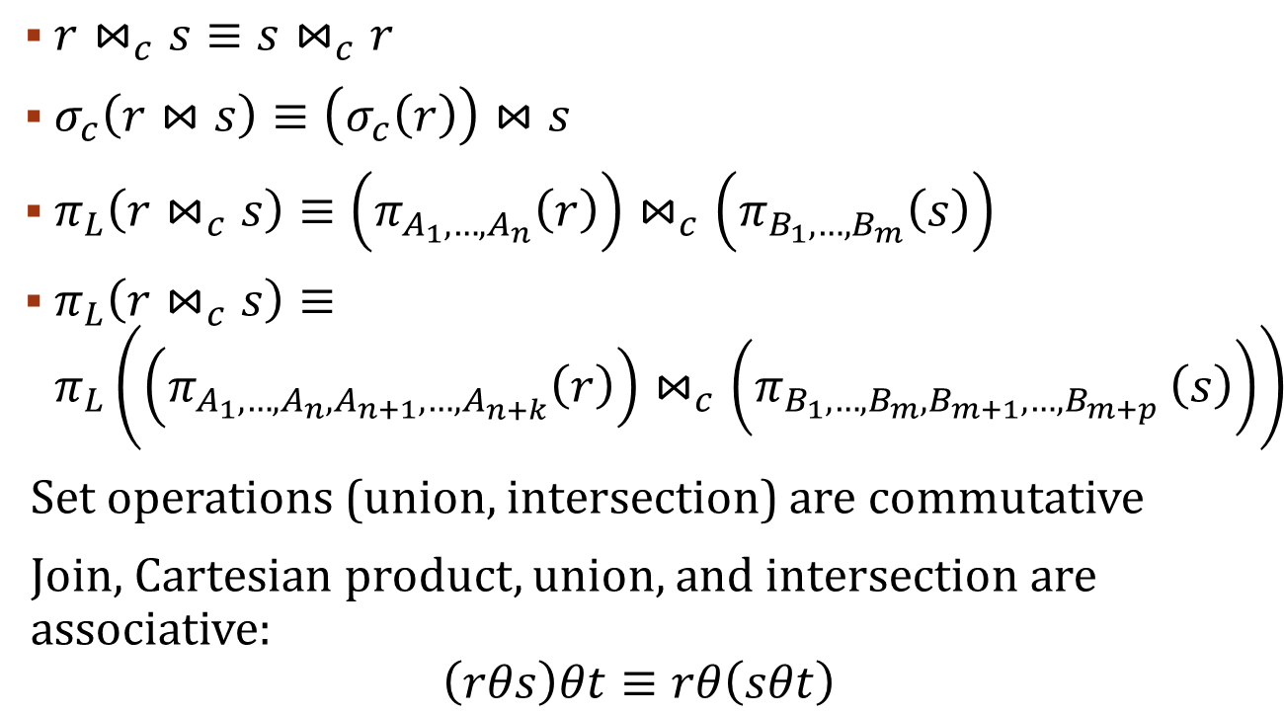
When are two trees equivalent? Relational algebra transformations II.
$r⋈_{c}s≡s⋈_{c}r$
$σ_{c}\left(r⋈s\right)≡\left(σ_{c}\left(r\right)\right)⋈s$
$π_{L}\left(r⋈_{c}s\right)≡\left(π_{A_{1},…,A_{n}}\left(r\right)\right)⋈_{c}\left(π_{B_{1},…,B_{m}}\left(s\right)\right)$
$π_{L}\left(r⋈_{c}s\right)≡π_{L}\left({\left(π_{A_{1},…,A_{n},A_{n+1},…,A_{n+k}}\left(r\right)\right)⋈}_{c}\left(π_{B_{1},…,B_{m},B_{m+1},…,B_{m+p} }\left(s\right)\right)\right)$
Set operations (union, intersection) are commutative
Join, Cartesian product, union, and intersection are associative:
$$\left(rθs\right)θt≡rθ\left(sθt\right)$$

Slide 85
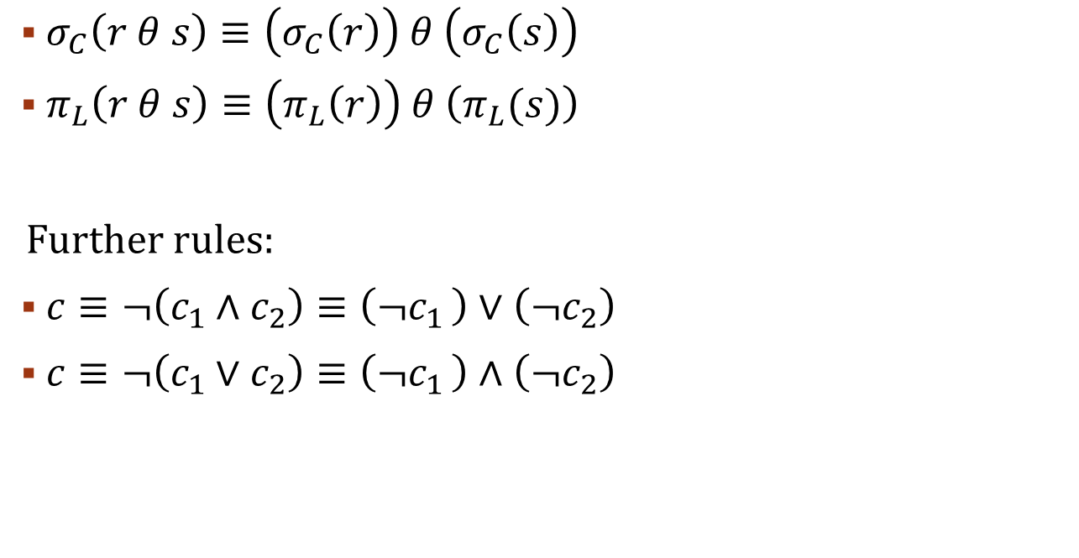
When are two trees equivalent? Relational algebra transformations III.
$σ_{C}\left(r θ s\right)≡\left(σ_{C}\left(r\right)\right) θ \left(σ_{C}\left(s\right)\right)$
$π_{L}\left(r θ s\right)≡\left(π_{L}\left(r\right)\right) θ \left(π_{L}(s)\right)$
Further rules:
$c≡¬\left(c_{1}∧c_{2}\right)≡\left(¬c_{1 }\right)∨\left(¬c_{2}\right)$
$c≡¬\left(c_{1}∨c_{2}\right)≡\left(¬c_{1 }\right)∧\left(¬c_{2}\right)$

Slide 86
Heuristic optimization Rules, summary
Conjuctions in selections are transformed to a series of selections.
Selections are swapped with the other operations.
Query tree leaves are re-arranged.
Cartesian products and the selection (join) condition above them are transformed to a single operation (theta join)
Projections are swapped with the other operations

