Slide 1


Transaction Management First Lecture
Databases
Levente Erős – eros@db.bme.hu
Ruba AlMahasneh - mahasnehr@gsuite.tmit.bme.hu

Slide 2
Agenda
Basic terms
Transactions
Items
Operations
Schedule
Serializability of Schedules
Concurrency Control
Concurrency Possible Problems [Cases to avoid with Schedules-Problems with schedules]:
Scheduler
Concurrency Control Techniques
Deadlocks and Livelocks- Concurrent Processing
Deadlock management techniques
The Wait-for Graph
Livelocks
Transaction models
Simple Transaction Model
R/W model
Precedence graph
Two-phase locking
Granularity and Performance
States of a transaction

Slide 3
Transactions
Transaction: is a single execution of a single program. Composed of read /write operations. This program may be a simple query or multiple queries/statements expressed in one of the query languages.
Ques: Can several independent executions of the same program run in progress simultaneously ? give an example?
A transaction reads and/or writes data to and from the database, into private workspace, where all computations are performed.

Slide 4
Example: Money Transfer
If I want to withdraw some money from the ATM machine
Does withdrawing money contain a single step? Or multiple steps?
Executing these series of steps must meet some requirements.
Atomic; all steps carried out or none.
Consistent; only fully completed Trs. will affect the DB.
Isolated; Transactions are unaware of other transactions performing operations on the DB. The output of each transaction is not affected by any other Trs.
Durable; the effects of Trs are preserved in the DB.
Notes:
A: Atomic; all or none.
C: Consistent; only fully completed Trs. affect the DB.
I: Isolated; unaware of other transactions performing operations on the DB. Output of each transaction is not affected by any other Trs.
D: Durable; the results of Trs are preserved in the DB [committed].

Slide 5
Data Items
What is a data item?
Items : units of data to which access is controlled (size may vary, how?)
Give examples?
The database must be partitioned into items. Why?
The size of items used by system is often called its granularity. "fine-grained" system uses small items and "coarse-grained" one uses large items.
Notes:
An Item is a relation , some rows, bunch of data in the database
(data file, data file block, etc

Slide 6
Schedule
Schedule: the order in which the steps of the transactions (read, write and so on) are executed.
Scheduler: is a portion of the database system that arbitrates between conflicting requests. It controls access rights of transactions.
Notes:
It controls access rights of transactions using locks.

Slide 7
Schedules
Serial : one transaction at a time - no overlapping transactions
Non-Serial: overlapping transactions (most common in practice)
Non-Serial can be Serializable
A schedule said to be serializable IIF all its effects are equal to a serial schedule = serial equivalent exists

Slide 8
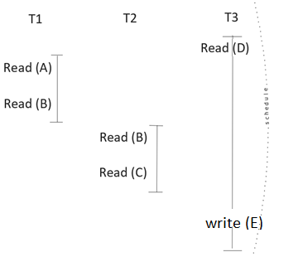
Serializability of Schedules
Ques:
Spot the serial and non serial schedule(s) parts.
Do serialized schedules exist in practice? Why?
Since Serial schedules are very unlikely in many practical cases→ Serial equivalent guarantees the same order as that obtained by running the same transactions serially in some order.

Slide 9
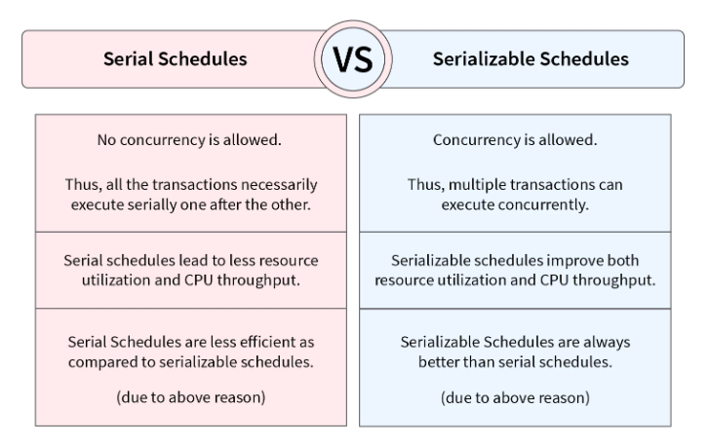

Slide 10
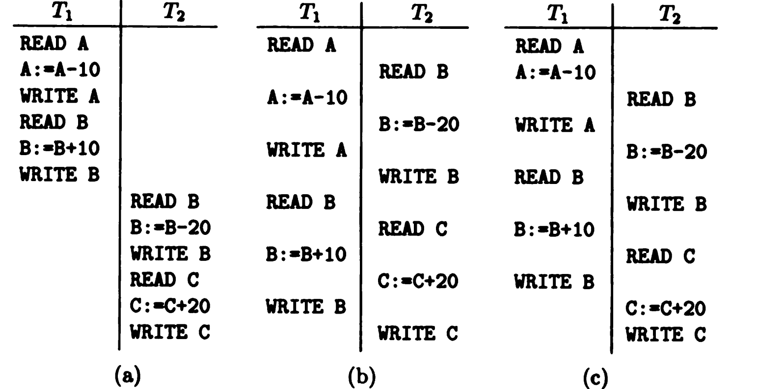
Serializability of Schedules

Slide 11
Discussion
It is possible to prevent the schedule of Figure section (c) from occurring by having all transactions lock before reading it.
In Figure section (a) we see serial schedule, and in Figure section (b) is serializable, but not serial, schedule. Figure section (c) shows non-serializable schedule.
Recall that we have defined schedule to be serializable if its effect is equivalent to that of serial schedule. However, it is not possible to test whether two schedules have the same effect for all initial values of the items, if arbitrary steps on the items are allowed, and there are an infinity of possible initial values. We assume that values cannot be the same unless they are produced by exactly the same sequence of steps.

Slide 12
Concurrency Control
It is the management of two simultaneous transactions to execute without conflicts between each other (such as in multiuser systems).
The simultaneous execution of transactions over shared databases can create several data integrity and consistency problems. How?
What advantages of concurrency control you can think of?

Slide 13
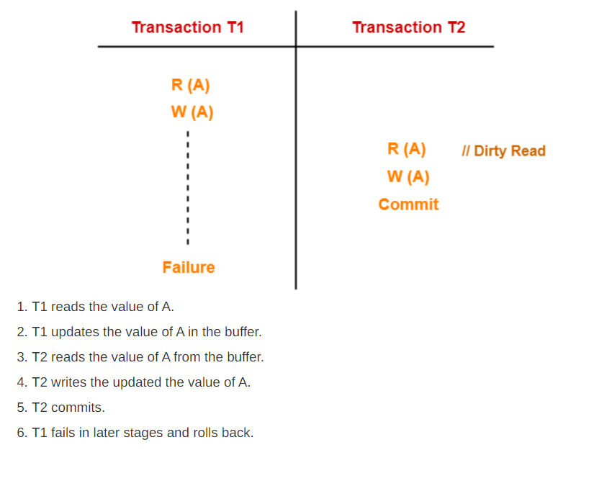
Concurrency Possible Problems [Cases to avoid with schedules-Problems with schedules ]:
Uncommitted Dependency or dirty read problem
Inconsistent retrievals

Slide 14
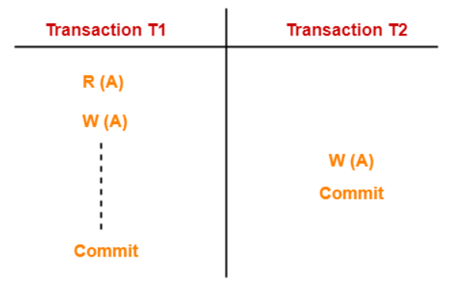
Lost Updates
T1 reads the value of A (= 10 say).
T2 updates the value to A (= 15 say) in the buffer.
T2 does blind write A = 25 (write without read) in the buffer.
T2 commits.
When T1 commits, it writes A = 25 in the database.
T1 over written value of A in the database.
Thus, update from T2 gets lost.

Slide 15
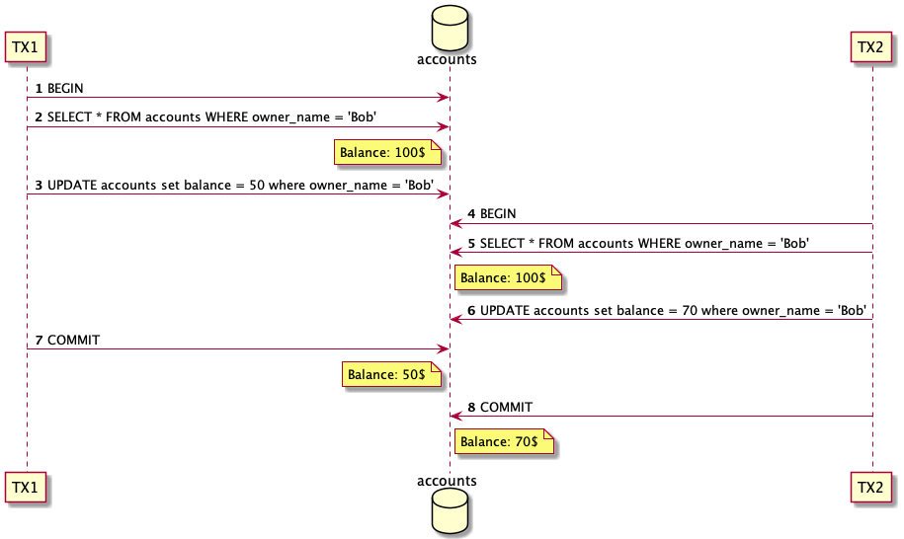
Lost Updates

Slide 16
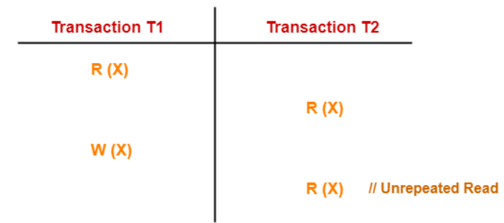
Unrepeatable Read
This problem occurs when a transaction gets to read unrepeated T1 reads the value of X (= 10 say).
T2 reads the value of X (= 10).
T1 updates the value of X (from 10 to 15 say) in the buffer.
T2 again reads the value of X (but = 15).
T2 gets to read a different value of X in its second reading.
T2 wonders how the value of X got changed because according to it, it is running in isolation.

Slide 17
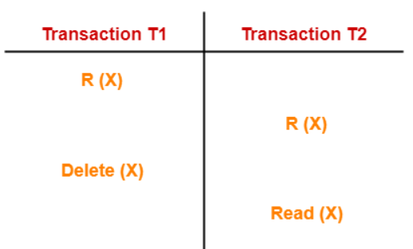
Phantom Read
T1 reads X.
T2 reads X.
T1 deletes X.
T2 tries reading X but does not find it.
T2 finds that there does not exist any variable X when it tries reading X again.
T2 wonders who deleted the variable X because according to it, it is running in isolation
Ques: How can we avoid all those problems ?

Slide 18
Conclusion –possible solution
Having a serial Schedule is the solution; where all the steps of each transaction occur consecutively.
Are serial schedules practical solution? Why ? What are other possible efficient solutions?
Notes:
schedule is serializable if its effect is equivalent to that of some serial schedule.

Slide 19
Concurrency Control Techniques – Scheduler
Lock: is access privilege to an item for a transaction, which the lock manager can grant or withhold from transaction. It stores the current locks in lock table, which consists of records (<data item>, <lock type>,<transaction> )
Ques: what is the meaning of record (I, L, T) ? → transaction T has lock of type L on item I
The lock manager finds locks on given items, insert lock records, and delete lock records, this will allow efficient management of locks.
Ques: what is the key for lock records? Why ?

Slide 20
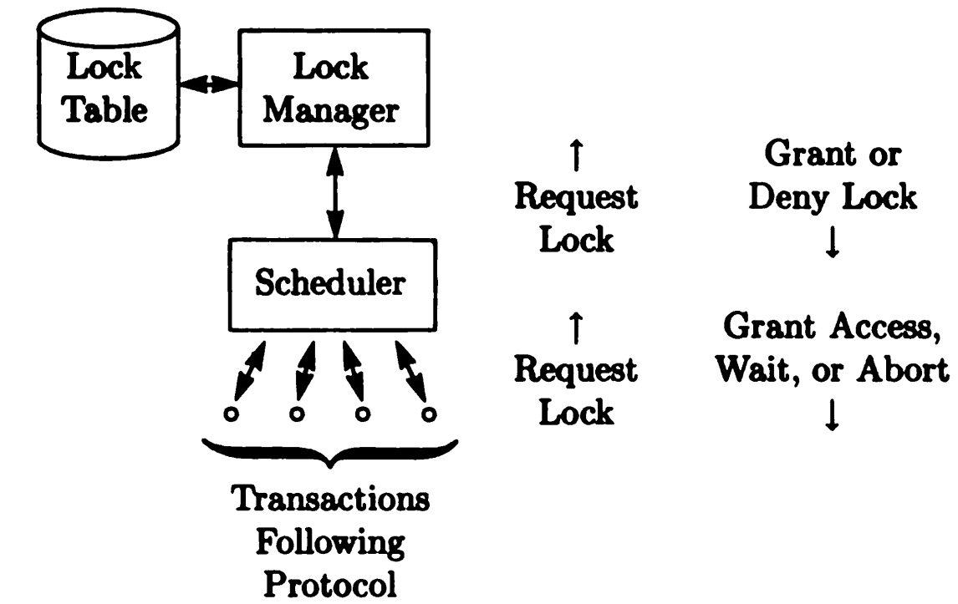
Concurrency Control -Relationship of the Lock Manager, Scheduler, and Protocol

Slide 21
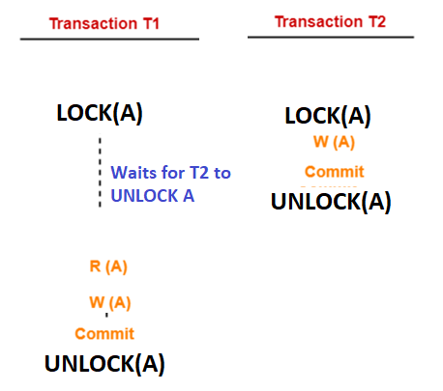
Concurrency Control Techniques
Locking : the transaction request to lock item(s) to perform some steps, after completion, the transaction releases the lock.
If an item was occupied when trying to lock it, the transaction will wait.
All locks must be released eventually.
How a lock solve the lost update problem here?

Slide 22
Deadlock- Concurrent Processing
Suppose we have two transactions T1 and T2 whose significant actions, as far as concurrent processing is concerned are:
T1: LOCK A; LOCK B; UNLOCK A; UNLOCK B;
T2: LOCK B; LOCK A; UNLOCK B; UNLOCK A;
Discuss : Suppose T1 and T2 begin execution at about the same time. T1 requests and is granted lock on A, and T2 requests and is granted lock on B. Then T1 requests lock on B, and is forced to wait because T2 has lock on that item. Similarly, T2 requests lock on and must wait for T1 to unlock A.

Slide 23
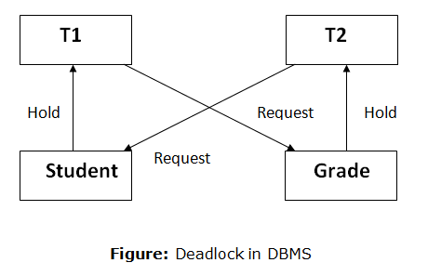
Deadlock
Neither transaction can proceed; each is waiting for the other to unlock needed item, so both T1 and T2 wait forever.
All activities come to a halt state and remain at a standstill.
It will remain in a standstill until the DBMS detects the deadlock and aborts one of the transactions.

Slide 24
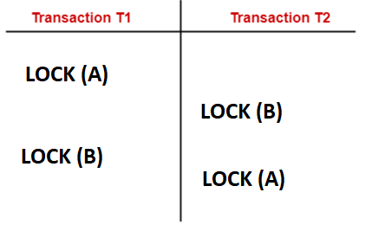
Deadlock Avoidance/Detection- Wait for Graph

Slide 25
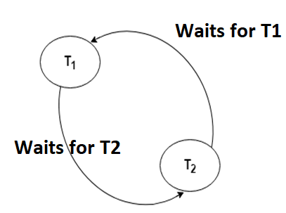
Deadlock Avoidance/Detection- Wait for Graph
Deadlock avoidance mechanism is used to detect any deadlock situation in advance. A method like "wait for graph" is used for detecting the deadlock situation but this method is suitable only for the smaller database.
The scheduler decides how to resolve this conflict , to release the deadlocks ( by aborting a transaction for example)

Slide 26
Deadlock- Possible Solutions
each transaction requests all its locks at once, and let the lock manager grant them all, if possible, or grant none and make the process wait, if one or more are held by another transaction.
Assign an arbitrary linear ordering to the items, and require all transactions to request locks in this order.

Slide 27
Deadlock
Deadlock Prevention
Deadlock prevention method is suitable for a large database. If the resources are allocated in such a way that deadlock never occurs, then the deadlock can be prevented.
The Database management system (DBMS) analyzes the steps of the transaction whether they can create a deadlock situation or not. If they do, then the DBMS never allowed that transaction to be executed.
Deadlock Ignorance
Another approach to handling deadlocks is to do nothing to prevent them. By periodically examine the lock requests and see if there is deadlock.
Why this might be beneficial as a solution?

Slide 28
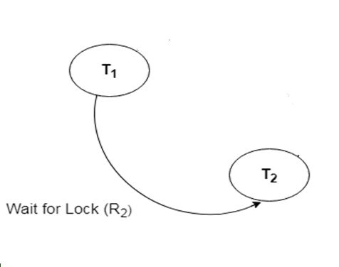
Live lock- Concurrent Execution
The system that grants and enforces locks on items cannot behave unpredictably.
Scenario: when T1 released its lock on A, the lock was granted to T2. What if while T2 was waiting, transaction T3 also requested lock on A, and T3 was granted the lock before T2? Then while T3 had the lock on A, T4 requested lock on A, which was granted after T3 unlocked A, and so on. It is possible that T2 could wait forever, since other transactions had lock on A, even though there are an unlimited number of times at which T2 might have been given chance to lock A.
Suggest Possible solutions for the live lock?

Slide 29
Transaction Models
Simple Transaction Model: one type of lock , two transactions can not lock the same item(s)
Precedence graph:
nodes represent the transactions.
Edges between T1 → T2 IIF there is a lock that T2 is granted and the last transaction who released that lock was T1 . There is an item that T1 unlocked and the first transaction to lock right afterwards (for the same item) was T2.
IIF Precedence is DAG (directed acyclic graph) ➔ the scheduling is serializable

Slide 30
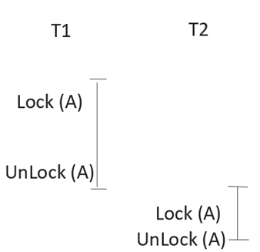
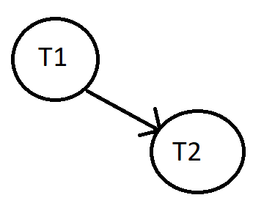
Precedence Graph

Slide 31
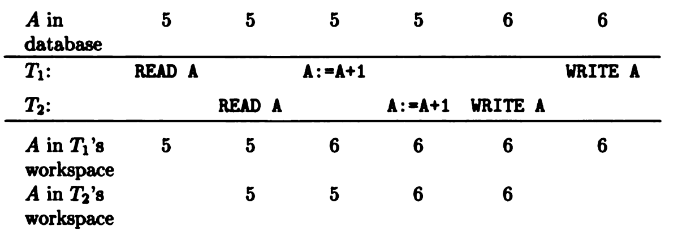
Discussion
How many programs are trying to modify record A. what are the possible real-life problems in this structure
Ques: What are the possible solution to prevent having two programs modifying the same record at the same time? Use the lock strategy we discussed earlier in the example below.

Slide 32
How Locks Control Concurrency When Transactions Execute in Parallel
Let us consider two transactions T1 and T2. Each Trs. accesses an item A, which we assume has an integer value, and adds one to A. The two Trs. are executions of the program P defined by:
P: READ A; A:=A+1; WRITE A; [the value of A exists in the database. P reads A into its workspace, adds one to the value in the workspace, and writes the result into the database]
Notes:
P471 book
We notice that although two transactions have each added 1 to A, the value of A has only increased by 1. This problem is serious if A represents seats
sold on an airplane flight, for example.
The most common solution to the problem represented by Example 9.1 is to provide a lock on A. Before reading A, a transaction T must lock A,
which prevents another transaction from accessing A until T is finished with A. Furthermore, the need for T to set a lock on A prevents T from accessing
A if some other transaction is already using A. T must wait until the other transaction unlocks A, which it should do only after finishing with A.

Slide 33
Possible Solution
The most common solution to the problem represented is to provide lock on A. Before reading A, transaction T1 must lock A, which prevents another transaction from accessing until T1 is finished with A.
The need for T1 to set lock on A prevents T2 from accessing A. T2 must wait until the other transaction unlocks A, which it should do only after finishing with A.

Slide 34
Remarks
Unlock command is executed by the transaction holding the lock.
Lock Manager: locks record for the transaction when it requests it for a specific item.
Each transaction will unlock any item it locks, eventually.
Notes:
Suppose again that T1 and T2 are two executions of P. If T1 begins first, it requests lock on A. Assuming no other transaction has locked A, the lock manager grants this lock. Now T1, and only T1 can access A.
If T2 begins before T1 finishes, then when T2 tries to execute LOCK A, the system causes T2 to wait. Only when T1 executes UNLOCK will the system allow T2 to proceed. As result, the anomaly CAN NOT occur; either T1 or T2 executes completely before the other starts, and their combined effect is to add to A.

Slide 35
THE TWO-PHASE LOCKING PROTOCOL
We want to avoid having a schedule that is not serializable , we should follow some rules → two phase locking
Two-phase locking:
requires that in any transaction, all locks precede all unlocks
each transaction releases a lock for the first time (the order of releasing is not important) before it receives the last lock.
( the point in between those two phases is called synchronization point→ when the transaction has received all its requested locks before releasing the first lock).

Slide 36
THE TWO-PHASE LOCKING PROTOCOL
Transactions obeying this protocol are said to be two-phase; the first phase is the locking phase, and the second is the unlocking phase.
The schedule that uses 2PL is serializable schedule
T1
Lock (A)
Lock(B)
→→ synchronization point →→
unlock(B)
unlock(A)
Note: When the transaction unlocks an item in the second phase it can not lock ANY other item again

Slide 37
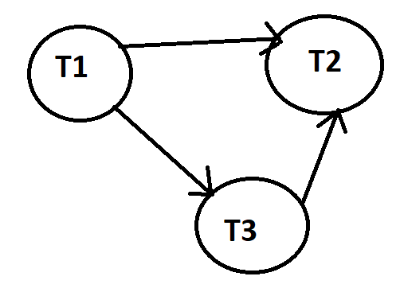
Serial equivalent from the precedent graph
Topological order : T2 ( it does not have a leaving edge) . T3, T1 == serial equivalent schedule of this graph →T1, T3, T2
In case of 2PL (since there might be many serial equivalents) ONE (since there can be many) serial equivalent is going to be the order of the synchronization points
[ie. According to the order of synchronization points].

Slide 38
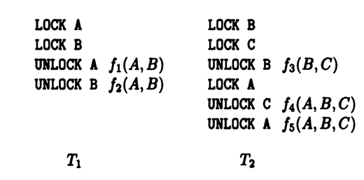
Which transaction is two-phase protocol and which is not ?

Slide 39
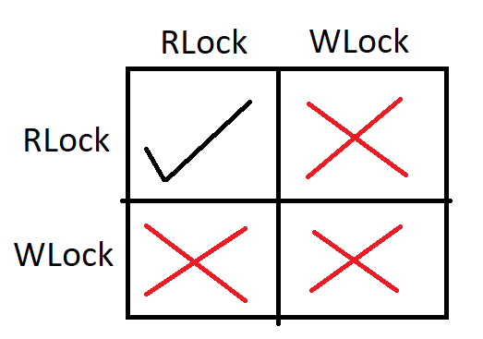
Control Concurrency when Transactions Execute in Parallel
Types of Locks
Shared Lock [Transaction can only read the data item values]
Exclusive Lock [Used for both read and write data item values]
Exclusive Lock [read/write lock Model]
Notes:
This gives us higher performance + better lock management system

Slide 40
Lock Based Protocol- Lock Manager
1. Shared lock:
It is also known as a Read-only lock. The data item can only be read by the transaction.
It can be shared between the transactions because when the transaction holds a lock, then it can't update the data on that data item.
2. Exclusive lock:
The data item can be both read and written by the transaction.
Multiple transactions do not modify the same data simultaneously.
How can we apply this concept to flight tickets booking process?

Slide 41
How Does items Granularity Affect Performance with Locks?
Choosing large granularity cuts down on the system overhead needed to maintain locks, since we need less space to store the locks, and we save time because fewer actions regarding locks need to be taken.
Small granularity allows many transactions to operate in parallel, since transactions are then less likely to want locks on the same items.

Slide 42
Brain Teaser
UPDATE Customers
SET ContactName = 'Alfred Schmidt', City= 'Frankfurt'
WHERE CustomerID = 1;
************************************************************
SELECT Orders.OrderID, Customers.CustomerName, Orders.OrderDate
FROM Orders INNER JOIN Customers ON Orders.CustomerID=Customers.CustomerID;
How would you choose the items in those two cases and why?
Hint: Consider best performance

Slide 43
Granularity
Rule of thump: proper choice for the size of an item is such that the average transaction accesses few items.
Assumption for simplicity: we shall assume that when part of an item is modified, the whole item is modified
Discuss
if the typical transaction (in relational system) reads or modifies one tuple, which it finds via an index, what would be the proper item?
If the typical transaction takes join of two or more relations, and thereby requires access to all the tuples of these relations, which item would you choose?

Slide 44
Conclusion: To Achieve More Concurrency While Guaranteeing Correctness. What must be done?
every schedule of every collection of transactions is allowed if its effect happens to be equivalent to some serial schedule and forbidden otherwise.

Slide 45
Is Abort Desirable or Not ? Why!
Forcing many transactions to wait for long periods may cause too many locks (waiting transactions might already have some locks).
deadlock causes many transactions to delay so long that the effect becomes noticeable for end users. ( Ex: the user standing at an ATM machine).
when deadlocks are inventible, the scheduler has no choice but to abort at least one of the transactions involved in the deadlock.

Slide 46
Possible States of a Transaction Explained
1. Failed state
If any of the checks made by the database recovery system fails, then the transaction is said to be in the failed state.
Example: total mark calculation, can you explain how this might apply?
2. Aborted
If any of the checks fail and the transaction has reached a failed state then the database recovery system will revert to its previous consistent state [it will abort or roll back the transaction].
If a transaction fails in the middle, then all the executed operations are rolled back.

Slide 47
Possible States of a Transaction
After aborting the transaction, the database recovery module will select one of the two operations:
1. Re-start the transaction
2. Kill the transaction
3. Active state
The active state is the first state of every transaction (the transaction is being executed).
For example: Insertion or deletion or updating a record is done in the active state BUT all the records are still not saved (committed) to the database.

Slide 48
Possible States of a Transaction
4. Partially Committed
a transaction executes its final step, but the data is still not saved to the database.
Ex : total mark calculation, a final display of the total marks step is executed in this state.
5. Committed
if the transaction executes all its steps successfully. In this state, all the effects are now permanently saved in the database.

Slide 49
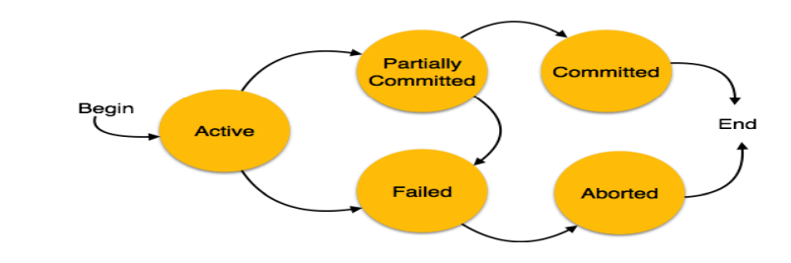
Possible States of a Transaction Explained

Slide 50
Transaction Management Second Lecture
Databases
Levente Erős – eros@db.bme.hu
Ruba AlMahasneh - mahasnehr@gsuite.tmit.bme.hu

Slide 51
Agenda
Read/Write Precedence Graph
Locks on Hierarchal structure –Tree Protocol
Tree Protocol
Warning Protocol
Scheduling with time stamps Protocol
When to abort a transaction?
Time Stamps Transaction Handling

Slide 52
R/W Lock Model
R/W Lock Model
Lock → Read Lock (RLock)
→ Write Lock (WLock)
Goal: Less restrictive lock management and higher performance
Compatibility Matrix

Slide 53
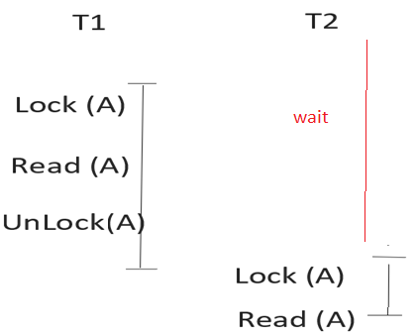
Simple Lock Model

Slide 54
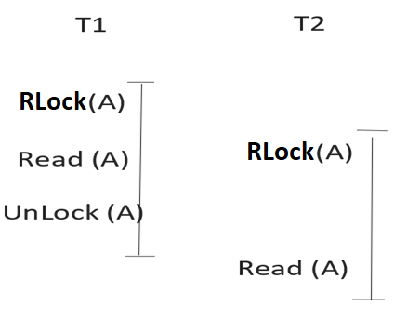
R/W Lock Model
Simple Lock Model

Slide 55
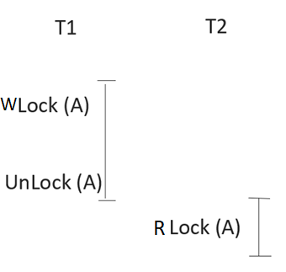
Read/Write Precedence Graph

Slide 56
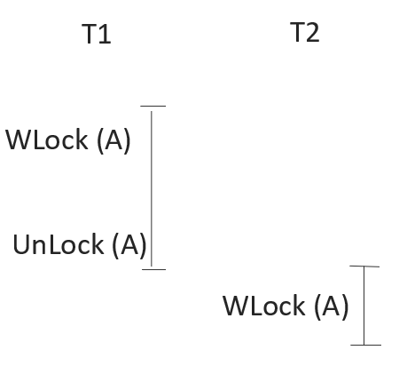
Read/Write Precedence Graph
Ques: What is the precedence graph if we have two read locks requested ?

Slide 57
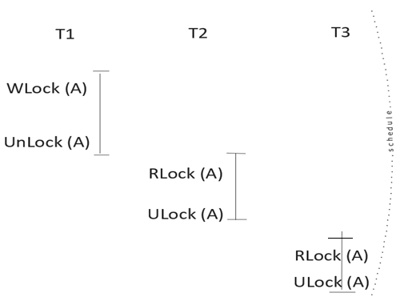
Read/Write Precedence Graph

Slide 58
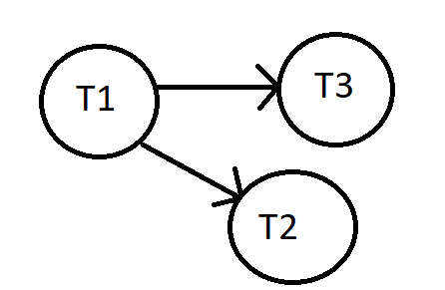
Precedence Graph-Serial Equivalent

Slide 59
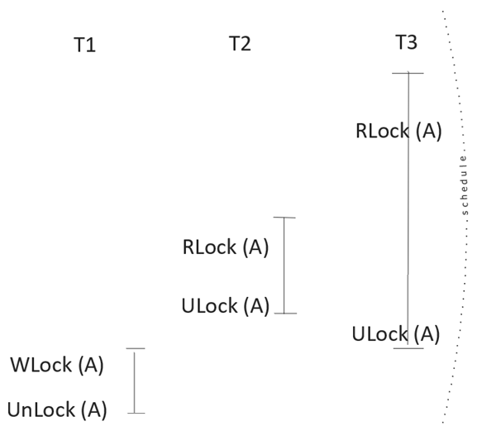
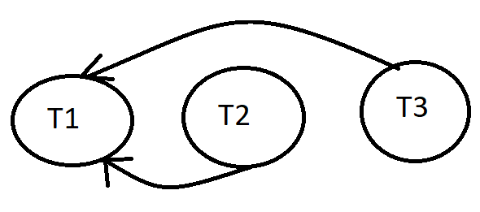
Read/Write Precedence Graph

Slide 60
Precedence Graph’s Rules
If there is no directed cycle graph then our schedule is serializable and it has serial equivalent schedule.
Read locks order is irreverent since it does not affect the data itself and no changes committed to the data
No edges between Read locks why?
Remark: Unlock is source of the arrow , W/R process is the destination of the arrow (edge) in the graph.

Slide 61
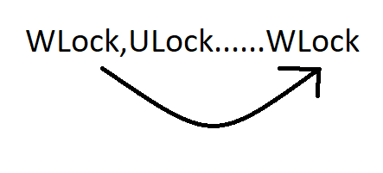
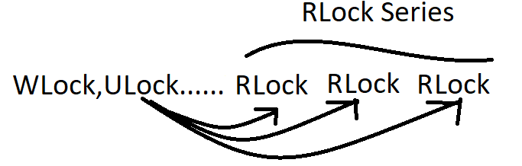
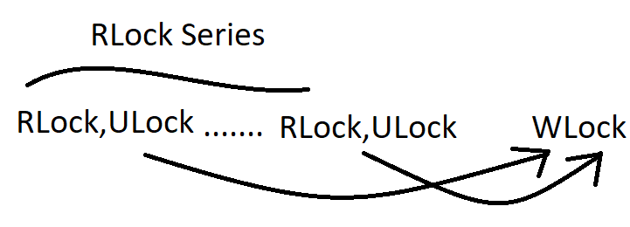
Precedence Graph’s Rules

Slide 62
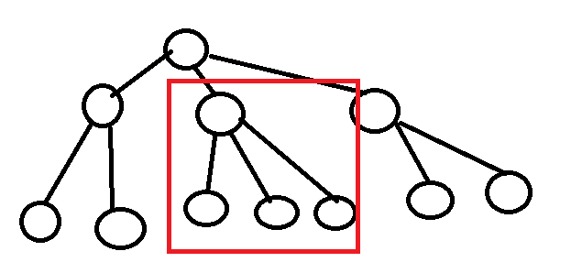
Locks on Hierarchical structure –Tree Protocol
Goal : Locking some parts of the tree
Protocols :
Tree Protocol : uses LOCK on a single node.
Serializable
No deadlocks
Warning Protocol : Uses WARN or LOCK on a single node

Slide 63
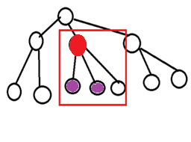
Locks on Hierarchal structure –Tree Protocol
Rules we must follow :
First Lock can be put on any single node
Further Locks must be children of a Locked node
One node can not be relocked (each node can be only locked once)
Remarks :
You are only allowed to access the Locked node [access privilege]
In Tree protocol, no dead locks occur
Tree protocol produces Serializable Schedule
Notes:
You are only allowed to access the Locked node [access privilege] but it doesn't mean they are locked by default when we lock the parent

Slide 64
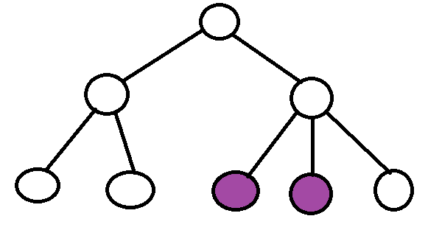
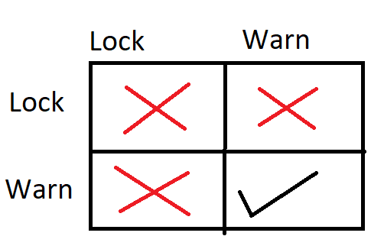
Locks on Hierarchal structure –Warning Protocol
Uses Warns and Locks
Locking a node is access to the whole sub Tree (R,W)
Rules:
Lock or Warn the root node
You can only Lock or Warn a node if there is a Warn on the parent
2 Phase locking must be used, meaning after the first unlock you can not place any warns or locks anywhere at the tree [crucial for schedule serializability]

Slide 65
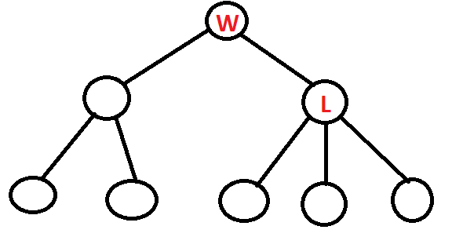
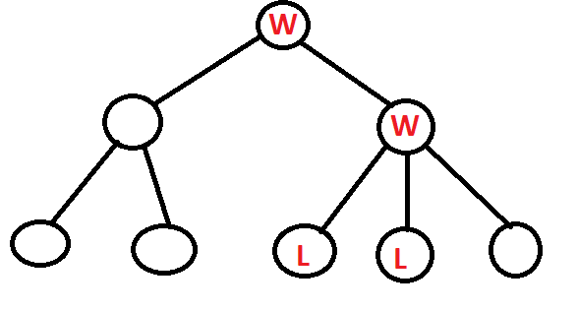
Locks on Hierarchal structure –Warning Protocol
Quest: How can I perform Warn/Lock structure on the below Tree
If I want to access the colored children ?

Slide 66
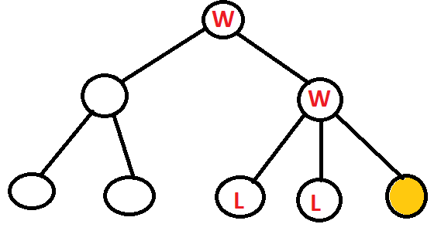
Locks on Hierarchal structure –Warning Protocol
Can you think on how another transaction can lock the colored node?
Notes:
Warnings can coexist, so it WARNs the first node then the second node is WARNed too then it LOCKs the last child

Slide 67
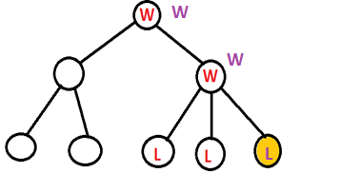

Slide 68
Scheduling with timestamps Protocol
The transaction don’t overlap and influence each others final results , they don’t collide too much.
Timestamping: for each transaction a unique identifier (time stamp) created by DBMS that indicates relative starting time of a transaction t(T 1)=1
Allocate time stamp for each transaction , it grows as the transaction proceed (timestamps are proportional to the start time)
Timestamps (Read/Write time stamps) are allocated for each data item.
Read timestamp for each data item [Timestamp of the transaction that read the data item most recently ]= R(A)
Write timestamp for each data item [Timestamp of the transaction that Wrote the data item most recently ]= W(A)

Slide 69
Scheduling with time stamps Protocol
Ultimate Goal
Create a predefine serial equivalent with W, R operations with all (unique) time stamps of all transactions, so if there was any transaction requested a read or write operation that is against this serial equivalent → will be aborted.
Example :
serial equivalent of transactions T1,T2,T3…..→ t(T1) < t(T2) < t(T3)
[growing]
This serial equivalent will be enforced otherwise anything that does not conform will be aborted
Notes:
Predefine the serial equivalent schedule (transaction time stamps), if there any (transaction) operation against this serial equivalent it will be aborted.

Slide 70
When to abort a transaction ?
If any of the checks fail and the transaction has reached a failed state then the database recovery system will revert to its previous consistent state.
If the transaction fails in the middle of the transaction, then all the executed transactions are rolled back to its consistent state.
After aborting the transaction, the database recovery module will select one of the two operations:
1. Re-start the transaction
2. Kill the transaction
Notes:
If not then it will abort / rollback the transaction.

Slide 71
Time Stamps Transaction Handling
Action : Transaction T reads or Writes Data Item A. WE REPRESETNT t(T)
A | T tries reads | T tries writes
R(A) <=t(T) W(A) <=t(T) | OK R(A) :=t(T) | OK W(T) :=t(T)
R(A) >t(T) W(A) <=t(T) | OK R(A) :=R(A) REMAINS | ABORT, because it does not conform with the serialized schedule TS
R(A) >t(T) W(A) >t(T) | ABORT VALUE DOES NOT EXIST | ABORT, because it does not conform with the serialized schedule TS
R(A) <=t(T) W(A) >t(T) R(A) <= t(T) < W(A) | ABORT VALUE DOES NOT EXIST | Either abort OR write, but the value will not updates (it will be rewritten), not abort and not write… Thomas writing rule

Slide 72
Transaction Management Third Lecture
Levente Erős – eros@db.bme.hu
Ruba AlMahasneh - mahasnehr@gsuite.tmit.bme.hu

Slide 73
Agenda
Scheduling Transactions With Time Stamps
Version Handling/Management Time Stamp Scheduling
Handling Transactions Errors
Possible causes and solutions
Time stamps and strictness
Handling OS and Media Errors –Journaling
Redo Recovery Protocol Procedure

Slide 74
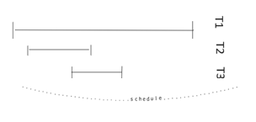
Scheduling Transactions With Timestamps
GOAL: to build the serial equivalent schedule using time stamps for the transactions [we are not using the lock concept]
Every transaction has a unique time stamp. We are forcing serial equivalent schedule where Transactions are executed in near zero amount of time .
There will be overlapping among transactions, thus if they do not follow the serial equivalent they must be aborted.

Slide 75
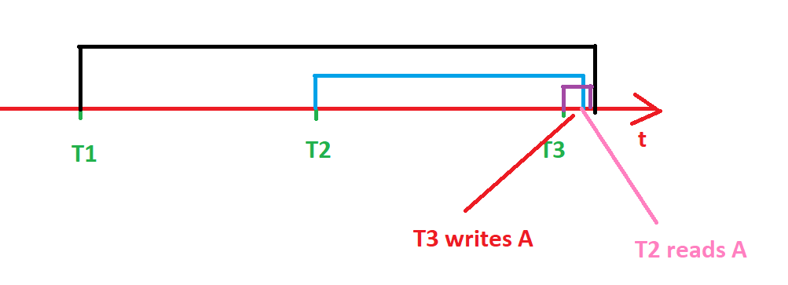
Version Handling/Management Timestamp Scheduling
When a data item is written, the original one is not overwritten but a new version of it is created.
The time stamp is not changed but a new time stamp is created for this transaction.
Ques: What shall we do at T2 where it wants to read A?

Slide 76
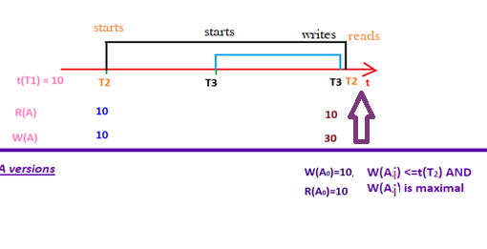
Version Handling/Management Time Stamp Scheduling
Different versions serve as logs and history tracking record for the data items and the operations that are done on them and when.
How does Timestamp scheduling avoid the two aborts we explained earlier?
Ques: When we want to perform the read operation of T2=>R(A) what shall we do to guarantee we are getting the latest value of item A?

Slide 77
Handling Transactions Errors
Transaction Error: is whatever cause a transaction not to terminate is considered a transaction error
Possible Causes:
Deadlock Resolution → Abort
Ensuring serializability of the schedule → Abort
Arithmetic/program error
OS Error
Media Failure

Slide 78
Handling Transactions Errors
Consistent state: the state of the DB only contains successful (fully executed) transactions.
The history of DB made from series of consistent states (one after another).
How can we make sure the DB changes from one consistence place to another ?
We eliminate the possibility of the first three transaction errors to ensure consistency of the DB states
Find the commit points. What is a commit point?

Slide 79
Handling Transactions Errors-Strict 2PL
Each transaction has work place, it performs all the actions there then it reaches the commit point when those operations are moved from the work space to the actual public DB space [then the first 3 errors can not affect the DB, why ? transaction can not fail anymore]
How does that help in keeping consistent DB state?
Conclusion: everything is dirty data before the commit point .

Slide 80
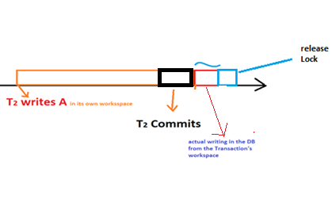
Strict 2PL
Strict two phase locking :
A transaction follows strict 2PL IIF:
2PL
It only writes in the DB after the transaction has reached its commit point
Cascading abort: A situation in which the abort of one transaction forces the abort of another transaction to prevent the second transaction from reading invalid (uncommitted) data.
No Dirty Data → no Cascading aborts
All those safety measures will affect the performance of the operations (no free lunch concept)

Slide 81
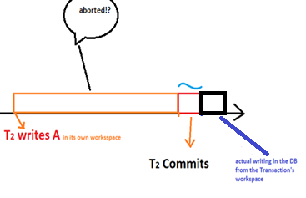
Time stamps and strictness
Problem : time stamps scheduling is optimal in case there are not overlapping transactions, and it uses aborts when needed.

Slide 82
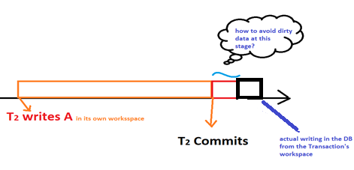
Time stamps and strictness
The time stamps are placed on different points (commit point, actual writing on DB) which can be problematic

Slide 83
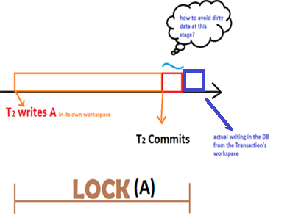
Time stamps and strictness
Solutions
1- We introduce lock with the time stamp scheduling between the beginning of the transaction and the actual writing in the DB from the local space
2- We accept that there will be dirty data
if we do not want to compromise the desired performance.
How does that affect the processing performance?

Slide 84
Aggressive Vs Conservative Protocols
1. Conservative Protocols :
It is also known as Static 2-PL.
This protocol requires the transaction to lock all the items it access before the transaction begins execution by pre-declaring its read-set and write-set.
If any of the pre-declared items needed cannot be locked, the transaction does not lock any of the items, instead, it waits until all the items are available for locking.
Conservative 2PL is deadlock-free.

Slide 85
Aggressive Vs Conservative Protocols
2. Aggressive Protocols (puts performance before avoiding aborts) :
Requests a lock on an item immediately before reading or writing the item. If an item is to be written after reading, the read-lock is taken first and upgraded to a write-lock when needed.
Can this lead to deadlocks ?
Which has better performance Aggressive Vs Conservative ?

Slide 86
Aggressive Protocols -
Example: Timestamp scheduling, we allow the transactions to run, which doesn't even lock and transactions don’t wait just perform operations and if a given operation is not allowed, abort.

Slide 87
Difference between Conservative and Strict/Aggressive 2-PL :
Conservative 2-PL
Strict 2-PL
In Conservative 2-PL, A transaction has to acquire locks on all the data items it requires before the transaction begins it execution. | In Strict 2-PL, A transaction can acquire locks on data items whenever it requires (only in growing phase) during its execution.
It does not have growing phase. | It has growing phase.
It has shrinking phase. | It has partial shrinking phase.
It ensures that the schedule generated would be Serializable and Deadlock-Free. | It ensures that the schedule generated would be Serializable, Recoverable and Cascadeless.
It does not ensures Recoverable and Cascadeless schedule. | It does not ensures Deadlock-Free schedule.

Slide 88
Difference between Conservative and Strict 2-PL :
Conservative 2-PL
Strict 2-PL
It does not ensure Strict Schedule. | It ensures that the schedule generated would be Strict.
It is less popular as compared to Strict 2-PL. | It is the most popular variation of 2-PL.
It is not used in practice. | It is the most popular variation of 2-PL
In Conservative 2-PL, a transaction can read a value of uncommitted transaction. | In Strict 2-PL, a transaction only reads value of committed transaction.

Slide 89
Handling OS and Media Errors –Journaling
Journaling guarantees that all changes are on disk before a transaction is marked committed as long as O/S and hardware caching are disabled.
Journaling (Log) for any transaction:
(T, Begin)
(T, Commit)
(T, Abort)
Write operation → (T, A’s old value + A’s New value)

Slide 90
Handling OS and Media Errors –Journaling
A Journal is written to mass storage before DB is written, except for abort (which is first performed then the logging of the event happens)
Redo Protocol is used: we will only store the new value of the transaction that has been written.
Redo Protocol is strict 2PL protocol [steps]:
(T, Begin)
(T, A, New value)
(T, Commit)
Move Journal→ Mass storage in DB
If any Modification in RAM →Mass storage [HDD]
Releasing Locks

Slide 91
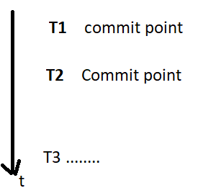
Journaling Performance ?
What if restoring a consistent state required going very far back in the logs?
To save changed pages in the database cache to the hard disk, we set up journaling checkpoints to occur automatically. After the checkpoint has been reached, the data in the journal file is no longer needed, so the file can be reused.

Slide 92
Why We Need Journaling ?
If the OS can not run for some reason (crash) we must set (restore) the DB to a consistent state (the committed transactions). Which will be the latest /most recent one logged in the journal.
Why we choose the most recent version ?
Check point : artificial consistent state, where you can start a new transaction == Latest consistent sate

Slide 93
Redo Recovery Protocol Procedure
Redo Recovery Steps:
Release locks
Finding committed transactions from the last consistent state =check point
Re-play [rewriting to the DB] committed transactions based on the journal

