Slide 1
Physical organization
Erős Levente, 2026

Slide 2
Base Concepts
Data file
record | record | record | record | record | record | record | record | record
Where are we now?
  3-layer DBMS model
    User views
    Logical database (ER, relational dm.)
    Physical database (current topic)
Concepts
  Each relation is stored in a data file on the mass storage (HDD, SSD)
  Each data file is a series of blocks of equal size
  Each block has a physical address used by pointers
  The operating system presents each file as a continuous series of blocks to the DBMS
Data block
Data block
Data block

Slide 3


Data files
Data file
record | record | record | record | record | record | record | record | record
Structure of blocks
  Header
  Series of equally sized records
    One record – one relation element/row
  Potential unused space
    Records don’t stretch over block borders
Notation
  b – block size (uniform)
  n_{r} – number of records
  s_{r} – record size (assumed as uniform)
  – number of records per block
  (blocking factor)
  – number of blocks of file
Data block
Data block
Data block
header | record | record | record | unused
header | field 1 | field 2 | field 3
Record

Slide 4
Types of stored data
Data in relations
Search structures
Data about data – metadata
  Structural metadata
    Which relation is stored in which file
    Size of fields
  Semantical metadata
    Meaning of fields/attributes
  Operational metadata
    Privileges, statistics

Slide 5
Accessing data from the mass storage
Record access
  Entire block is read from the mass store to the RAM
  One block movement – one block operation
  RAM fits a single block by default
4 operations
  Read, write, delete, modify
    Read efficiency directly influences the rest
  Unit of measure: number of block operations
    Takes way more than processing data in the RAM
Search key: attribute being searched – not necessarily a key
RAM
Mass storage

Slide 6
Heap
Data file and nothing else
Records are unorganized
Search: linear, all blocks read into the RAM one-by-one – b_{r} steps
  If key attribute is searched, then halt once found
  Otherwise search till the end of the file
Data file
17 |  | 18 | 1 | 3 | 6 | 7 | 8 | 9 | 25 | 21 | 30 | 15 | 11 | 10 | 40 | 41 | 42
Data block
Data record (only search key attribute value is displayed here
while whole record, i.e. all attribute values are stored in reality)

Slide 7
Bucket hashing
Data file is split up to buckets
  Series of blocks
  Number of buckets: B
Hash table
  Array of pointers (no search keys)
  Usually fits in RAM
Hash function & search
  h(K) → [0..B-1]
    Returns value i for the search key as input
    Pointer in hash_table[i] is followed
    Linear search within bucket
  Good hash function →
    distributes values evenly
    For example: K mod B
  Fast if buckets are short
5 | 15 | 45 | 30
16 | 31 | 21 | 26 | 41
Hash table
7 | 22 | 32 | 42
Buckets
23 | 3 | 18 | 58
14 | 24 | 34 | 19 | 149

Slide 8
Sparse Index, structure
Key+pointer (k, p) pairs in index file
Key is the lowest search key attribute value of the pointed data block
1 index entry per data block
data file ordered on block level
Index record / index entry
containing search key attribute value and pointer
Index block
1 | 7 | 10 | 17 | 21 | 40 | … | …
 |  |  |  |  |  | … | …
Index file
pointer
Data file
17 |  | 18 | 1 | 3 | 6 | 7 | 8 | 9 | 25 | 21 | 30 | 15 | 11 | 10 | 40 | 41 | 42
Data block
Data record

Slide 9
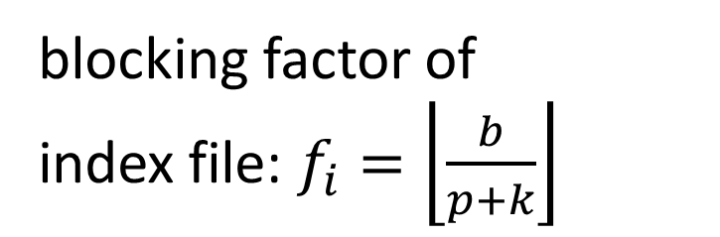
Sparse Index, structure
blocking factor of
index file: $f_{i}=\left\lfloor \frac{b}{p+k}\right\rfloor$
Index record / index entry
containing search key attribute value and pointer
Index block
1 | 7 | 10 | 17 | 21 | 40 | … | …
 |  |  |  |  |  | … | …
Index file
pointer
Data file
17 |  | 18 | 1 | 3 | 6 | 7 | 8 | 9 | 25 | 21 | 30 | 15 | 11 | 10 | 40 | 41 | 42
Data block
Data record

Slide 10
Sparse Index, search
Only blocks are shown
index file
data file

Slide 11
Sparse Index, search
Only blocks are shown

Slide 12
Sparse Index, search
Only blocks are shown

Slide 13
Sparse Index, search
Only blocks are shown

Slide 14
Sparse Index, search
Only blocks are shown

Slide 15
Sparse Index, search
Only blocks are shown

Slide 16

Sparse Index, search
Only blocks are shown
Binary search + 1 block read from the data file
$\left\lceil \log_{2}\left(b_{i}+1\right)\right\rceil +1$

Slide 17
Sparse Index, Insert
Search+insert into appropriate block
Case 1: Inserting 19
1 | 7 | 10 | 17 | 21 | 40 | … | …
 |  |  |  |  |  | … | …
17 |  | 18 | 1 | 3 | 6 | 7 | 8 | 9 | 25 | 21 | 30 | 15 | 11 | 10 | 40 | 41 | 42

Slide 18
Sparse Index, Insert
Search+insert into appropriate block
Case 1: Inserting 19
1 | 7 | 10 | 17 | 21 | 40 | … | …
 |  |  |  |  |  | … | …
17 | 19 | 18 | 1 | 3 | 6 | 7 | 8 | 9 | 25 | 21 | 30 | 15 | 11 | 10 | 40 | 41 | 42

Slide 19
Sparse Index, Insert
Search+insert into appropriate block
Case 2: Inserting 20 – destination block is the same, but has no space
1 | 7 | 10 | 17 | 21 | 40 | … | …
 |  |  |  |  |  | … | …
17 | 19 | 18 | 1 | 3 | 6 | 7 | 8 | 9 | 25 | 21 | 30 | 15 | 11 | 10 | 40 | 41 | 42

Slide 20
Sparse Index, Insert
Search+insert into appropriate block
Case 2: Inserting 20 – splitting data block, splitting index block if needed
1 | 7 | 10 | 17 | 21 | 40 | … | …
 |  |  |  |  |  | … | …
17 | 18 |  | 1 | 3 | 6 | 7 | 8 | 9 | 25 | 21 | 30 | 15 | 11 | 10 | 40 | 41 | 42 | 19

Slide 21
Sparse Index, Insert
Search+insert into appropriate block
Case 2: Inserting 20 – splitting data block, splitting index block if needed
1 | 7 | 10 | 17 | 21 | 40 | … | …
 |  |  |  |  |  | … | …
17 | 18 |  | 1 | 3 | 6 | 7 | 8 | 9 | 25 | 21 | 30 | 15 | 11 | 10 | 40 | 41 | 42 | 19 | 20

Slide 22
Sparse Index, Insert
Search+insert into appropriate block
Case 2: Inserting 20 – splitting data block, splitting index block if needed
1 | 7 | 10 |  | 17 | 19 |  |  | 21 | 40 | … | …
 |  |  |  |  |  |  |  |  |  | … | …
17 | 18 |  | 1 | 3 | 6 | 7 | 8 | 9 | 25 | 21 | 30 | 15 | 11 | 10 | 40 | 41 | 42 | 19 | 20

Slide 23
B* tree, structure
Sparse indices built on each other
  sparse index on topmost level has 1 block – root of the tree
Index blocks contain keys and pointers
  the pointer to the left of key K points to a subtree each element of which is <K
  the pointer to the right of key K points to a subtree each element of which is >=K
  the number of pointers in a block may be by 1 greater than the number of keys
for interval search, lowest level tree blocks can be linked by pointers
 | 17 |  | ---
 | 7 |  | 10
 | 21 |  | 40
17 |  | 18 | 1 | 3 | 6 | 7 | 8 | 9 | 25 | 21 | 30 | 15 | 11 | 10 | 40 | 41 | 42

Slide 24
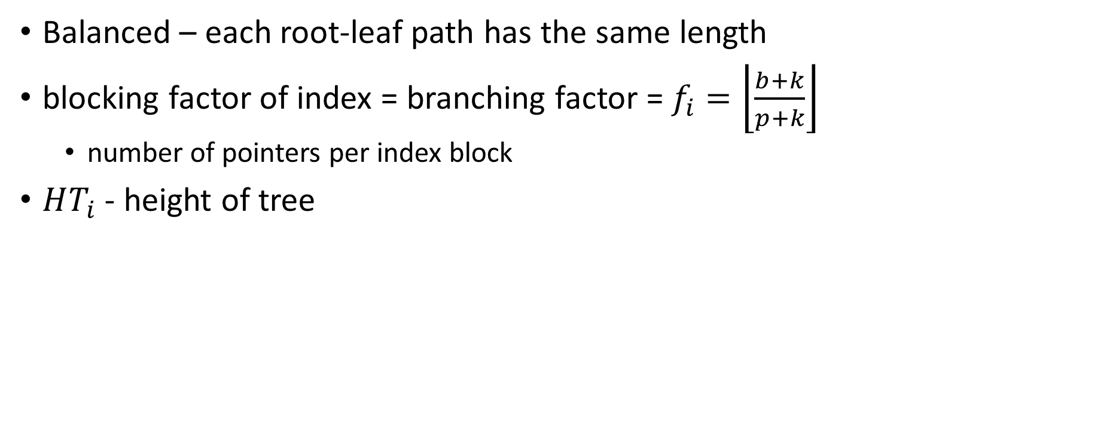
B* tree, structure
Balanced – each root-leaf path has the same length
blocking factor of index = branching factor = $f_{i}=\left\lfloor \frac{b+k}{p+k}\right\rfloor$
  number of pointers per index block
$HT_{i}$ - height of tree
 | 17 |  | ---
 | 7 |  | 10
 | 21 |  | 40
17 |  | 18 | 1 | 3 | 6 | 7 | 8 | 9 | 25 | 21 | 30 | 15 | 11 | 10 | 40 | 41 | 42

Slide 25
B* tree, search
Searching for 18
 | 17 |  | ---
 | 7 |  | 10
 | 21 |  | 40
17 |  | 18 | 1 | 3 | 6 | 7 | 8 | 9 | 25 | 21 | 30 | 15 | 11 | 10 | 40 | 41 | 42

Slide 26
B* tree, search
Searching for 18
 | 17 |  | ---
 | 7 |  | 10
 | 21 |  | 40
17 |  | 18 | 1 | 3 | 6 | 7 | 8 | 9 | 25 | 21 | 30 | 15 | 11 | 10 | 40 | 41 | 42

Slide 27

B* tree, search
Searching for 18
with each index block read, all pointers are discarded, but a single one
  search space is shrunk to its $f_{i}$th , only the $f_{i}$th portion of the index (and the data file) is considered from the next search step on
  $\left\lceil \log_{f_{i}}\left(b_{i}+1\right)\right\rceil +1=$ $HT_{i}$
 | 17 |  | ---
 | 7 |  | 10
 | 21 |  | 40
17 |  | 18 | 1 | 3 | 6 | 7 | 8 | 9 | 25 | 21 | 30 | 15 | 11 | 10 | 40 | 41 | 42

Slide 28
B* tree, search
B* tree
data file

Slide 29
B* tree, search
B* tree
data file

Slide 30
B* tree, search
B* tree
data file

Slide 31
B* tree, search
B* tree
data file

Slide 32
B* tree, search
B* tree
data file

Slide 33
B* tree, search
B* tree
data file

Slide 34
B* tree, search
B* tree
data file

Slide 35
B* tree, search
B* tree
data file

Slide 36
B* tree, search
B* tree
data file

Slide 37
B* tree, insert
Search+insert into appropriate block
Case 1: Inserting 19
 | 17 |  | ---
 | 7 |  | 10
 | 21 |  | 40
17 |  | 18 | 1 | 3 | 6 | 7 | 8 | 9 | 25 | 21 | 30 | 15 | 11 | 10 | 40 | 41 | 42

Slide 38
B* tree, insert
Search+insert into appropriate block
Case 1: Inserting 19
 | 17 |  | ---
 | 7 |  | 10
 | 21 |  | 40
17 |  | 18 | 1 | 3 | 6 | 7 | 8 | 9 | 25 | 21 | 30 | 15 | 11 | 10 | 40 | 41 | 42

Slide 39
B* tree, insert
Search+insert into appropriate block
Case 1: Inserting 19
 | 17 |  | ---
 | 7 |  | 10
 | 21 |  | 40
17 |  | 18 | 1 | 3 | 6 | 7 | 8 | 9 | 25 | 21 | 30 | 15 | 11 | 10 | 40 | 41 | 42

Slide 40
B* tree, insert
Search+insert into appropriate block
Case 1: Inserting 19
 | 17 |  | ---
 | 7 |  | 10
 | 21 |  | 40
17 | 19 | 18 | 1 | 3 | 6 | 7 | 8 | 9 | 25 | 21 | 30 | 15 | 11 | 10 | 40 | 41 | 42

Slide 41
B* tree, insert
Search+insert into appropriate block
Case 2: Inserting 43 – block is full, block shall be split
  can lead to splitting index blocks
  can lead to splitting root block → new root, +1 layer (not in this case)
 | 17 |  | ---
 | 7 |  | 10
 | 21 |  | 40
17 | 19 | 18 | 1 | 3 | 6 | 7 | 8 | 9 | 25 | 21 | 30 | 15 | 11 | 10 | 40 | 41 | 42

Slide 42
B* tree, insert
Search+insert into appropriate block
Case 2: Inserting 43 – block is full, block shall be split
  can lead to splitting index blocks
  can lead to splitting root block → new root, +1 layer (not in this case)
 | 17 |  | ---
 | 7 |  | 10
 | 21 |  | 40
17 | 19 | 18 | 1 | 3 | 6 | 7 | 8 | 9 | 25 | 21 | 30 | 15 | 11 | 10 | 40 | 41 |  | 42 | 43

Slide 43
B* tree, insert
Search+insert into appropriate block
Case 2: Inserting 43 – block is full, block shall be split
  can lead to splitting index blocks
  can lead to splitting root block → new root, +1 layer (not in this case)
 | 17 |  | 40
 | 7 |  | 10
 | 21 |  | ---
 | 42 |  | ---
17 | 19 | 18 | 1 | 3 | 6 | 7 | 8 | 9 | 25 | 21 | 30 | 15 | 11 | 10 | 40 | 41 |  | 42 | 43

Slide 44
Dense Index, structure
Key+pointer (k, p) pairs in index file
Key is the search key attribute value of the pointed data record (block including the given record is pointed to physically)
1 index entry per data record
data file unordered
not a standalone structure – sparse index / B* tree on top
Sparse index
Dense index file
1 | 3 | 4 | 5 | 6 | 7 | 8 | 9 | 10 | 11 | 12 | 13 | 14 | 15 | 16 | 17
Data file
13 | 5 | 12 | 4 | 11 | 14 | 1 | 15 | 3 | 10 | 6 |  | 16 | 17 | 7 | 8 | 9

Slide 45
Dense Index, structure
blocking factor of
index file: $f_{i}=\left\lfloor \frac{b}{p+k}\right\rfloor$
Sparse index
Dense index file
1 | 3 | 4 | 5 | 6 | 7 | 8 | 9 | 10 | 11 | 12 | 13 | 14 | 15 | 16 | 17
Data file
13 | 5 | 12 | 4 | 11 | 14 | 1 | 15 | 3 | 10 | 6 |  | 16 | 17 | 7 | 8 | 9

Slide 46
Dense Index, search
Searching sparse index / B* tree
+1 block read from dense index
+1 block read from data file
Sparse index
Dense index file
1 | 3 | 4 | 5 | 6 | 7 | 8 | 9 | 10 | 11 | 12 | 13 | 14 | 15 | 16 | 17
Data file
13 | 5 | 12 | 4 | 11 | 14 | 1 | 15 | 3 | 10 | 6 |  | 16 | 17 | 7 | 8 | 9

Slide 47
Dense Index, insert
Insert anywhere in the data file
create new index entry in the ordered dense index file
(if needed, split records, and modify sparse index / B* tree too)
Sparse index
Dense index file
1 | 3 | 4 | 5 | 6 | 7 | 8 | 9 | 10 | 11 | 12 | 13 | 14 | 15 | 16 | 17
Data file
13 | 5 | 12 | 4 | 11 | 14 | 1 | 15 | 3 | 10 | 6 |  | 16 | 17 | 7 | 8 | 9

Slide 48
Inverted files
What if we would like to search based on multiple search keys (one at a time)?
  for example: search by name OR search by phone number
Sparse index 1
Sparse index 2
Dense index 1
Dense index 2
Data file

