Slide 1

Model Driven Software Development
Homework
3. Phase
Tamás Borbás Péter Lunk Dávid Zilahi

Slide 2
Individual Tasks
Tamás Borbás
  GraphML visualization
  Run-time model visualization using Zest
  Example JavaFX client
Péter Lunk
  DFN meta-model
  Model validation using EMF-IncQuery validation framework
  EMF IncQuery Patterns used by Code generator
Dávid Zilahi
  XTend based code generator
  Environment for running the generated code

Slide 3

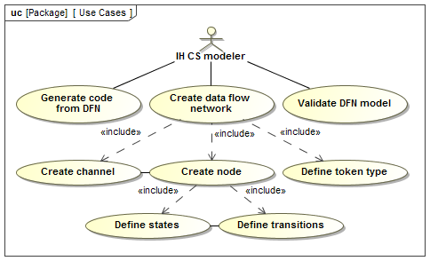

Specification evolution
I. Phase :

Slide 4
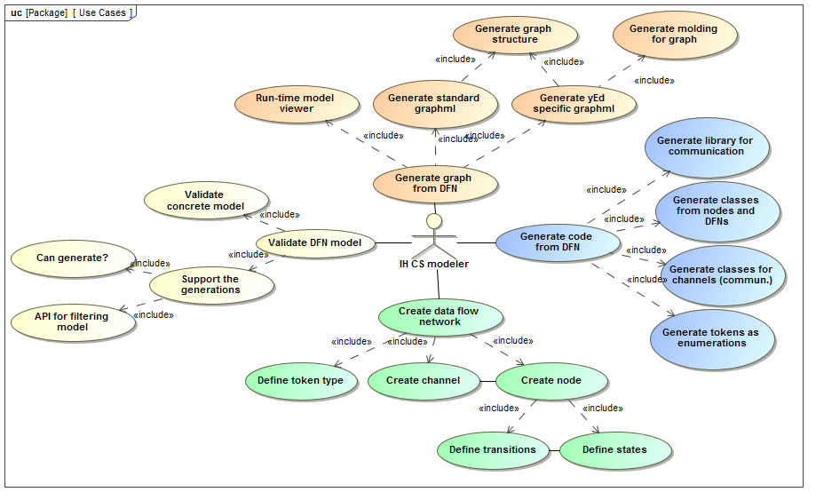
Specification evolution
III. Phase:

Slide 5
Meta-model design
Main decisions:
  Token management:
    Integer and string tokens
    String token → value is selected from a set of literals
  Introduction of Ports
    Channels, nodes →Contained by a DFN object
    Ports → represent Channels in the scope of Nodes
    Input and output ports are distinguished
  Input and output ports for DFN objects
    Representing data sources and sinks

Slide 6
Meta-model design
Main decisions :
  Mapping support
    Transaction trigger conditions, and action objects
    Integer token → Equation , Inequality (<,<=,>,>=)
    String token →Maps the value of the string token on the given channel to a static literal
  Individual applications, communication protocols
    Represented in the model

Slide 7
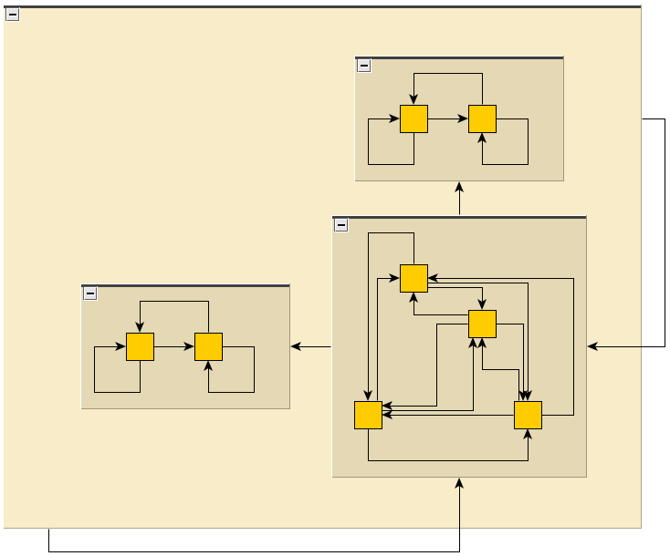
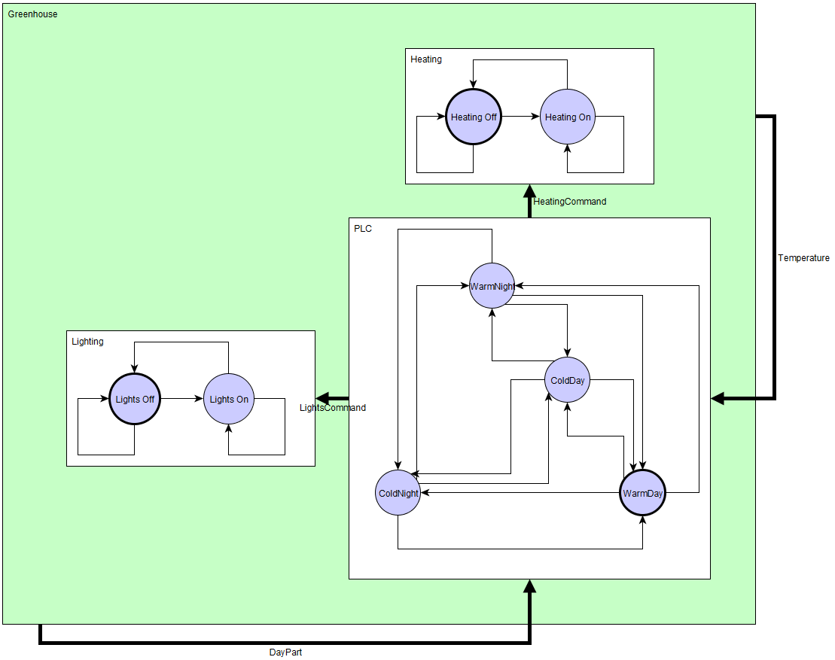
Graph generation
Two different GraphML file format
  Standard GraphML file → no tool specific elements are used
  yEd specific GraphML file →elements are formatted and labeled

Slide 8
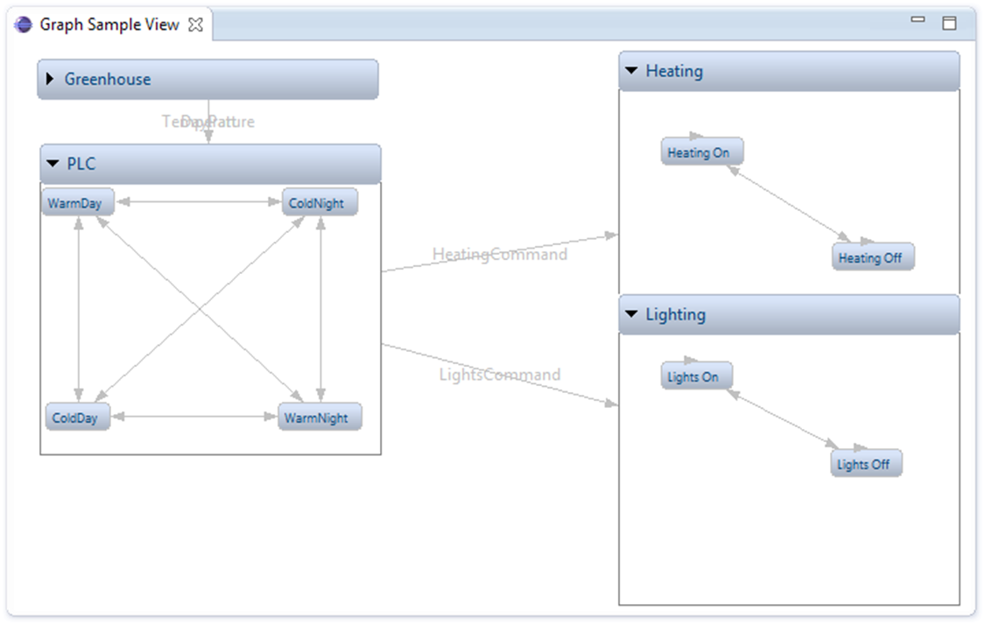
Additional visualization
Zest-based graph visualization View
  Goal: live representation of the DFN being edited

Slide 9

Model validation
Well-formedness constraints
  Described by IncQuery patterns
  Different semantics compared to OCL
  The problematic elements are selected
IncQuery Validation Framework
  Annotated incQuery patterns used
  Based on them a validation incQuery project is generated
  The validator is registered to the given model
  Code generation is blocked if there are errors
  Suggestions for the errors

Slide 10
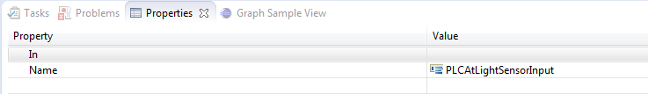
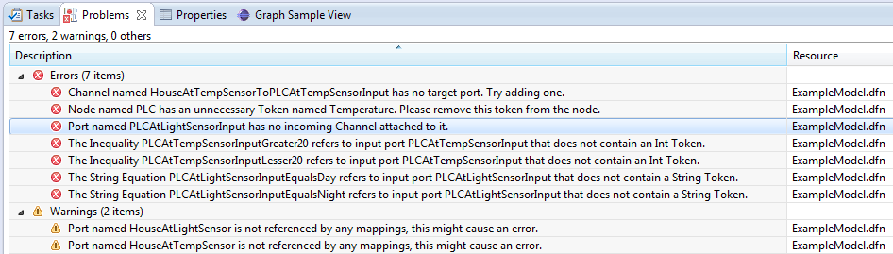
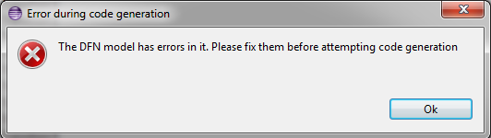
IncQuery – Model validation example

Slide 11
IncQuery – Used by code generator
Code generation is blocked if there are errors
LHS conditions described with IncQuery patterns
Using the IncQuery generated API
  Patterns used by the generator→ Codegen.eiq
  Patterns → code is generated by the IncQuery framework→ being called by the generator
Custom API for these patterns
  IncQuery project → CodegenApi.java
  Instead of IncQuery specific objects, returns java collections → easier processing during code generation

Slide 12

Code generation
Java source code generated based on the model
Using XTend templates

Slide 13
Code generation - implementation
The generator traverses the model
Generates code for every type that demands it (e.g. Node)
  Individual Xtend template for each type
  Other properties of these types → represented by attributes or methods (e.g Channel)
Nodes →Independent Java applications
Communication between them
  MQTT és JMS support
Communication with UI
  Using a central API

Slide 14
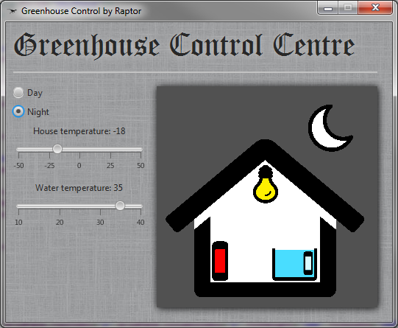
Example JavaFX GUI

Slide 15
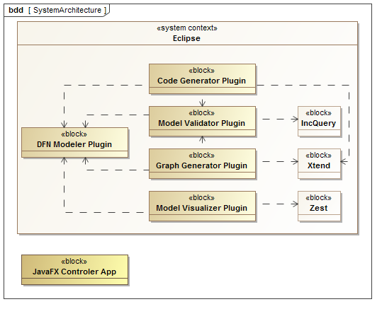

System Architecture

Slide 16
Summary
Tamás Borbás
  GraphML visualization
  Run-time modell visualization using Zest
  Example JavaFX client
Péter Lunk
  DFN meta-model
  Model validation using EMF-IncQuery validation framework
  EMF IncQuery Patterns used by Code generator
Dávid Zilahi
  XTend based code generator
  Environment for running the generated code

