Slide 1
Instructional Practices | Unit 1: Building an Effective Classroom | Classroom Culture| Lesson 1.04
Planning and Delivering Effective Directions
This work is licensed under a Creative Commons Attribution-Noncommercial-Share Alike 4.0 International License.

Slide 2
TEKS Standards & Objectives
TEKS 7A, 7C, 7D
The student will:
define and describe characteristics of effective directions

Slide 3
Bellringer
Think about the routines that we use in class, including what to do when you enter the classroom, Stand Up – Hand Up – Pair Up, and Turn and Talk. What do these routines have in common?

Slide 4
Vocabulary
Transition: The space and time between instructional activities during which teachers and students make a shift from one activity to another.
Sequential: Occurring in a specific order
Observable: Able to be seen

Slide 5
Characteristics of Effective Directions
Specific
  Effective directions describe concrete actions that students should take
Sequential
  Set out the order in which actions should be taken
Observable
  The teacher needs to be able to see the students following the directions

Slide 6
When should a teacher provide effective directions?
During a transition, which is the space and time between instructional activities during which teacher and students make a shift from one activity to another.

Slide 7
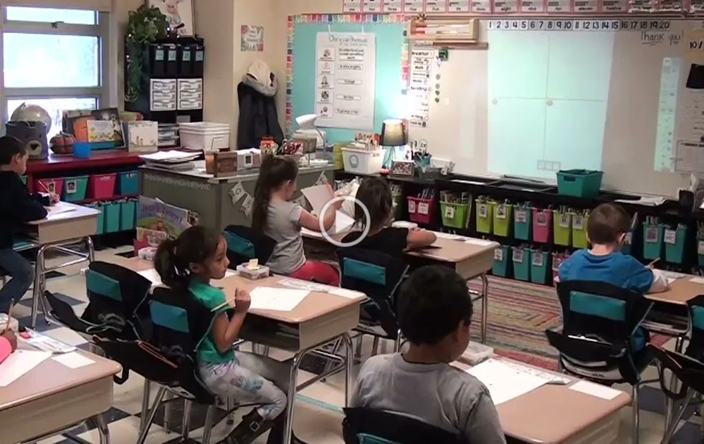
Video: Planning & Delivering Instruction
Planning & Delivering Instruction-J. Crucetti

Slide 8
Exit Ticket
List and explain the three key characteristics of effective directions.

