Slide 1
Instructional Practices| Unit 10: Putting it All Together | Lesson 10.07
Reflective, Collegial Practices | Growing Collaborative Skills and Mindsets
This work is licensed under a Creative Commons Attribution-Noncommercial-Share Alike 4.0 International License.

Slide 2
TEKS Standards & Objectives
TEKS 5A, 11A
The student will…
Identify why collaboration is necessary to improving practice
Explain and identify dispositions and practices that are helpful for collaboration (protocols and professional learning communities, inviting feedback, being observed, etc.)

Slide 3
Bellringer
How do you define effective collaboration?
In what ways has collaborating with another person helped you to grow or improve in the past?

Slide 4
Vocabulary
Term | Definition
Collegial Collaboration | Cooperative relationship of colleagues working together toward the pursuit of shared goals and outcomes

Slide 5

Collaboration in T-TESS Rubric

Slide 6
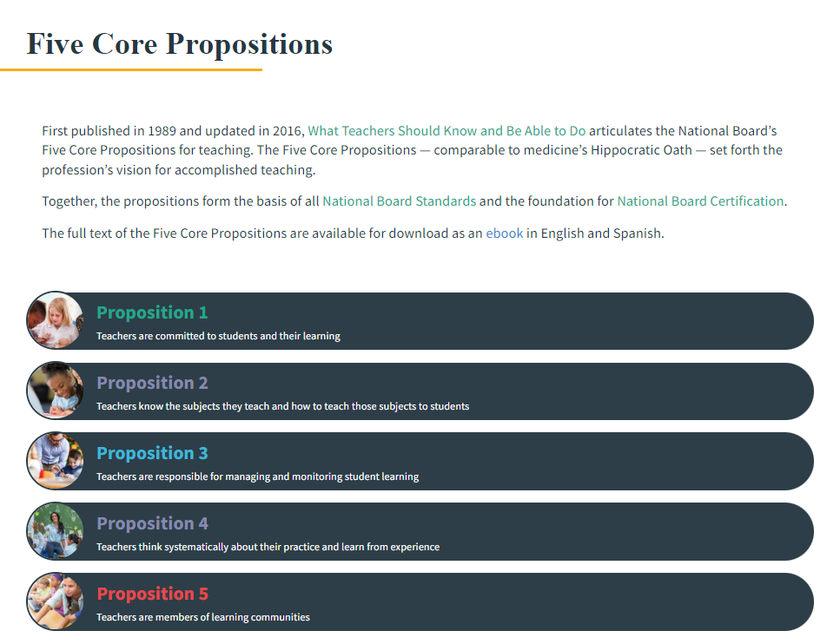
Collaboration in National Board Certification

Slide 7
Benefits of Collegial Collaboration
Helps to build relationships. As teachers work together, they begin to rely on each other, and you get the sense you are not in it alone.
Creates a sense of shared responsibility. In working together, teachers learn that they share the responsibility for student learning and can work to share the burdens as well.
Strengthens each other. As teachers work together, they learn to effectively leverage the strengths that each bring to achieve their goals.
Increases knowledge. Teachers who collaborate can share best practices and learn from other’s experiences and knowledge.
Increases student achievement. Many research studies have shown that students had higher achievement gains in schools with strong collaborative environments.

Slide 8
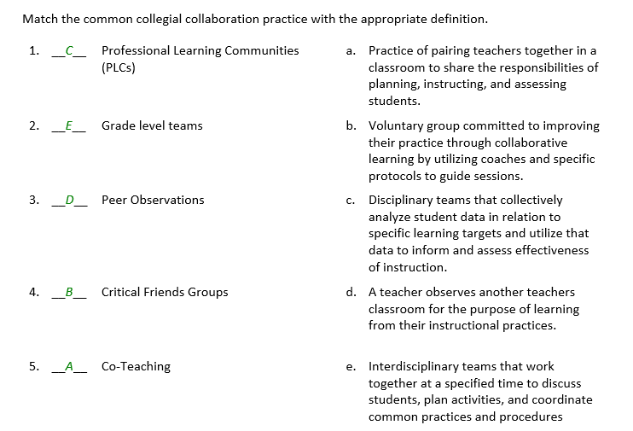
Collegial Collaboration Practice Answers

Slide 9
Exit Ticket
Why is collaboration so important as an educator? List at least 2 benefits of collegial collaboration.
Identify and explain at least three common practices for collegial collaboration.

