Slide 1
Instructional Practices| Unit 10: Putting it All Together | Lesson 10.08
Reflective, Collegial Practices | Developing Habits of Continuous Improvement
This work is licensed under a Creative Commons Attribution-Noncommercial-Share Alike 4.0 International License.

Slide 2
TEKS Standards & Objectives
TEKS 5A, 11A
The student will…
Describe parts and purposes of the continuous improvement cycle (Plan-Do-Study-Act).
Observe and discuss the continuous improvement cycle as demonstrated by Texas Lesson Study.

Slide 3
Bellringer
Of the quotes listed below, select one of them that speaks most to you. Why does this quote stand out? Do you agree or disagree with it? How do you think the quote you selected applies to teaching and learning?
Quote A: “When you’re in a growth mindset, what that means is that you choose to see struggle and challenge as an opportunity for growth and for learning and development.” -Chris Bertram
Quote B: “It is only after you’ve stepped outside your comfort zone that you begin to change, grow, and transform.” -Roy T. Bennett
Quote C: “Practice the philosophy of continuous improvement. Get a little better every single day.” -Author Unknown

Slide 4
Vocabulary
Continuous Improvement Cycle: An intentional approach to improving one’s practice through planning, action, and reflection.
Texas Lesson Study: A continuous improvement cycle in which Texas teachers work collaboratively to plan, practice, and reflect on instruction around a particular problem of practice within their content and grade level.

Slide 5
Plan-Do-Study-Act
Plan
Do
Study
Act
An example of a continuous improvement cycle where, when used in education, teachers plan for, implement, and observe the process of a desired change.

Slide 6
Plan
Identify the problem
List possible steps to approach the problem
List desired outcomes

Slide 7
Do
Apply the steps listed in the plan
Take notes/make observations during this time

Slide 8
Study
Study the results after applying the plan.
  Did you see the outcome you expected?
  What were the actual results when compared to the desired ones?

Slide 9
Act
Consider your next steps.
Has the solution addressed the problem?
Do you need to return to any of the previous step?

Slide 10
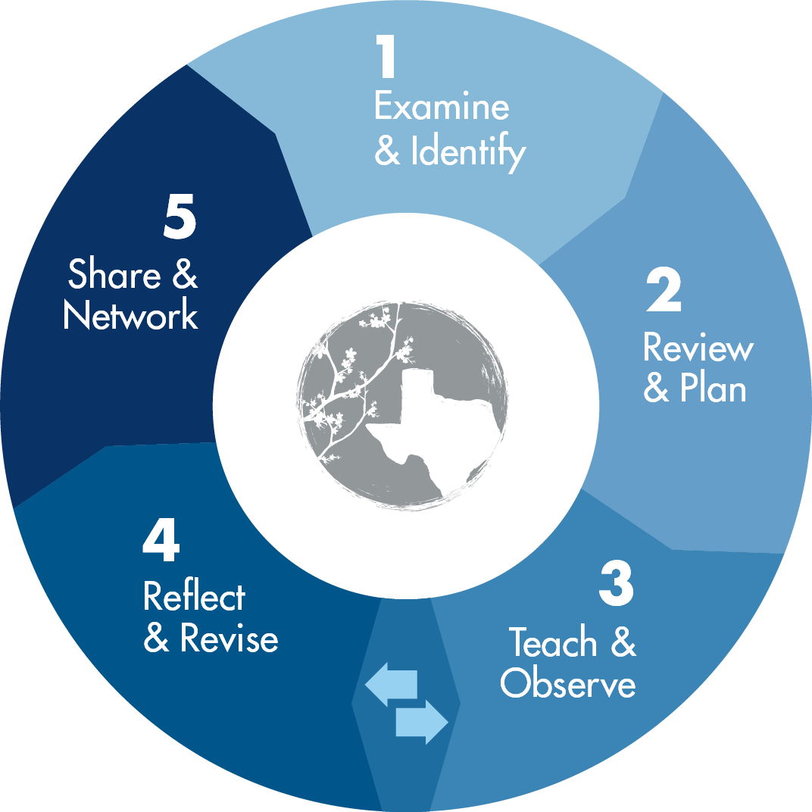
Texas Lesson Study Model

Slide 11
Exit Ticket
Explain the steps of the Plan-Do-Study-Act continuous improvement cycle.
How do continuous improvement cycles benefit teachers? How do they benefit students?
Return to your bellringer from earlier in class. How does the quote you selected relate to Continuous Improvement Cycles, such as Texas Lesson Study?

