Slide 1
Instructional Practices| Unit 10: Putting It All Together| Lesson 10.18
Professional Portfolio:
Personal Philosophy Presentations
This work is licensed under a Creative Commons Attribution-Noncommercial-Share Alike 4.0 International License.

Slide 2
TEKS Standards & Objectives
TEKS 13A, 13B
The student will:
Understand the expectations for the Personal Philosophy and Instructional Practices portfolio presentation
Present Portfolio

Slide 3
Bellringer
Compare your Portfolio Presentation to the Presentation Checklist to make sure all components are included in your PowerPoint.

Slide 4
Bellringer
Presentation Checklist
Your “Why” as it relates to teaching. (Why the profession matters, why you are considering pursuing the profession.)
A Personal Philosophy of Education
Reflections on your practice through your field experiences, including:
  one situation that demonstrates a personal strength in your approach to teaching.
  one situation where you see an area where you grew in your approach to teaching through this course.
Identify at least 2 artifacts that reflect the values you shared in your philosophy of education and explain how they do so. This may include:
  Classroom Management Plan
  Lesson Plans
  Sample Assessments
Outline your goals for pursuing a career in education and a plan for how you hope to achieve these goals.

Slide 5
Components of an Effective Presentation:
  Directions: Use the next few minutes to silently review and practice your Portfolio Presentation. Refer to the “Components of an Effective Presentation” and/or your Checklist to make changes or revisions.
  Organization and Structure: The presentation is developed in a focused, creative, and coherent way.
  Content: The presentation addresses all required components and provides appropriate elaboration around each element.
  Design: The presentation is visually appealing, using colors, images, and graphics to strengthen the quality of the final product.
  Language and Delivery: The presenter speaks clearly, effectively, and confidently (e.g., volume, pace, articulation) in a presentation that does not exceed 10 minutes.

Slide 6
Portfolio Presentation Norms
As you are an audience member of Portfolio Presentations, please use the following Norms:
• Listen actively.
• Remain engaged and focused on the presenter.
• Respect the presenter.
• Raise your hand to ask relevant questions.

Slide 7
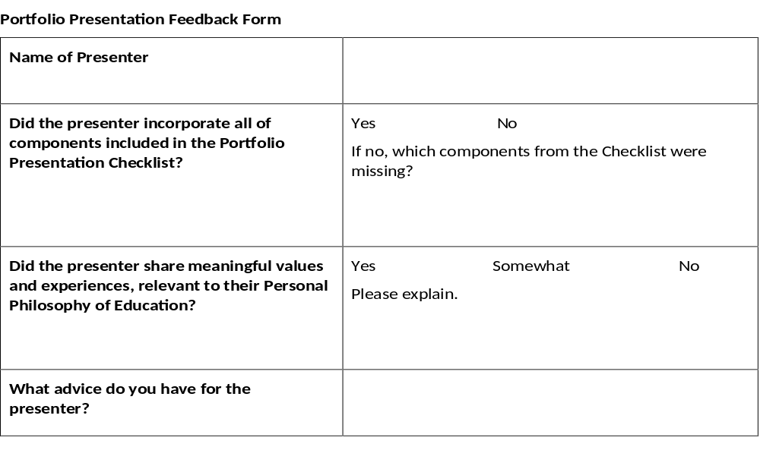
Portfolio Presentation Feedback Form

Slide 8
Exit Ticket
In lieu of an exit ticket, please submit your completed portfolio presentation.

