Slide 1
Instructional Practices | Unit 1: Building an Effective Classroom | Classroom Culture| Lesson 1.03
Types of Routines
This work is licensed under a Creative Commons Attribution-Noncommercial-Share Alike 4.0 International License.

Slide 2
TEKS Standards & Objectives
TEKS 7A, 7C, 7D
The student will:
practice participating in routines that contribute to a safe and effective classroom environment
explain the importance of systems and routines in creating safe and effective learning environment
define and identify academic, behavioral, and cultural routines

Slide 3
Bellringer
Think back to the video we watched at the end of our last class. What stood out most to you and why?

Slide 4
Vocabulary
Procedure: The step-by-step process for completing a recurring action in the classroom
Routine: Procedures and systems that are automatic and habitual
System: A set of related procedures that helps a classroom run smoothly and efficiently

Slide 5
Types of Routines
Academic Routines: Routines that “enable students to complete tasks that directly support learning, like how to annotate a text or make eye contact during a classroom discussion” (Texas TLAC Online)
Behavioral Routines: Routines that “help students manage themselves, their space, and their materials while maximizing efficiency” (Texas TLAC Online)
Cultural Routines: Routines that “give students clear actions to demonstrate their shared classroom values, norms, and aspirations” (Texas TLAC Online)

Slide 6
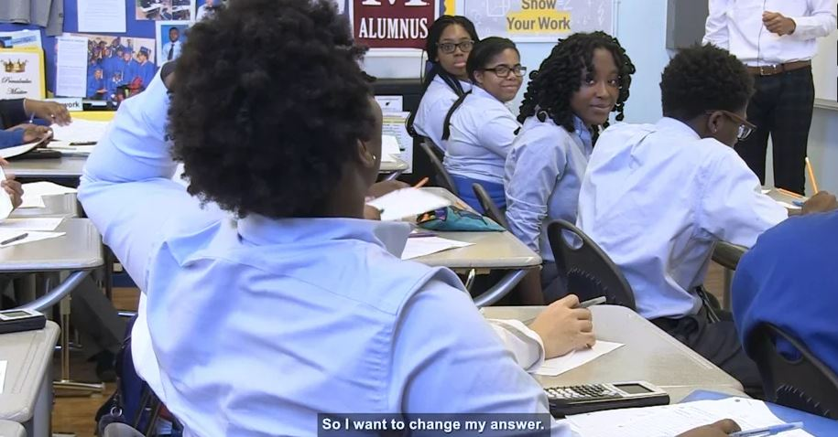
Types of Routines: Video
Designing Systems and Routines: Denarius Frazier

Slide 7
Exit Ticket
Review each of the routines on your Exit Ticket. For each routine, identify the type of routine (academic, behavioral, or cultural) and explain how it contributes to a safe and effective classroom.

