Slide 1
Instructional Practices| Unit 2: Classroom Management| Lesson 2.12
A Well-Designed Classroom
This work is licensed under a Creative Commons Attribution-Noncommercial-Share Alike 4.0 International License.

Slide 2
TEKS Standards & Objectives
TEKS 7A, 7E
The student will:
identify components of a well-designed classroom
describe how the physical layout of a classroom contributes to a safe and effective learning environment

Slide 3
Bellringer
Choose either a classroom in which you find it easy to learn or a classroom in which you find it difficult to learn. Describe the classroom in detail. Consider the following questions:
  When you are at your desk, what can you see in this classroom?
  How is the classroom arranged? How does the arrangement contribute to your (in)ability to learn?
What is the mood of the classroom and what about the classroom contributes to this mood?

Slide 4
Video: Classroom Organization
Classroom Management-Organize the Physical Classroom

Slide 5
Essential Components of Classroom Design
Allows for smooth transitions
Provides access to materials
Limits noise and distractions
Meets individual needs of students, such as:
  Students who need to be close to the board
  Students who need to be away from distractions
  Students who need space for more frequent breaks
  Students who need to be close to the teacher or sit with a buddy
  Students who may have personal classroom aides
  Students who need extra space for wheelchairs or other mobility supports

Slide 6
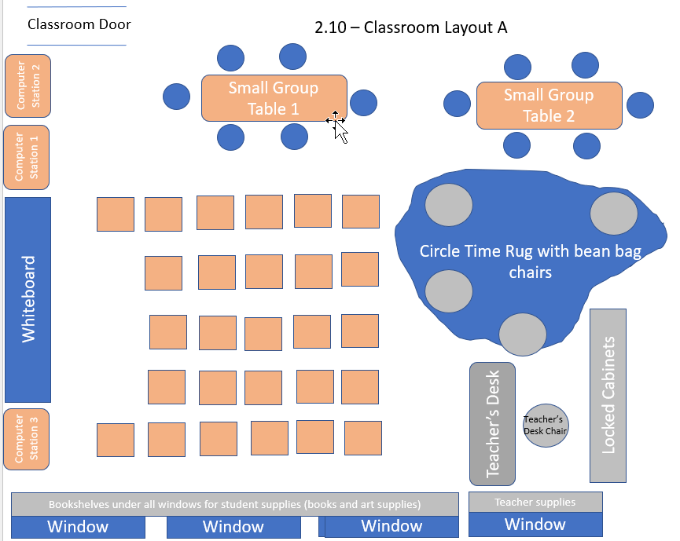
Analyze an Example

Slide 7
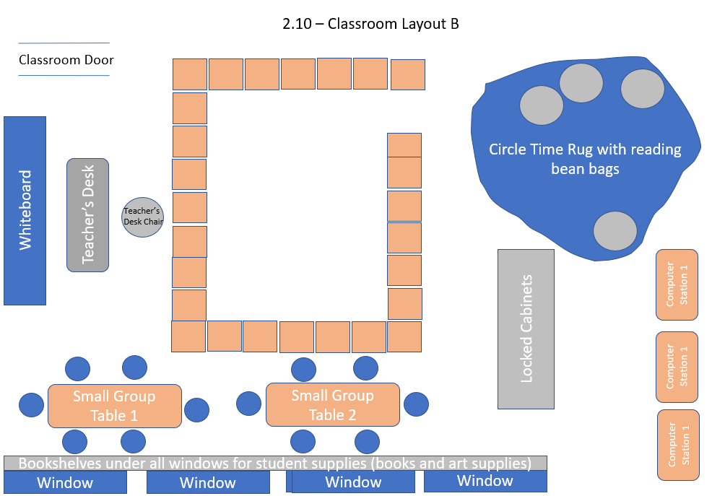
Analyze a Non-Example

Slide 8
Exit Ticket
Identify what elements of the classroom design help make it a safe and effective learning environment (Consider furniture, materials, and spaces for activities)? Is there anything you would add or take away from the space?
Pryor's 3rd Grade Classroom

