Slide 1
Instructional Practices| Unit 2: Classroom Management| Lesson 2.13
A Well-Designed Classroom, Part II
This work is licensed under a Creative Commons Attribution-Noncommercial-Share Alike 4.0 International License.

Slide 2
TEKS Standards & Objectives
TEKS 7A, 7E
The student will:
evaluate classroom designs for effectiveness
design a classroom layout that allows for smooth transitions, whole group discussion, small group work, and access to materials

Slide 3
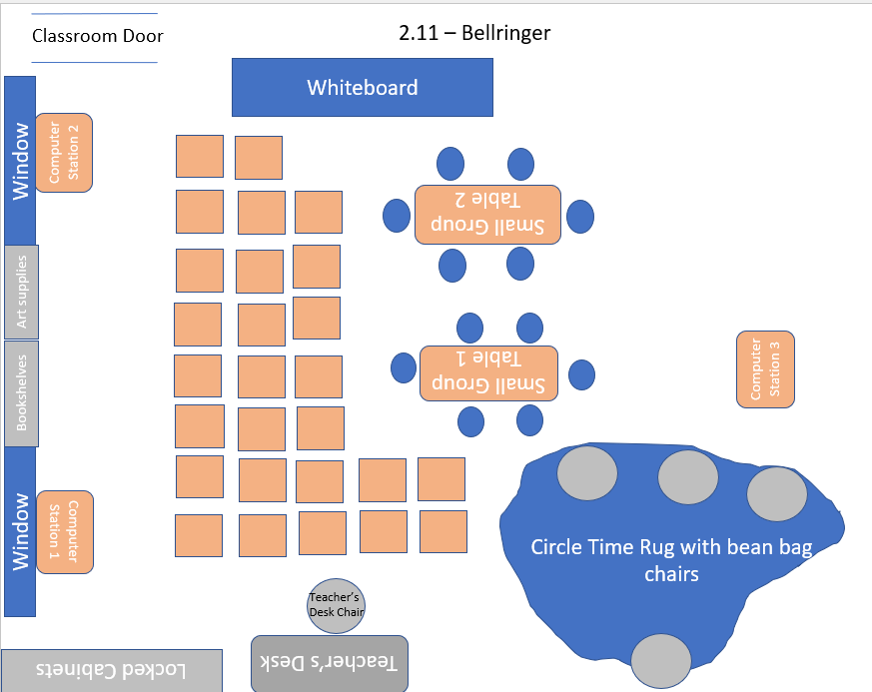
Bellringer
Review the classroom layout. Complete the related evaluation and analysis.

Slide 4
Exit Ticket
Consider your future classroom. What are some ideas you have for classroom design?
Justify your choices by explaining how they will support students.

