Slide 1
Instructional Practices| Unit 2: Classroom Management| Lesson 2.16
Radar | Building Radar, Part II
This work is licensed under a Creative Commons Attribution-Noncommercial-Share Alike 4.0 International License.

Slide 2
TEKS Standards & Objectives
TEKS 7A, 7C, 7E
The student will:
identify and apply effective behavior management techniques
plan and deliver specific, concrete, observable directions for a common scenario in a classroom
analyze a classroom scenario to determine how well the teacher used the Radar technique.

Slide 3
Bellringer
Read the following scenario and rewrite the script to include specific, concrete, and observable directions.
Scenario: “Good morning! Please follow our morning procedures as you enter the class and get started on your bellringer.”

Slide 4
Vocabulary
Radar | A classroom management strategy in which the teacher gives clear, observable directions, visually scans the room, and positions themself to be easily seen by students.
Observable Directions | Directions that allow the teacher to see if students are meeting the expectation
Specific | Clearly defined or identified
Concrete | Providing specific instructions or actions
Scanning | Looking consistently and intentionally across the entire classroom
Pastore’s Perch | Observing from the corner of the room where you can see most effectively and proficiently.

Slide 5
Video Analysis
Building Radar: Kerri Rizzolo

Slide 6
Video: Pastore’s Perch
Building Radar: Patrick Pastore

Slide 7
Notes: Pastore’s Perch
Pastor’s Perch helps teacher’s see more of the room
If a teacher is standing at the center of the room, they will need to scan a field of 150 degrees to see all students
If a teacher is standing in the corner of the room – Pastore’s Perch – they only need to scan 80 degrees to see all students
Field of vision is wider from Pastore’s Perch – there are fewer blind spots

Slide 8
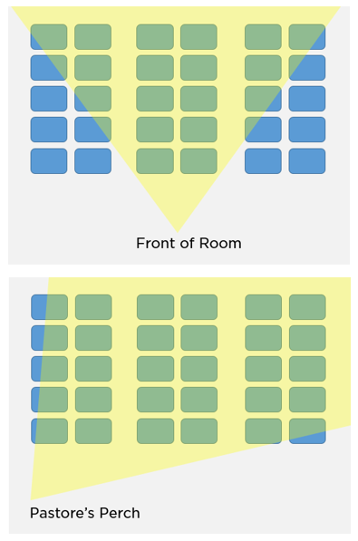
Pastore’s Perch

Slide 9
Exit Ticket
Analyze the scenario below to determine how well Ms. Mason used the Radar technique. Use the rubric below to provide specific evidence from the scenario to support your response and make suggestions for improvement.
Ms. Mason is teaching a science lesson. Ms. Mason instructs her class by saying, “please find the rock sample labeled #1 and place it in front of you.” As she does so, she glances down, using the moment just after her direction to double-check her notes and glance at her watch to see how she’s doing for time.

