Slide 1
Instructional Practices| Unit 4: The Science of Learning| Lesson 4.03
Attending to the Most Important Content

Slide 2
TEKS Standards & Objectives
TEKS 4A, 4B, & 6D
The student will…
…describe why focusing attention on the most important content is necessary for effective instruction
…analyze examples of learning activities to determine how they focus student attention on the most important content

Slide 3
Bellringer
A social studies teacher’s students need to understand the effects of volcanoes in shaping the landscape. Which learning activity would best do this?
Students create a paper mâché volcano, paint it, and make it erupt using baking soda and vinegar
Students read a short article about volcanoes, answer five multiple-choice questions, and draw a picture of a volcano
Students choose a region whose geography is affected by volcanoes. They collect research from three different approved sources and give a short presentation about their findings.
Use the table in your Student Guide to analyze the three options.

Slide 4
Five Principles for Teaching based on the Science of Learning
Principle 1
Principle 2
Principle 3
Attending
Prior Knowledge
Avoiding Overload
Learning requires attending to the most important content
Learning builds on prior knowledge.
Too much information at once can interfere with learning.
Principle 4
Principle 5
Cognitive Engagement
Practice with Feedback
Learning requires cognitive engagement and should be effortful.
Practice and feedback are essential to move ideas permanently into long-term memory.

Slide 5
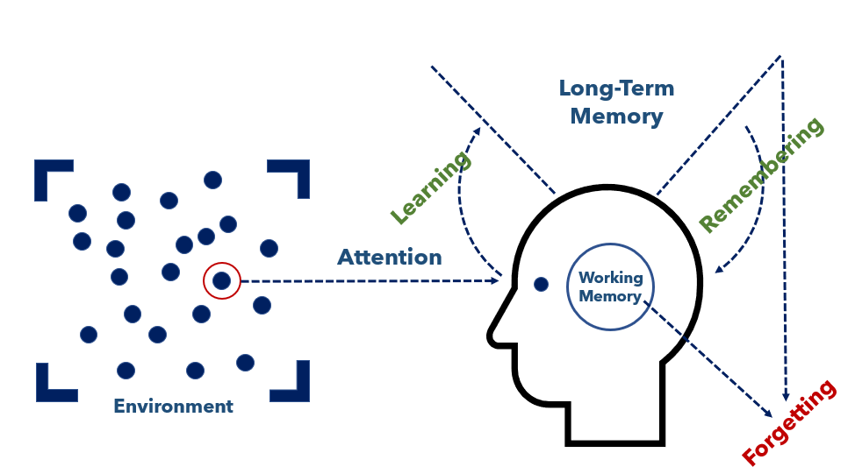
Thinking about the simple memory model, what is a math teacher trying to do when she says to her students, “I always tell you to make sure you put units on your answers to word problems – 4.3 seconds, 900 kilograms, 12 candy bars – why do you think I am such a stickler for that?”

Slide 6
Exit Ticket
Describe why directing student’s attention is vital to helping students learn. Use components of the Simple Memory Model to explain why.
Choose which activity best focuses students’ attention on the most important content. Why did you choose this activity?

