Slide 1
Instructional Practices| Unit 4: The Science of Learning| Lesson 4.08
Cognitive Engagement
This work is licensed under a Creative Commons Attribution-Noncommercial-Share Alike 4.0 International License.

Slide 2
TEKS & Objectives
TEKS 4A, 4B, 6D
The student will…
…define cognitive engagement
…identify examples and non-examples of cognitive engagement in a lesson plan
…evaluate the impact of cognitive engagement on learning

Slide 3
Bellringer
Read the following two scenarios. Your task is to determine which would lead to better learning and explain why.
Scenario #1: Mrs. James is teaching students about the changing shape of land. During her lesson, Mrs. James presents images of various landforms and has students consider what caused the formation through a series of open-ended questions. Students explore water and land interactions by using a model to investigate what happens to land when it interacts with waves along a shoreline. Students analyze and compare solutions to problems caused by water changing the shape of the land. Students apply what they have learned using the engineering design process to develop a shoreline protection system that could slow changes to the shore of Port Aransas to prevent the Aransas Pass Lighthouse from falling into the ocean.
Scenario #2: Mrs. Emery is also teaching students about the changing shape of land. She presents a PowerPoint on the role water plays in shaping land and creating landforms. Mrs. Emery shows students images of landforms and reads various texts about how different landforms were formed by water. At the end of the lesson, students take an assessment on water and land interactions.

Slide 4
Five Principles for Teaching based on the Science of Learning
Principle 1
Principle 2
Principle 3
Attending
Prior Knowledge
Avoiding Overload
Learning requires attending to the most important content
Learning builds on prior knowledge.
Too much information at once can interfere with learning.
Principle 4
Principle 5
Cognitive Engagement
Practice with Feedback
Learning requires cognitive engagement and should be effortful.
Practice and feedback are essential to move ideas permanently into long-term memory.

Slide 5
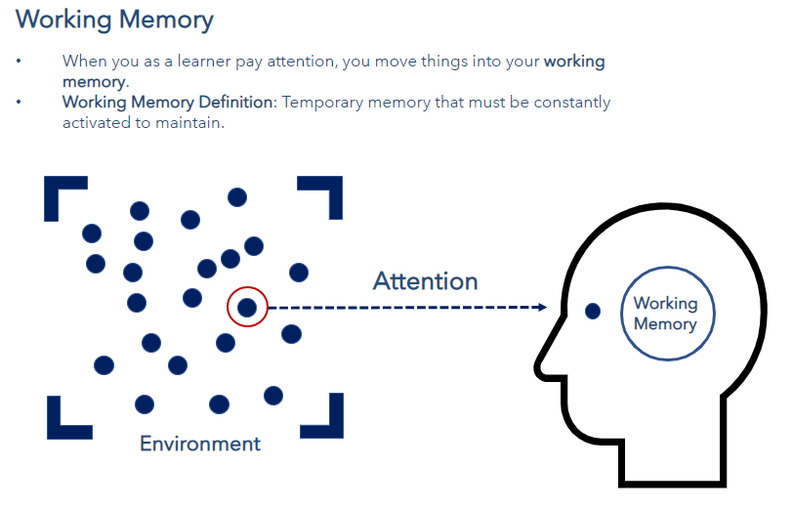
Working Memory

Slide 6
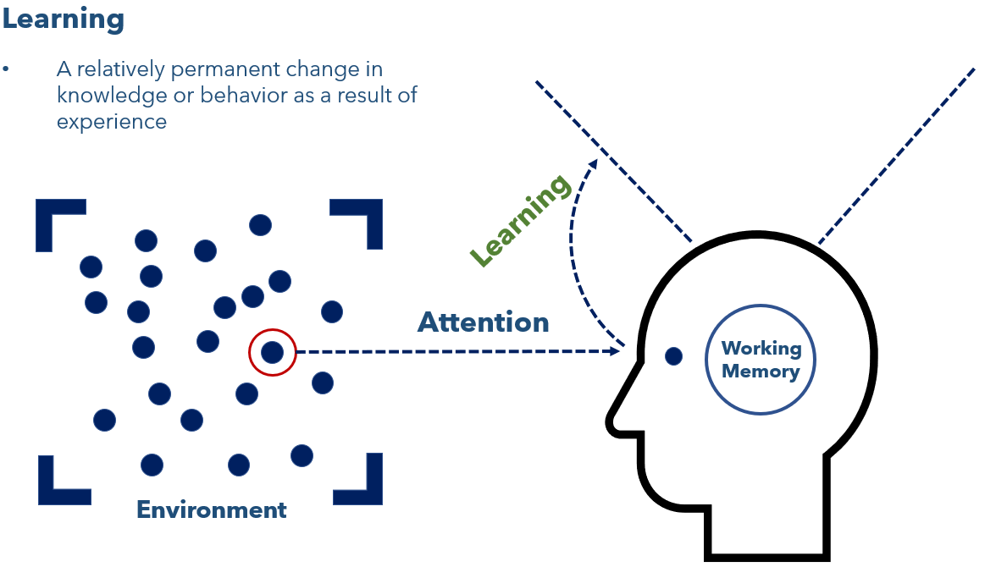
Learning

Slide 7
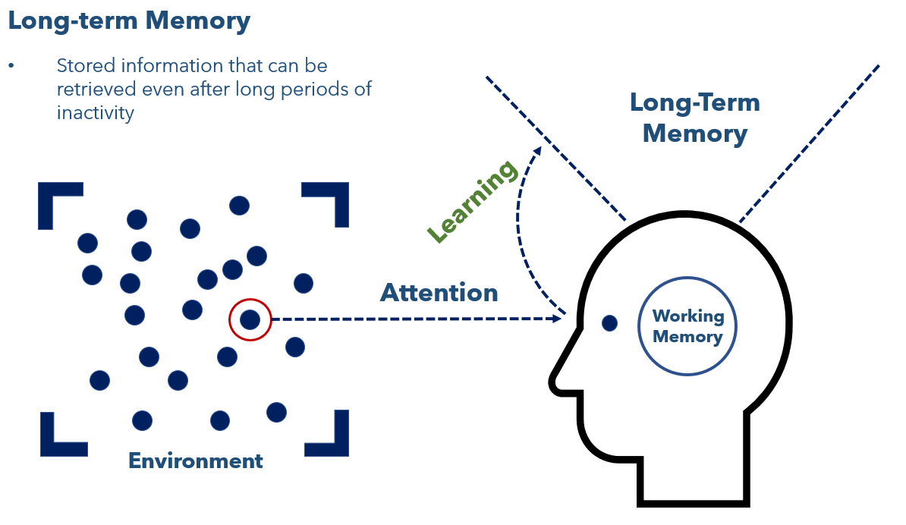
Long Term Memory

Slide 8
Guidelines for Cognitive Engagement
Guideline | Examples | Non-Examples
Requires students to organize a body of knowledge and understand how it works together. | Question: What are the organs of the body, their purpose, and how do they work together? Task: Create a visual model to show the purpose of each organ of the body and how the organs work together. | Question: What are the organs of the body? Task: Using the image of the body, draw and label the organs.

Slide 9
Guidelines for Cognitive Engagement
Guideline | Examples | Non-Examples
Requires students to organize a body of knowledge and understand how it works together. | Question: What are the organs of the body, their purpose, and how do they work together? Task: Create a visual model to show the purpose of each organ of the body and how the organs work together. | Question: What are the organs of the body? Task: Using the image of the body, draw and label the organs.
Requires students to think about why something happens. | Question: Why does the author use this adjective in the opening sentence? Task: Draft an opening sentence using descriptive language. Highlight the adjectives used in your sentence and explain why you chose to use that adjective in your sentence. | Question: What adjective does the author use in the opening sentence? Task: Make a list of the different adjectives you see used in the paragraph.

Slide 10
Guidelines for Cognitive Engagement
Guideline | Examples | Non-Examples
Requires students to organize a body of knowledge and understand how it works together. | Question: What are the organs of the body, their purpose, and how do they work together? Task: Create a visual model to show the purpose of each organ of the body and how the organs work together. | Question: What are the organs of the body? Task: Using the image of the body, draw and label the organs.
Requires students to think about why something happens. | Question: Why does the author use this adjective in the opening sentence? Task: Draft an opening sentence using descriptive language. Highlight the adjectives used in your sentence and explain why you chose to use that adjective in your sentence. | Question: What adjective does the author use in the opening sentence? Task: Make a list of the different adjectives you see used in the paragraph.
Requires students to think about how something happens. | Question: How does water shape land? Task: Build a model to test ways to slow down erosion. | Question: Can water shape the land? Task: Write a paragraph to explain erosion.

Slide 11
Guidelines for Cognitive Engagement
Guideline | Examples | Non-Examples
Requires students to organize a body of knowledge and understand how it works together. | Question: What are the organs of the body, their purpose, and how do they work together? Task: Create a visual model to show the purpose of each organ of the body and how the organs work together. | Question: What are the organs of the body? Task: Using the image of the body, draw and label the organs.
Requires students to think about why something happens. | Question: Why does the author use this adjective in the opening sentence? Task: Draft an opening sentence using descriptive language. Highlight the adjectives used in your sentence and explain why you chose to use that adjective in your sentence. | Question: What adjective does the author use in the opening sentence? Task: Make a list of the different adjectives you see used in the paragraph.
Requires students to think about how something happens. | Question: How does water shape land? Task: Build a model to test ways to slow down erosion. | Question: Can water shape the land? Task: Write a paragraph to explain erosion.
Requires students to compare and contrast ideas. | Question: What similar themes are conveyed in these two short stories? How do they convey these themes using different literary devices? Task: Write your own short story. With a partner, read each other’s short stories. Create a Venn Diagram to analyze how the themes and the literary devices used to convey those themes compare between your two short stories. | Question: Are the two stories similar or different? Task: Write a short paragraph to tell what is similar about the two stories.

Slide 12
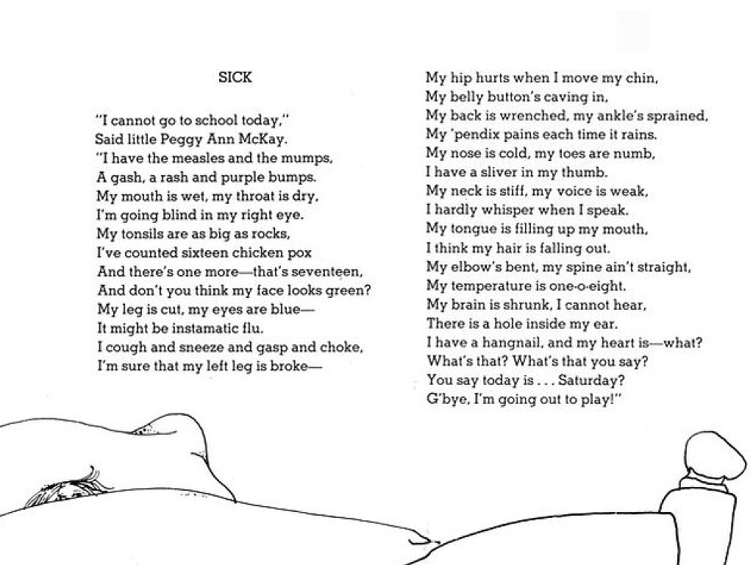
Sick, Shel Silverstein

Slide 13
Exit Ticket
Examine Module 1 - Lesson 3.1 from 3rd Grade Eureka Math – Understand equal groups of as multiplication (Teacher Guide Pages 23-33).
Identify how the lesson requires cognitive engagement and record your evidence in the graphic organizer on your Exit Ticket.

