Slide 1
Instructional Practices| Unit 4: The Science of Learning| Lesson 4.10
Deepening Student Understanding with Examples and Non-Examples
This work is licensed under a Creative Commons Attribution-Noncommercial-Share Alike 4.0 International License.

Slide 2
TEKS Standards & Objectives
TEKS 4A, 4B, & 6D
The student will…
…identify and analyze the use of examples and non-examples in a lesson.
…evaluate the impact of using examples and non-examples in a lesson.

Slide 3
Bellringer
Look at the following tasks to determine which task is more rigorous based on the guidelines for rigorous tasks listed below. Use the guidelines for rigorous tasks to support your answer.
Task 1: What is 1/3 of ½?
Task 2: Ms. Green makes a full pan of brownies to bring to school. She’s going to bring half of the pan to share with her students. She knows many of her students like icing, so she needs to figure out how much icing to make. If she ices one third of the part that she’s taking to school, how much of the whole pan would that be? Write an equation to represent this, and then use a fraction bar or number line to explain your answer.

Slide 4
Vocabulary
Examples: Something that shows what is expected or what something is.
Non-Examples: Something that shows what is not expected or what something is not.

Slide 5
Success Criteria: Deans of Impact
Lessons should include varied examples that will help students recognize the concept or idea in a variety of contexts.
Lessons should include contrasting non-examples that will help students develop an accurate mental picture of what a concept is and is not.
Lessons should prompt students to elaborate about the connections and differences among the examples and non-examples.

Slide 6

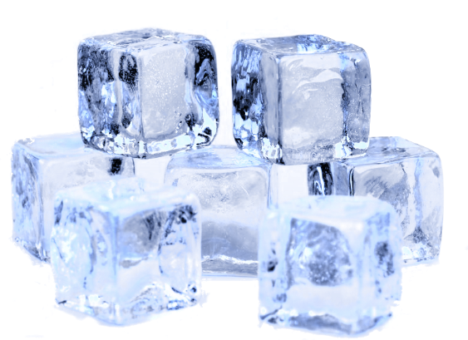

Guidelines Practice
Guideline 1: Lessons should include varied examples that will help students recognize the concept or idea in a variety of context.
Example: Solids and Non-Solids
Solid: A type of matter that keeps its shape.

Slide 7

Guidelines Practice
Guideline 2: Lessons should include contrasting non-examples that will help students develop an accurate mental picture of what a concept is and is not.
Why is water a non-example of a solid?

Slide 8
Partner Practice
First Period
Integers: An integer is a number with no decimal or fractional part, from the set of negative and positive numbers, including zero.
Examples: -5, 0, -1, 5, 8, -97, and 3,043
Second Period
Integer

Slide 9
Exit Ticket
Read the “Slice It Up!” Lesson Plan.
This lesson uses only examples to teach the concept of partitioning a whole into fractions.
Identify two examples used in the plan.
Suggest a specific nonexample the teacher could use to build understanding.
Describe how the teacher could help students understand the connections and differences between the examples and nonexamples.

