Slide 1
Instructional Practices| Unit 4: The Science of Learning| Lesson 4.13
Practice with Feedback | Deliberate Practice
This work is licensed under a Creative Commons Attribution-Noncommercial-Share Alike 4.0 International License.

Slide 2
TEKS & Objectives
TEKS 4A, 4B
The learner will…
…understand why practice is vital to learning
…relate and implement principles and theories about the learning process to teaching and training situations

Slide 3
Bellringer
Have you ever heard someone use the phrase “practice makes perfect?”
Why do you think practicing helps to learn new concepts or ideas?
How does this relate to what you already know about the simple memory model?

Slide 4
Five Principles for Teaching based on the Science of Learning
Principle 1
Principle 2
Principle 3
Attending
Prior Knowledge
Avoiding Overload
Learning requires attending to the most important content
Learning builds on prior knowledge.
Too much information at once can interfere with learning.
Principle 4
Principle 5
Cognitive Engagement
Practice with Feedback
Learning requires cognitive engagement and should be effortful.
Practice and feedback are essential to move ideas permanently into long-term memory.

Slide 5
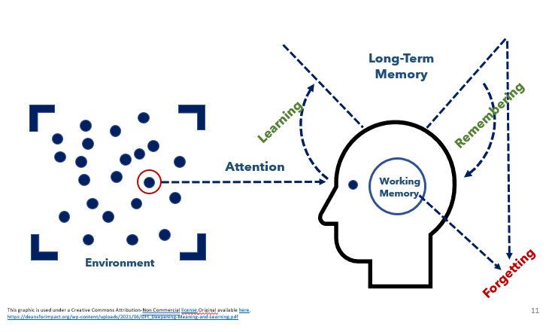
The Simple Memory Model

Slide 6
Vocabulary
Guided Practice: Practice where students are engaged in working on problems or practicing skills with support provided by the teacher.
Independent Practice: Practice where students engage in working on problems or practicing skills on their own.
Deliberate Practice: Practice that performs the learning goal (authentic), is spaced over time, is low-stakes, and is paired with timely feedback for improvement.
Feedback: Practice of giving students information about their performance against a standard with the purpose of improving student performance.

Slide 7
Deliberate Practice is Authentic
Authentic: Practice should require the student to perform the actual learning goal.
Example: If the goal is to write a thesis statement for an essay, students should practice writing thesis statements before moving to writing the entire essay.
Non-Example: Students were asked to read through essays and identify the thesis statements. They are not practicing the skill of writing the thesis statements which make the practice authentic.

Slide 8
Deliberate Practice is Spaced Over Time
Spaced Over Time: Practice should happen regularly over time.
Example: If you are introduced to new vocabulary words in Spanish class. You are initially introduced to the words, then you practice using the words in speaking and writing each day throughout the entire unit.
Non-Example: If you learned new vocabulary in Spanish class, practiced it in that class but never returned or used that vocabulary again, that is not an example of practice spaced over time.

Slide 9
Deliberate Practice is Low Stakes
Low Stakes: Practice should happen before assigning major grades or placing high value.
Example: If students must give a big speech, they may practice at home first, then give to a friend before delivering speech in class.
Non-Example: A non-example of low stakes would be standing up in front of a large group of people you don’t know to practice the speech. This is high stakes because you might feel self -conscious or uncomfortable practicing in front of you don’t know or feel like they are judging you.

Slide 10
Deliberate Practice is Paired with Timely Feedback
Paired with Timely Feedback: Practice provides opportunities to check to make sure that the skills and content practiced are correct.
Example: A teacher circulates around the room during independent practice and identifies one strength and one areas of growth for each student.
Non-Example: A teacher collects student homework, grades it for completion and returns it a week later.

Slide 11
Exit Ticket
A kindergarten teacher has created the following lesson goal and planned practice in her math lesson on the topic of attributes of two related objects. Examine the lesson goal and the corresponding practice.
  Does this practice activity reflect the characteristics of deliberate practice?
  Explain why or why not.
Why is deliberate practice important to the learning process?

