Slide 1
Instructional Practices| Unit 4: The Science of Learning| Lesson 4.14
Practice with Feedback | Quality Feedback
This work is licensed under a Creative Commons Attribution-Noncommercial-Share Alike 4.0 International License.

Slide 2
TEKS & Objectives
TEKS 4A, 4B
The learner will…
…identify characteristics of quality feedback

Slide 3
Bellringer
You have asked two friends to review the poem that you have just written for your English class. Below is the feedback that you received from each:
Friend 1: The imagery in your work is very strong. I was able to see the environment that you described and felt like I was there, and it pulled me in as a reader.
Friend 2: I really liked your poem. Great job!
After considering the feedback, which of the two do you feel is most helpful? What makes the feedback more helpful than the other?

Slide 4
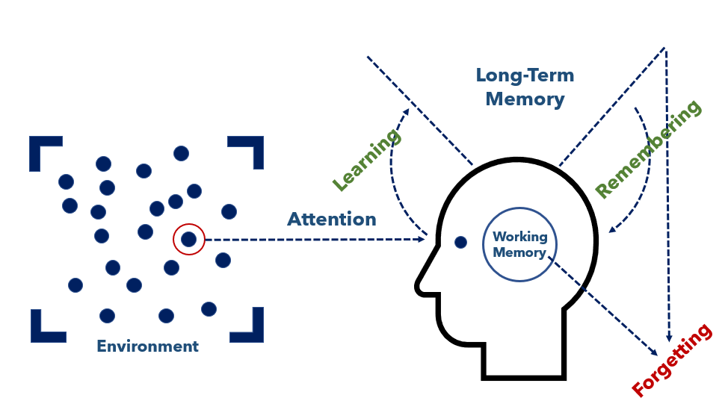
The Simple Memory Model

Slide 5
Vocabulary
Feedback: Practice of giving students information about their performance against a standard with the purpose of improving student performance.

Slide 6
Quality Feedback Criteria
Specific & clear: The feedback provides specific information about the strengths and areas where the work can be improved. You will remember that the feedback from friend 1 in the bellringer example clearly identified the strength of the poem to be the imagery and described how the imagery impacted the reader.
Focused on task, rather than student: A key piece of quality feedback is that is references standards versus referencing the student. Feedback such as “I noticed you only had 3 supporting details. The assignment asks for 5 supporting details” provides key information to the student about how they can strengthen their work.
Identifies strengths & areas of growth: While it is important to know the areas growth and improvement, it is also important to recognize what is done well so that can be replicated in future work.

Slide 7
Exit Ticket
Read the feedback statements below. Determine if the feedback statement meets the criteria for quality feedback. Explain why or why not.
“Well done! You are one smart cookie!”
“Your artwork includes strong lines and contrast. Next time you might want to consider adding additional laters or colors to provide more depth.”
“You calculated the problem correctly, but the question asked you to show your thinking by drawing a picture. Please re-submit with a picture that explains your thinking.”
“I don’t like your word choice here.”

