Slide 1
Instructional Practices| Unit 5: Planning For and With Assessment | Lesson 5.03
Best Practices for Formal and Informal Assessment
This work is licensed under a Creative Commons Attribution-Noncommercial-Share Alike 4.0 International License.

Slide 2
TEKS Standards & Objectives
TEKS 3B, 6D, 8A, 8C
The student will:
Identify use of a variety of assessments in a lesson plan
Analyze how different types of formative assessments are used in a lesson

Slide 3
Bellringer
Read the scenario located on your student guide. As you read, look for formative assessments the teacher uses. Underline every instance of a formative assessment that you see.

Slide 4
Vocabulary
Formal Assessment | Structured instructional activities within the lesson in which students and teachers assess the progress of student’s learning to help in the learning process (practice sets, homework, fluency assessment)
Informal Assessment | Quick conversational or observation-based checks for understanding (thumbs up, white boards, first to 5, feedback on students’ verbal response)
Pacing | The timing of instruction that includes how fast to move through new material and when to shift from one lesson segment to another
Reteaching | Teaching material in a new way when necessary
Remediation | Teaching content again to students who didn't learn it the first time; filling in gaps
Strategic Grouping | Placing students in small groups with purpose and intentionality based on reteaching needs

Slide 5
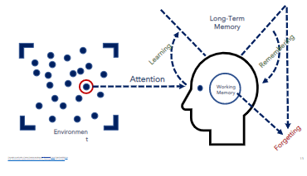
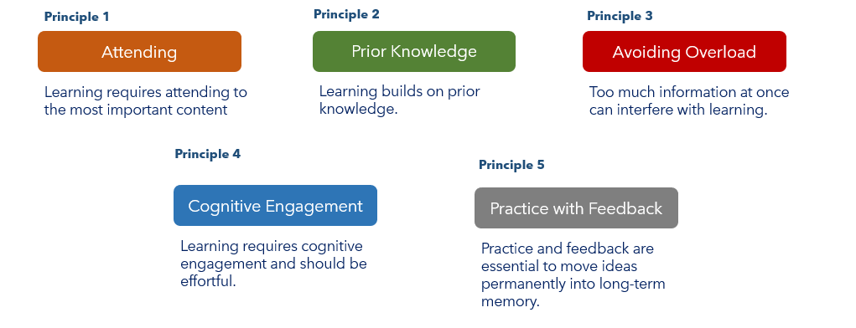
Best Practices for Using Formative Assessments
Create a portfolio with a variety of assessments over time
Use throughout a lesson
Use to make strategic decisions

Slide 6
Strategic Decisions
Pacing: Should I move faster or slower? Should I review the material again or are students ready to move forward?
Reteaching: Do I need to reteach part or all this lesson? How do I know? Do I need to reteach part of all the lesson to all students or a small group?
Remediation and Enrichment: Do some students need remediation to learn background knowledge they should but do not have? Do some students need to go deeper faster because they already know the material?
Strategic Grouping: Based on who understands the lesson and who doesn’t, how can I group students to support one another? How can I group students so that I can reteach portions or all of the lesson only to those students who need it? How will I enrich the new learning for students who are ready to move on? How might I pair students for peer teaching and support?

Slide 7
Exit Ticket
Read the scenario below. Identify and analyze the assessments the teacher uses. Use the graphic organizer on your Exit Ticket to guide your analysis.
In a lesson about maps and how to draw maps to represent information, Mr. Hillary begins by providing his students with an image of a map and asking them to describe what they see and what they know about maps. Next, he teaches key elements of maps and then engages students in a discussion about key elements as they annotate the map together based on his questions (Where on this map do you see the legend? How does this map show elevation?). Students then work in partners to draw their own map of the playground, ensuring that they use the essential elements of a map in their work. Finally, as an exit ticket, Mr. Hillary provides students a new map and asks them to annotate the important parts.

