Slide 1
Instructional Practices| Unit 5: Planning For and With Assessment | Lesson 5.05
Introduction to Strategic Questioning
This work is licensed under a Creative Commons Attribution-Noncommercial-Share Alike 4.0 International License.

Slide 2
TEKS Standards & Objectives
TEKS: 3B, 6D, 6F
The student will:
Understand the characteristics of effective questions
Evaluate questions according to the characteristics of effective questions

Slide 3
Bellringer
Read the scenario below. Analyze the two questions from the lesson using the guiding questions in your Student Guide.
The goal of your 4th grade science class today is to teach students to analyze data to describe the relationship between characteristics (category of descriptions, like color) and traits (distinct description, like red). The following are two questions from your lesson:
What is one characteristic of tomatoes?
How would you describe the relationship between characteristics and traits? Provide an example using tomatoes.

Slide 4
Introduction to Strategic Questioning: Characteristics 1 &2
Be meaningful and understandable to students (succinct)
  Example: What is one characteristic of this tomoato?
  Non-Example: Given this specimen that you see in front of you, what qualities would you attribute to this delectable fruit?
Focus on the most important content
  Example: What is one word that describes this tomato?
  Non-Example: Do you like tomatoes? Why or why not?

Slide 5
Introduction to Strategic Questioning: Characteristics 3&4
Align to the level of thinking required in the learning target
  Example: How would you describe the relationship between characteristics and traits?
  Non-Example: What is a characteristic? What is a trait?
Increase in complexity and demand as learning progresses
  Example: Varying question types throughout the lesson while steadily increasing to get to the highest complexity required by the learning target
  Non-Example: Keeping questioning at the same level of complexity throughout a lesson, starting with the hardest questions at the beginning of a lesson

Slide 6
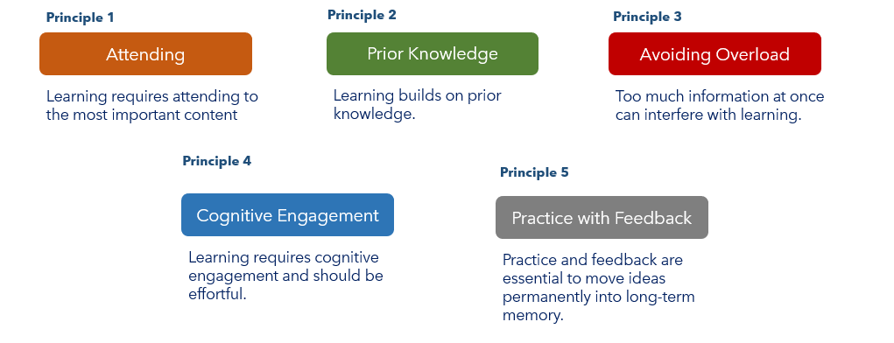
Principles of Learning

Slide 7
Exit Ticket
Review the lesson objective and related lesson on your Exit Ticket. Evaluate each question based on the first two criteria for effective questions. If a question does not fit both criteria, revise or make suggestions for improvement.
Students will demonstrate reading comprehension of fiction texts by comparing and contrasting two texts and finding similarities and differences between them.

