Slide 1
Instructional Practices| Unit 5: Planning For and With Assessment | Lesson 5.06
Strategic Questioning Continued
This work is licensed under a Creative Commons Attribution-Noncommercial-Share Alike 4.0 International License.

Slide 2
TEKS Standards & Objectives
TEKS 3B, 6D, 8A, 8C
The student will:
Explain the Question Matrix
Evaluate a set of questions based on an understanding of the Question Matrix and characteristics of effective questions

Slide 3
Bellringer
What are the characteristics of effective questions?
Why does the order and progression of questions matter for instruction based on the principles informed by the science of learning?

Slide 4
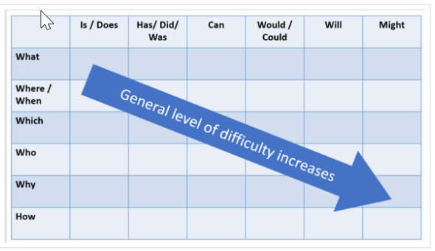
Question Matrix

Slide 5
Exit Ticket
Mr. M. is teaching a lesson about creating claims based on evidence. His goal for the day is that his students will be able to create a claim based on evidence in a text and then collaborate with peers to refine their claims.
Review the lesson goal and the pre-planned questions. For each question, determine what information the teacher can learn and what their next steps might be.
Evaluate the question set as a whole. Does the question set meet the characteristics of effective questions? Explain your reasoning.

