Slide 1
Instructional Practices| Unit 5: Planning For and With Assessment | Lesson 5.07
Effective Question Delivery
This work is licensed under a Creative Commons Attribution-Noncommercial-Share Alike 4.0 International License.

Slide 2
TEKS Standards & Objectives
TEKS 3B, 6D
The student will:
Identify the characteristics of effective question delivery and response
Define and apply wait time when delivering questions
Practice and evaluate question delivery and response

Slide 3
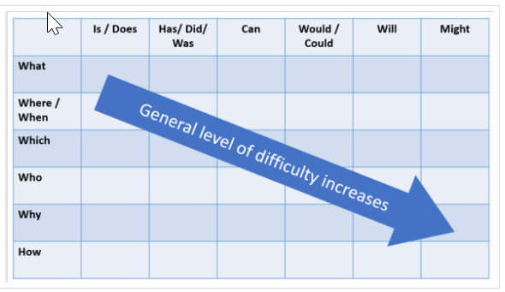
Bellringer
Sort and evaluate the questions in your Bell Ringer based on the Question Matrix.
What does your sorting tell you about the set of questions?
How might the teacher revise the set if necessary?

Slide 4
Vocabulary
Wait time | A period of time between when a teacher poses a question and when students are given the opportunity to answer

Slide 5
Wait Time
Wait time is a period of time between when a teacher poses a question and when students are given the opportunity to answer.
Wait time provides an opportunity for all students to consider the answer (not only the fastest thinkers) and can improve the quality of responses.
Teachers should wait at least five seconds between the time they ask a question and the time they call on or allow a student to answer.

Slide 6
Practicing Wait Time
How do you find the area of a rectangle?
What are the names of the planets in our galaxy?
What are the roles of the three branches of government?
What is the Greatest Common Factor of 16 and 24?
Explain the steps of the water cycle?
What are the seven continents on Earth?

Slide 7
Delivery to Many Students
Deliver the question to as many students as possible:
Ask a question first, then call students by name
Call on students who do not volunteer

Slide 8
Stretch It
Respond to “stretch it” and deepen thinking.
Provides opportunity for multiple students to answer the same question by agreeing, disagreeing, adding on, and providing reasoning.

Slide 9
Exit Ticket
What are the three characteristics of effective question delivery?
Based on today’s practice and the fishbowl activity, what do you think will be the easiest characteristic for you to master? The hardest? Explain your reasoning.

