Slide 1
Instructional Practices| Unit 6: Instructional Alignment| Lesson 6.01
High Quality Curricula

Slide 2
TEKS Standards & Objectives
TEKS 3B, 6A, 6C, 6F
The student will…
…identify and describe the purpose and value of a high-quality curriculum.
…identify the components of a high-quality curriculum.

Slide 3
Bellringer
In your Student Guide, complete the anticipatory set to demonstrate what you already know about curriculum.
Curriculum: A sequenced collection of instructional materials such as lesson plans, learning tasks, and assessments.

Slide 4
Curriculum & HQIM
Curriculum: A sequenced collection of instructional materials such as lesson plans, learning tasks, and assessments.
Curriculum is used by teachers to guide students towards proficiency in content knowledge and skills.
High Quality Instructional Materials (HQIM): Instructional materials that are research based, closely aligned to rigorous standards, and reviewed by a team of experts.

Slide 5
High Quality Instructional Materials
High Quality | May Not be High Quality
Materials rated as high-quality by the Texas Resource Review: Based on Texas Standards Latest curriculum research Best practices Input from Texas educators | Materials found online (both free and paid for)—these materials may not have been vetted Older instructional materials—these may not reflect the latest TEKS or curricular research Materials from conferences or professional learning—these materials may not have been vetted

Slide 6


Slide 7


Slide 8


Slide 9
High Quality Curriculum
A high-quality curriculum is a tool that, when used properly by a well-prepared teacher, can have a significant positive impact on student learning.
A high-quality curriculum is NOT a substitute for a qualified teacher.

Slide 10
How do teachers know what to teach or what should be in a curriculum?
Standards: The expectations for what students should know and be able to do by the end of each grade level.
Texas Essential Knowledge and Skills (TEKS): The Texas state learning standards. The TEKS outline what students in Texas should know and be able to do at each grade level.
English Language Proficiency Standards (ELPS): These standards outline the instruction that must be provided to allow English language learners the full opportunity to learn English and succeed academically.

Slide 11
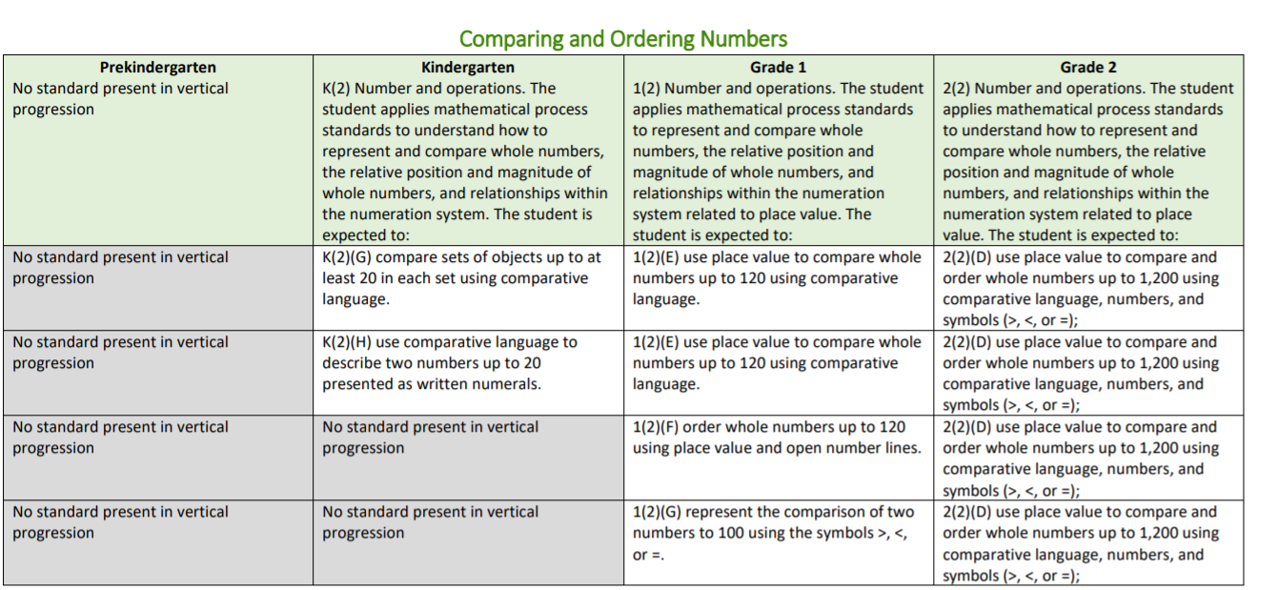
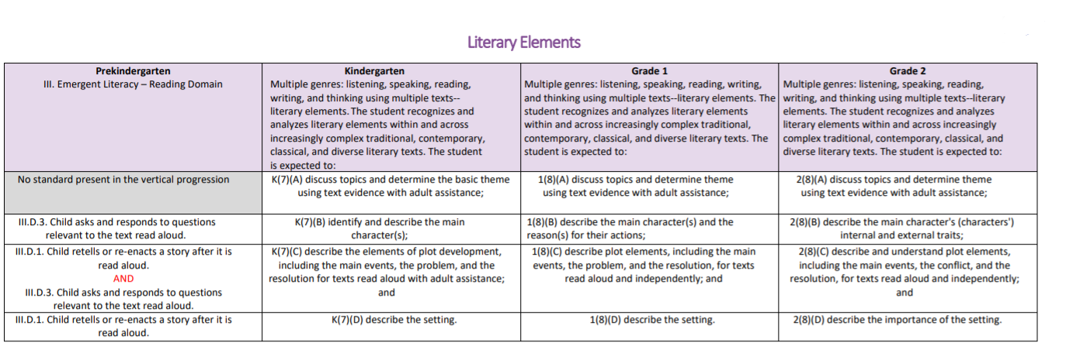
Components of a Curriculum
Vertical Alignment: Shows the standards that are taught at each grade level

Slide 12
Vertical Alignment Example

Slide 13
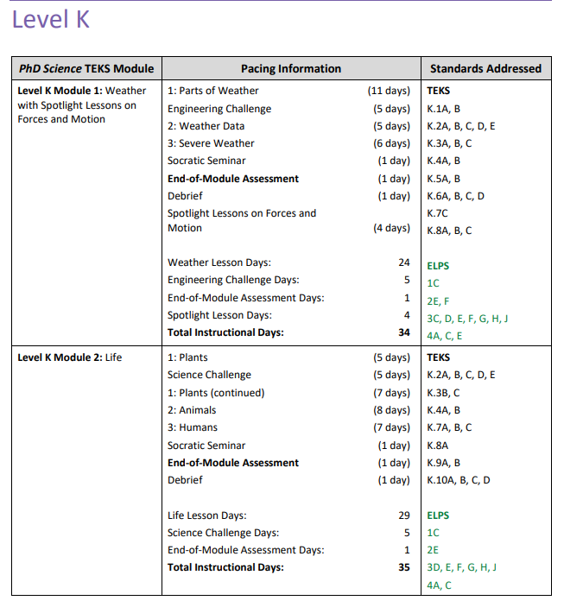
Scope and Sequence
Scope and Sequence: Outlines the learning plan for the year. Shows when certain standards are taught and how long it will take to teach them.

Slide 14
Components of a Curriculum
Units:
Groups of learning standards are taught in units or modules
A unit is a collection of daily lessons and assessments around a broad topic
Each unit has goals or essential questions and a summative assessment
Lesson Plans:
Units are divided into daily lesson plans
Daily lesson plans target specific objects that support achievement of unit goals and standards
Lesson plans include targeted objectives, learning activities, and formative assessments

Slide 15
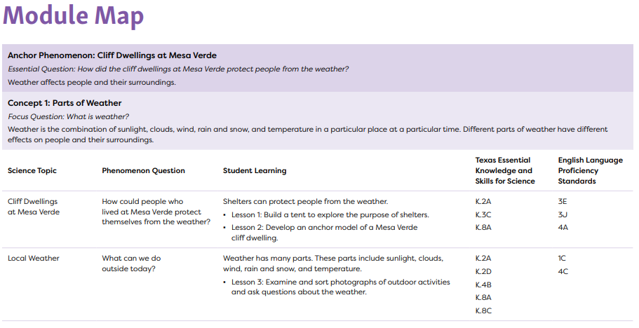
Essential Question: A big, memorable question that students need to be able to answer at the end of a unit or course.

Slide 16
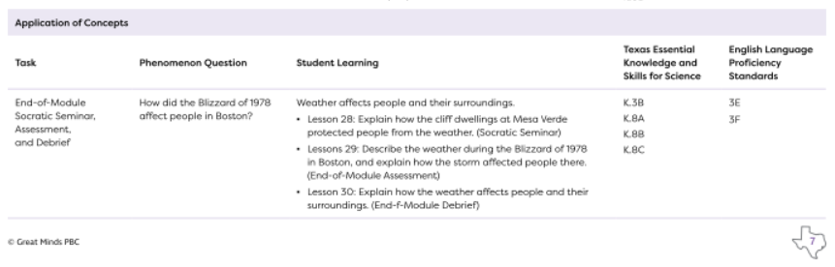
Assessment: Any tool used to collect, analyze and respond to information about student understanding of learning targets

Slide 17
Exit Ticket
In your Student Guide, answer the following questions:
What are the features of a high-quality curriculum?
What are the benefits of using a high-quality curriculum?
Match the components of a curriculum with the description

