Slide 1
Instructional Practices| Unit 6: Instructional Alignment| Lesson 6.02
Sequencing a Unit Plan
This work is licensed under a Creative Commons Attribution-Noncommercial-Share Alike 4.0 International License.

Slide 2
TEKS Standards & Objectives
TEKS 3B, 6A, 6C, 6F
The student will…
…define and describe sequencing
…identify and evaluate how learning is sequenced throughout a unit to build understanding

Slide 3
Bellringer
Create a concept map to show the relationships between the key components of a curriculum.

Slide 4
Quote
“He who would learn to fly one day must first learn to stand and walk and run and climb and dance; one cannot fly into flying.”
-Friedrich Nietzsche

Slide 5
Vocabulary
Sequencing: Organizing concepts in an order that starts simple and build in complexity

Slide 6

Simple Memory Model
Long-Term Memory
Remembering
Learning
Attention
Working Memory
Environment
Forgetting
This graphic is used under a Creative Commons Attribution-Non Commercial license.Original available here.
https://deansforimpact.org/wp-content/uploads/2021/06/DFI_Deepening-Meaning-and-Learning.pdf

Slide 7
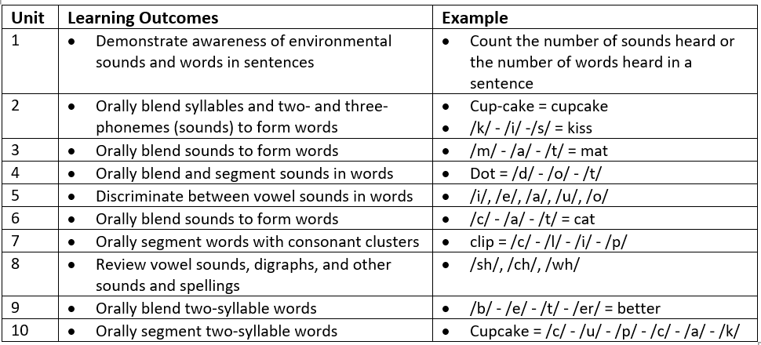
Example

Slide 8
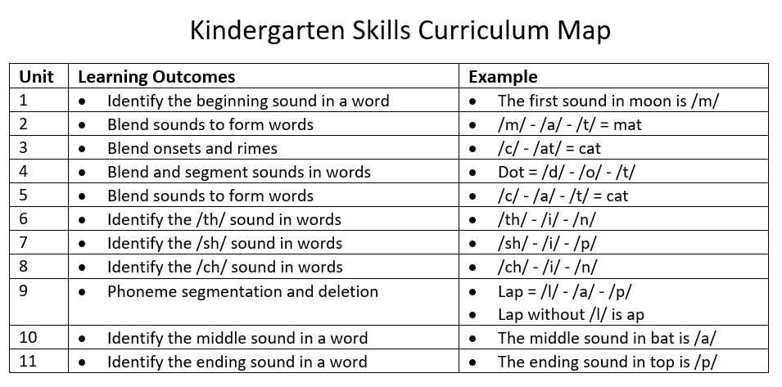
Non-Example

Slide 9
Exit Ticket
In your Student Guide, answer the following questions:
What is sequencing as it relates to a unit plan?
How does sequencing a unit in a logical way help build student mastery of the standard?
How does sequencing of a unit relate to the Science of Learning?
Read the scenario. Do you think this is the best approach to build student understanding? Why or why not?

