Slide 1
Instructional Practices| Unit 6: Instructional Alignment| Lesson 6.04
Standard & Objective Alignment

Slide 2
TEKS Standards & Objectives
TEKS 3B, 6A, 6C, 6F
The student will:
define and describe standards and objectives
explain the key differences between standards and objectives
identify and evaluate objective to determine alignment with the standards

Slide 3
Bellringer
Consider this 3rd grade standard:
The student understands the purposes of earning, spending, saving, and donating money. The student is expected to:
(A) Identify ways of earning, spending, saving, and donating money.
Work with a partner to underline the verbs in the student expectation and brainstorm ways in which students would show their learning of this concept.

Slide 4
Vocabulary
Standards: The learning goals or expectations for what students should know and be able to do at each grade level.
Objectives: Brief statements that describe what students will be expected to learn by the end of the unit or lesson.

Slide 5
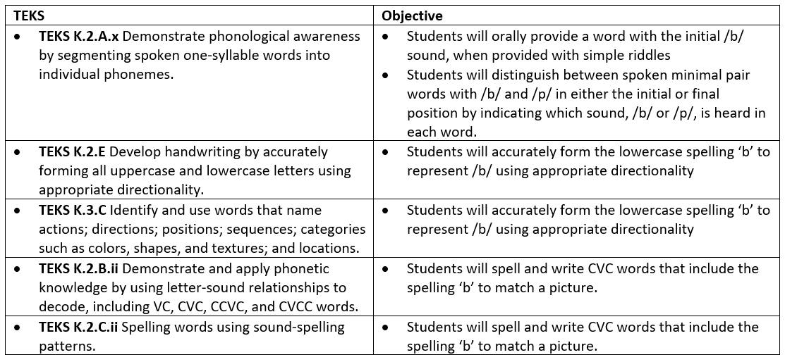
Standards Example

Slide 6
Standards Example

Slide 7
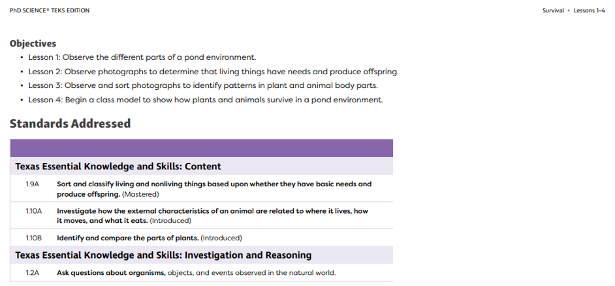
Practice
Standard | Do (Verbs) | Content (Nouns) | Objective that Aligns to the Standard
1.9A | Sort, classify | living and nonliving things based on basic needs and production of offspring. | Observe photographs to determine that living things have needs and produce offspring

Slide 8
Exit Ticket
A student moves to a new school in the same state mid-year. Explain why the use of consistent state standards is beneficial in this situation.
Read the standard below and circle the objectives that most closely align to the standard.
TEKS 1.3B: Use objects and pictorial models to solve word problems involving joining, separating, and comparing sets within 20 and unknowns as any one of the terms in a problem such as 2+4=[ ]; 3 + [ ] = 7; and 5= [ ] -3

